Slide 1
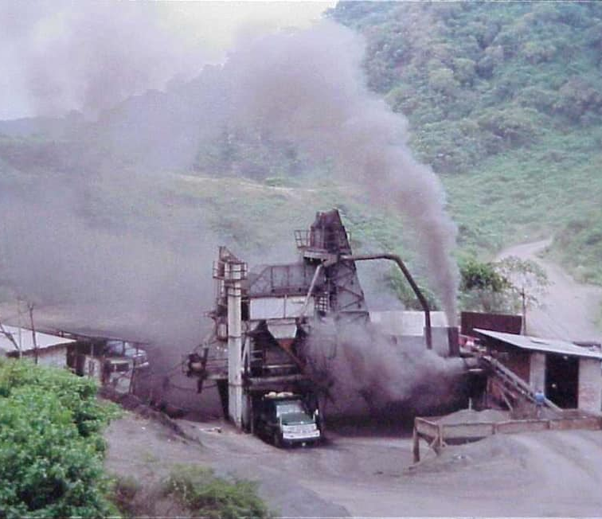
Has Your Asphalt Plant Had A Physical?
Richard J. Schreck
Technical Services and Applications Director

Slide 2



Did You Have a Physical Last Year?

Slide 3
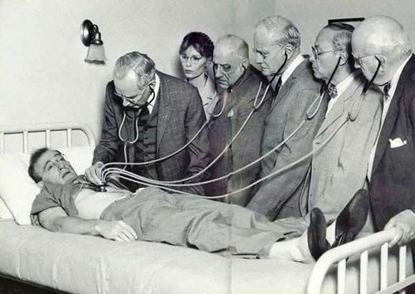
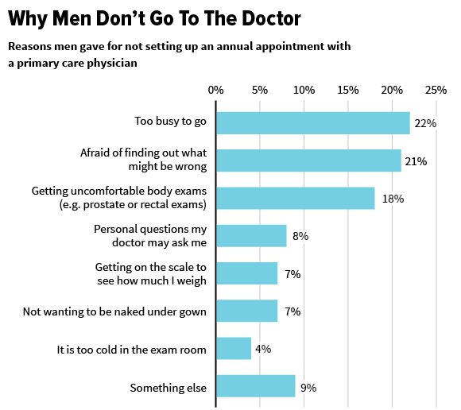
What’s Your Excuse?

Slide 4


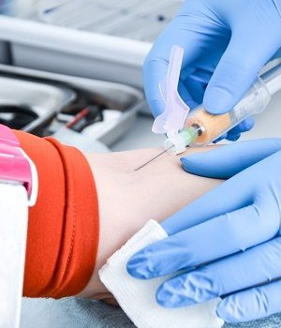
Why Annual Physical Matters
Assess Your Overall Health
Personalized Medical Counseling
Customized Plan According to Risk Factors
Preventive care that allows the patient to discover unforeseen medical issues.
Gives you the opportunity to talk to your doctor about any pain or symptoms you might be experiencing.
Evaluation of test results and bloodwork help you understand potential future issues and address them proactively.

Slide 5
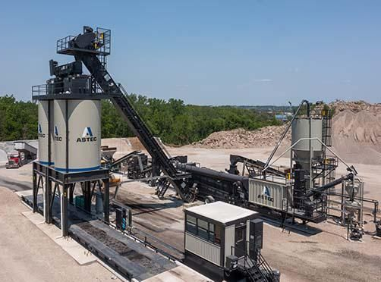
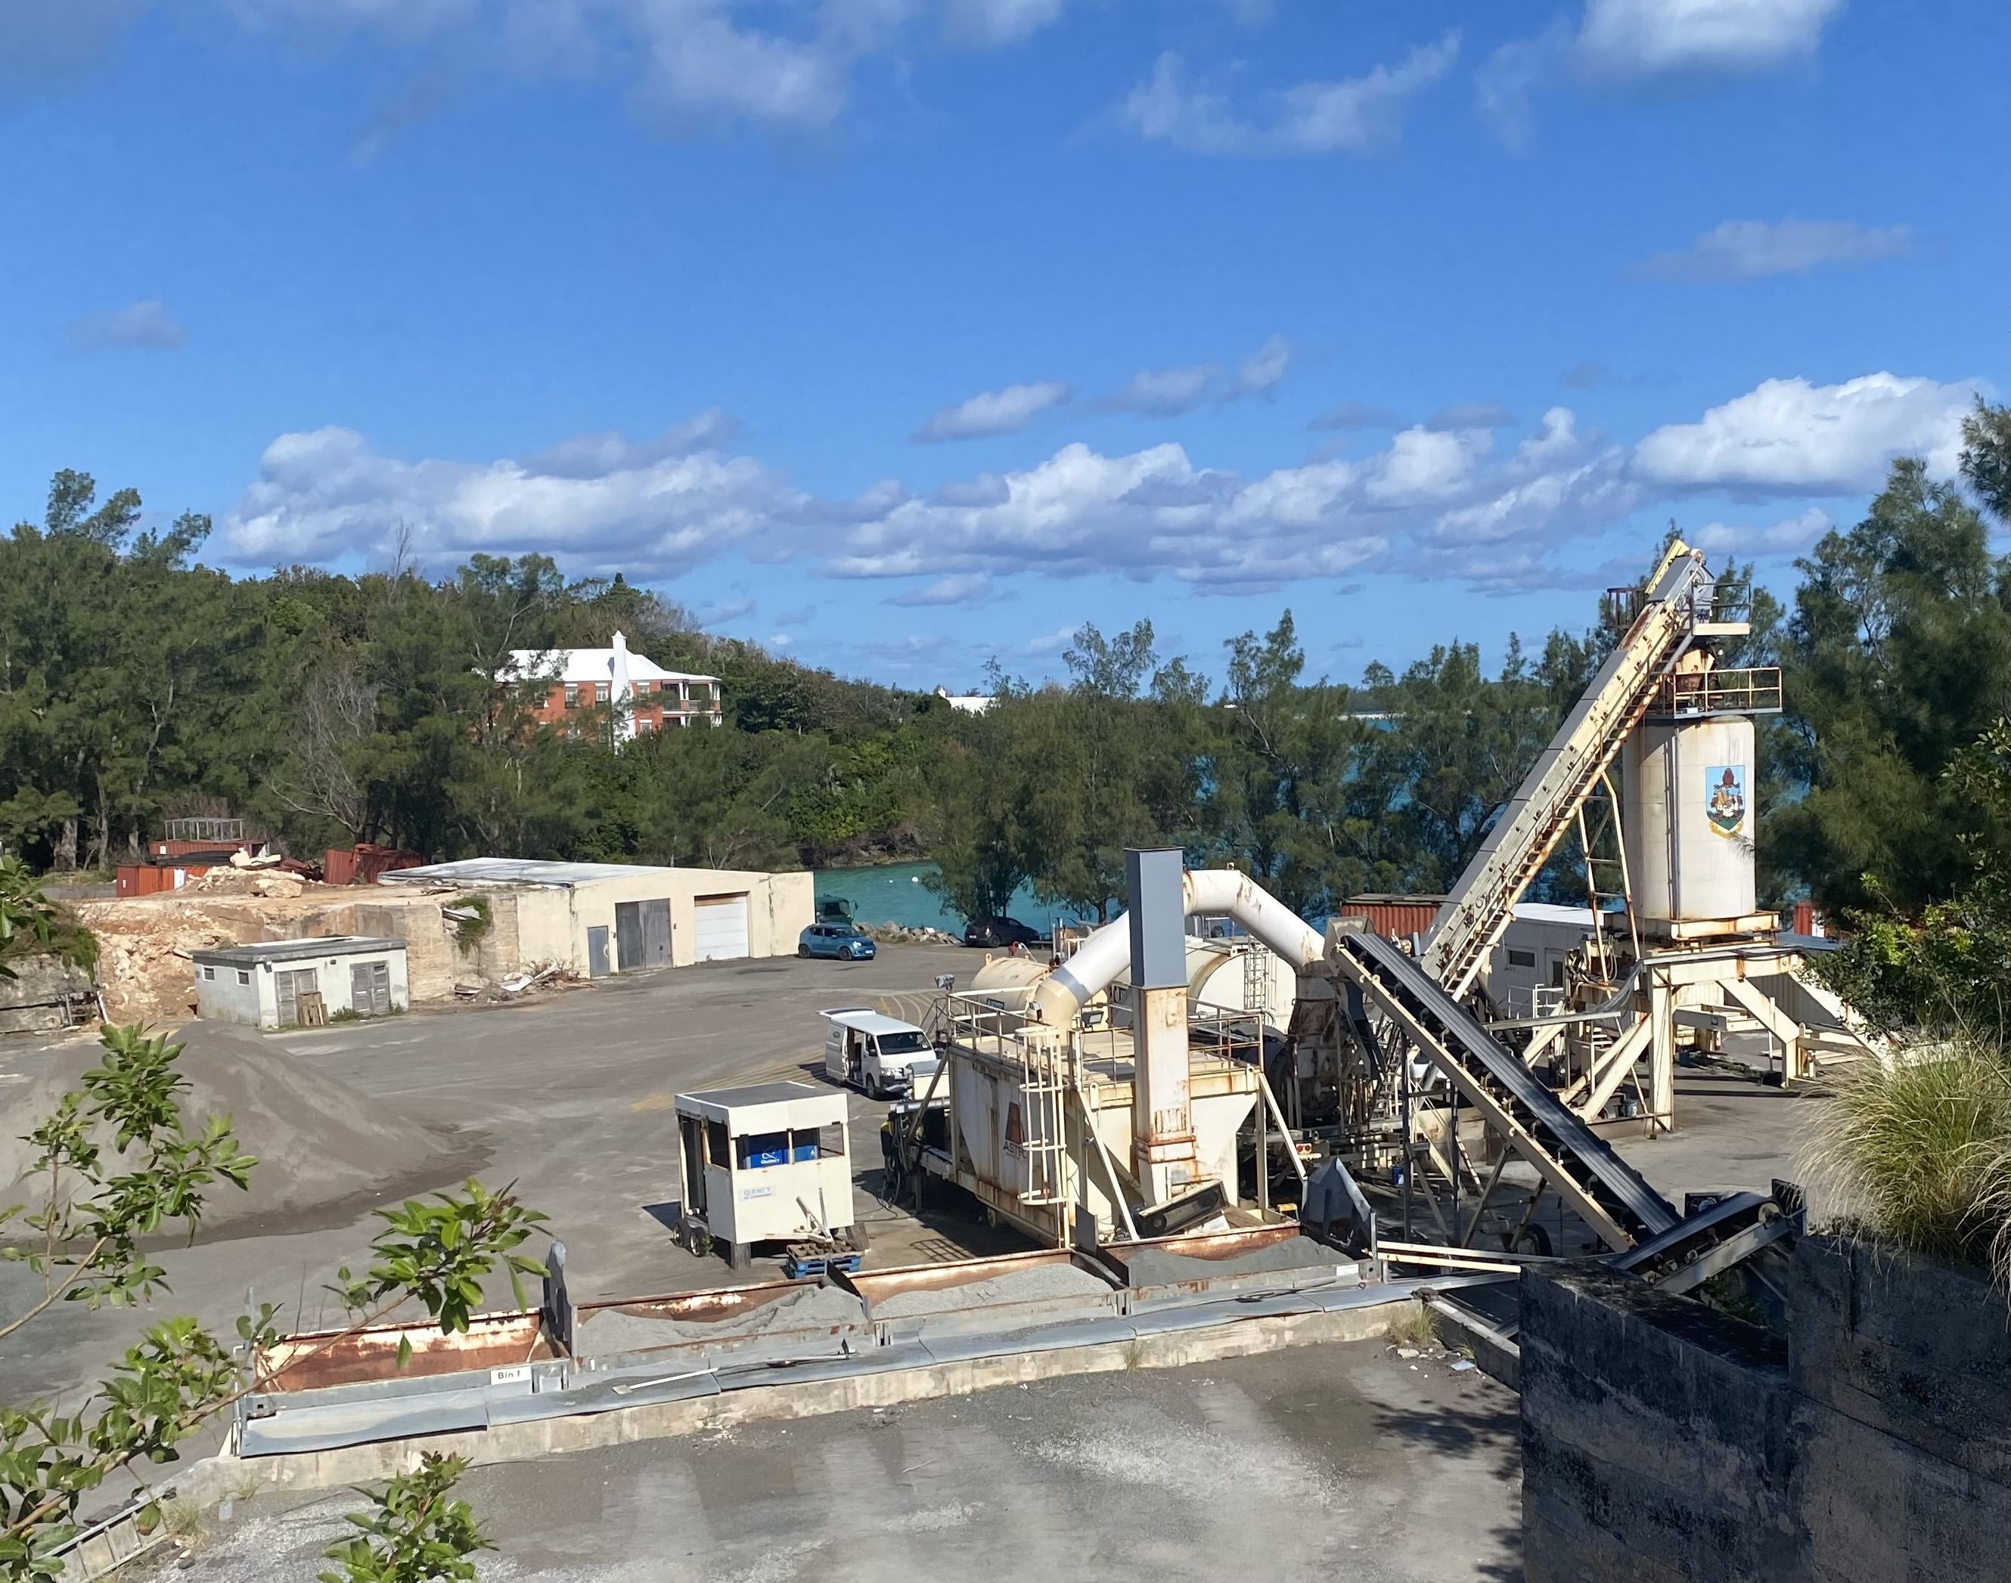
Plants Don’t Stay New Forever
What to do when the “new” wears off

Slide 6
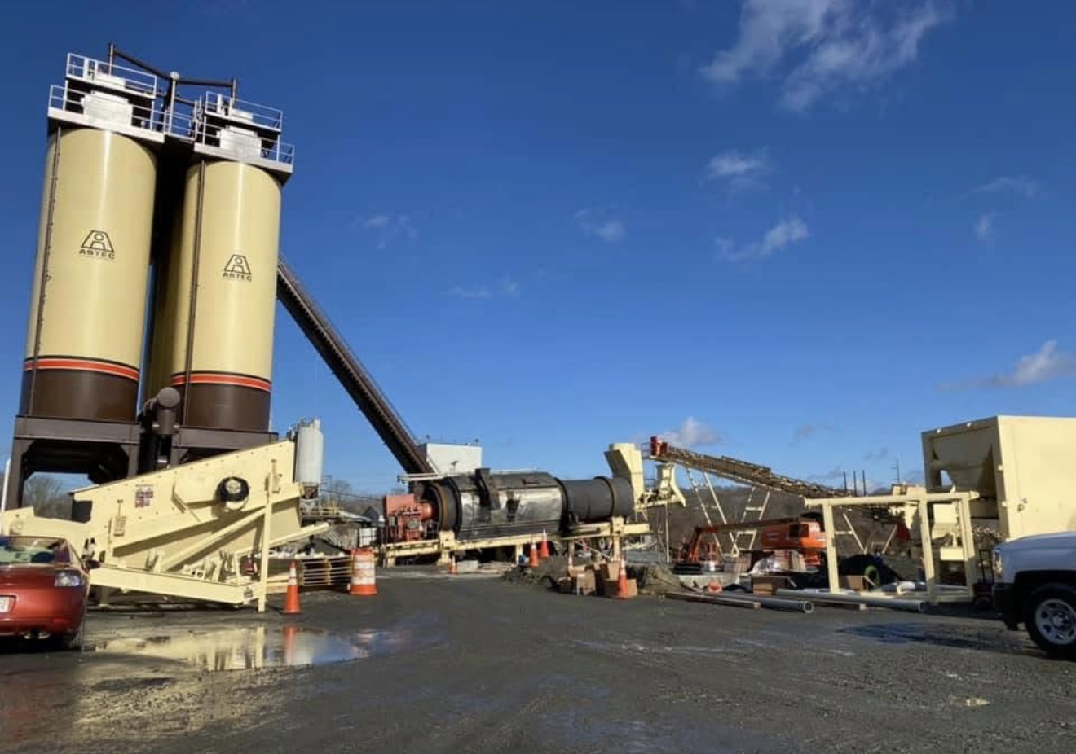
When
was the last time your asphalt plant had a physical?

Slide 7
The
Invitation
And The
Challenge
Asphalt Recycling Operations Assessment
1
Customer concerned their RAP utilization and consistency was impacting their competitiveness and limiting production capabilities.
Astec put together a team of subject matter experts to examine full spectrum of HMA/WMA recycling, including RAP mix design, materials processing, method of introduction, plant equipment and operations with the goal of determining barriers to recycling and focus areas.
2
Purpose & Desired Outcomes
3
Develop detailed recommendations on how to increase RAP usage and increase plant / operation efficiency.
4
Share findings with senior management, operations and other personnel. Assist in the development of strategies and training necessary to address the findings.

Slide 8

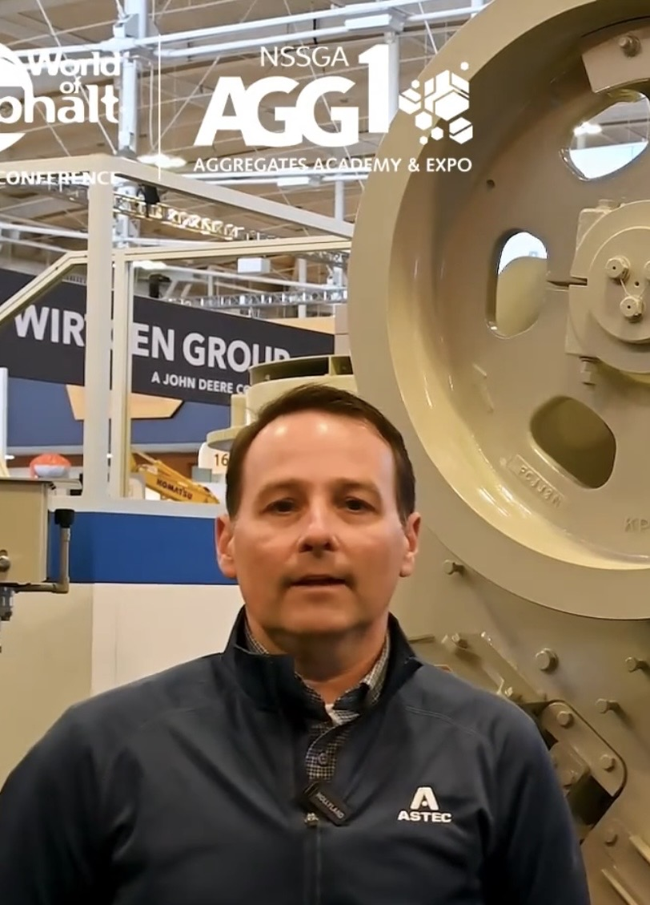

The Astec Assessment Team
Greg Renegar
Vice President of Customer Success
Chris Worley
Product Sales Manager
Richard Schreck
Technical Services and Applications Director

Slide 9
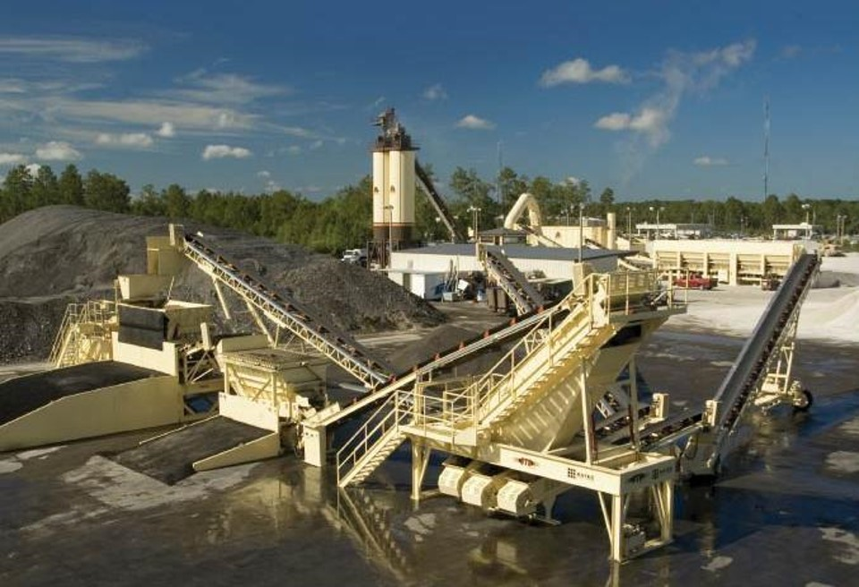
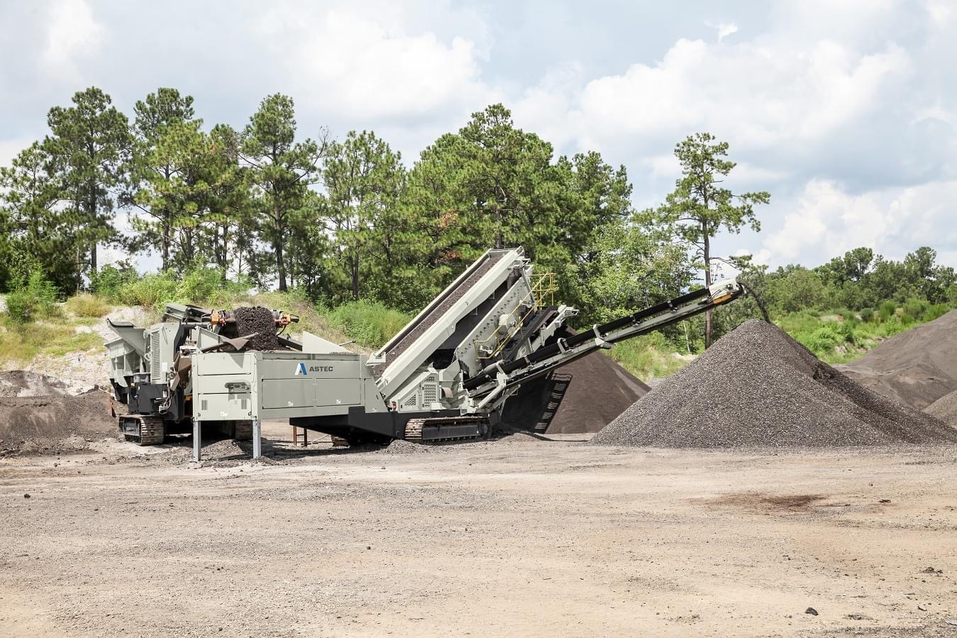
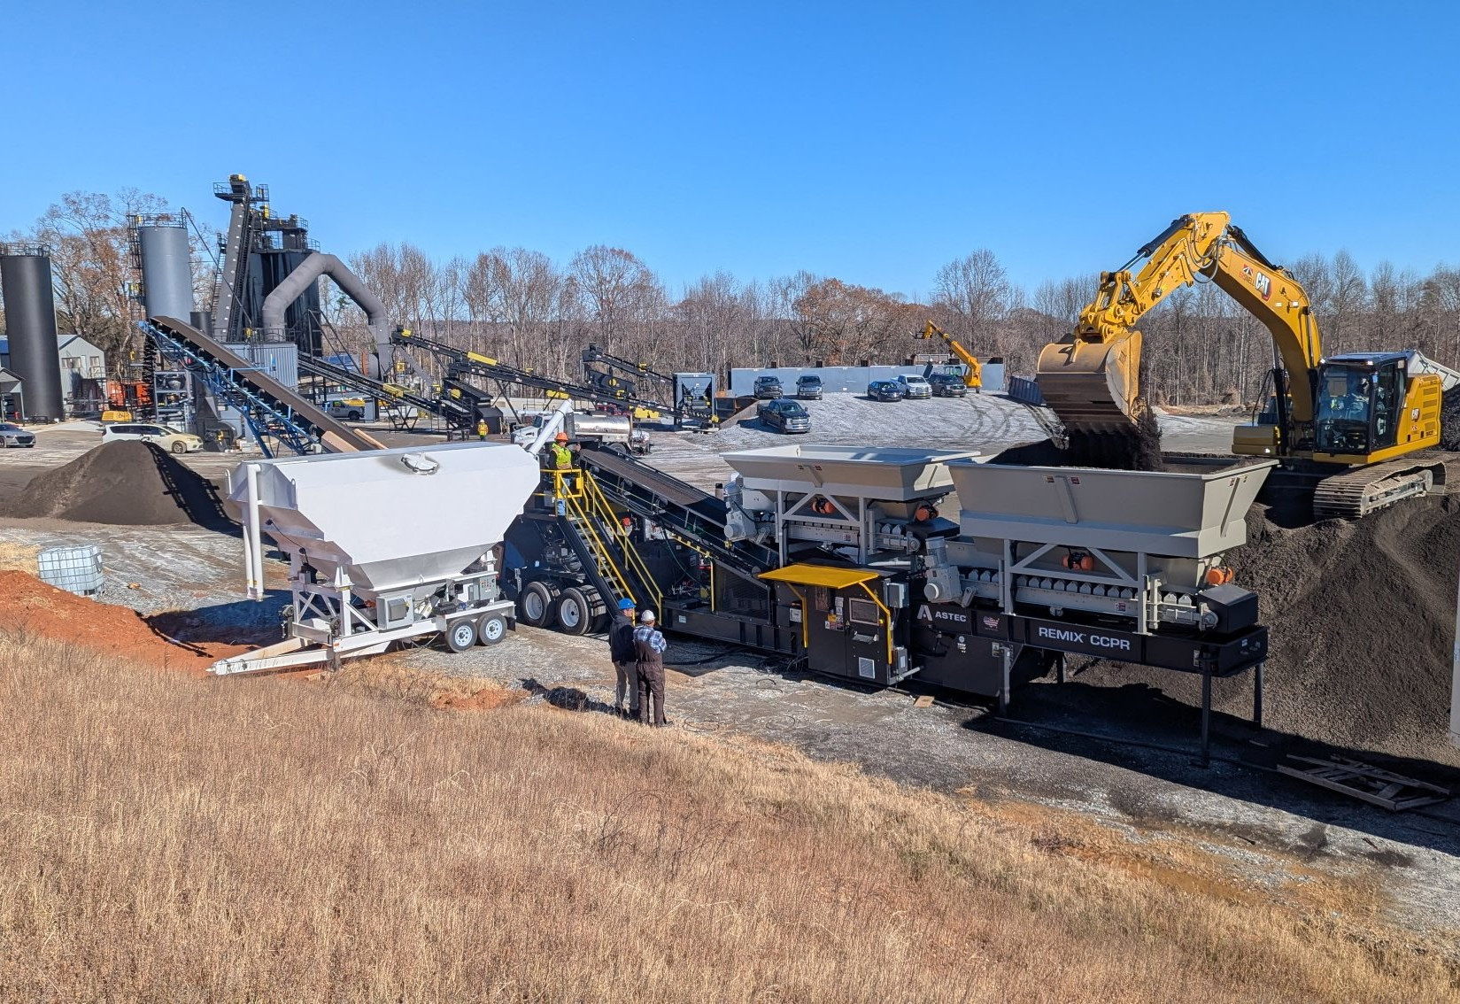
Assessing Recycling Operations
HMA/WMA Recycling
Reclaimed Asphalt Pavement (RAP)
Other Recycling Options
Where you are
Where you want to be
What’s allowed
What’s possible
How to get there
How to go for more
Materials sources
Processing
Plant Introduction
Mix Design
QC/QA
Cold Central Plant Recycling (CCPR)
Foamed Asphalt
Asphalt Emulsion
Notes:
Based on Jaco’s direction, we should host in Chattanooga.

Slide 10
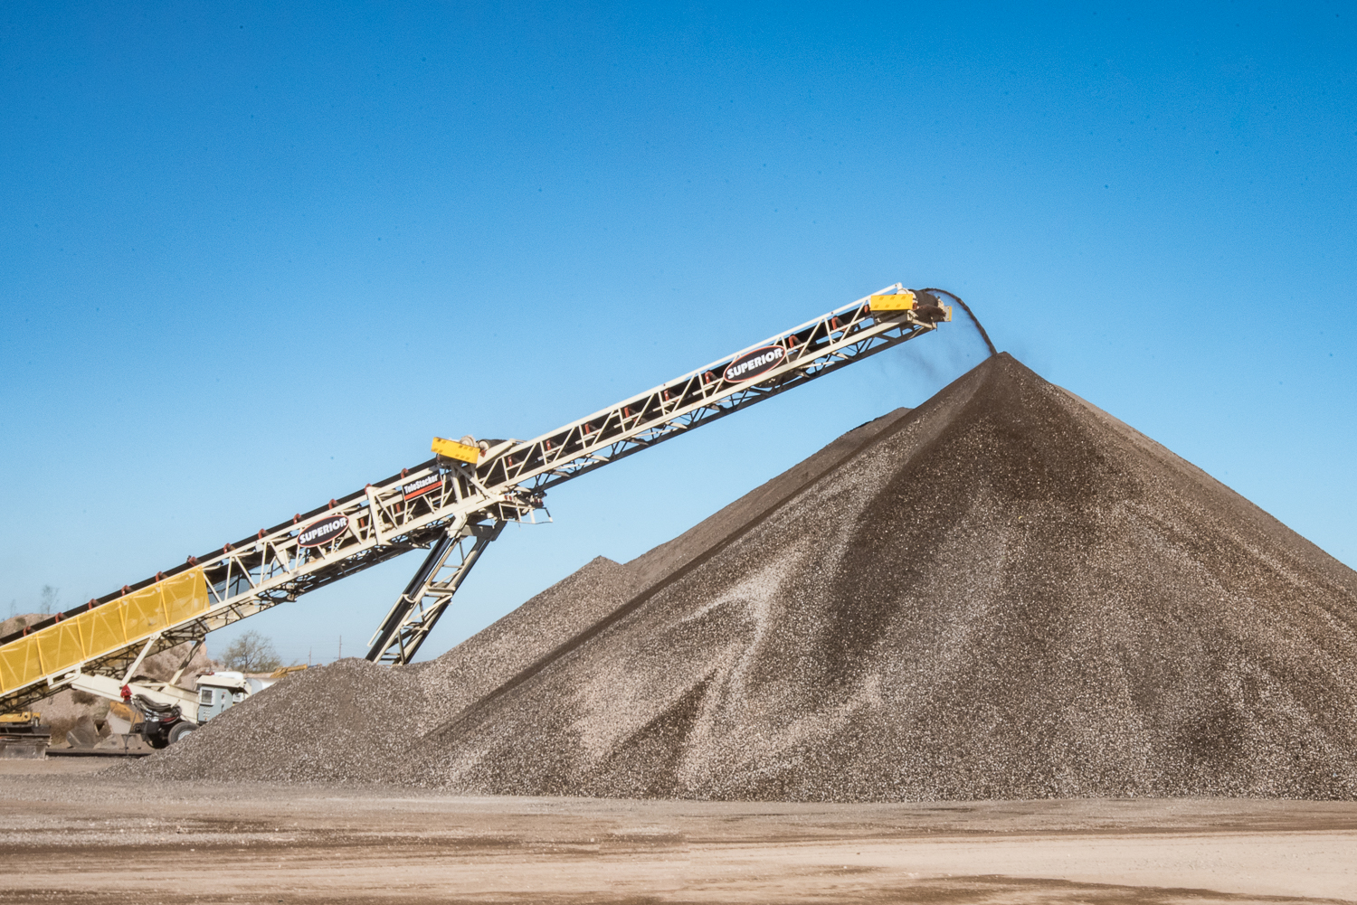
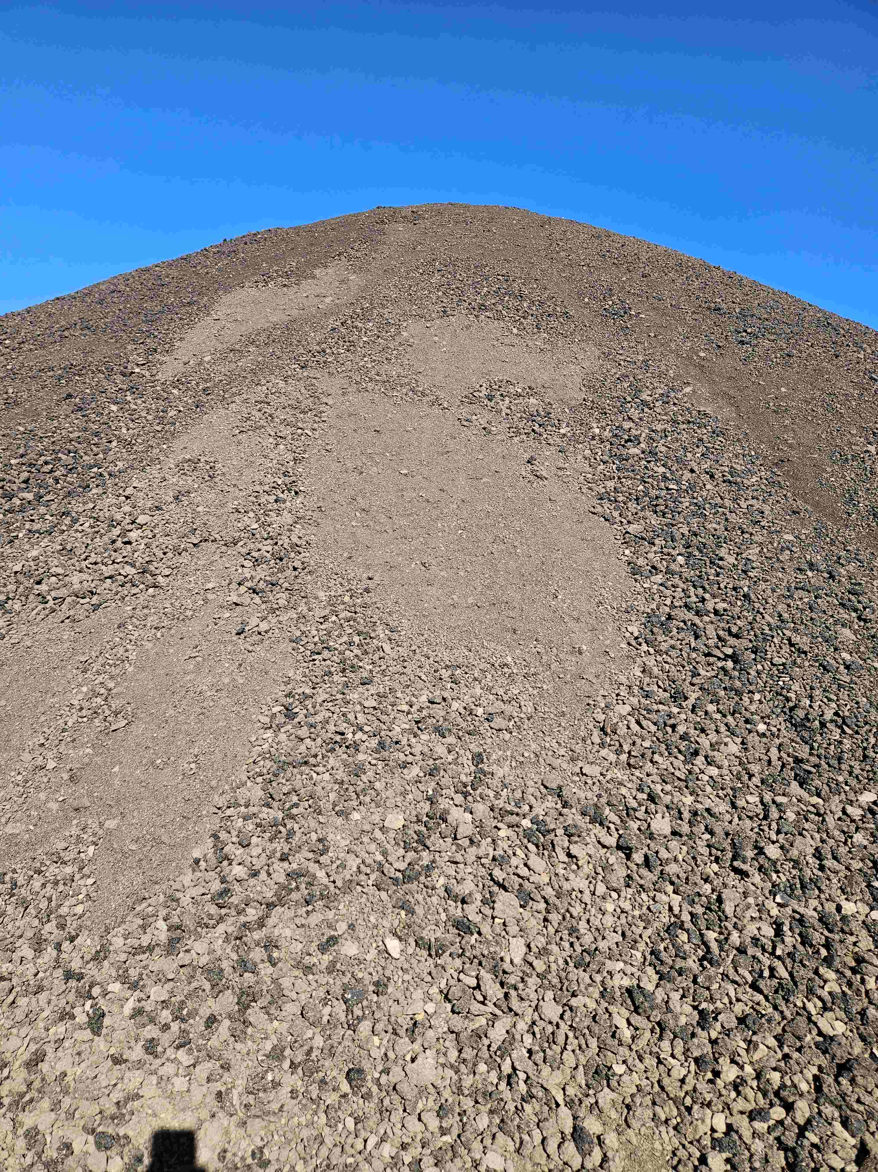
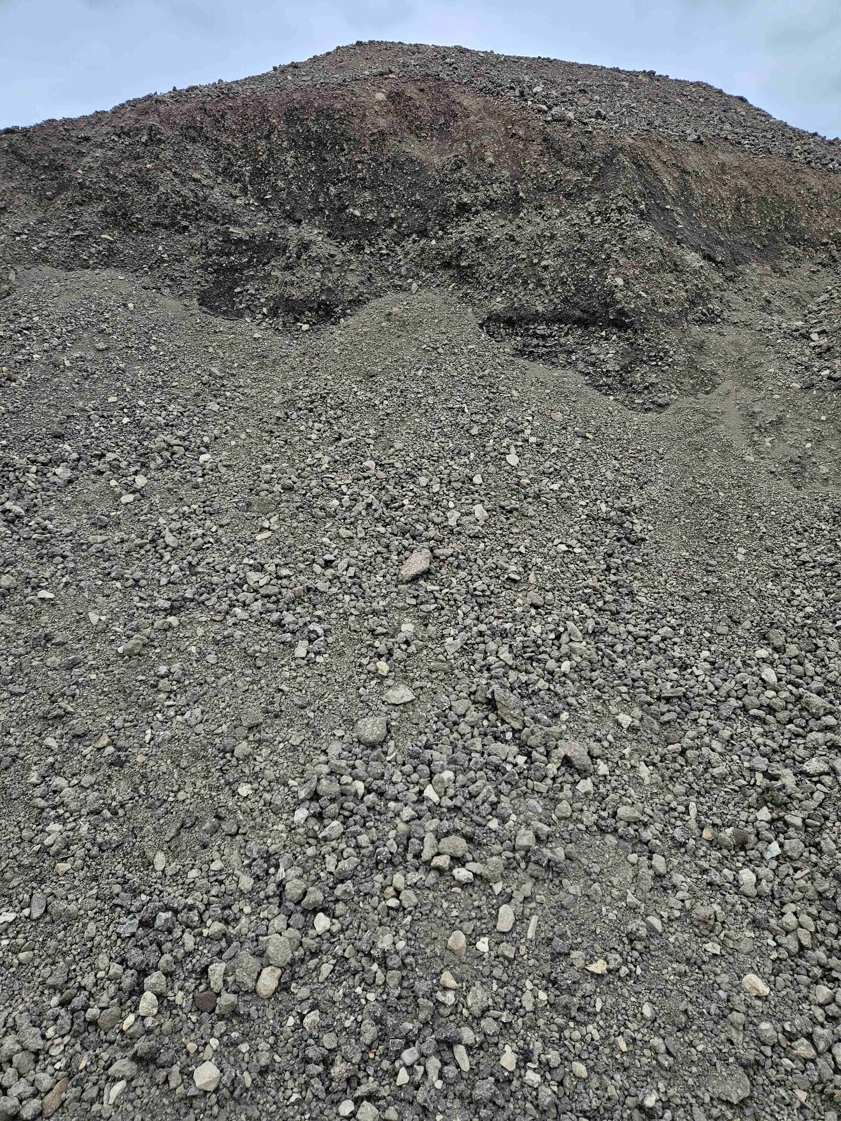
Findings…
All RAP crushed to minus 1” and stockpiled

Slide 11
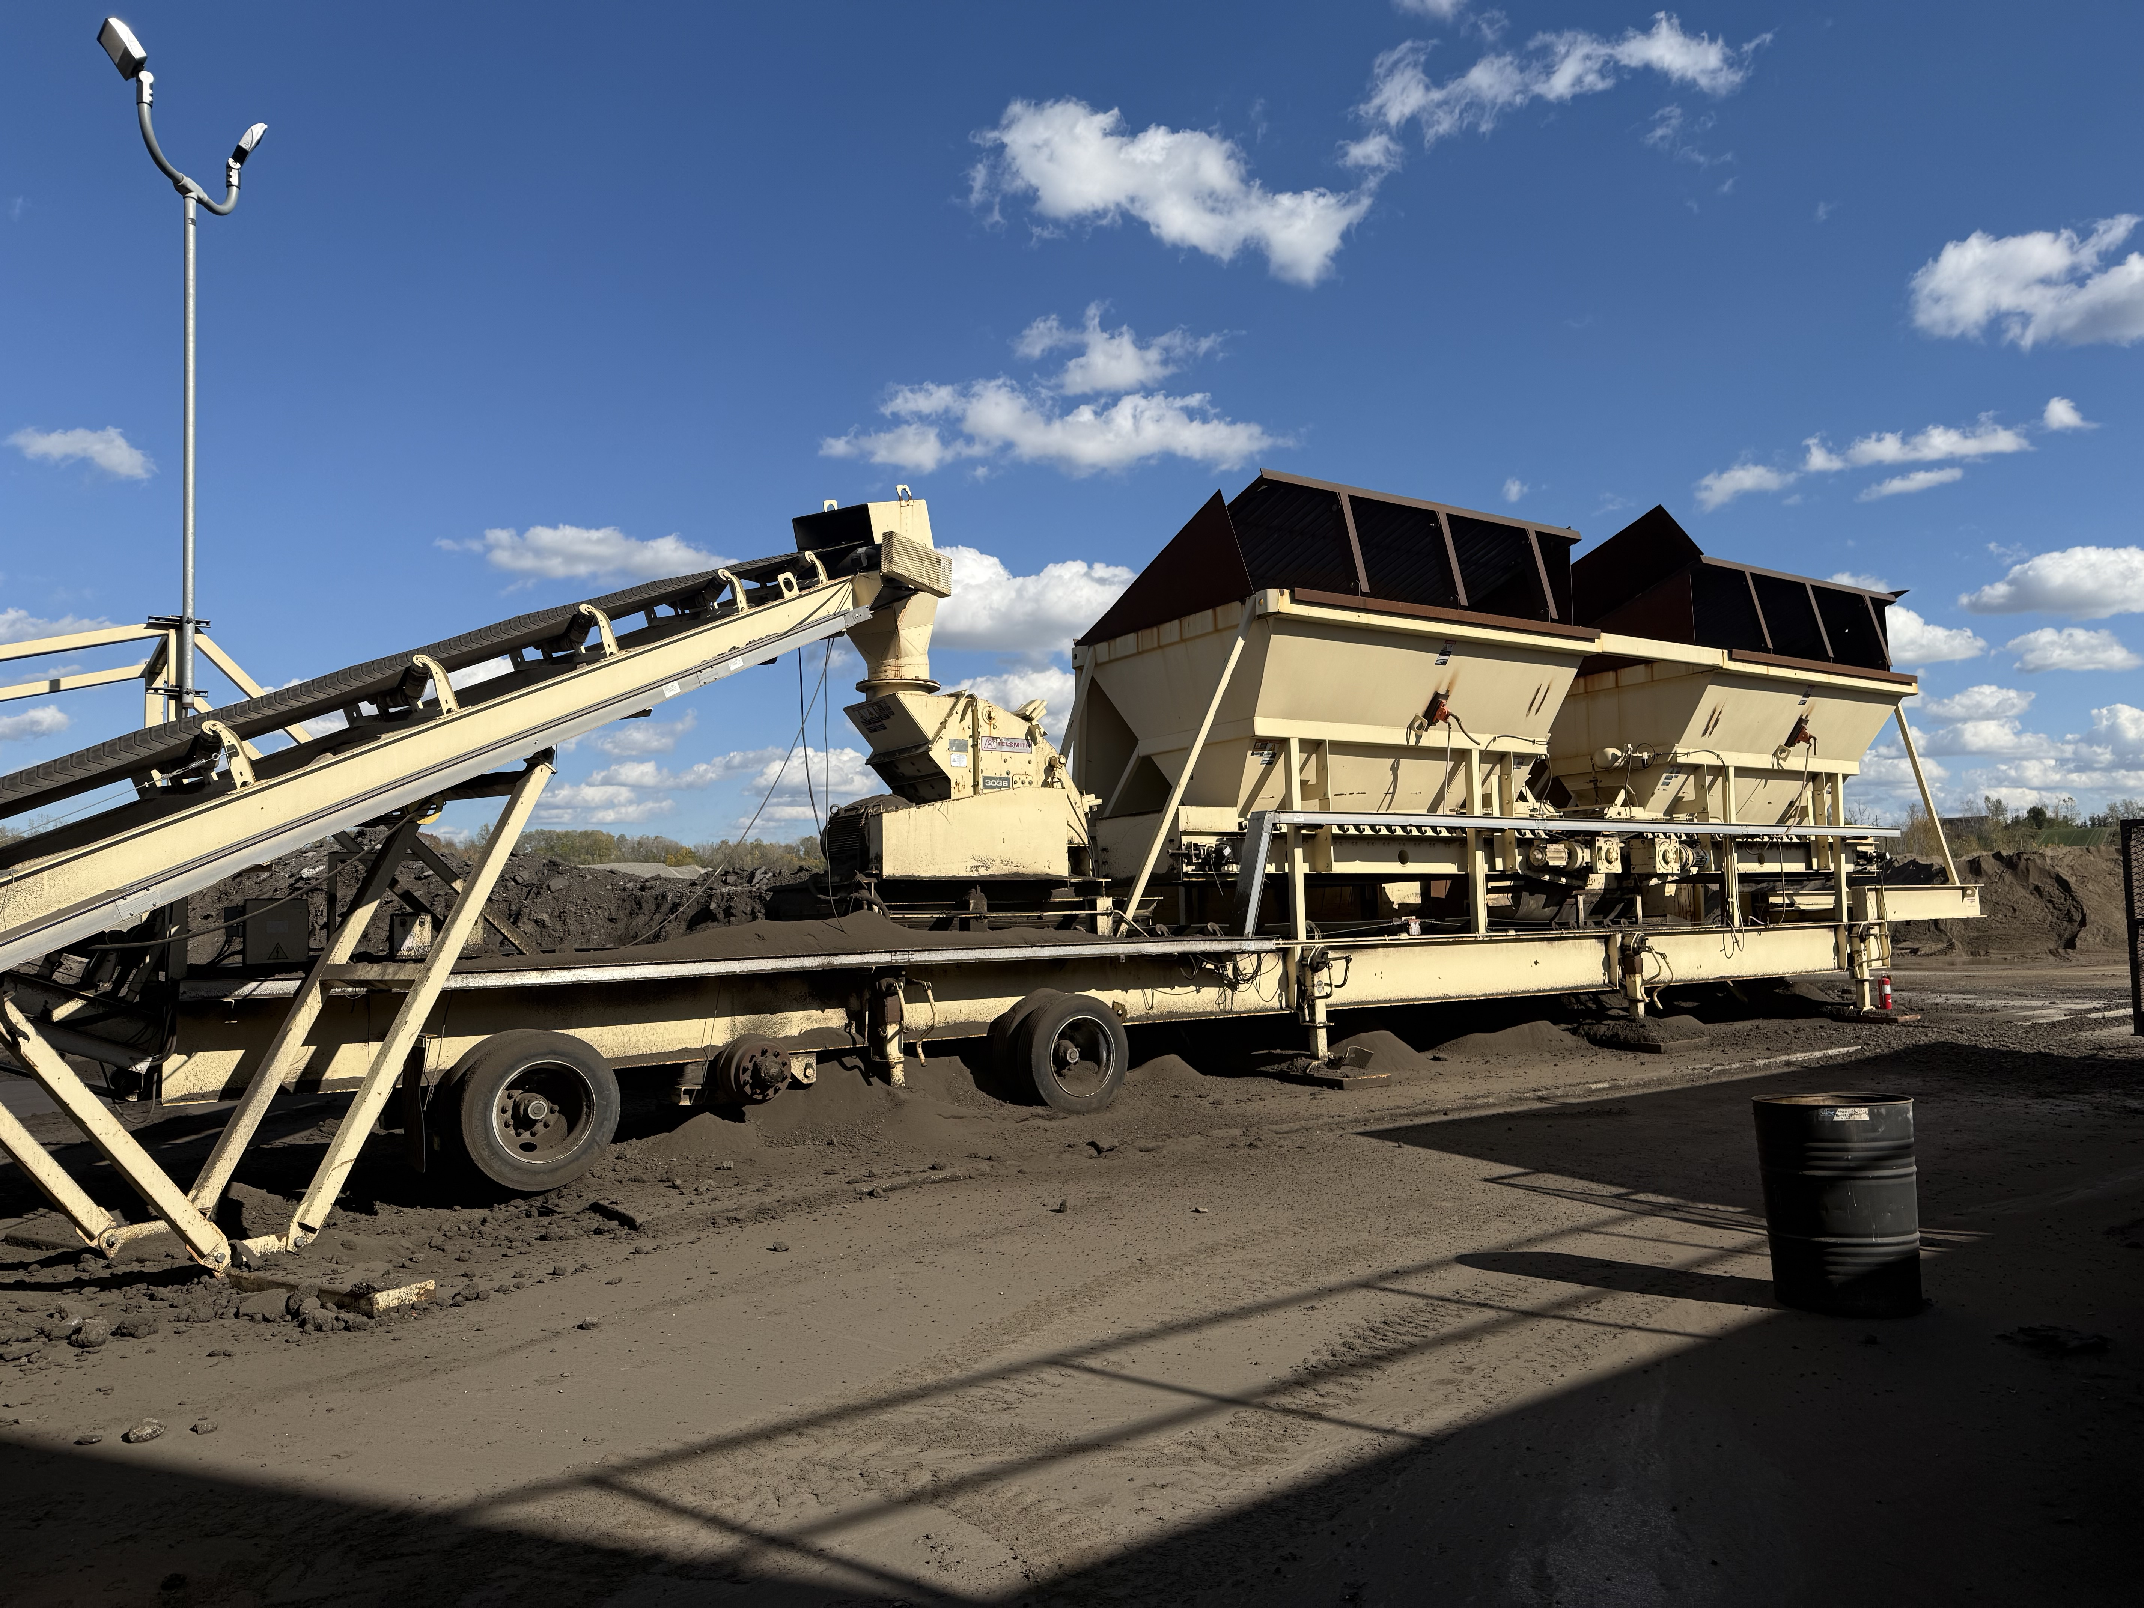
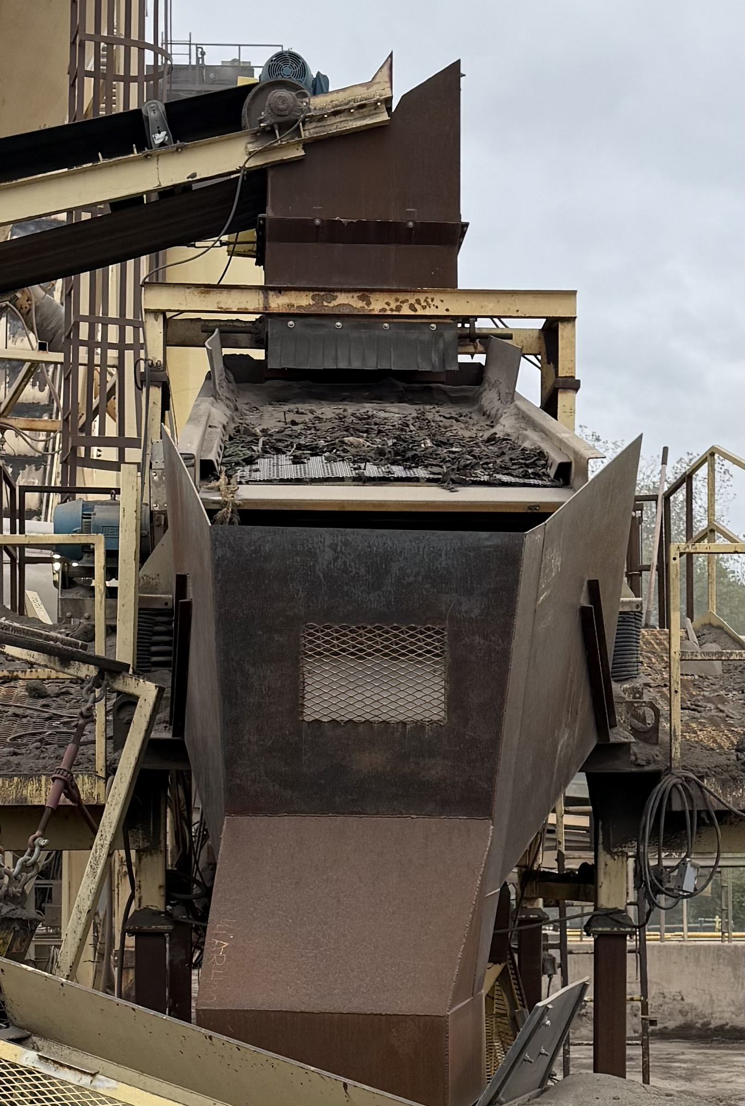
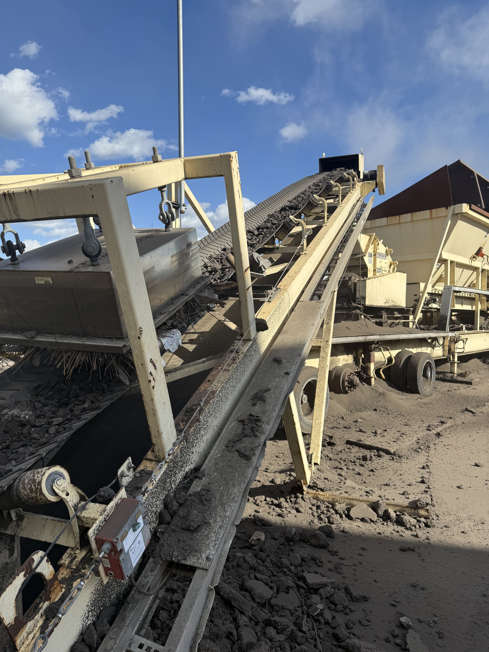
Findings…

Slide 12
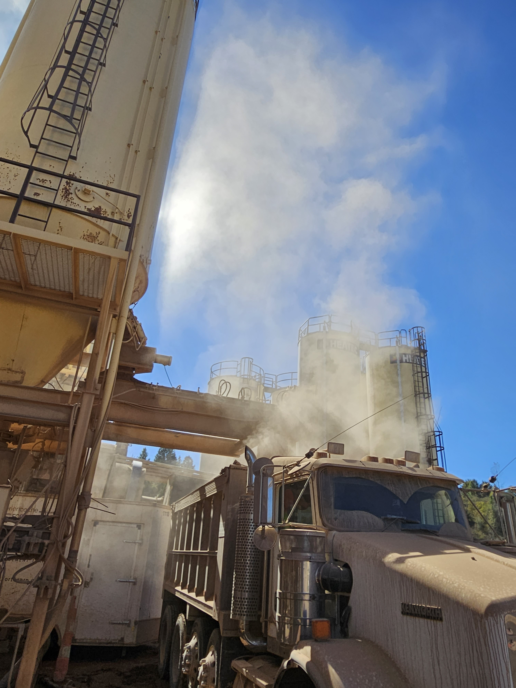
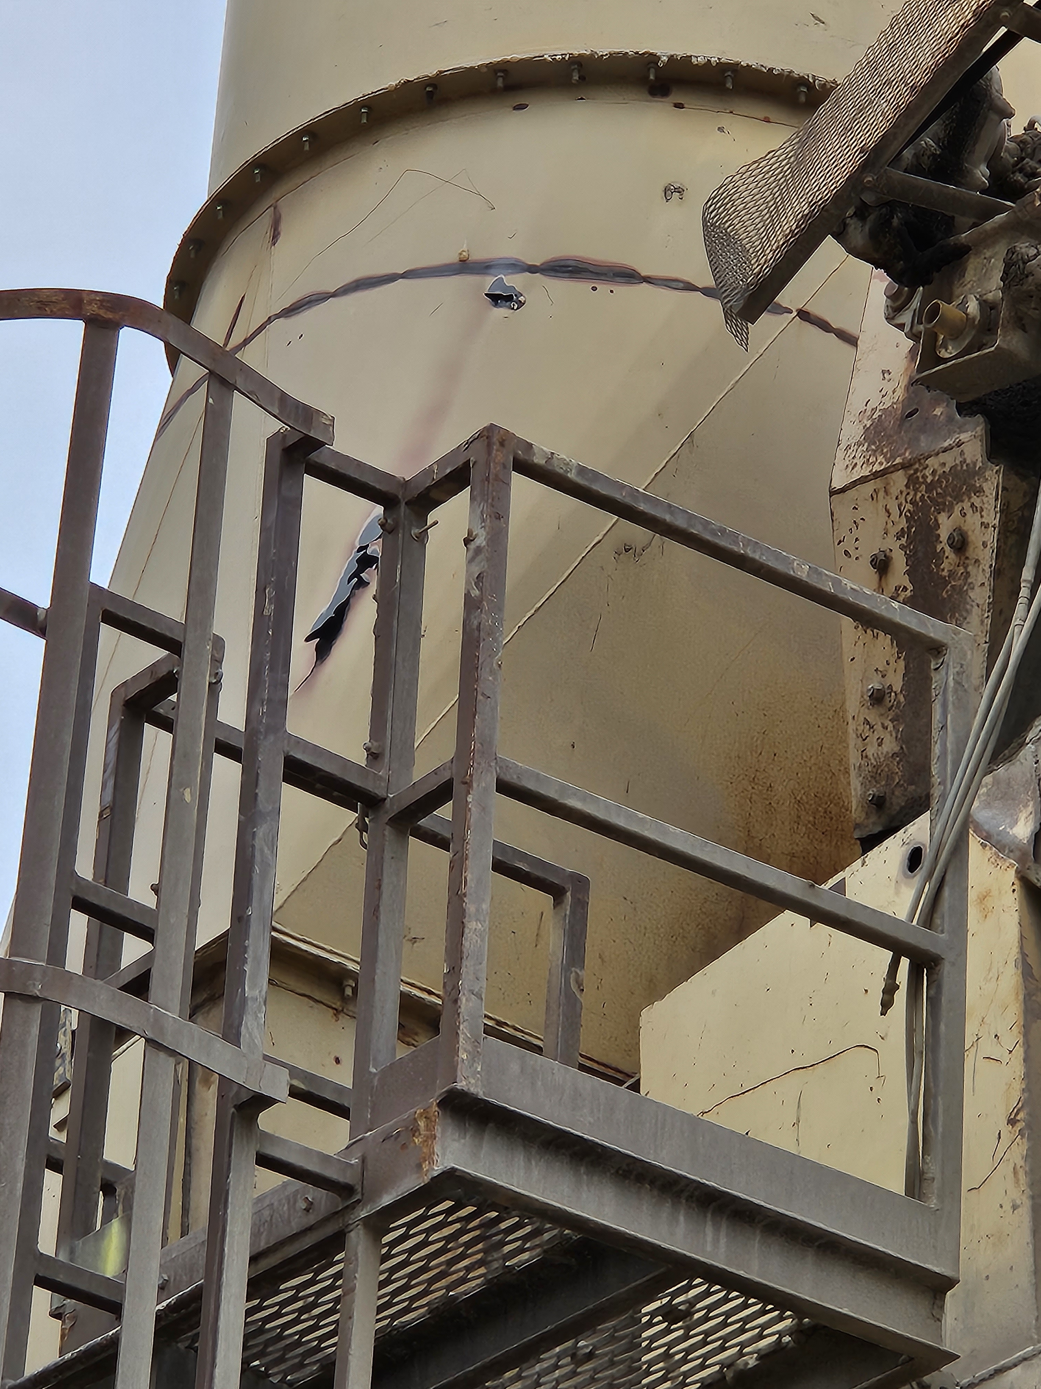
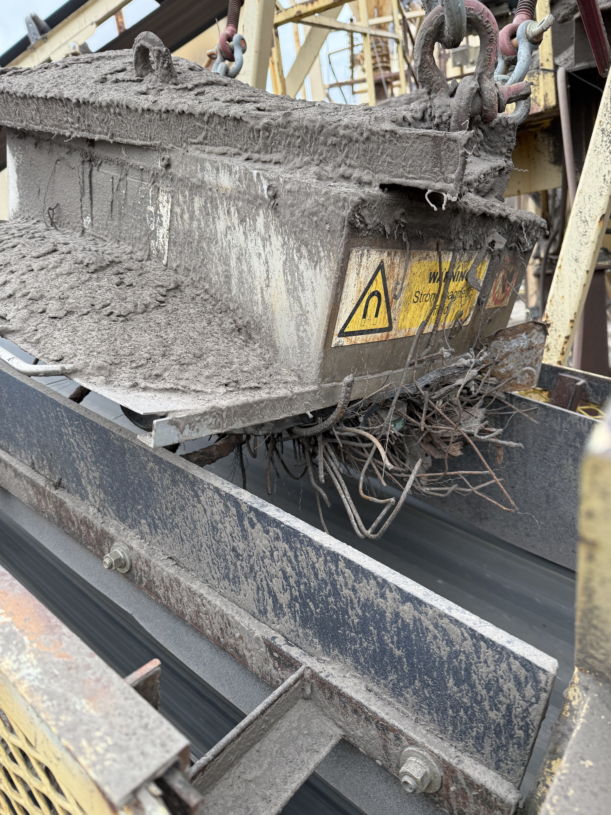
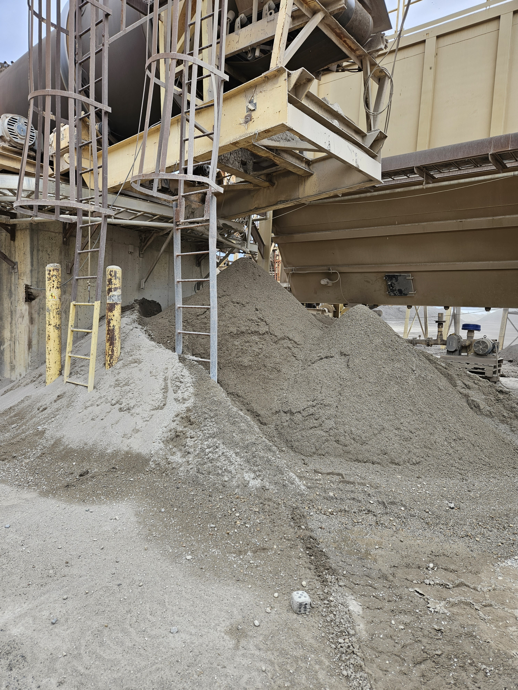
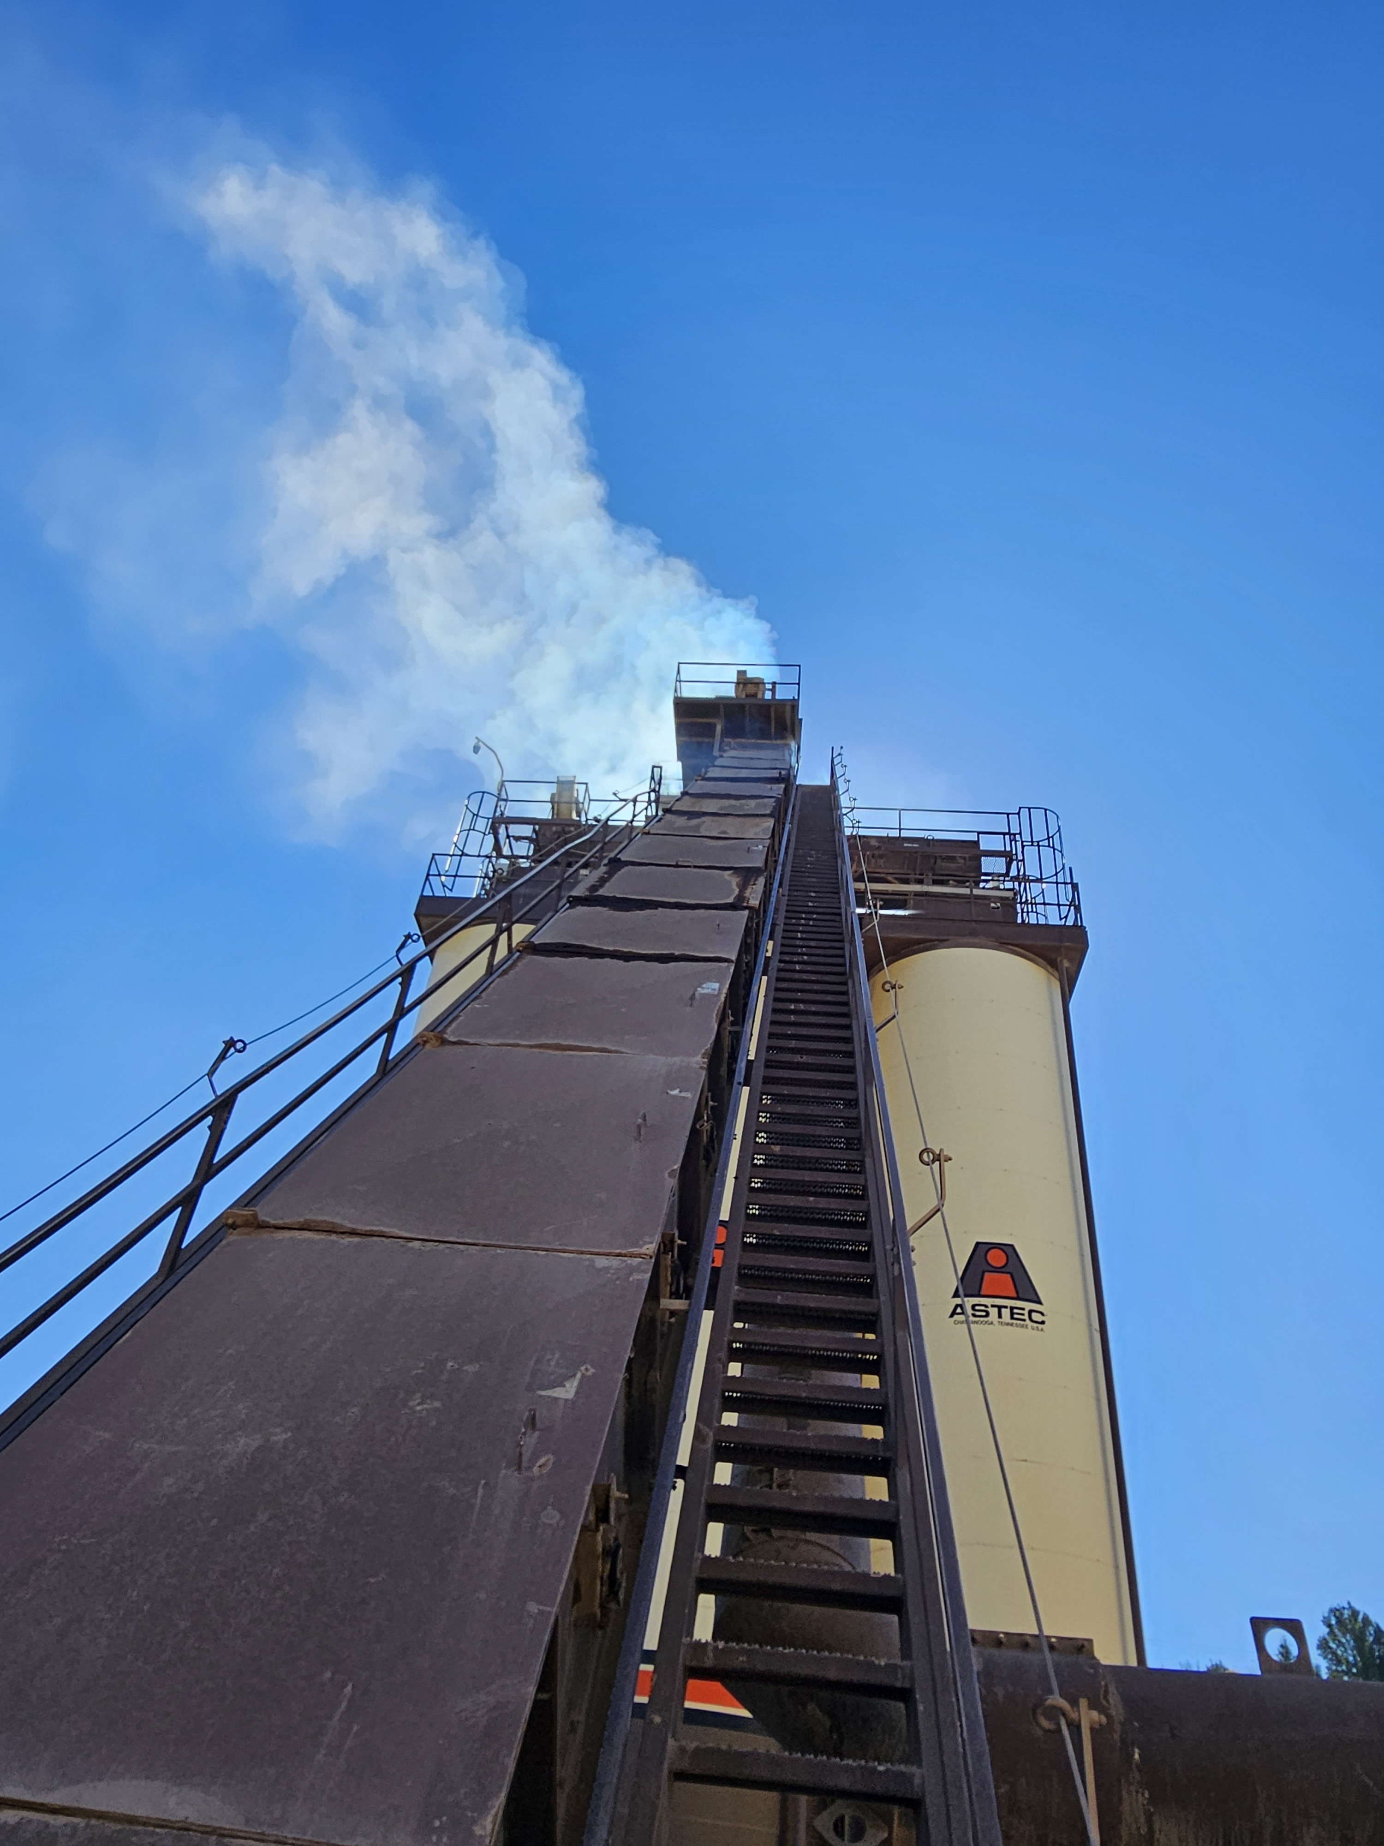
Findings…
Mix Design, RAP processing and RAP introduction issues.
QC/QA, plant operations and process control issues.
Deficiencies in normal/routine maintenance, housekeeping, operations and staffing.
Significant and dangerous structural issues on some plants.
Some of the plants have stack/emission issues that need to be addressed.
Operational efficiencies not optimized.

Slide 13
Conclusions and Recommendations
1
Eleven page final report with detailed assessments, photographs, conclusions and recommendations.
The
Final Report
2
RAP processing inadequate to produce specification mix with the percentage of RAP allowed by agencies. Specific RAP processing and virgin materials assessments and recommendations to address these and other deficiencies.
3
Although the plants are approximately 10-30 years old, several of the major components have been replaced. Wear had been addressed in some places but not in others.
4
Plant specific recommendations on what plant issues need to be addressed immediately and suggestions on future component maintenance and replacement.
5
Recognition that a plant evaluation and assessment program, or Asphalt Plant Physical, would be very beneficial to Astec customers. Astec has the expertise and resources to develop this type of program and offer it to our customers.

Slide 14
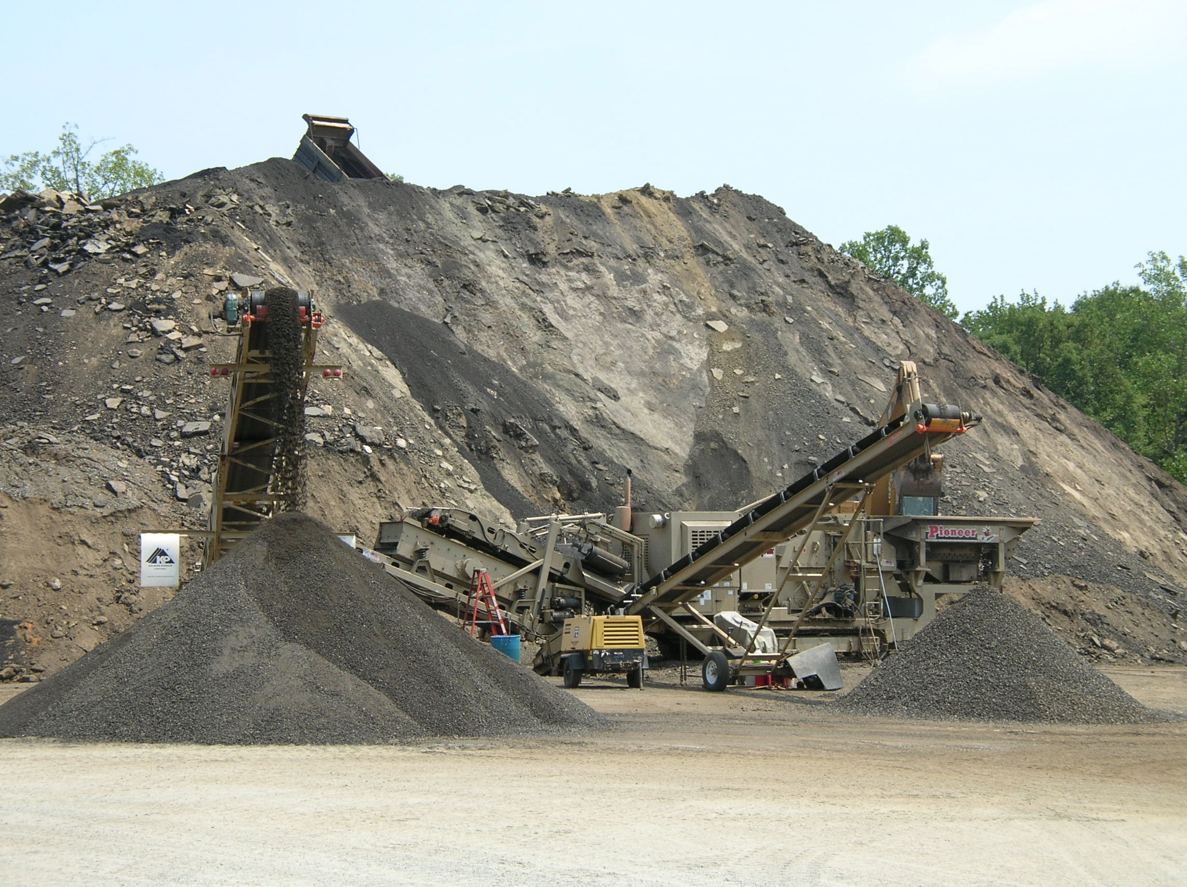
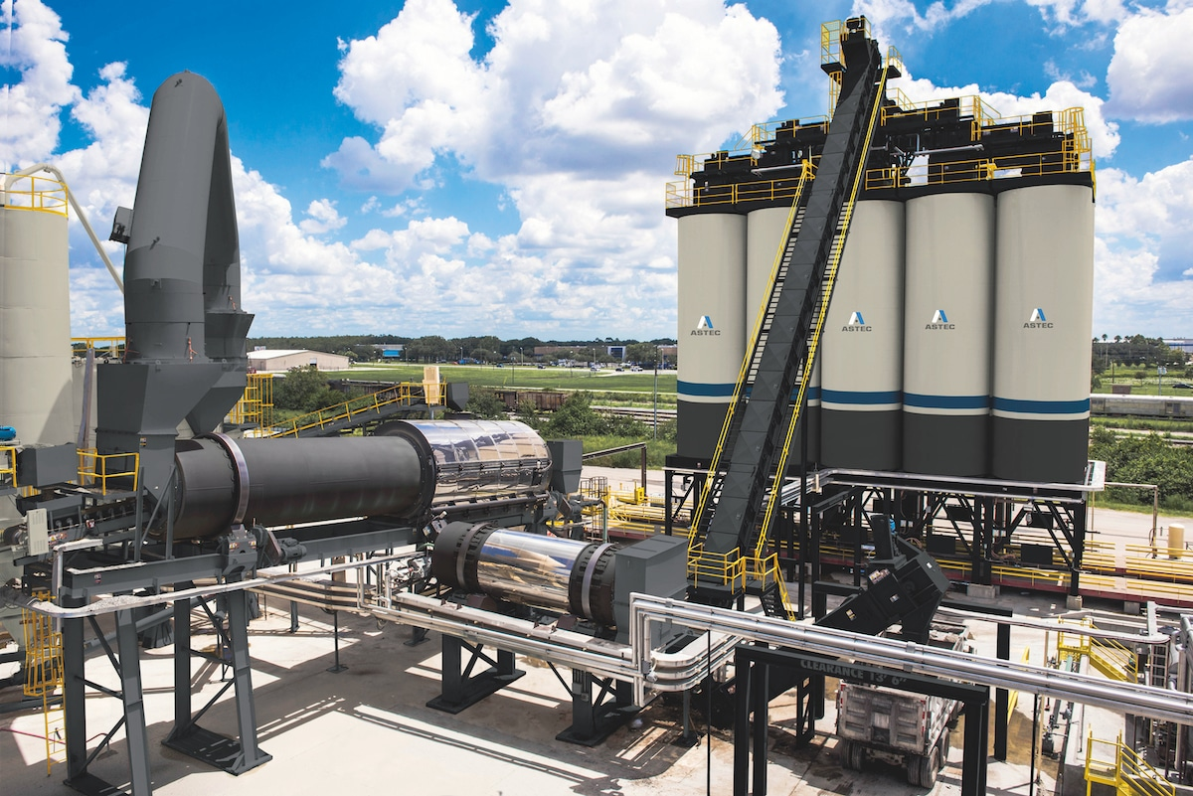
Separate Programs Needed
Recycling Operations Assessment
Plant Operations and Efficiency Assessment

Slide 15
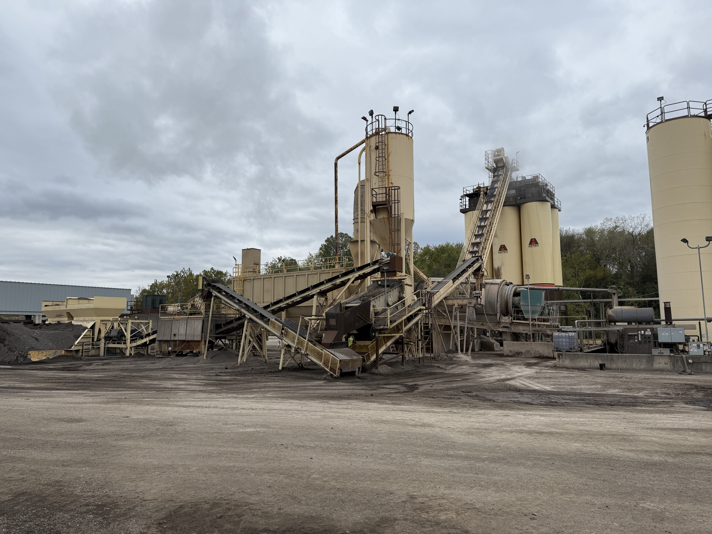
Developing the Plant Physical Concept
Plant Components Condition Analysis
  Cold Feeds & Conveyors (virgin/RAP/other)
  Drum/dryer
  Ductwork and Baghouse
  Silos/mix Storage
  Controls
  Binder and Fuel Storage
  Scales
  Additive systems
What should be addressed and when

Slide 16

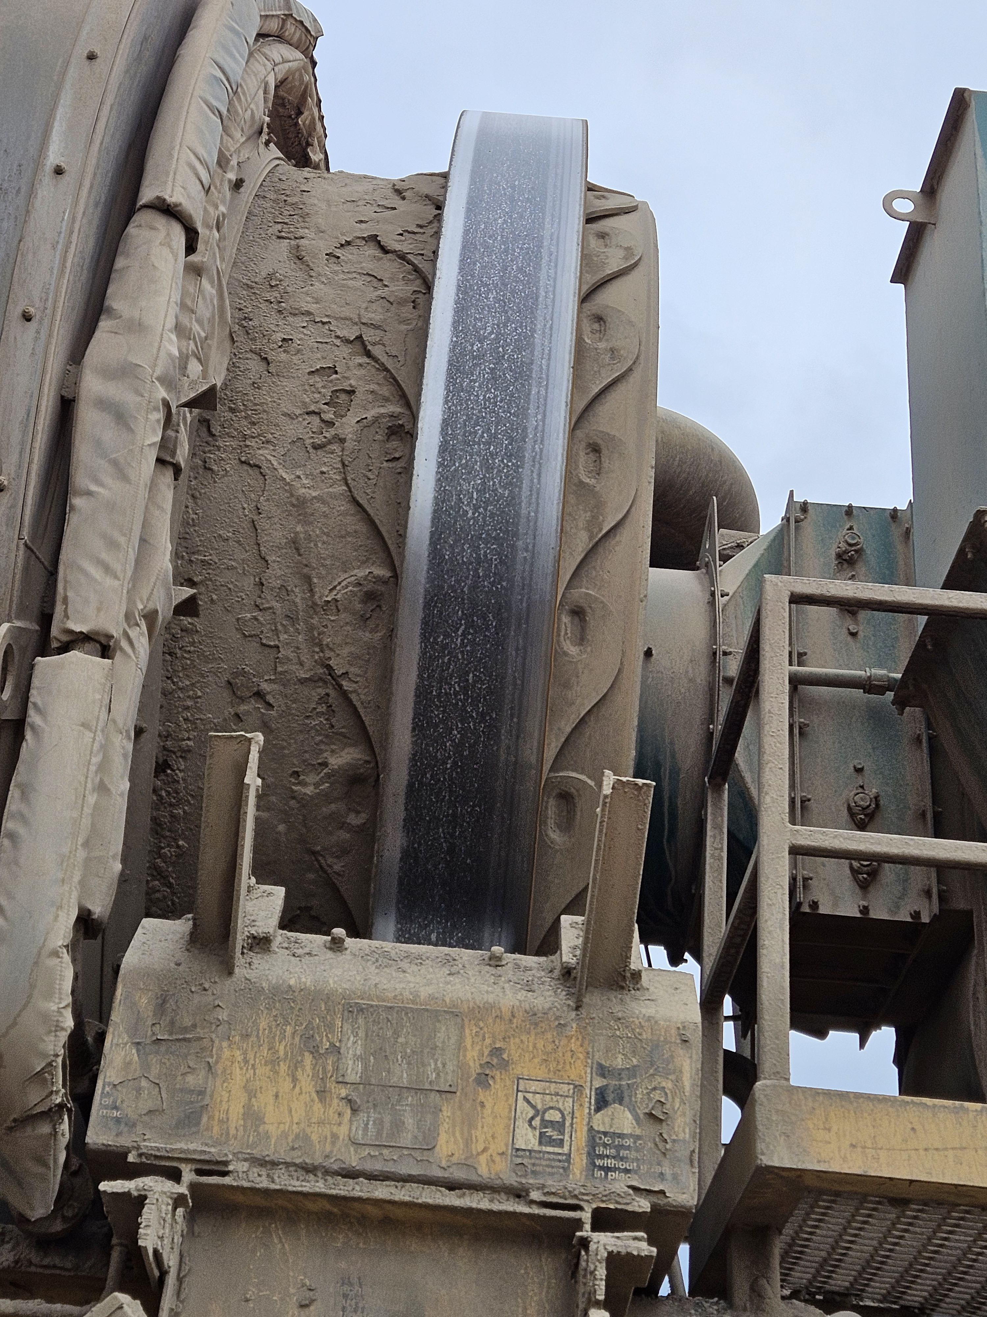
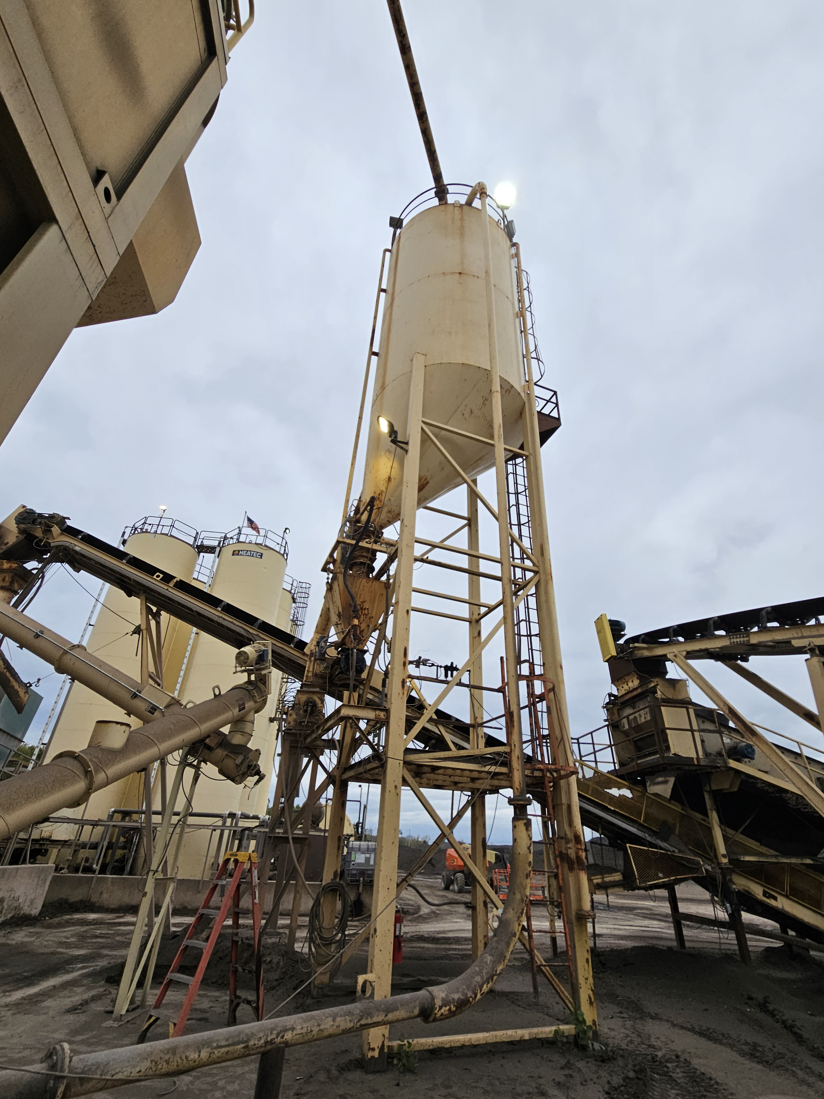
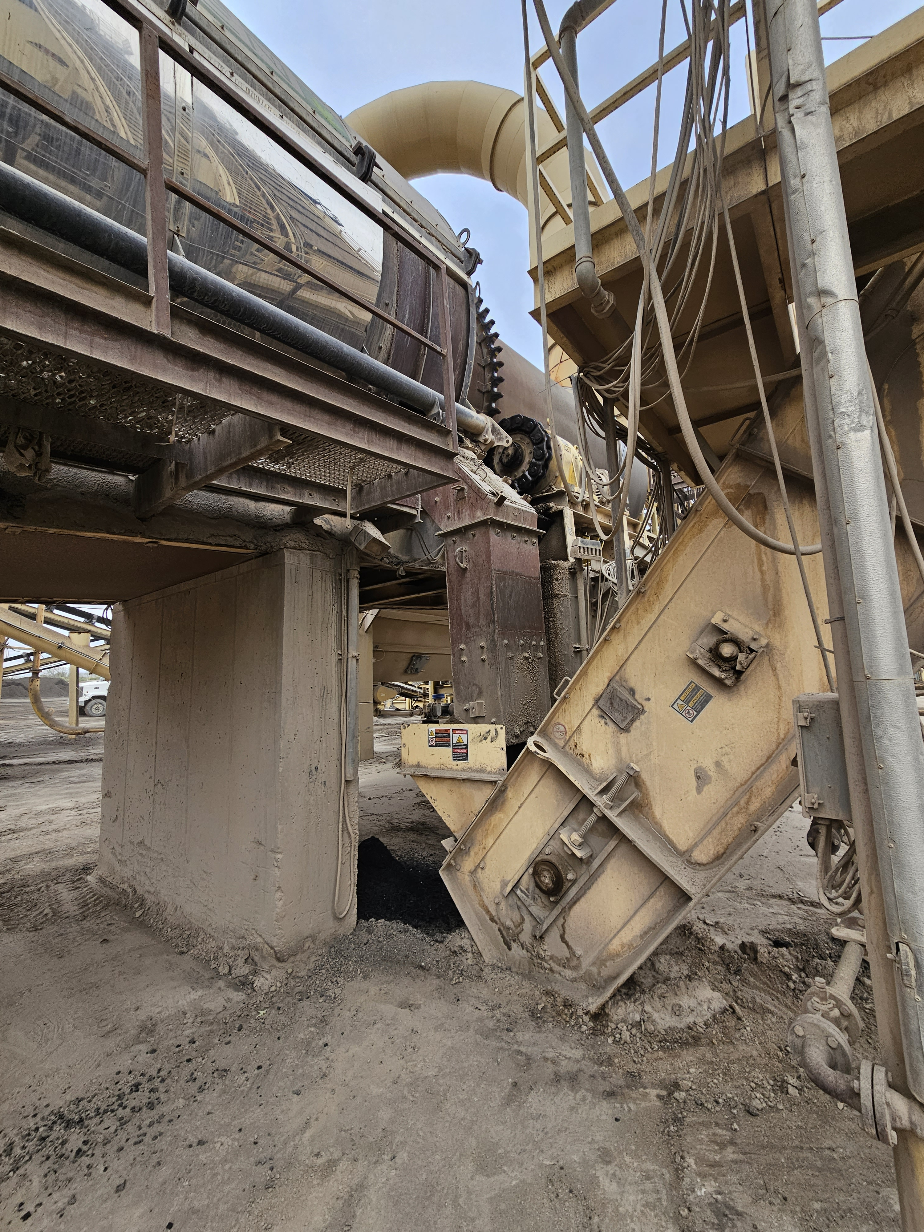
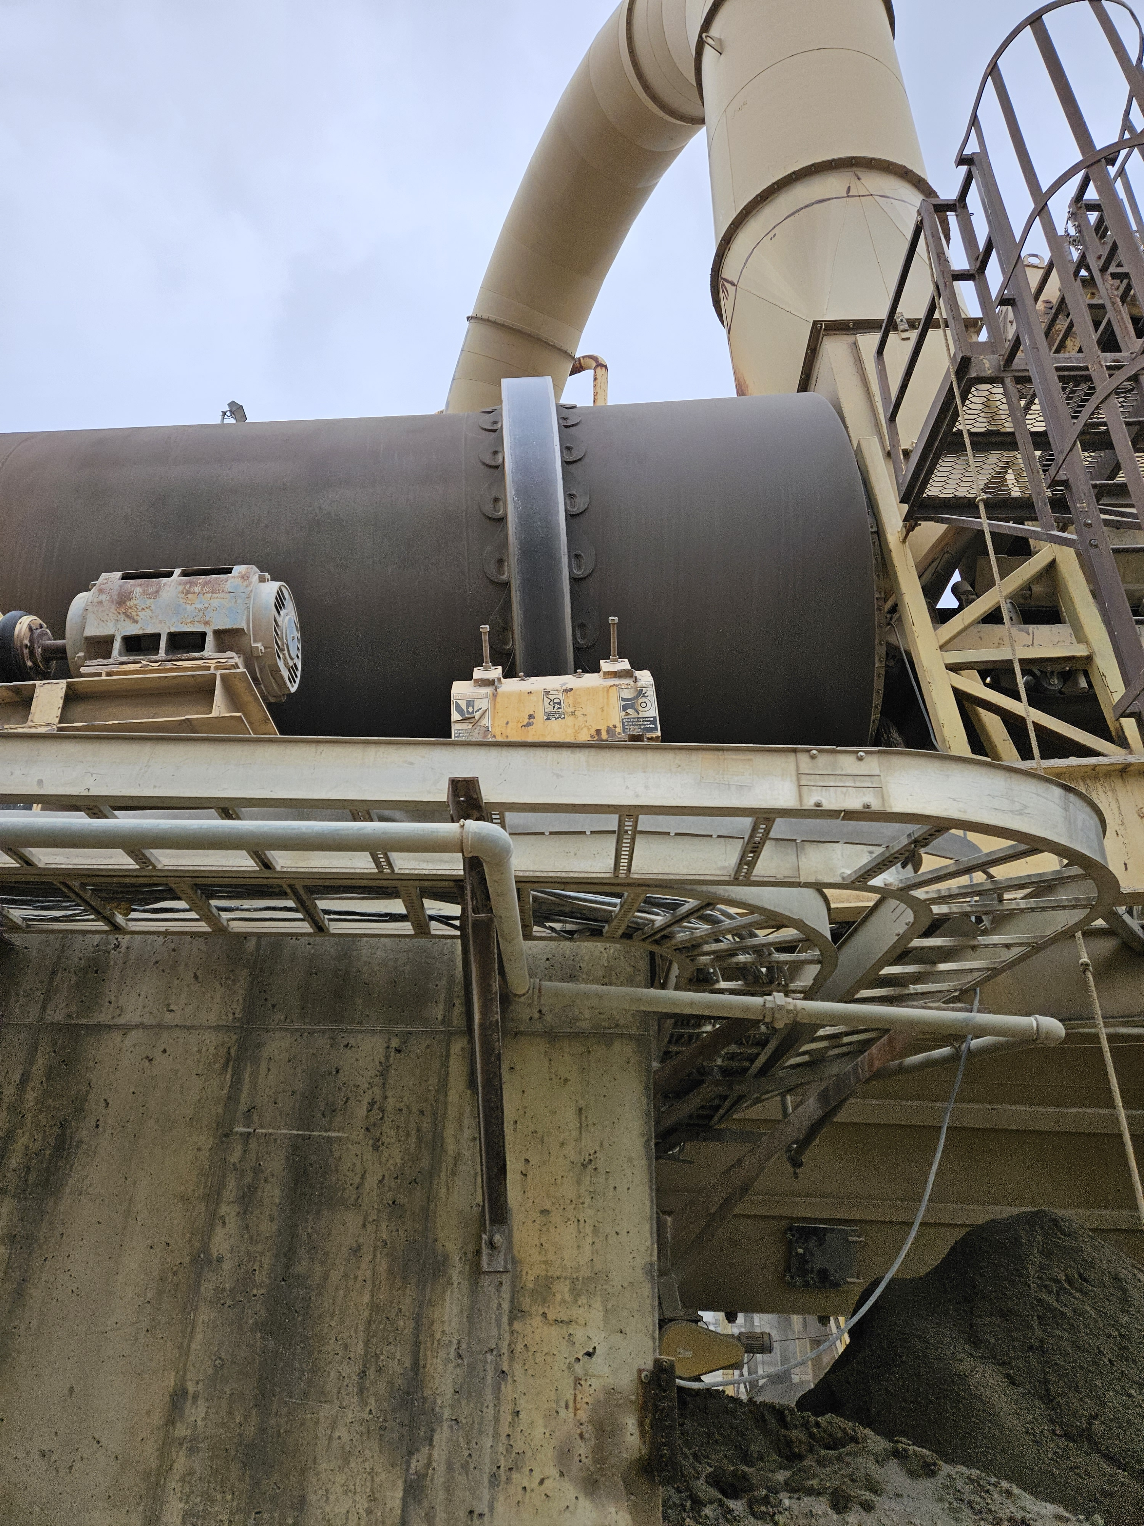
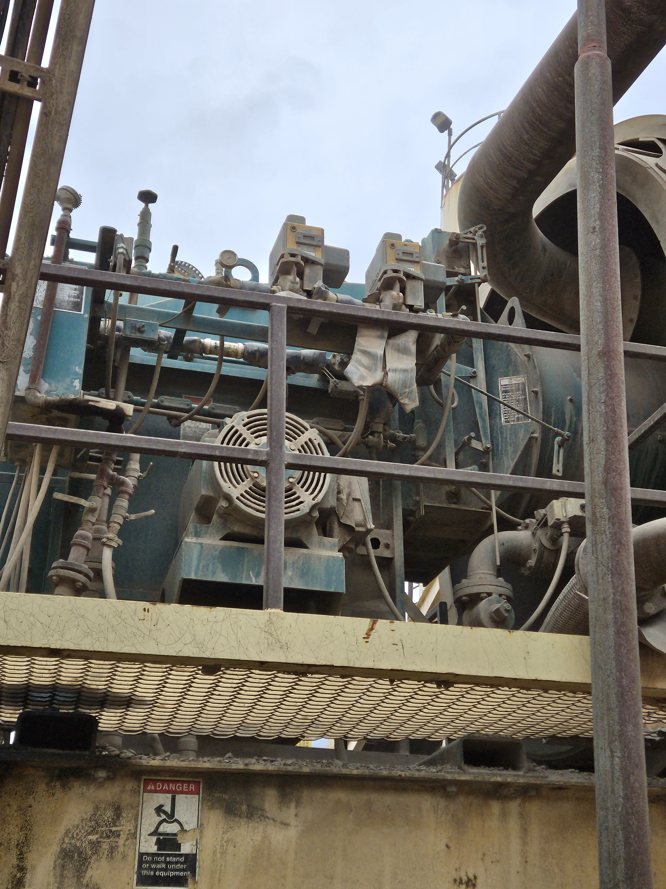
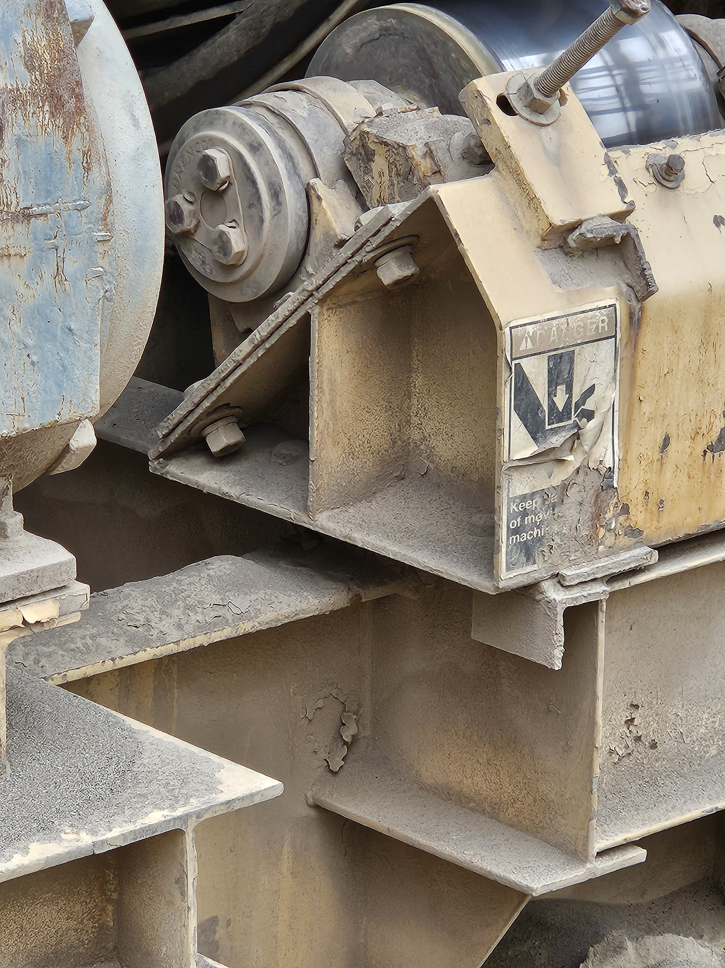
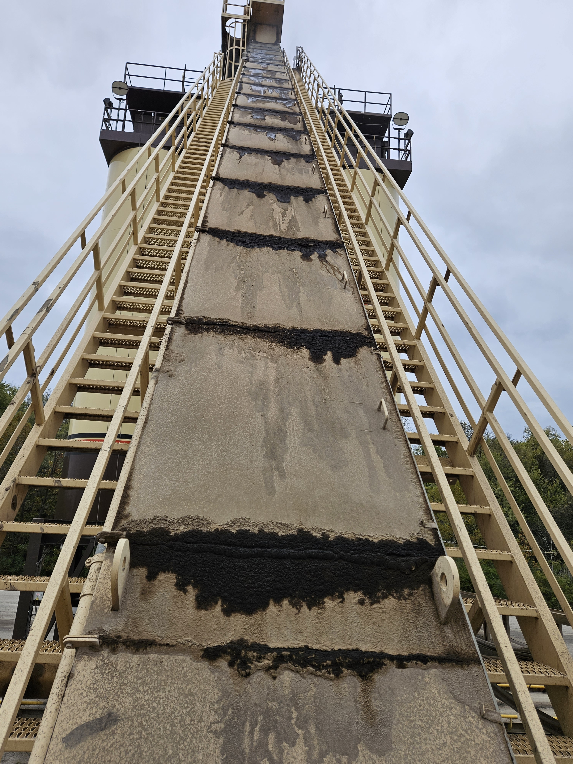
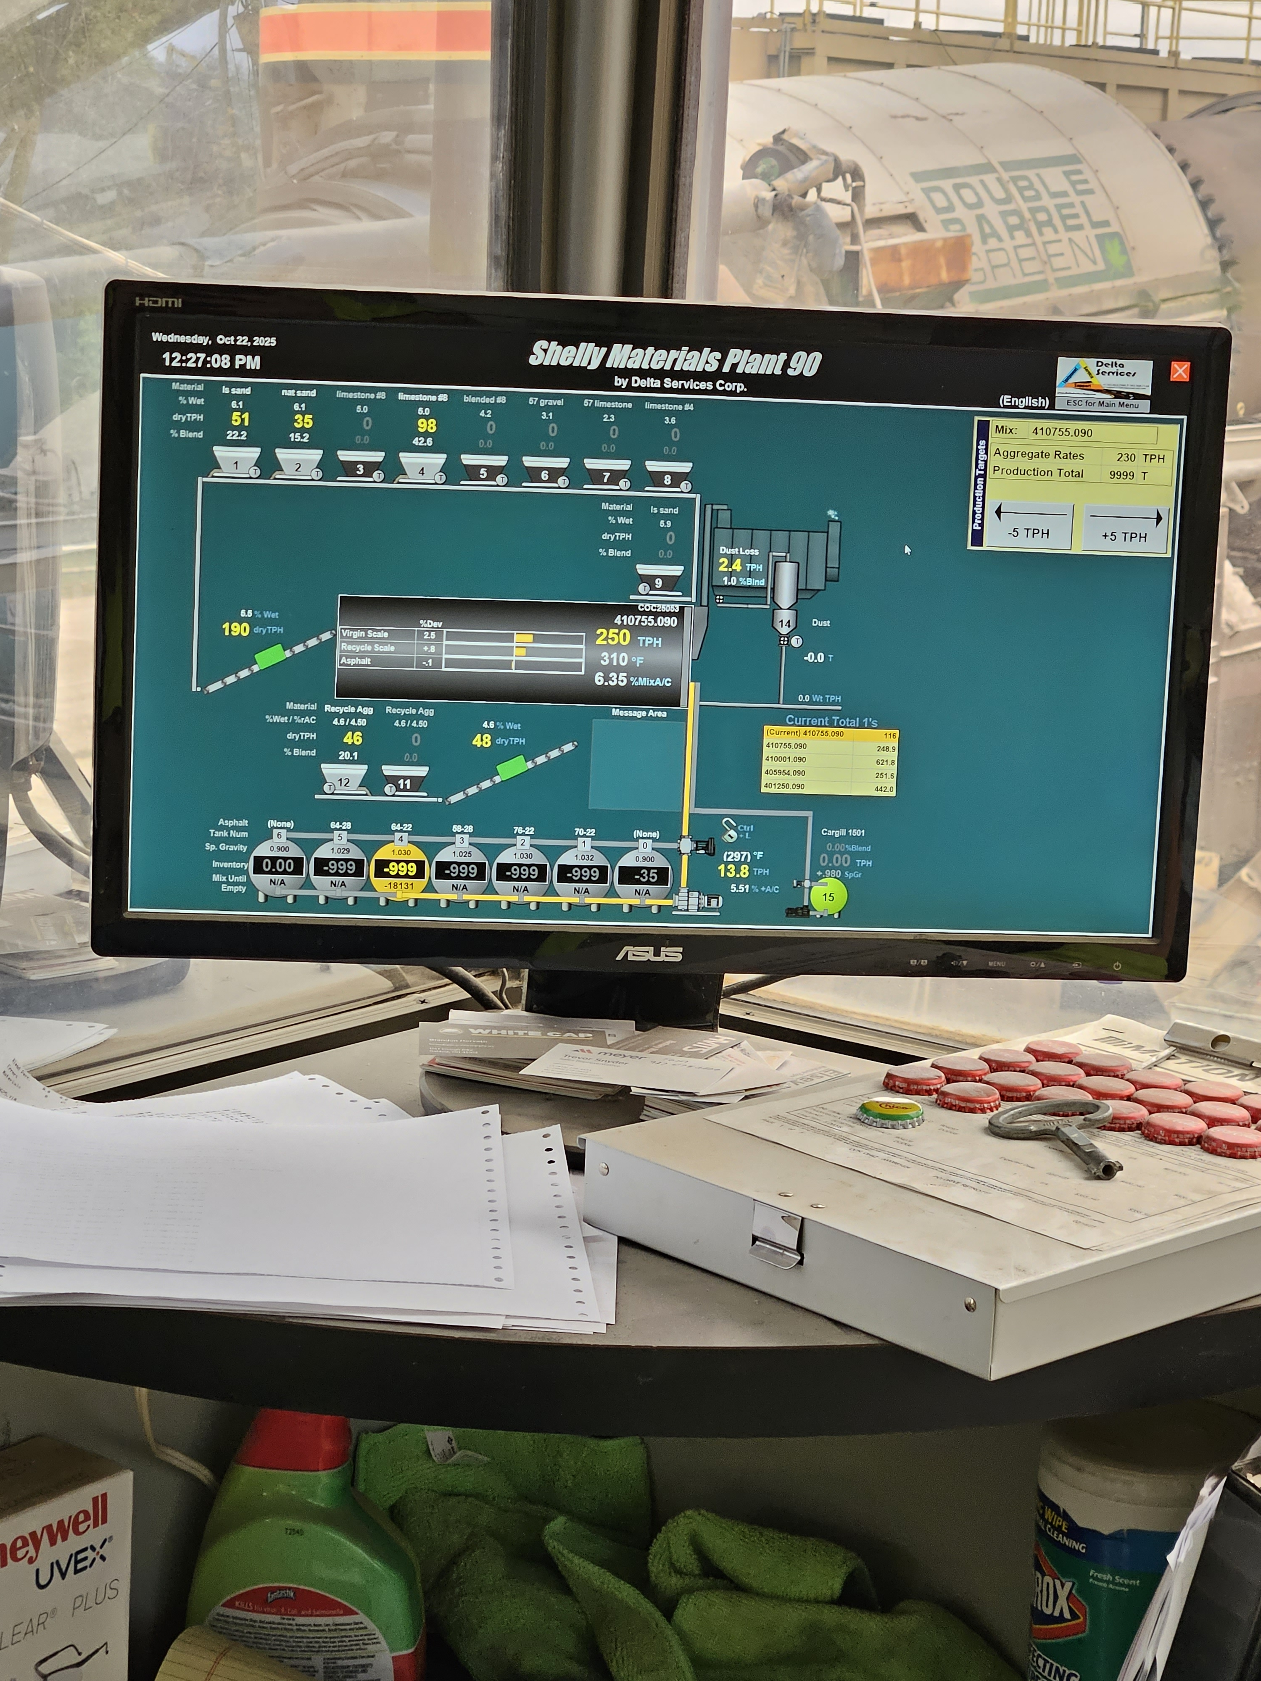
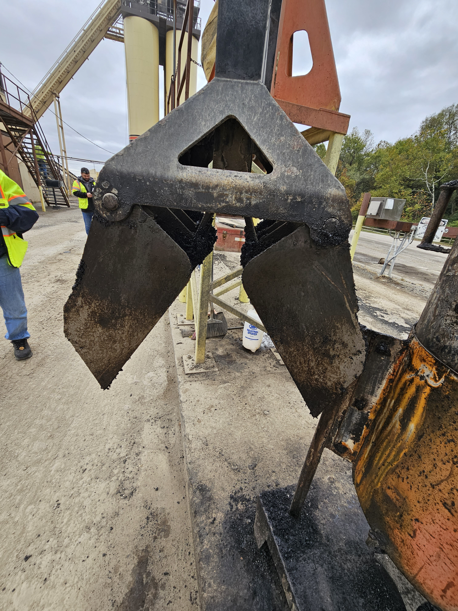
Annual Checkup Concepts
Medical Physical
Asphalt Plant Physical
Reduce The Risk Of Shutdowns
Increase Chances For Treatment
Efficiency Cost Savings
Reduce Plant Maintenance Costs
Cut Down On Component
Maintenance/Repairs
Establish A Baseline
Update Routine Maintenance
Manage Upgrades And Replacements
Guidance On Future Needs

Slide 17
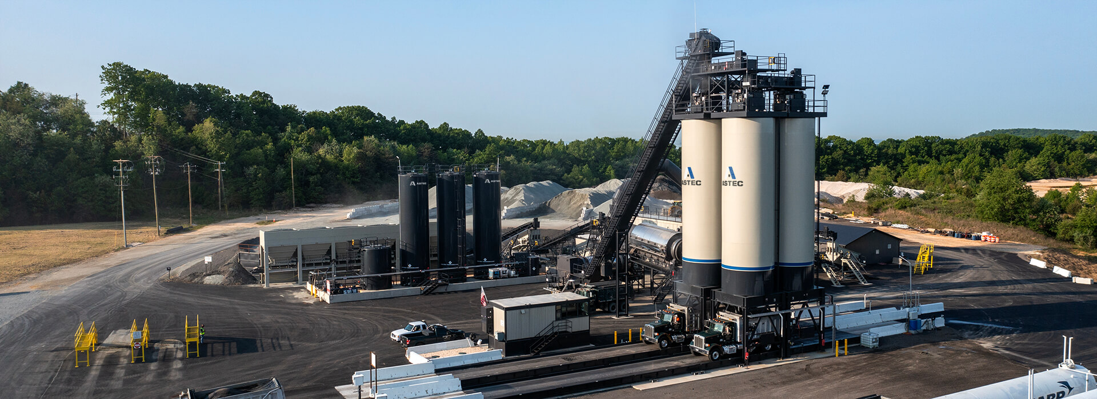

Plant Physical
Developing A “Report Card” Grading System
Grading System
Vs.
Detailed Report
In the United States, academic grading commonly takes on the form of five, six or seven letter grades. Traditionally, the grades are A+, A, A−, B+, B, B−, C+, C, C−, D+, D, D− and F, with A+ being the highest and F being lowest.

Slide 18
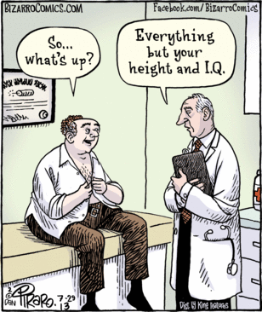
A Few Facts About Men Health…
Men tend to die earlier than women.
Men are more likely to die from eight out of ten top causes of death.
Men are more likely to smoke and drink heavily.
Men tend to take more risks than women.
Men have more dangerous jobs than women.
Men are less socially connected.
But the biggest issue is men just don’t like to go to the doctor as much as women do…half as likely!

Slide 19
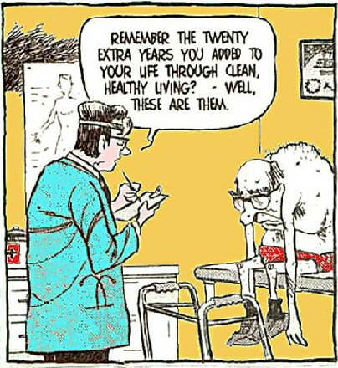
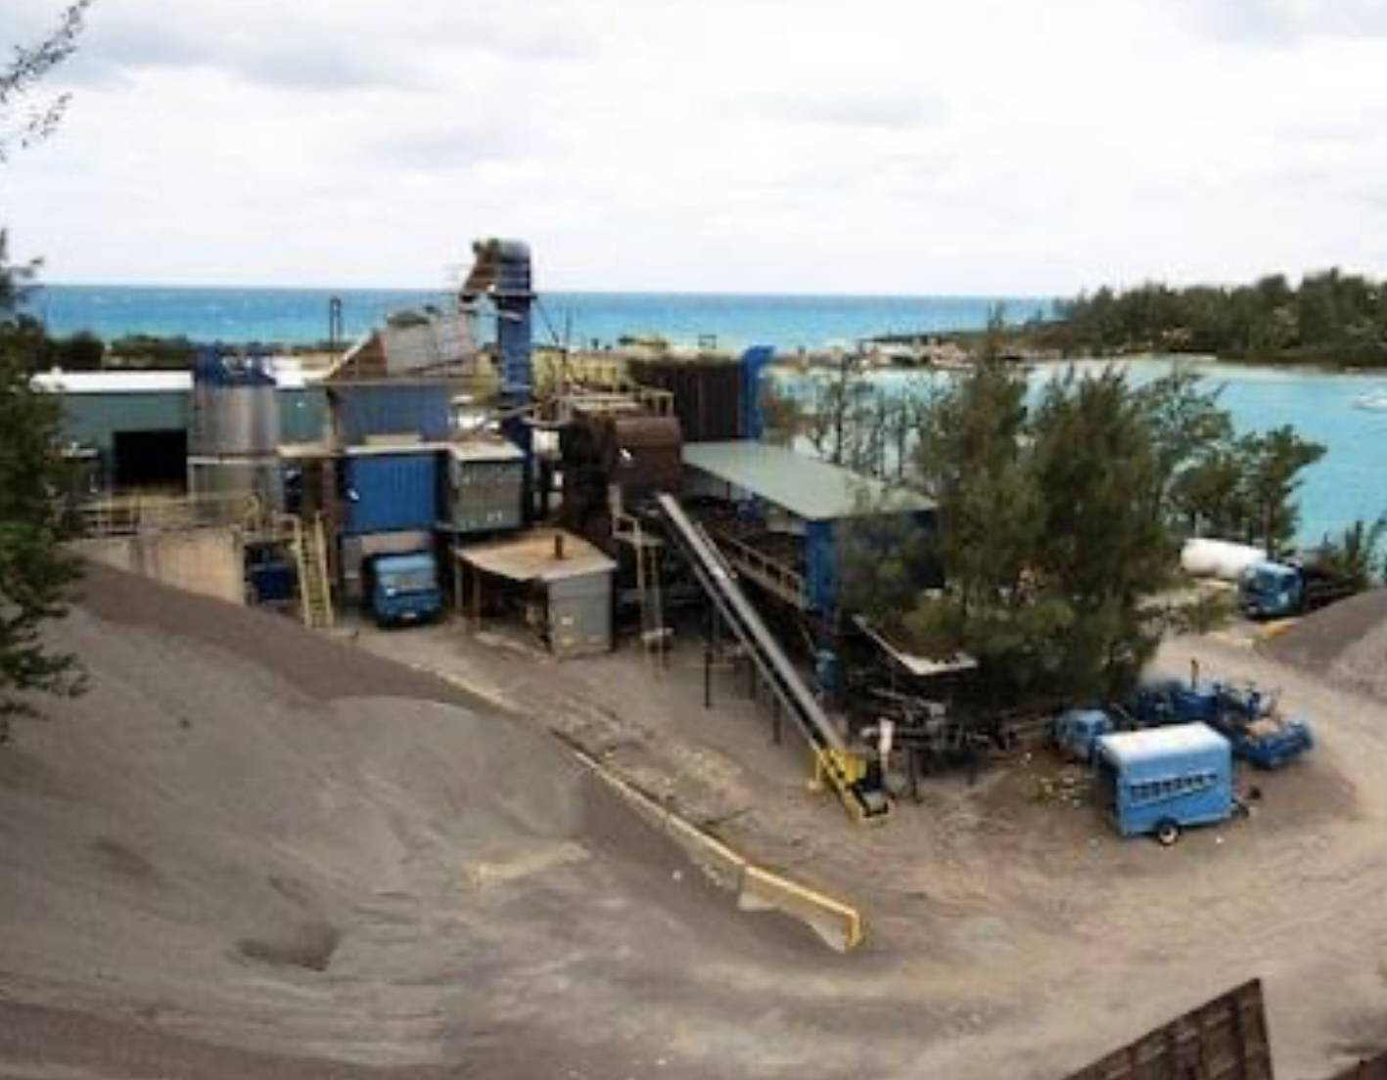
Plants Don’t Stay New Forever

Slide 20

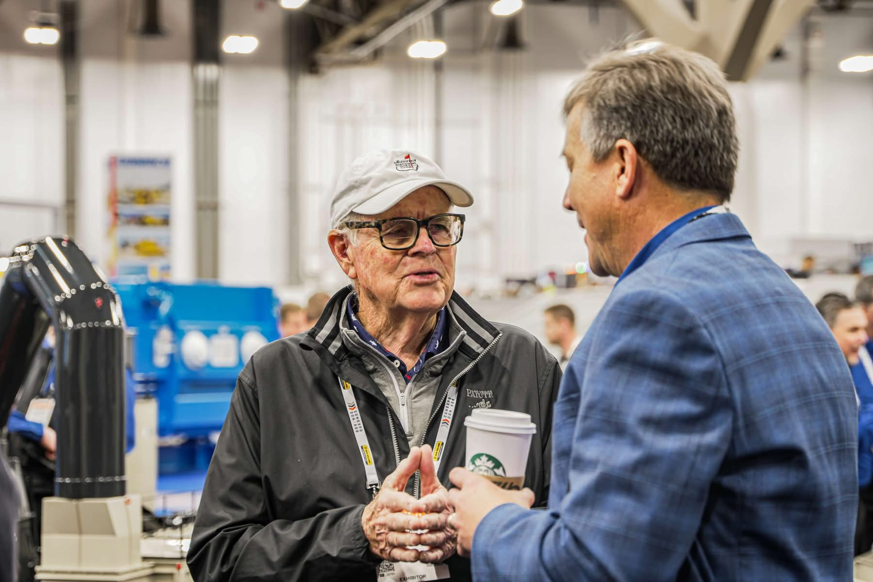
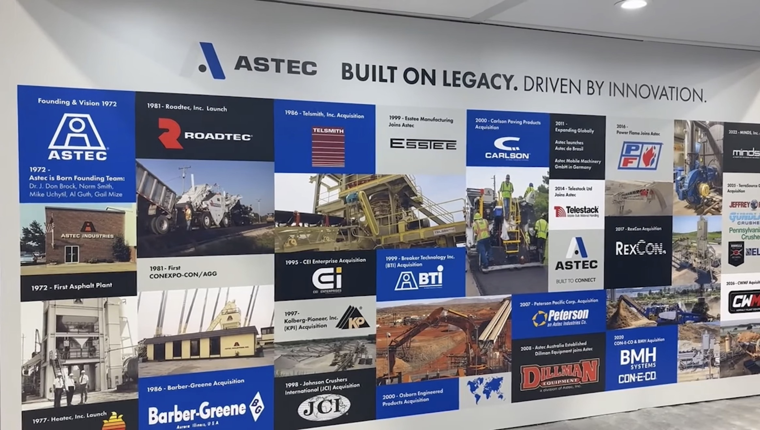
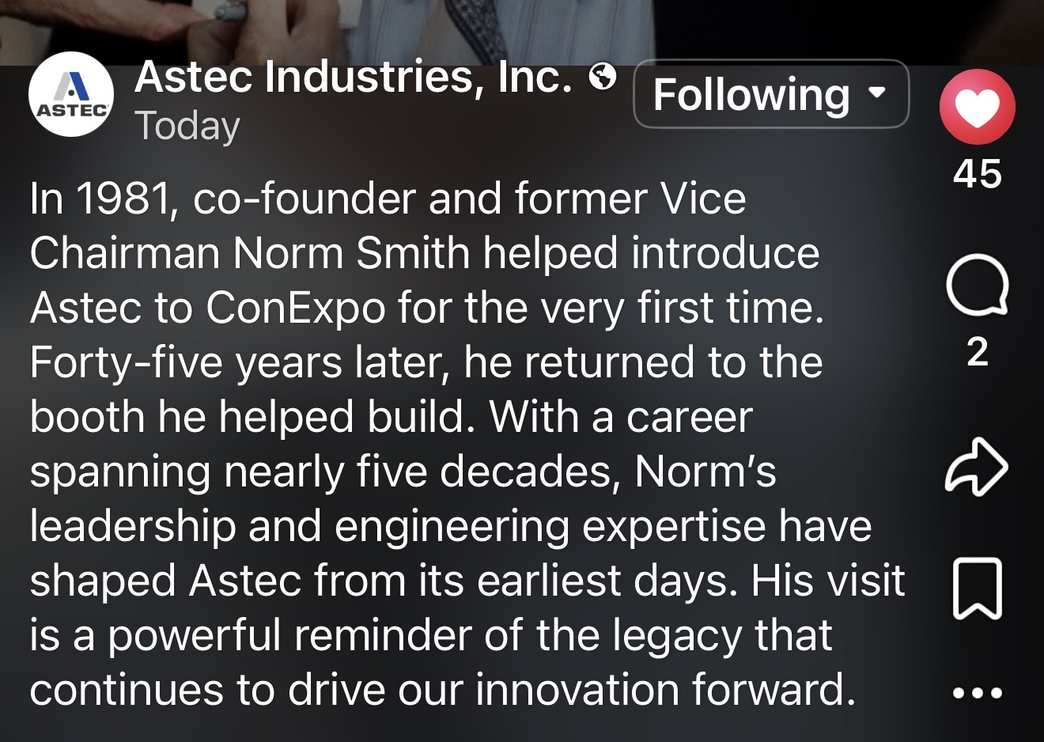
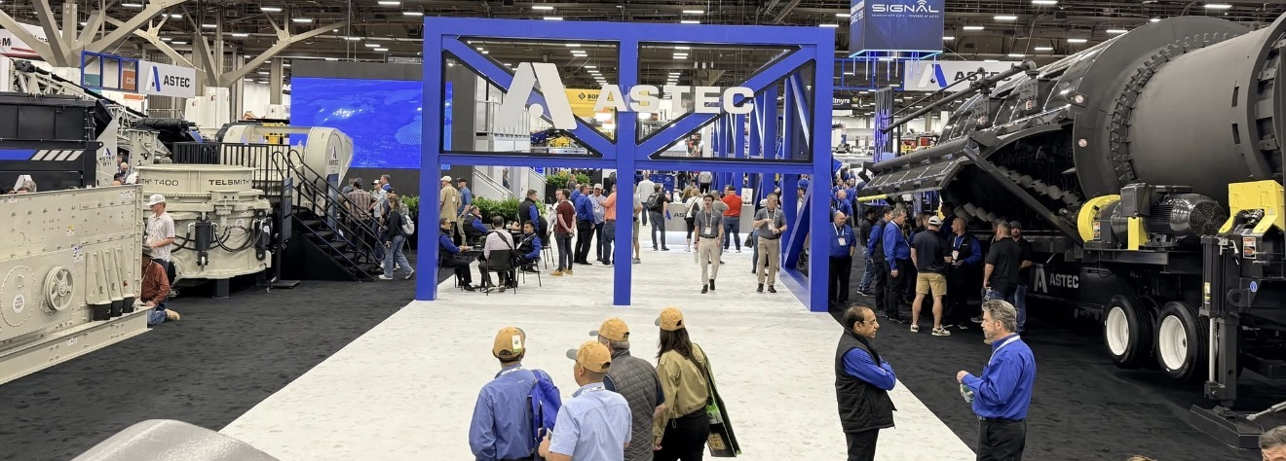

Innovation…It’s What We Do At Astec

Slide 21
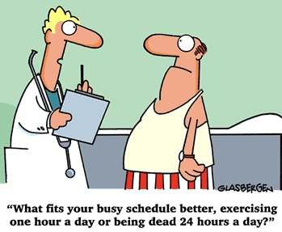
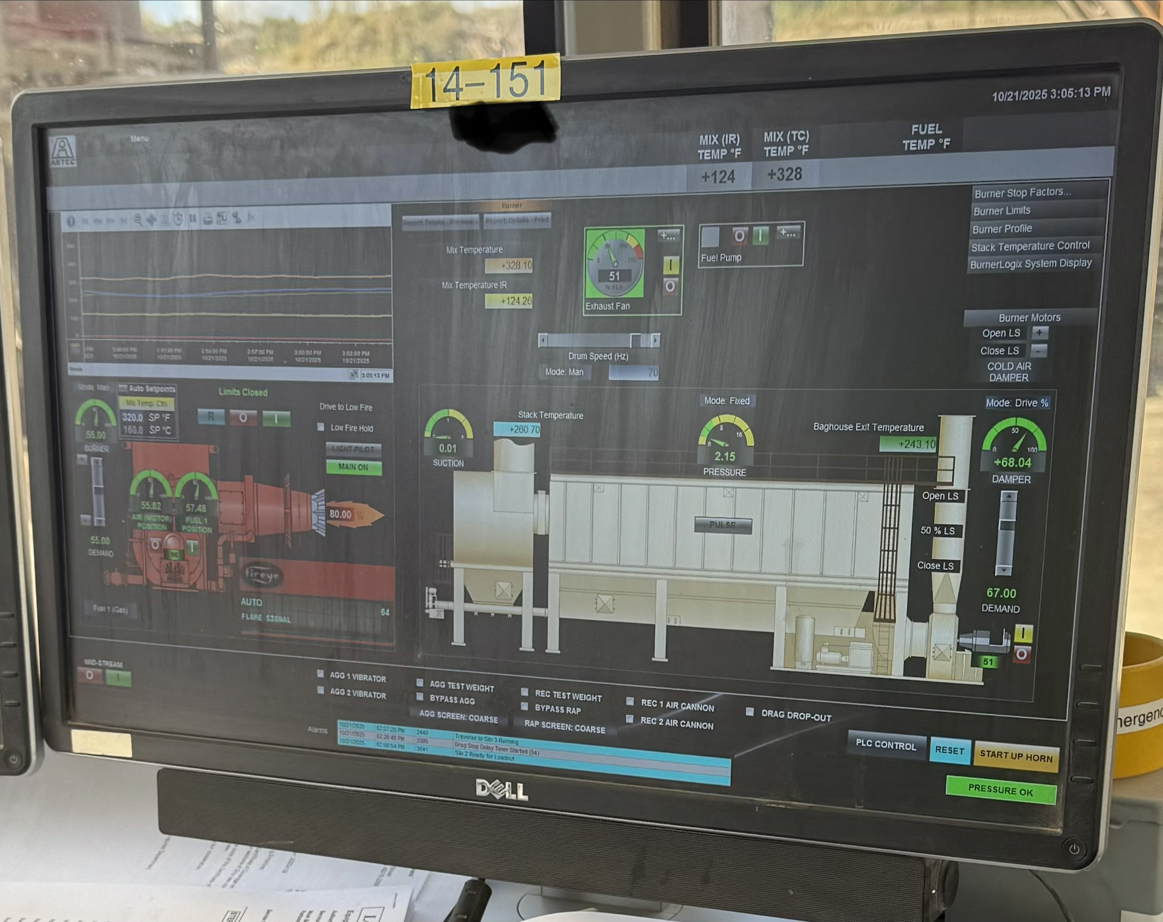
A Physical May Save Your Life
…And Your Plant’s

Slide 22

Astec Plant Physical Concept
Plant Components Condition Analysis
  Cold Feeds & Conveyors (virgin/RAP/other)
  Drum/dryer
  Ductwork and Baghouse
  Silos/mix Storage
  Controls
  Binder and Fuel Storage
  Scales
  Additive systems
What should be addressed and when

