Slide 1
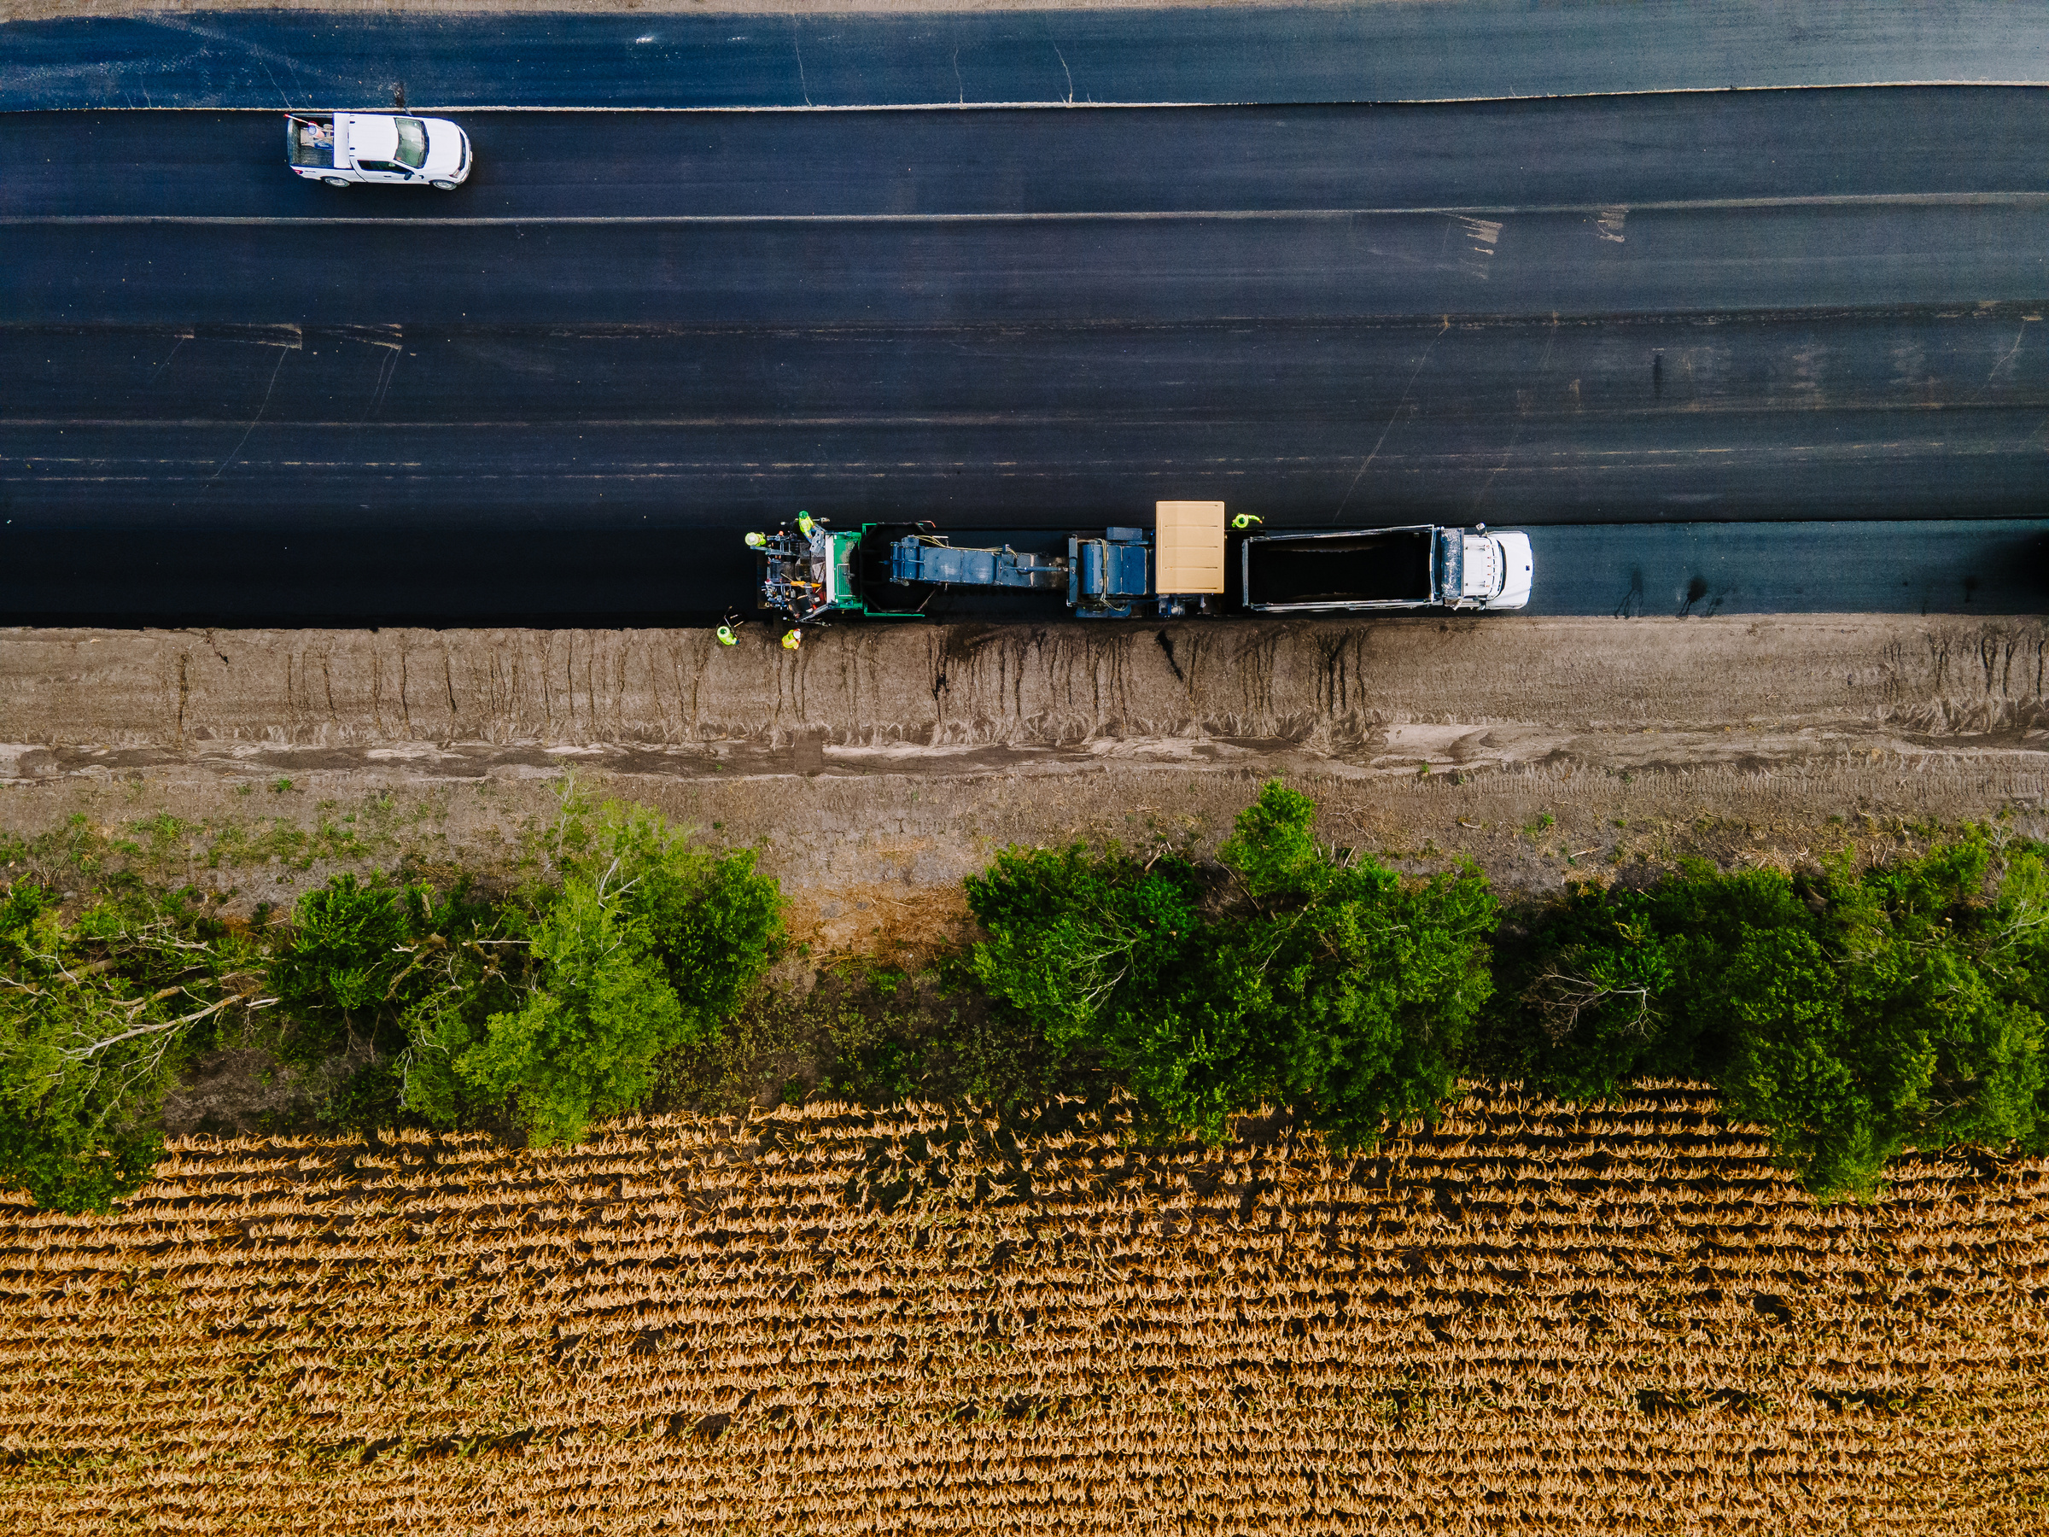
Quality Pavement Through Communication
Chuck Fuller: Texas Asphalt Pavement Association

Slide 2


Slide 3
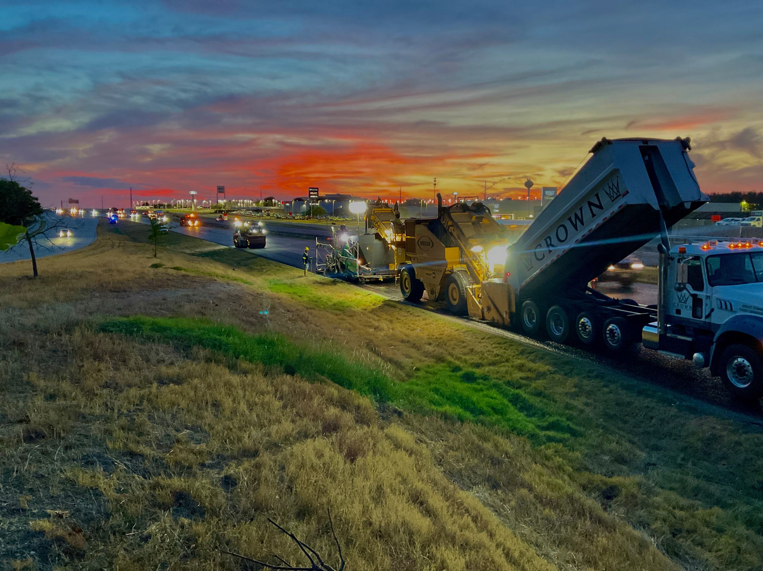
P
ositive
N
uetral
P
oison

Slide 4
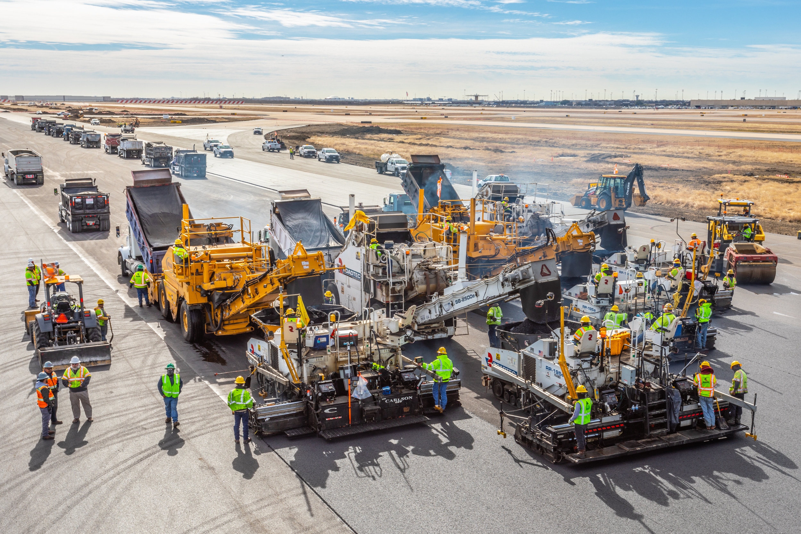

"Nothing Bad Happens Until Something Bad Happens."

Slide 5
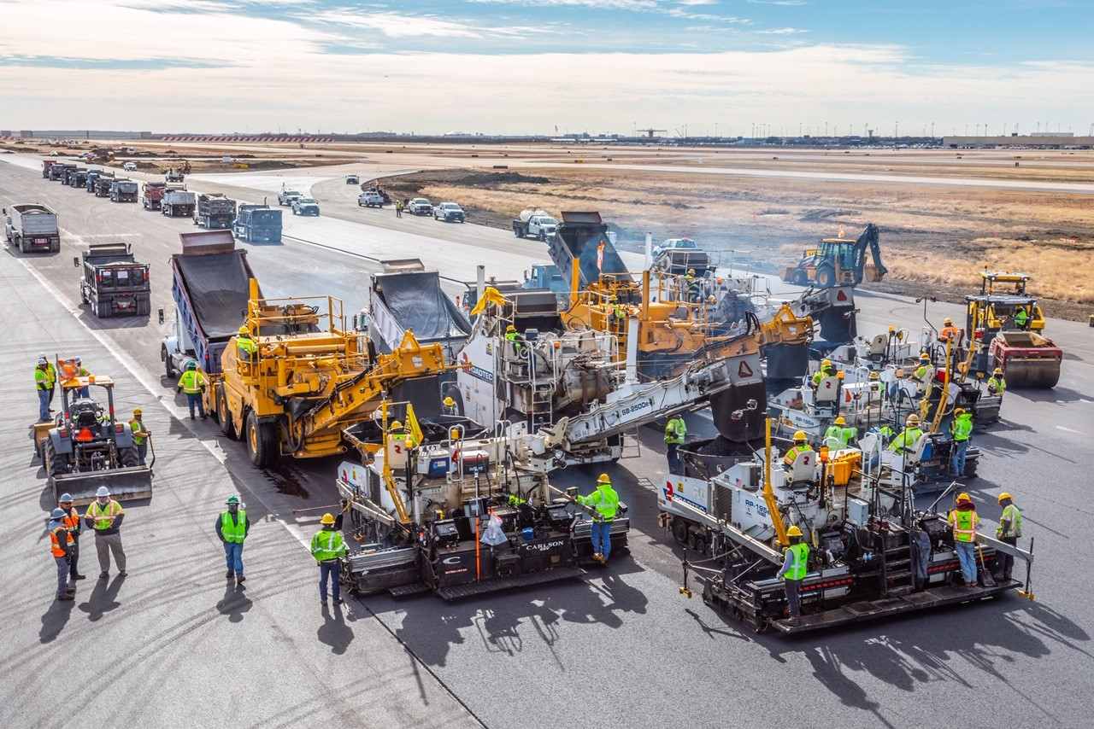
COMMUNICATION
PAVING IS A TEAM PROJECT
Including Management
Goal is Non-Stop Paving
Balanced Paving

Slide 6

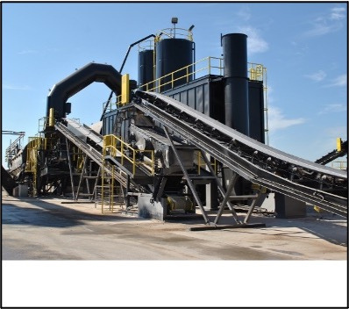
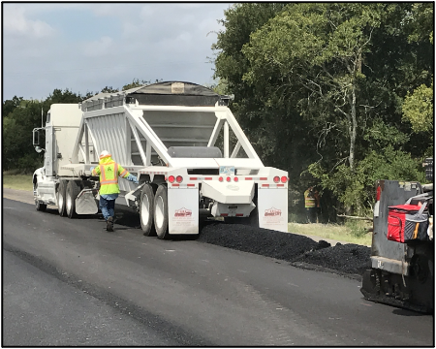
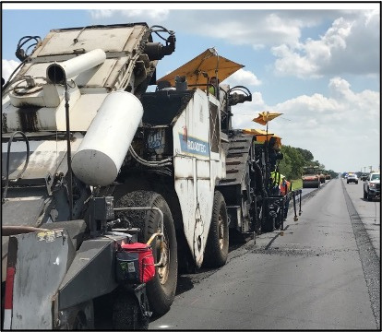
QUALITY CONTROL PLAN (QCP)
DEVELOP & FOLLOW
Submit a written QCP before the mandatory pre-paving meeting Receive approval of the QCP before the beginning of production. Include the following items in the QCP:
  Project Personnel “Certifications
  Production “Asphalt Plant”
  Transporting “Trucking”
  Placement “Laydown”
  Compaction “Rolling”

Slide 7
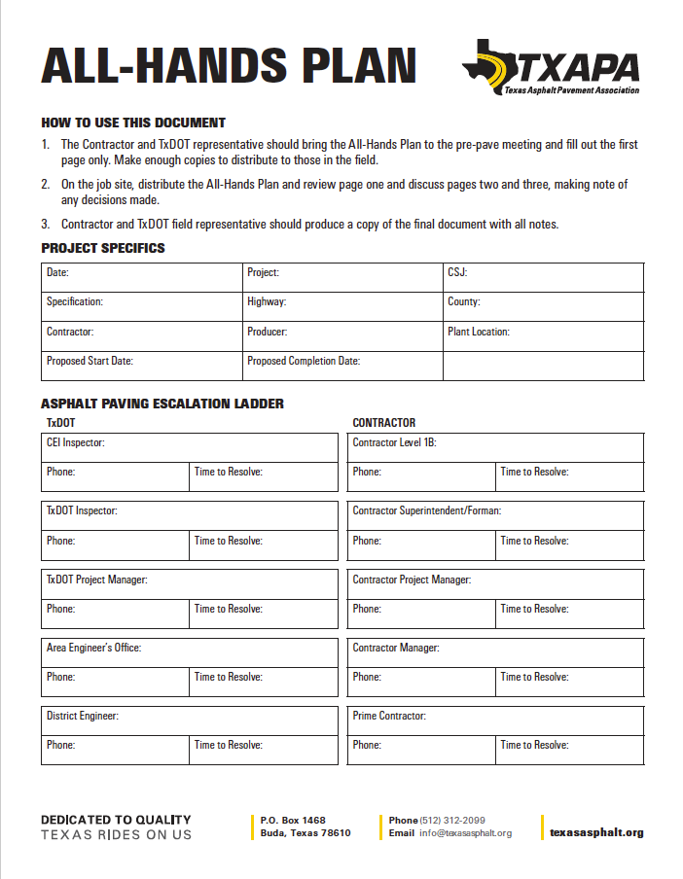
AGENDA FOR ASPHALT
PRE-PAVING MEETING
  Project Information
  Project Staffing
  Project Materials
  Production - Sampling - Testing
  Placement - Sampling - Testing
  Construction Procedures
  (Phasing - Ride Quality)

Slide 8
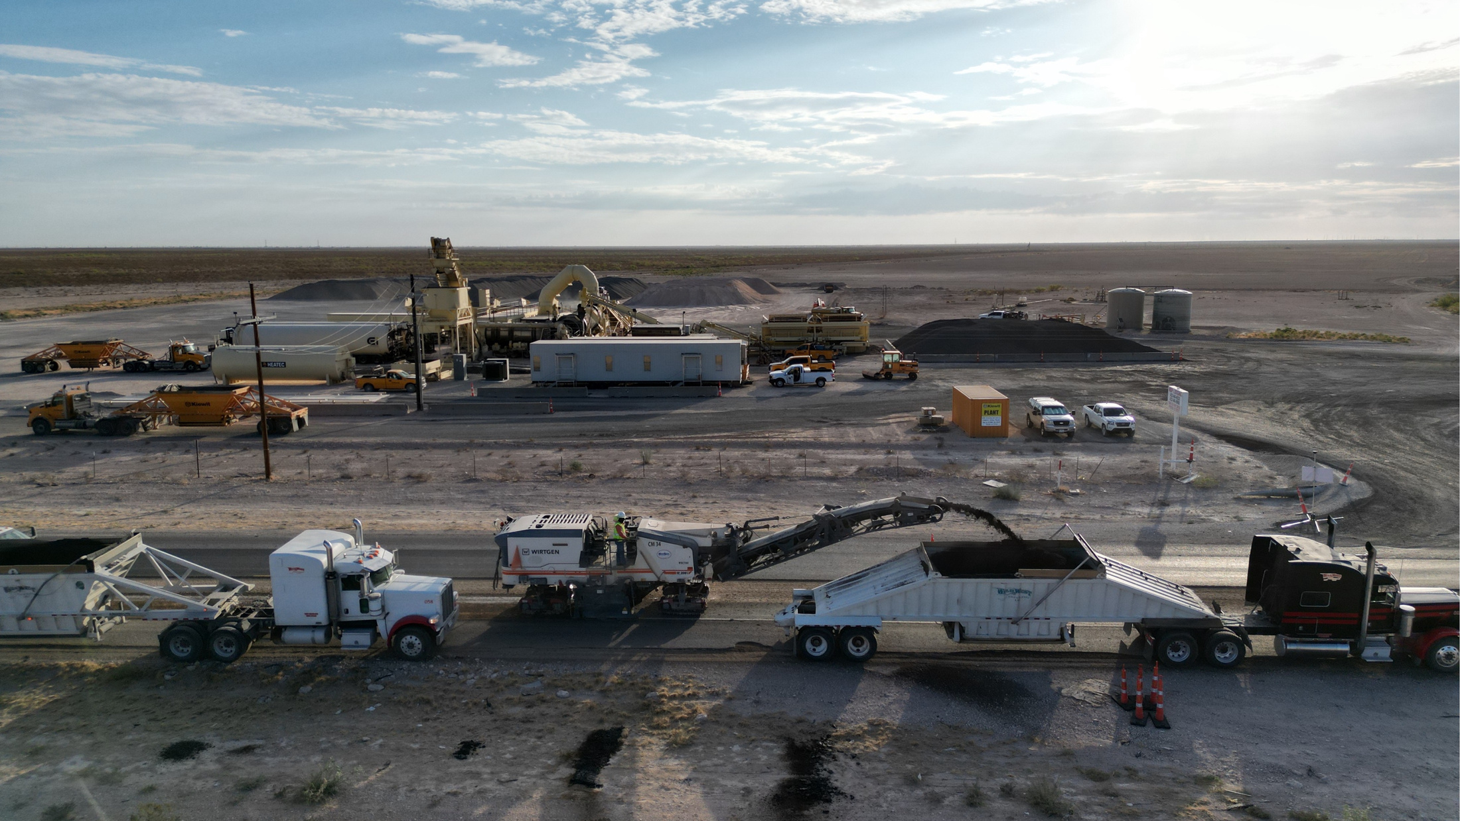
PROJECT
INFORMATION
  Roadway
  County
  Location
  Start Date
  Producer
  Crew Placing

Slide 9

Escalation Ladder
PROJECT
STAFFING
  Owner Engineer
  Owner Project Manager
  Owner Inspector
  Contractor Super
  Contractor Quality Control
  Plant Supervisor

Slide 10
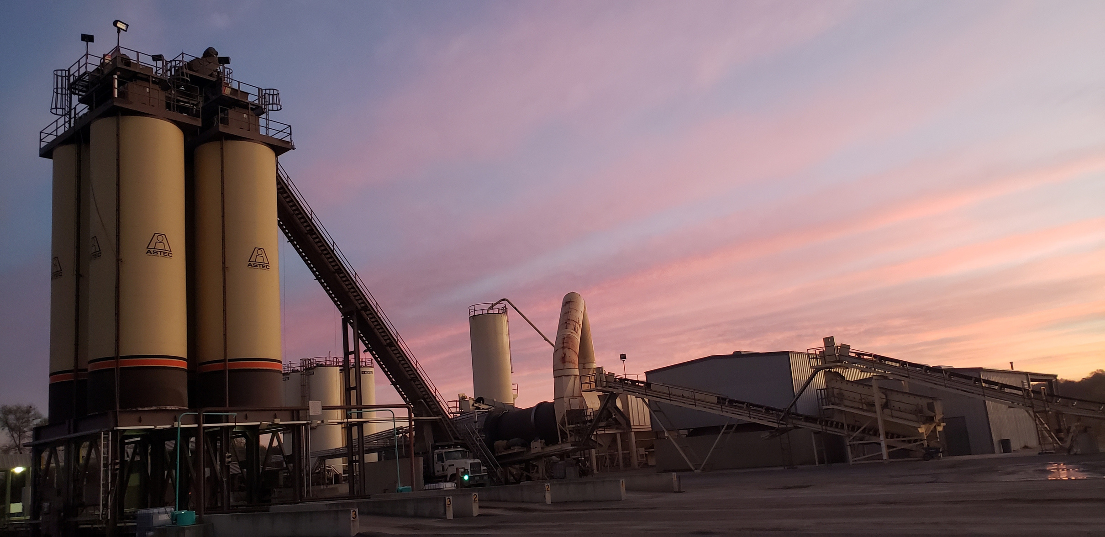
PRODUCTION
  QCP Approved
  Mix Design Approved
  Lot Size - Testing
  Binder - Testing
  Reporting Timeframe

Slide 11
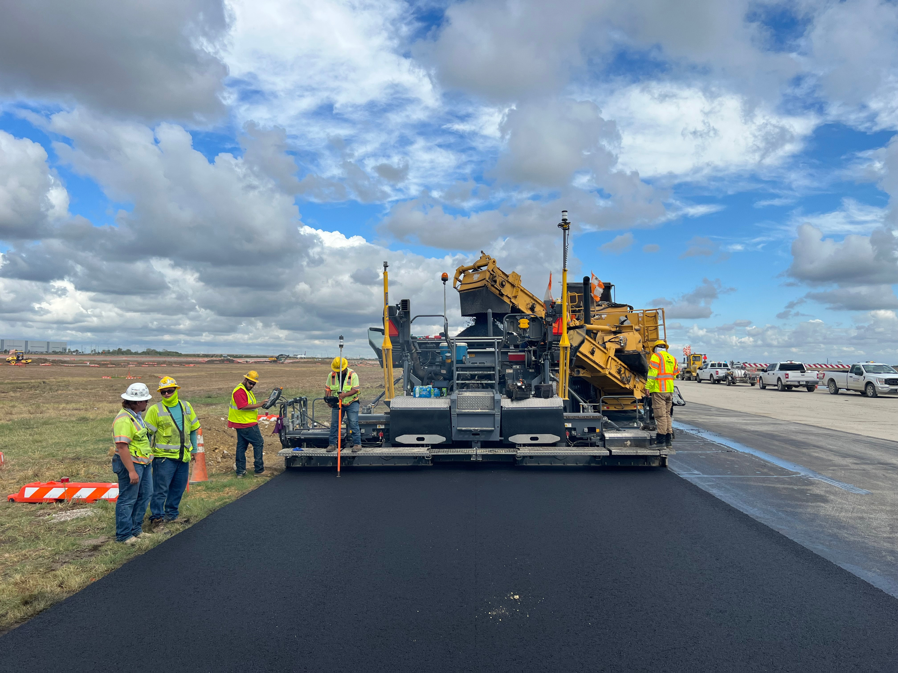
PLACEMENT
  Min. - Max. Lift Thickness
  Min. - Max Temperatures
  Density Locations
  Exempt Areas
  Segregation
  Mix Tickets - Yield

Slide 12
CONSTRUCTION
PROCEDURES
  Phasing
  Traffic Control
  Building Edge
(Driveway - Intersection)
  Ingress - Egress
  Surface Irregularities
  Straight Edge

Slide 13
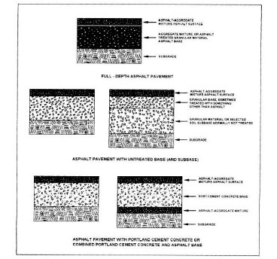
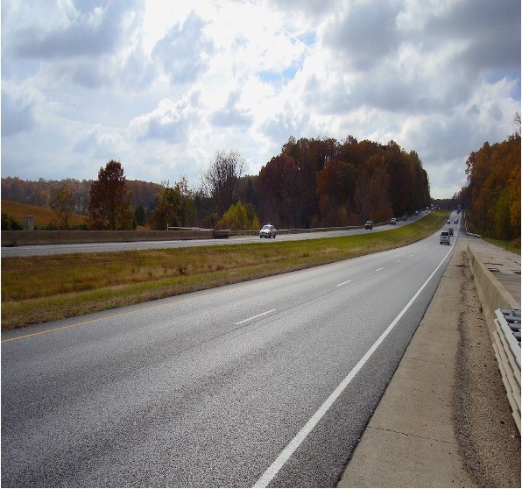
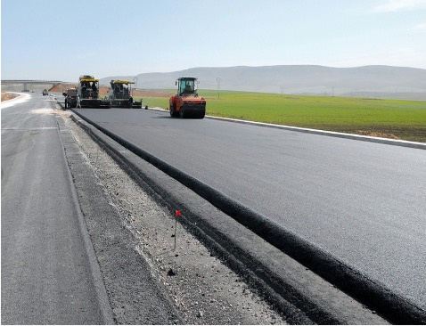
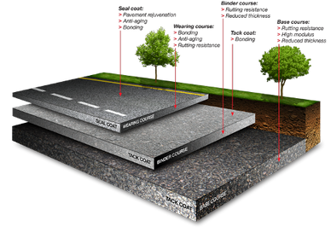
PAVING PLAN,
WIDTHS, OFFSETS, & THICKNESSES

Slide 14
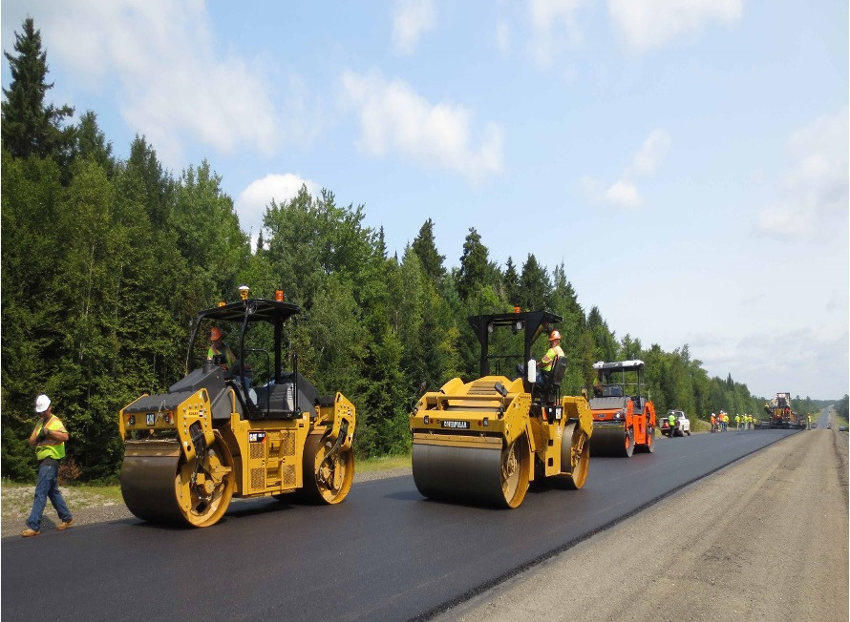

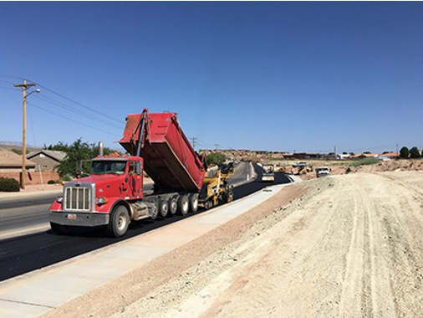
BALANCE PRODUCTION,
DELIVERY, COMPACTION, & SMOOTHNESS

Slide 15
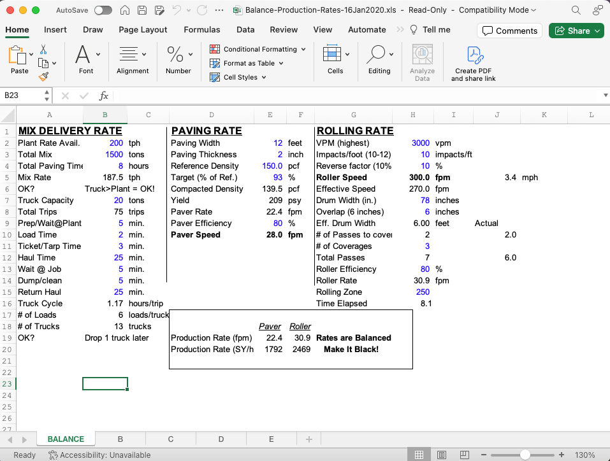

BALANCE PRODUCTION, DELIVERY,
COMPACTION, & SMOOTHNESS
Balance-Production-Rates
QR code

Slide 16
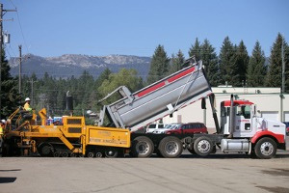
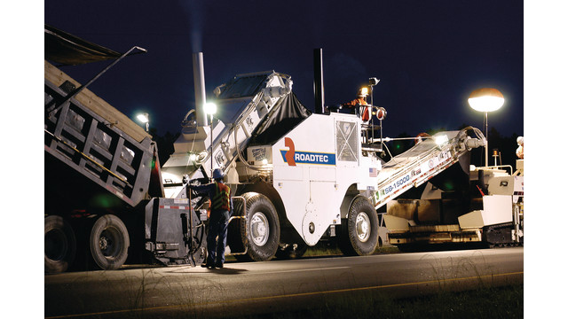
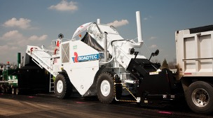
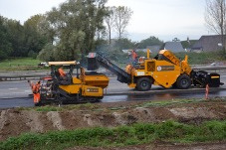
TRANSFER MIXTURE INTO PAVER AVOIDING
SEGREGATION & SPILLAGE

Slide 17
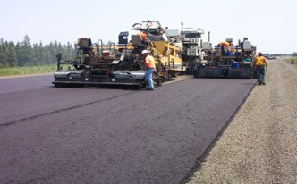
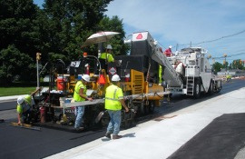
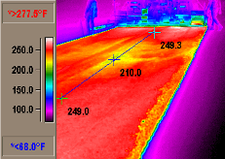
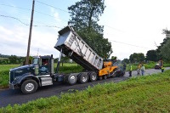
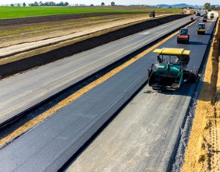
PAVER
OPERATIONS

Slide 18
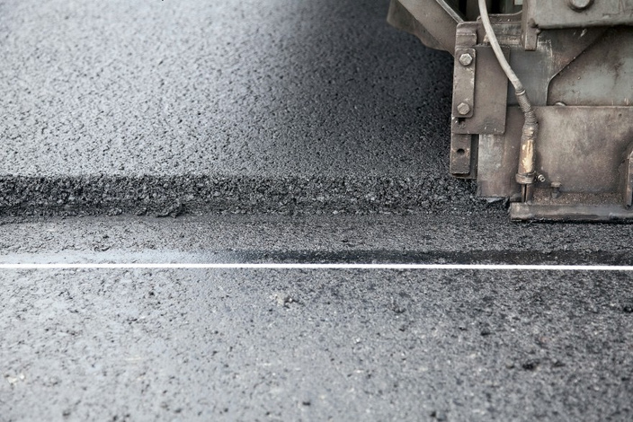
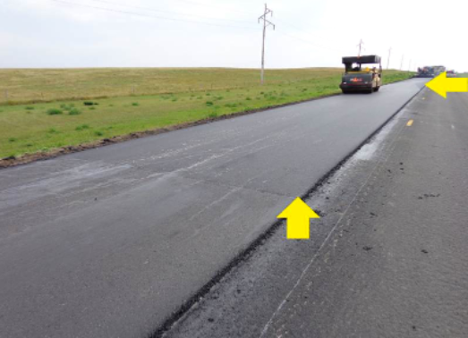
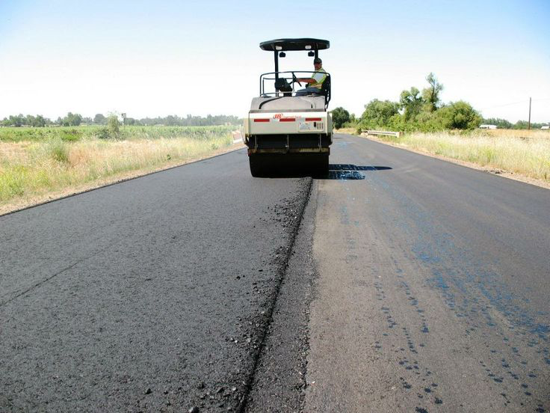
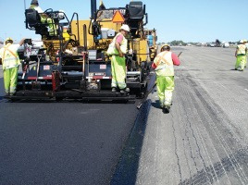
QUALITY LONGITUDINAL
AND TRANSVERSE JOINTS

Slide 19
Some unique issues that can be discussed and agreed upon before construction
  Contractor doesn’t want to throw mix away
  Owner wants a smooth, durable, long-lasting pavement
  Discuss before pavement work begins
  Discuss payment options

Slide 20
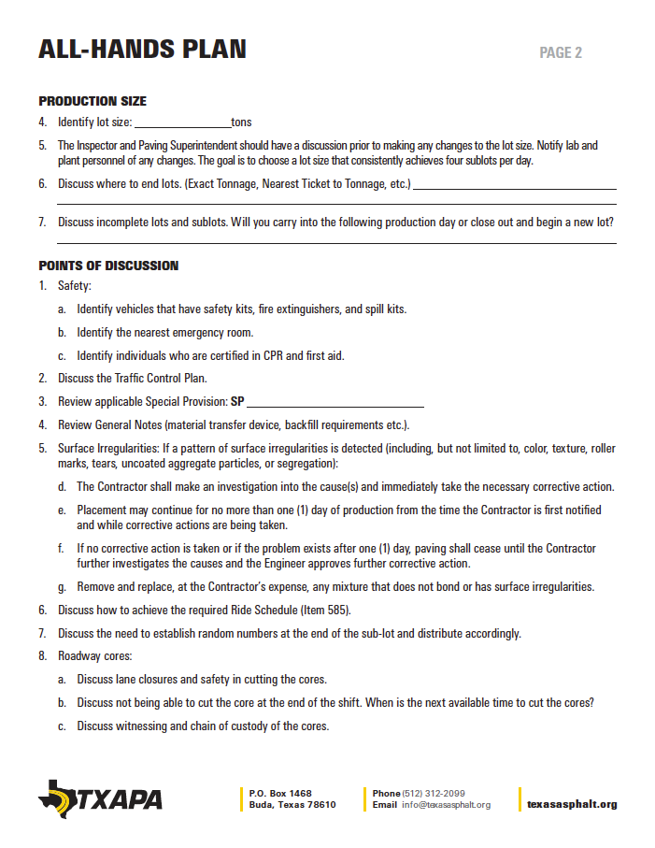
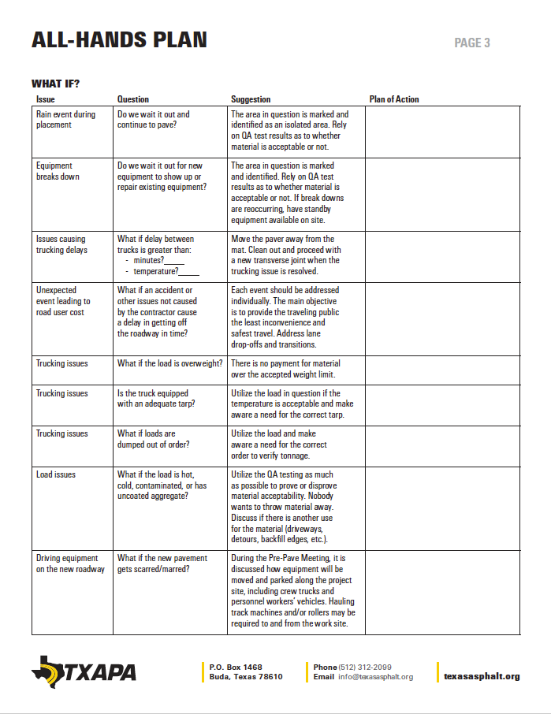
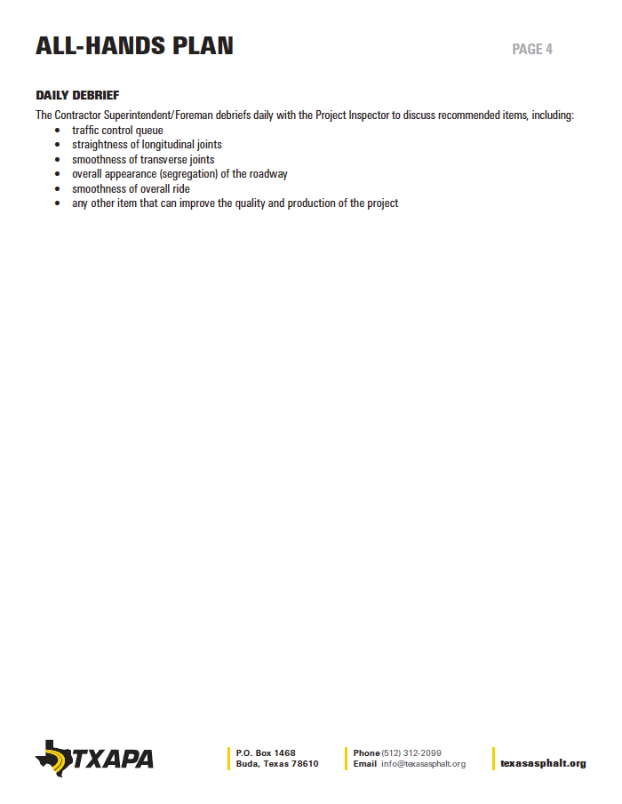
ALL-HANDS PLAN

Slide 21
ALL-HANDS PLAN
  PROJECT SPECIFICS
  ESCALATION LADDER

Slide 22
ALL-HANDS PLAN
  PRODUCTION SIZE
  POINTS OF DISCUSSION

Slide 23
ALL-HANDS PLAN
  WHAT IF?

Slide 24
ALL-HANDS PLAN
  DAILY DEBRIEF

Slide 25
PAVEMENT PREP FOR OVERLAYS & MAINTENANCE WORK
  Physically look at pavement structure
  If repair is needed - look for the cause
  Understand the need to repair
  Utilize the tools in the toolbox
  If not corrected be aware of the consequences

Slide 26

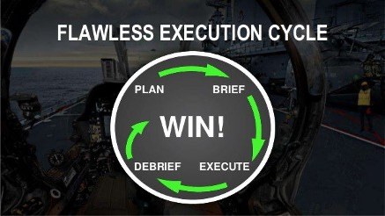

TOP 5 TAKEAWAYS
1
Communication
2
Quality Control Plan
3
Escalation Ladder
4
Resource Page
5
All Hands (Debrief)

Slide 27
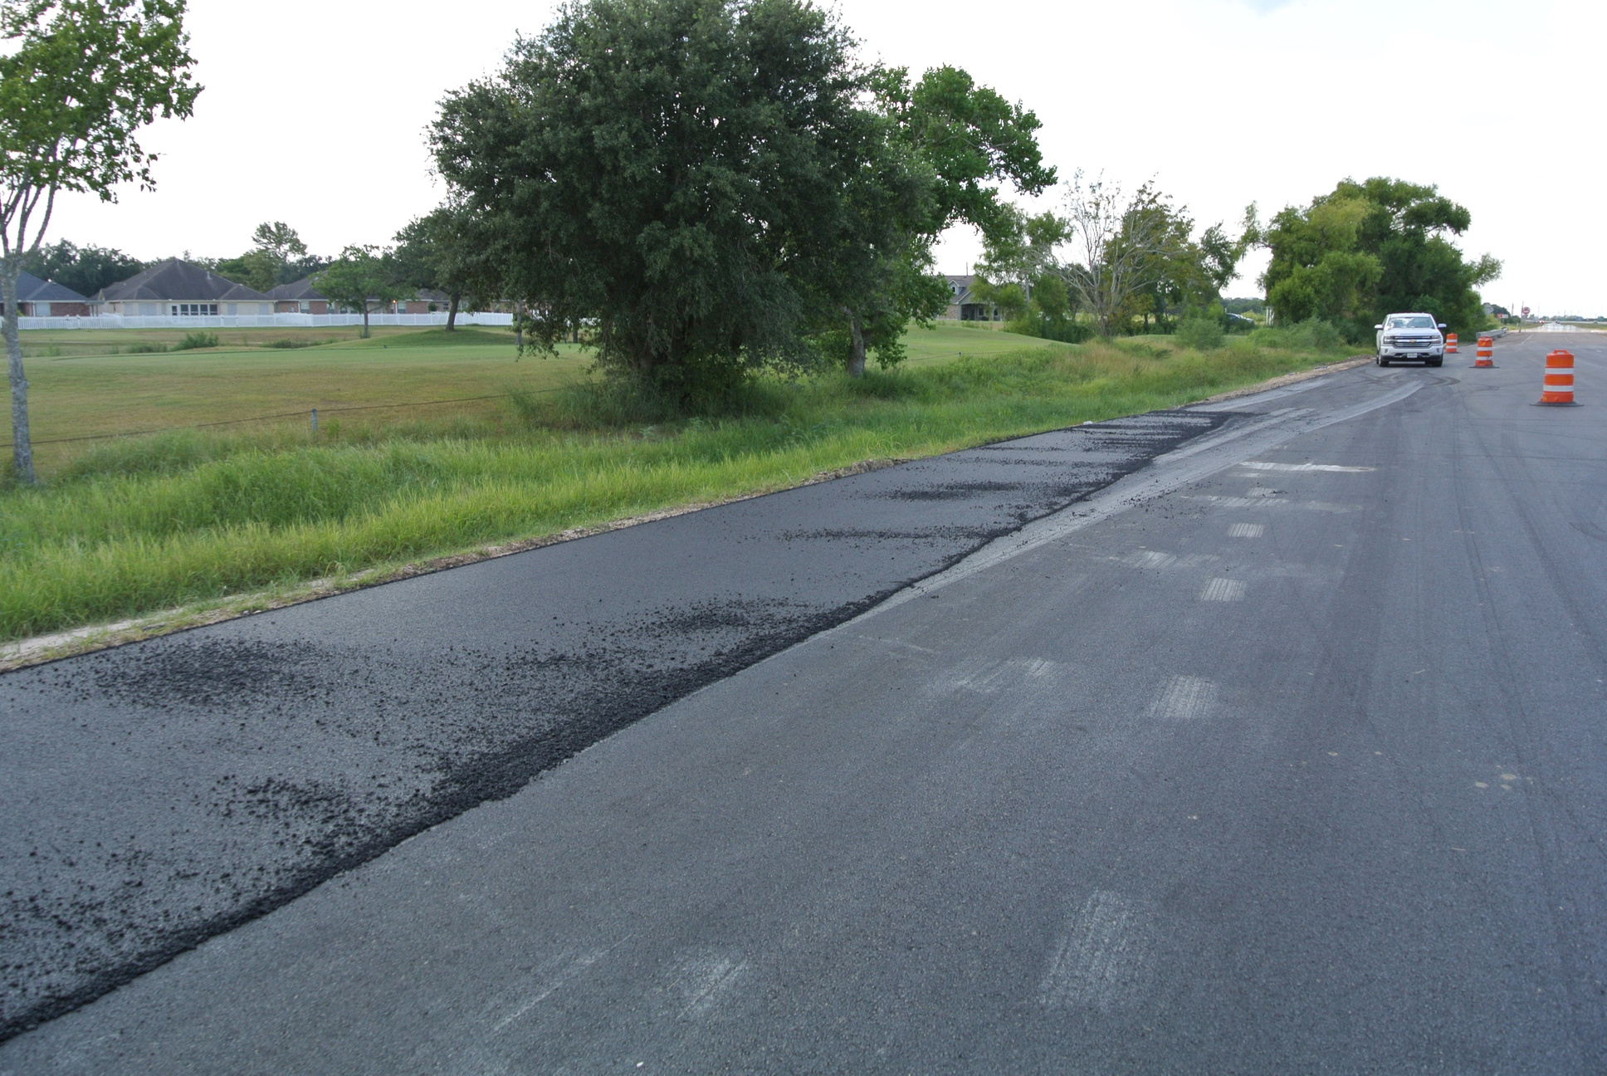
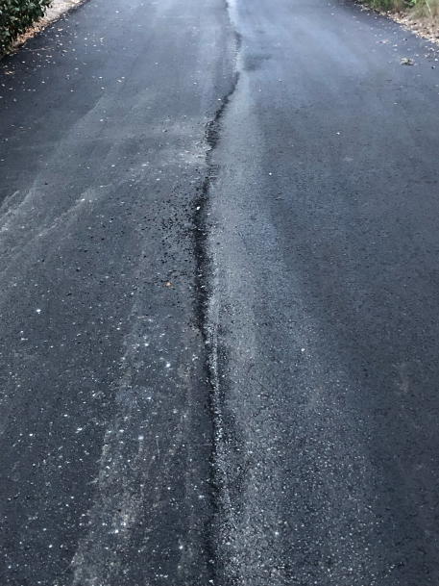
WHAT DO
YOU SEE?

Slide 28
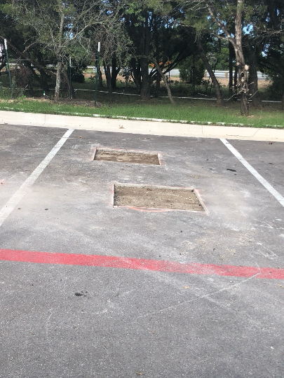
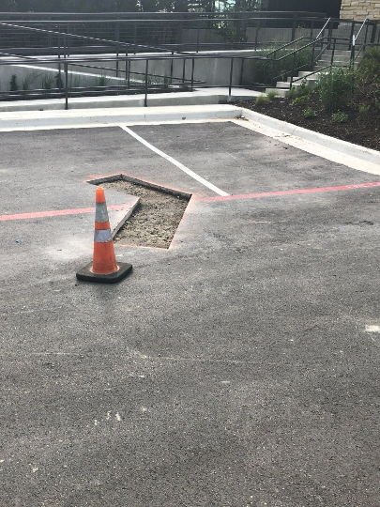
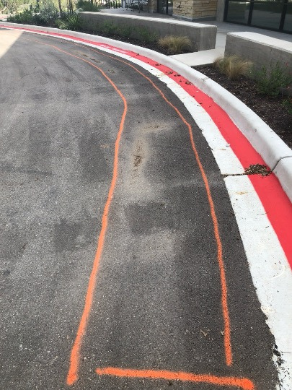
WHAT DO
YOU SEE?

Slide 29
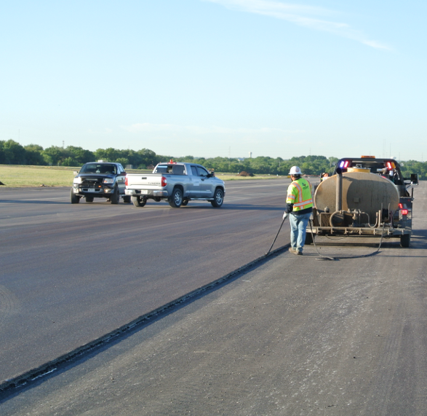
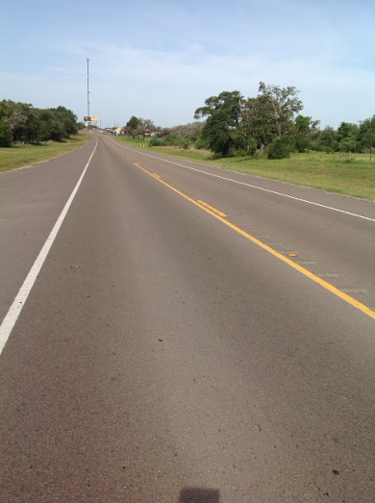
WHAT DO
YOU SEE?

Slide 30
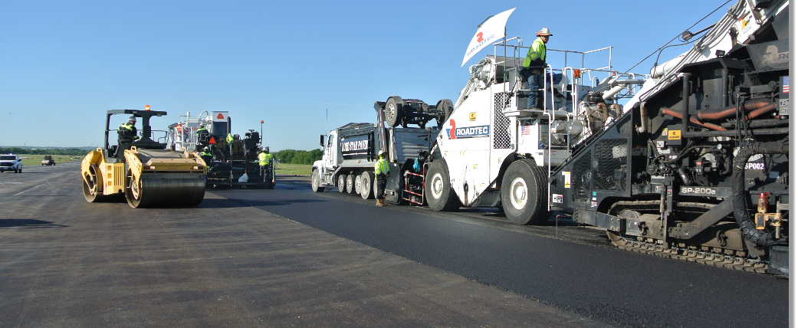
WHAT DO
YOU SEE?

Slide 31
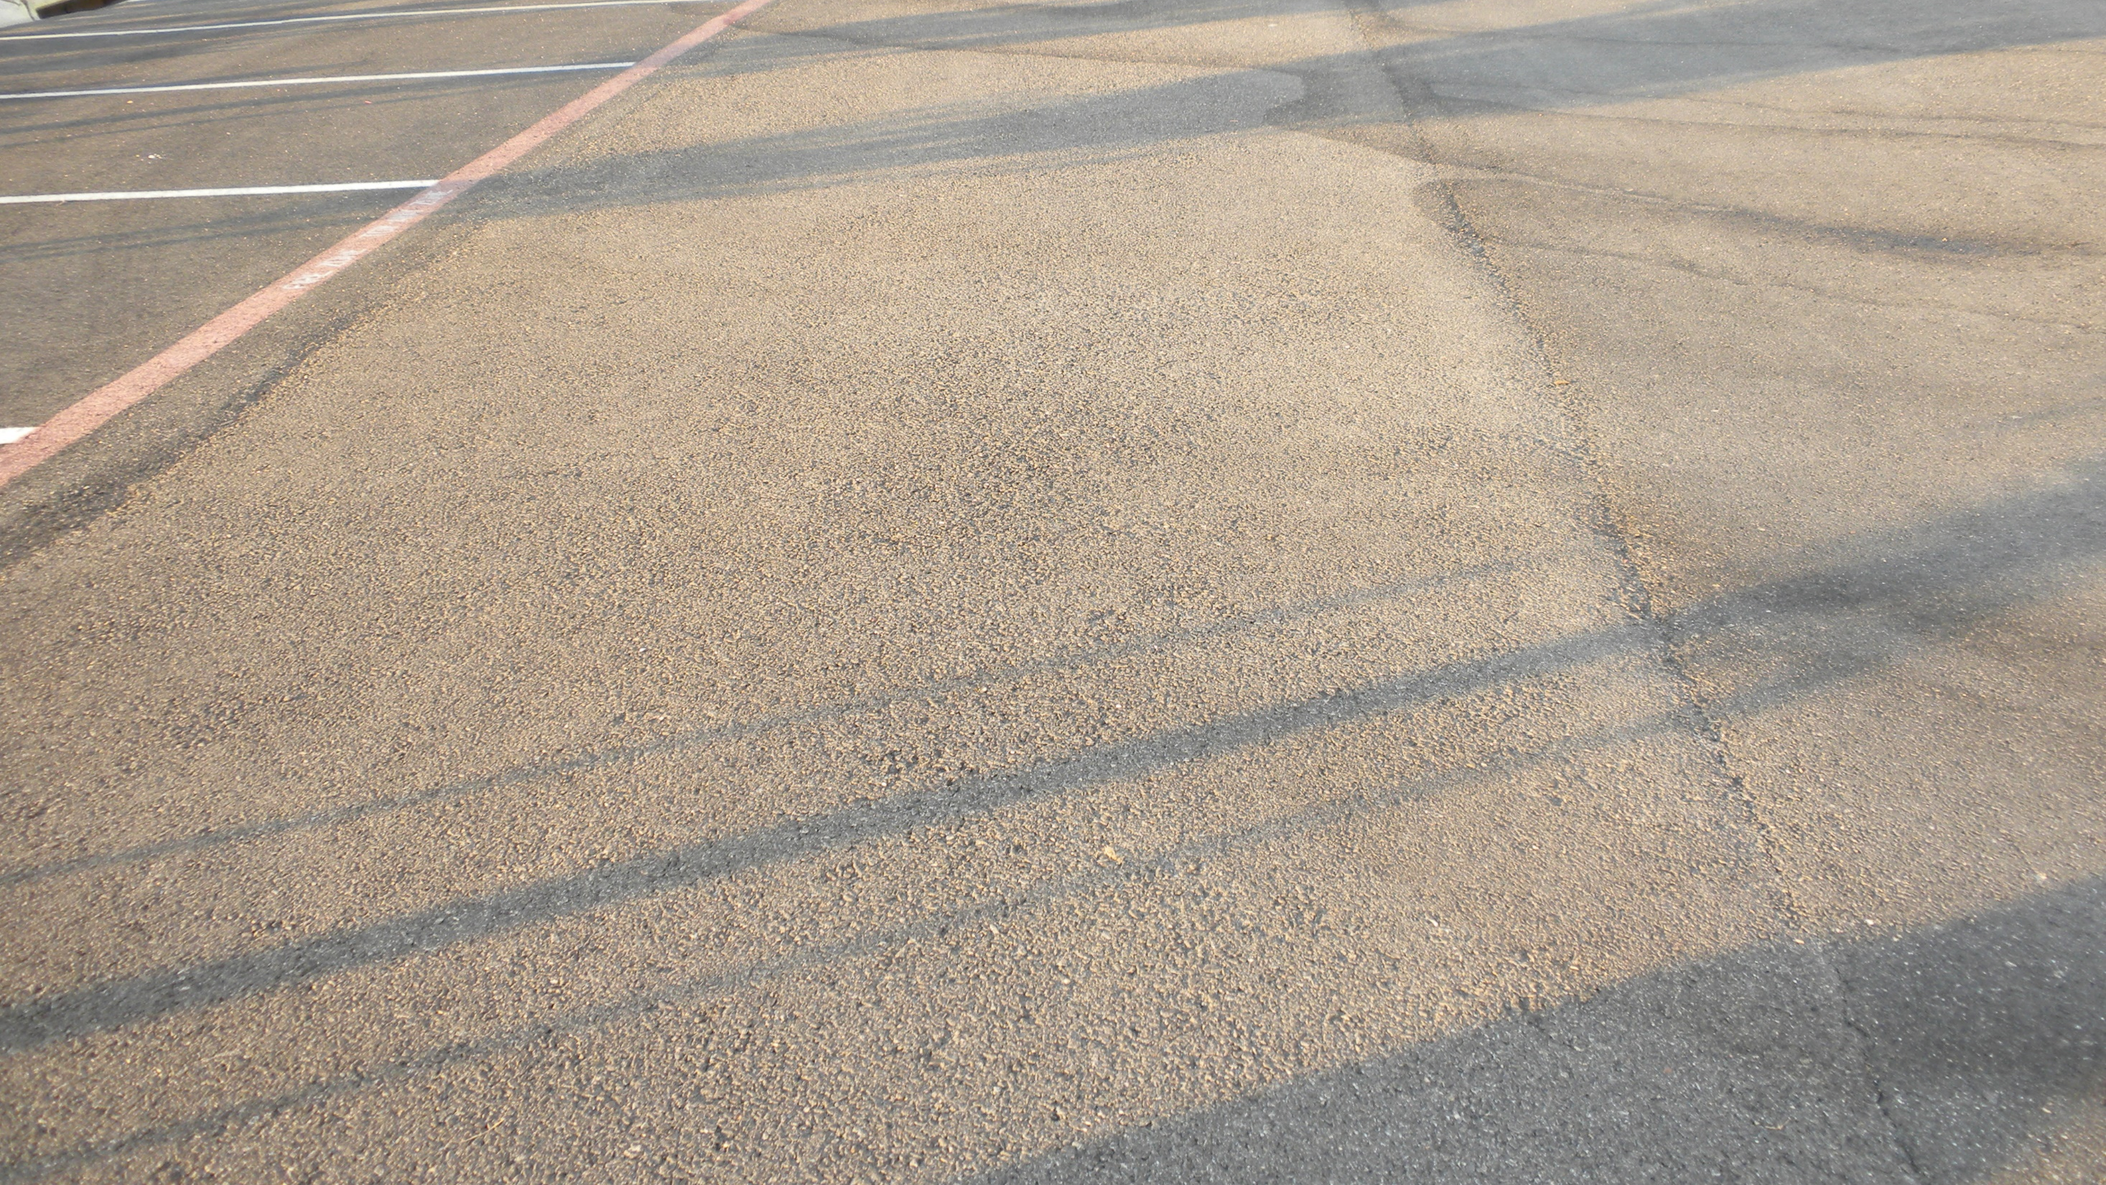
WHAT DO YOU SEE?

Slide 32
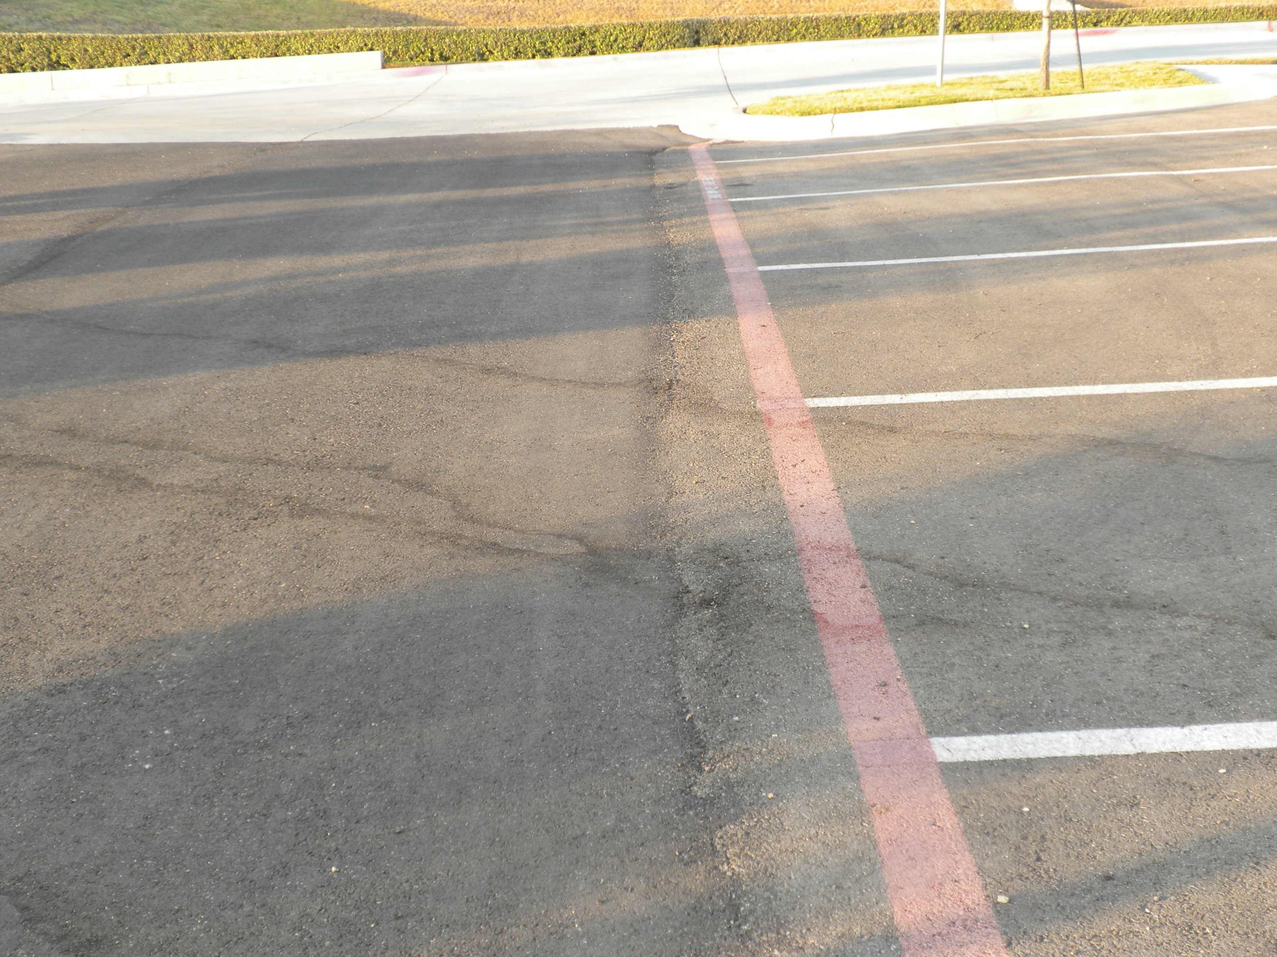
Parking lot with RAS
WHAT DO YOU SEE?

Slide 33
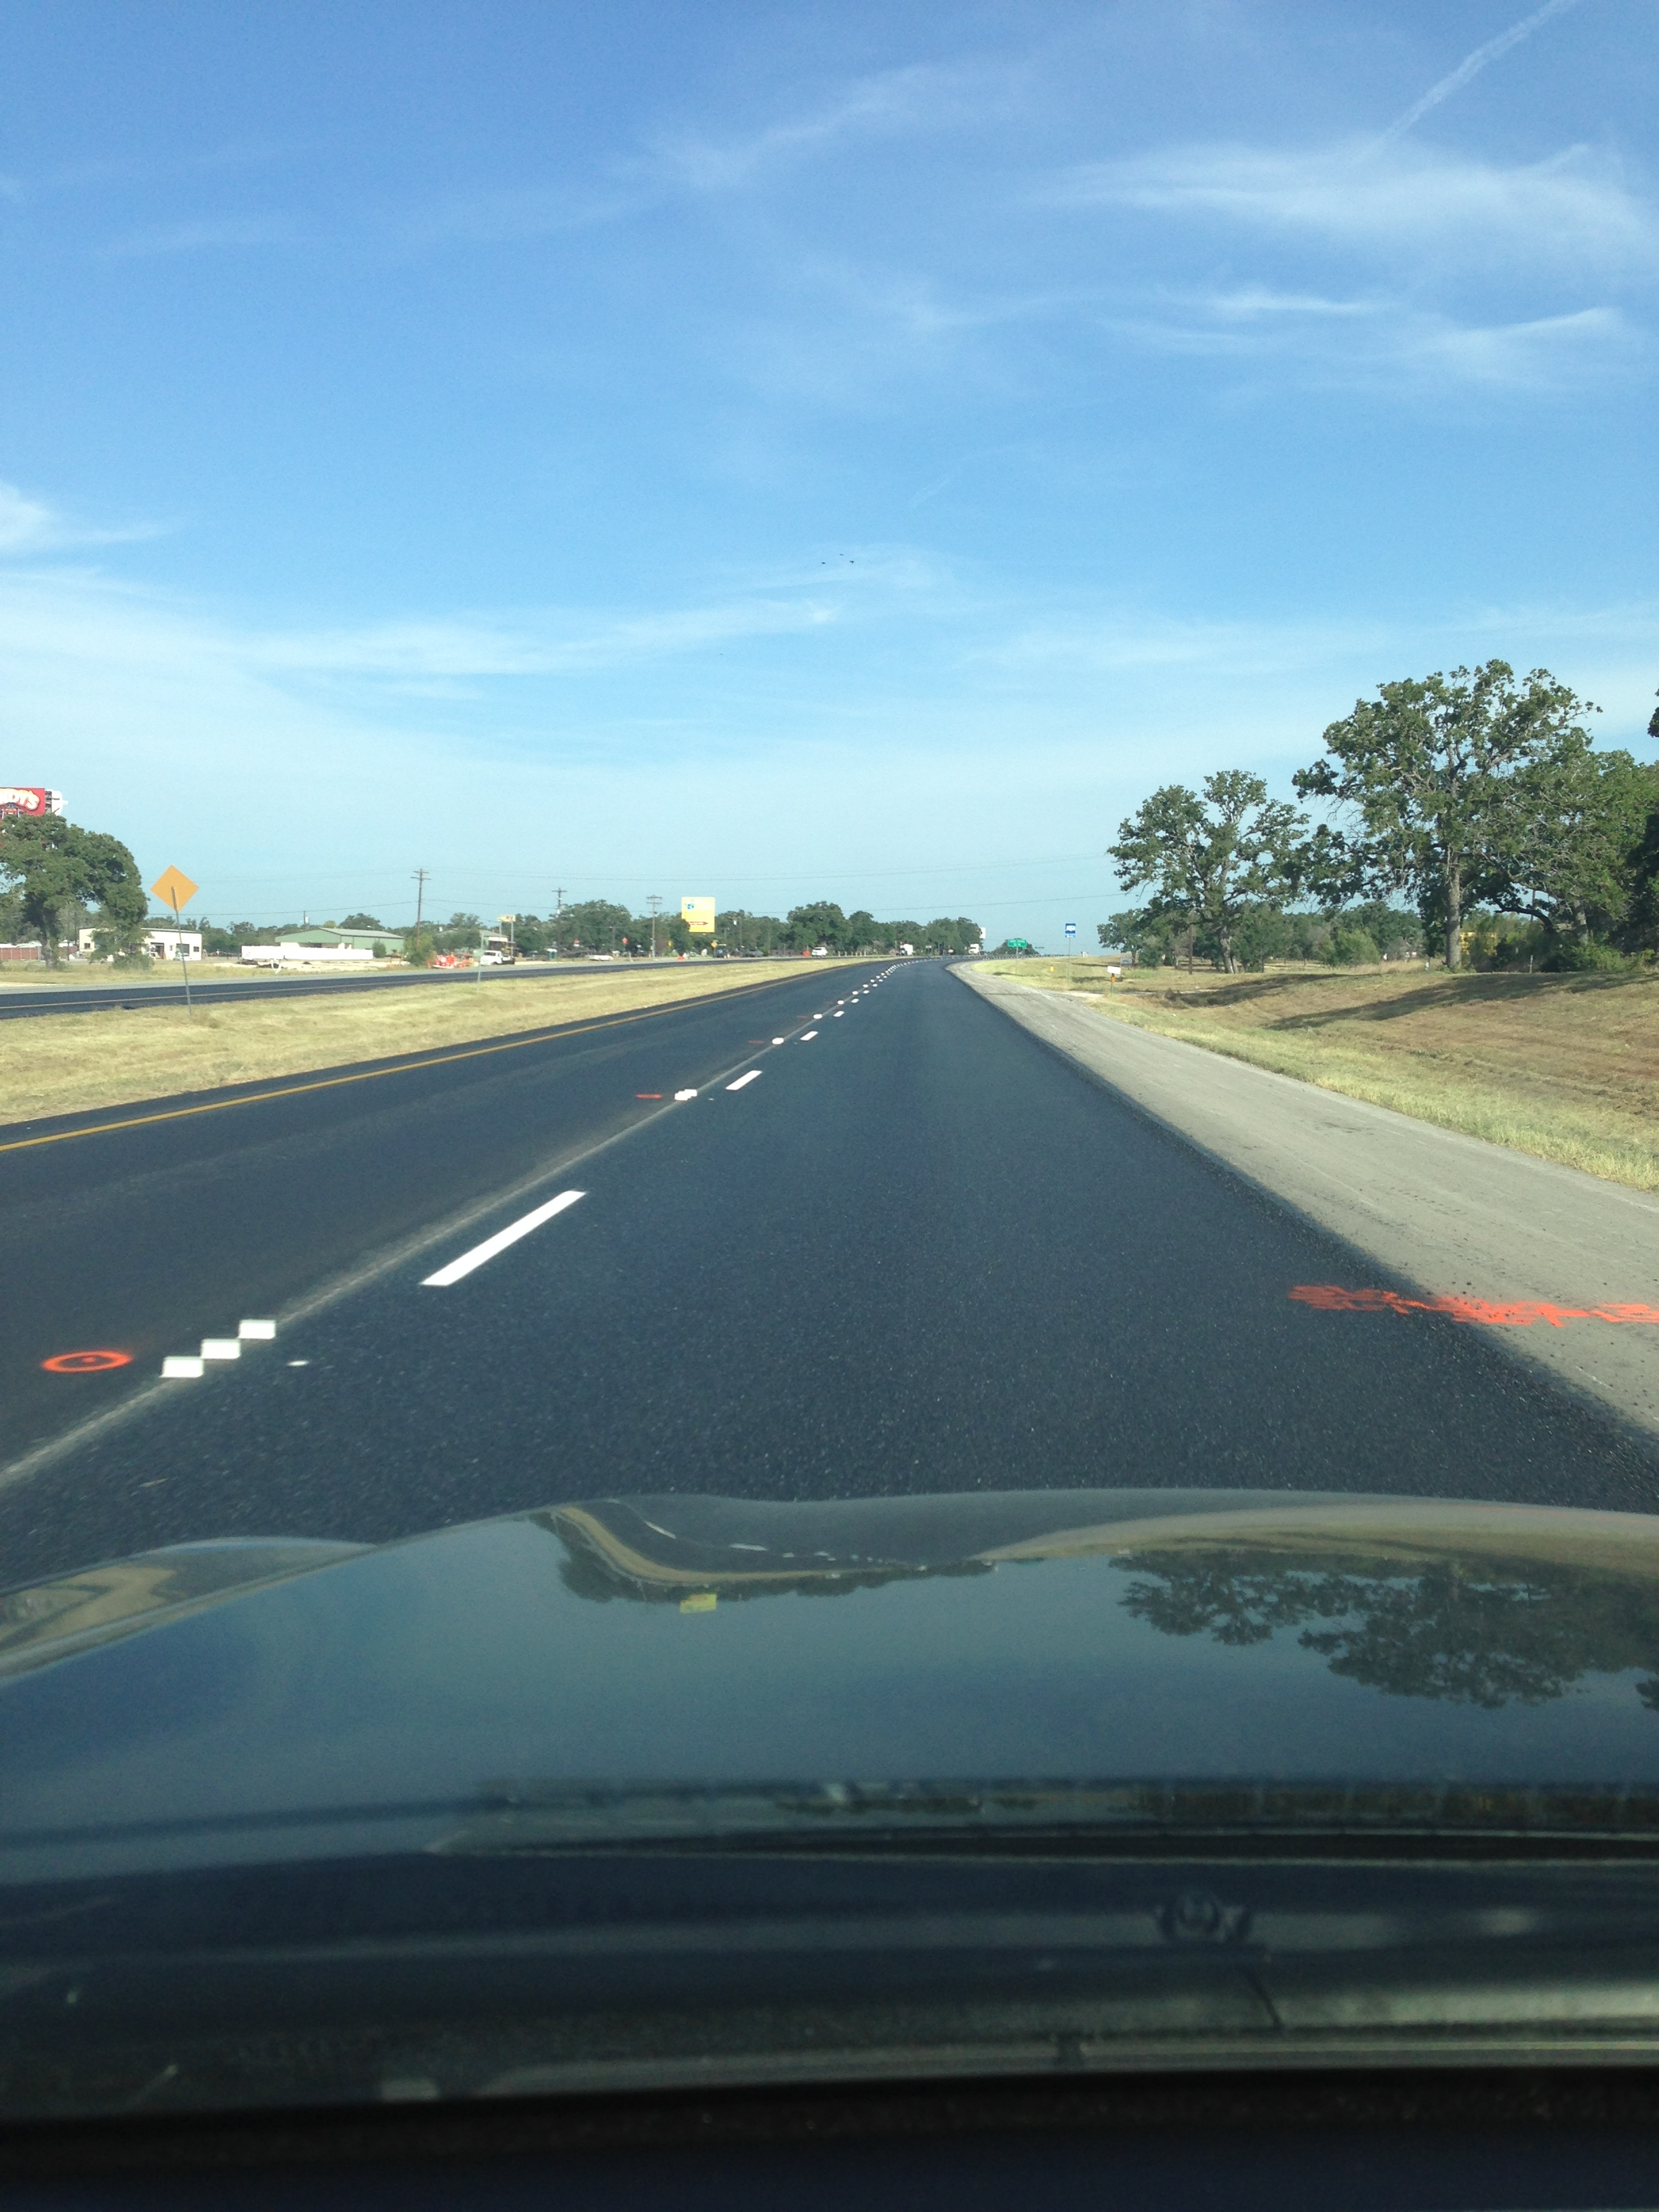
Asphalt Paving Industry Knowledge Transfer Visit, October 26-28, Central Texas –TxAPA, TxDOT , TTI and the AAPA
WHAT DO YOU SEE?

Slide 34
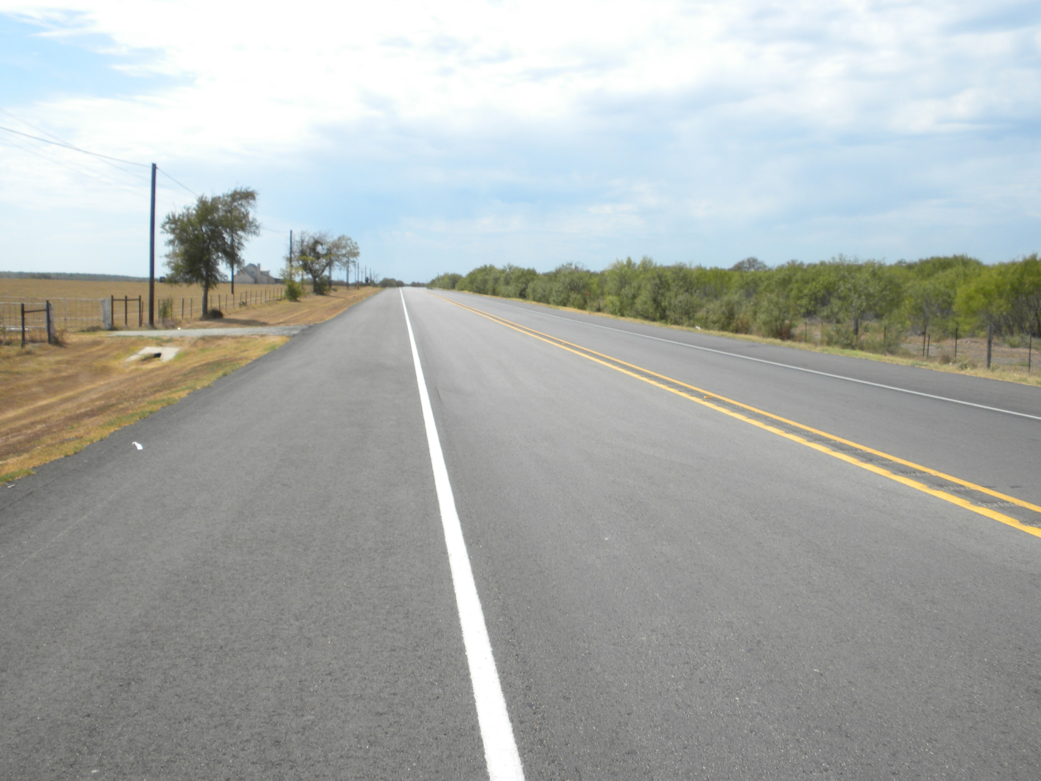
Bastrop SH 21
WHAT DO YOU SEE?

Slide 35
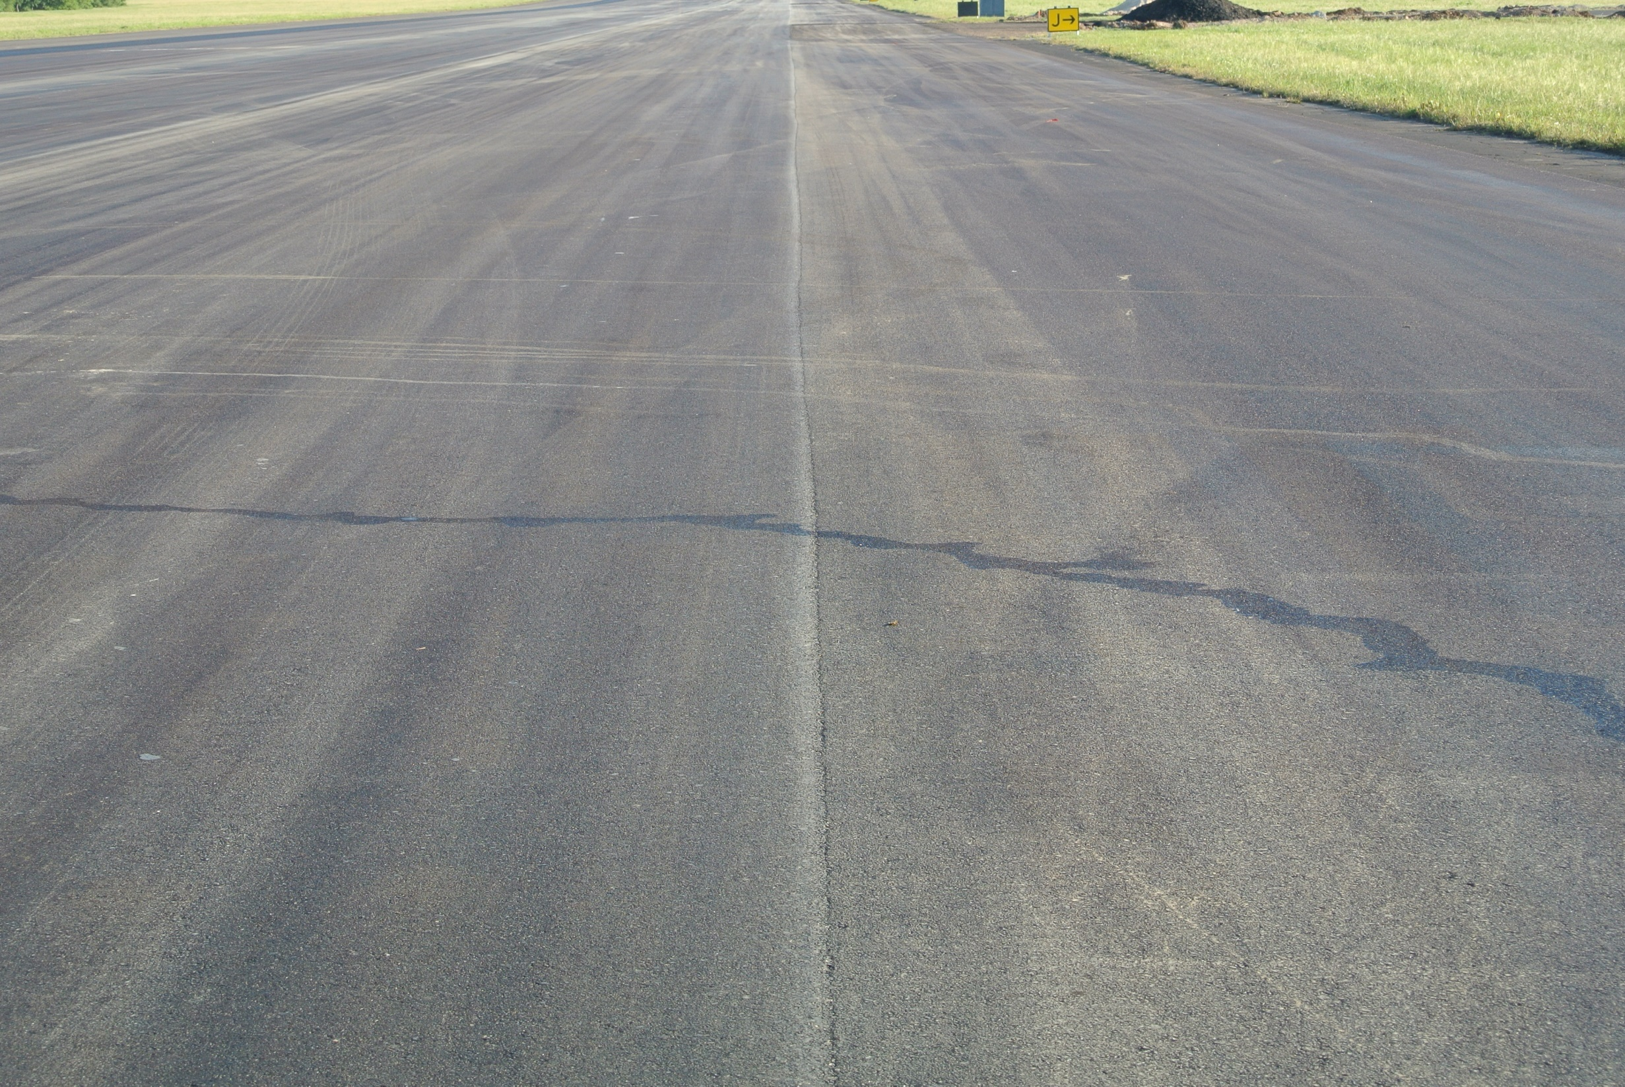
WHAT DO YOU SEE?

Slide 36
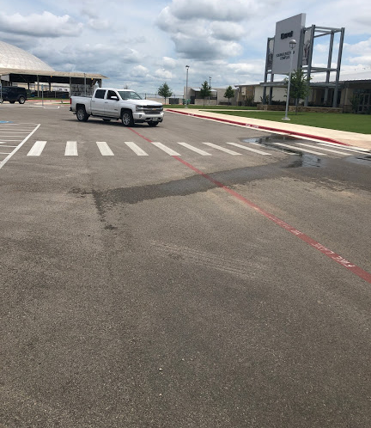
WHAT DO
YOU SEE?

Slide 37
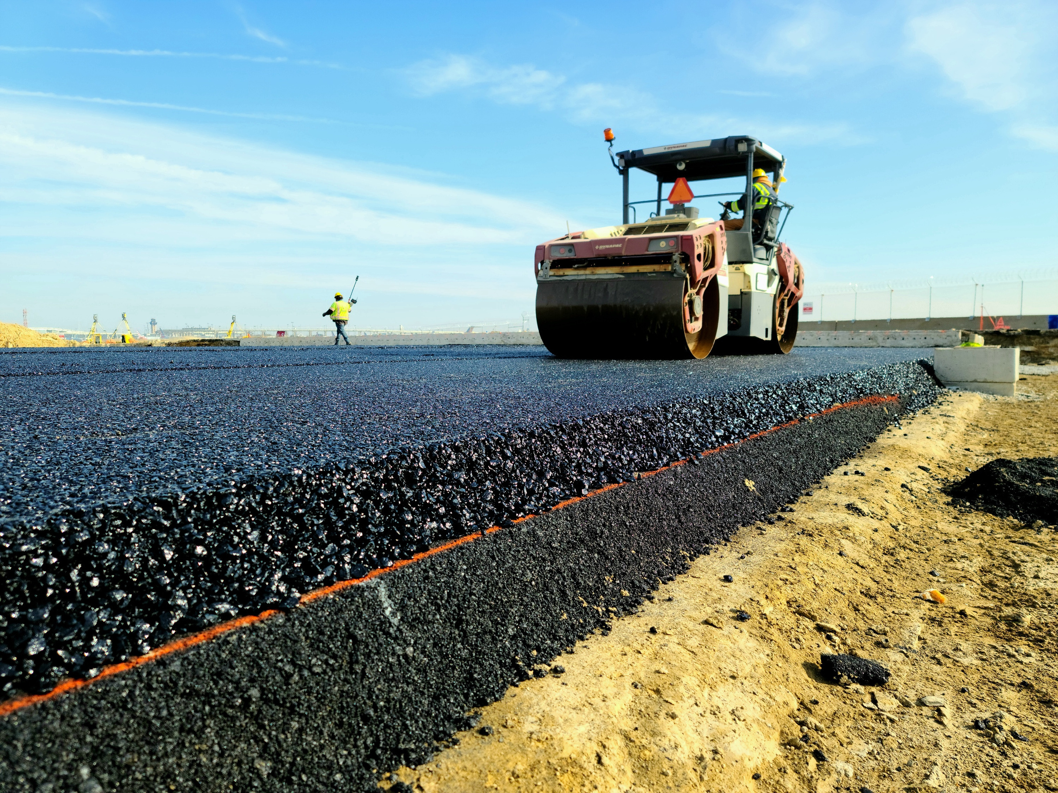


Questions?
Chuck Fuller
512-657-7970
Send us an email
chuckfuller61@gmail.com

