Slide 1
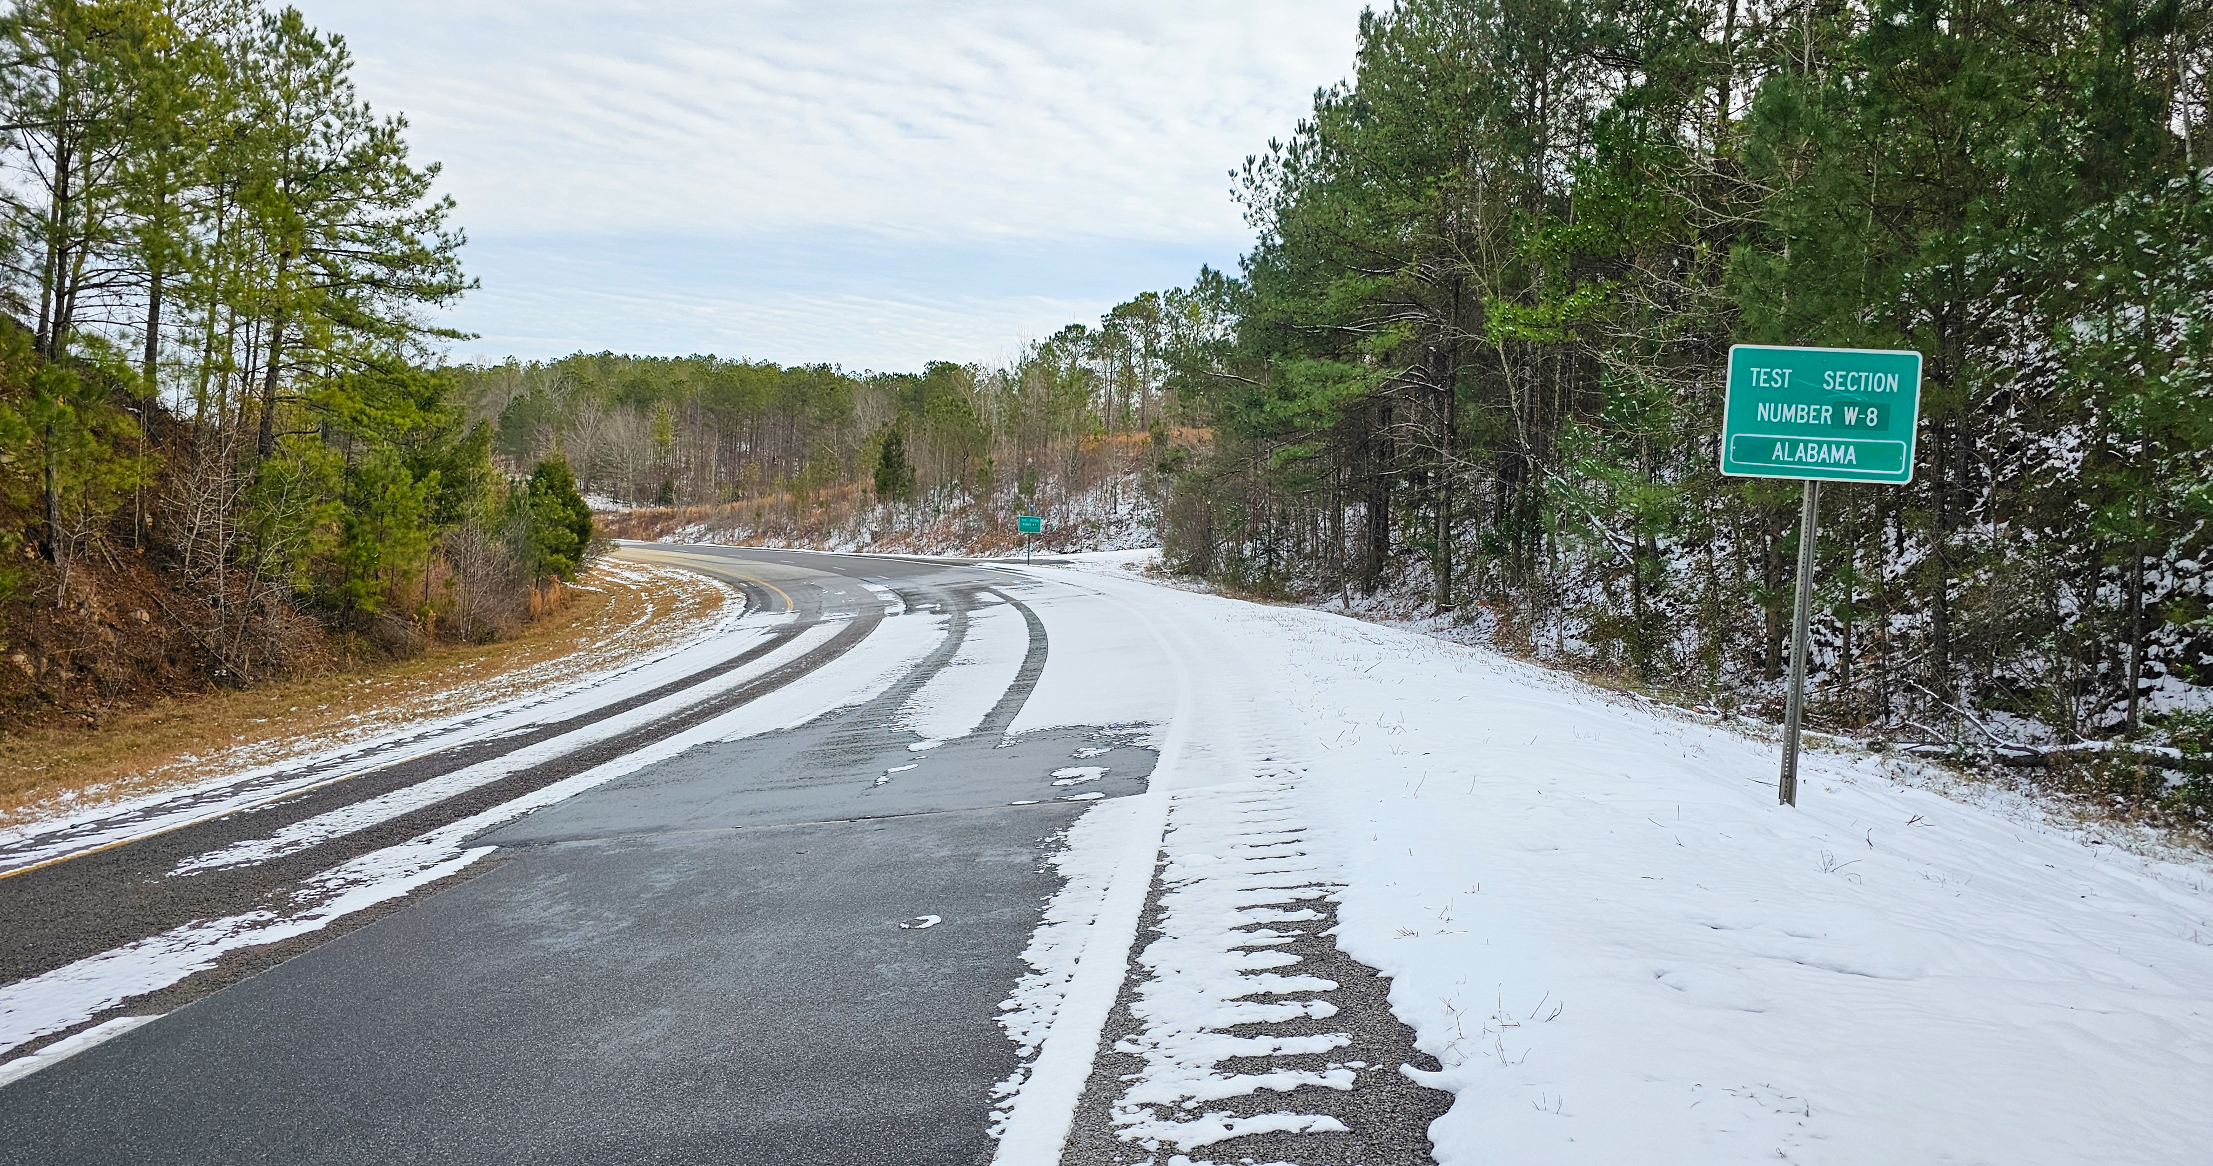


NCAT Test Track Update
Nathan Moore, P.E.
2026 AAPA Conference
March 12, 2026

Slide 2























2024-2027 NCAT Test Track Sponsors

Slide 3
Appreciation and Thanks!
Asphalt Plus
Asphalt Solutions
Associated Asphalt
Astec
Aztec Asphalt Technology
Blacklidge
C.W. Matthews
Cargill
CAT
Chris Clark Grading and Paving
Cimline
Collaborative Aggregates
Corrective Asphalt Materials
East Alabama Paving
Ergon Asphalt and Emulsions
Great Lakes Minerals
Hi-Tech Asphalt Solutions
Ingevity
JAG Trucking
Jon Grelle
Larry Scofield/IGGA
Lehigh
Liberty Tire
Pavement Resoration Inc.
Russell Standard
Skidabrader
Southeast Grinding & Grooving
Tractor Equipment Company
Wirtgen/Hamm
Vulcan Materials

Slide 4
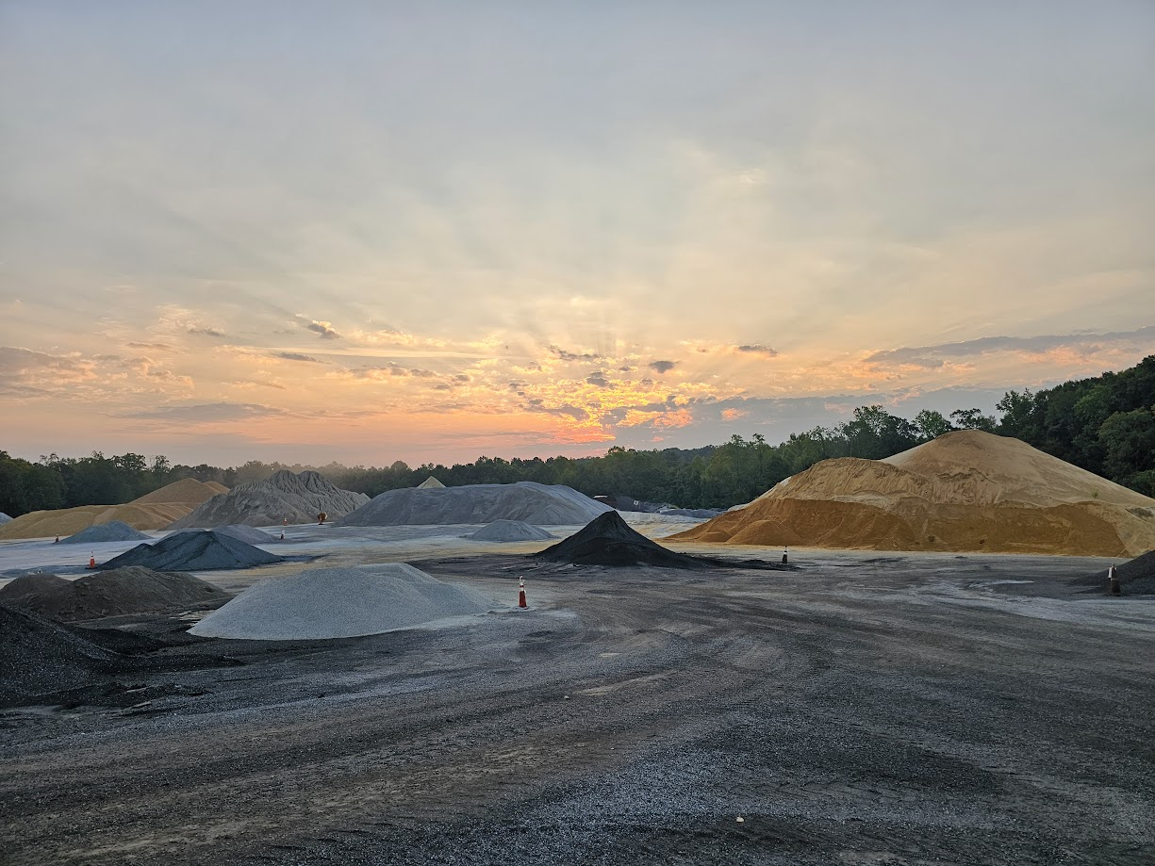
2024 Track Build by the Numbers
58 unique aggregate/RAP stockpiles
>300 truck loads of aggregate/RAP hauled in
6 different asphalt binders + 3 tack products + 1 VRAM
4 asphalt plants (2 HMA + 1 Wirtgen KMA + 1 PRI Pugmill)
30 unique mixes + 31 trial runs (practice runs)
3 CCPR + 23 HMA + 4 WMA mixes
16 actively instrumented structural test sections
2 sections removed and replaced

Slide 5
2024 Track Build by the Numbers
36 working days (7 weeks + 1 day)
2 hurricane delays (Helene & Milton)
  Delayed by only 3 days
850+ buckets of mix sampled
7 new NCAT personnel in critical roles during build process
75+ visitors during Track construction
Notes:
NCAT people:
Nathan – Director
Zane, Graham, Madison – Lab engineers / mix designers
Robert – Lead Track technician
Mike – Trucking coordinator / plant QC/QA
Cody – Photography/videographer

Slide 6
2024 Track Build by the Numbers (QC Results)
Parameter Avg Δ (Target – Actual)
  #4 Sieve - 0.8%
  #8 Sieve +0.6%
  #30 Sieve +0.2%
  #200 Sieve +0.3%
  Air Voids +0.1%
  VMA +0.1%
  Lift Thickness -0.03 in
Average Density 94.4%
Minimum Density 92.6%
Notes:
NCAT people:
Nathan – Director
Zane, Graham, Madison – Lab engineers / mix designers
Robert – Lead Track technician
Mike – Trucking coordinator / plant QC/QA
Cody – Photography/videographer

Slide 7
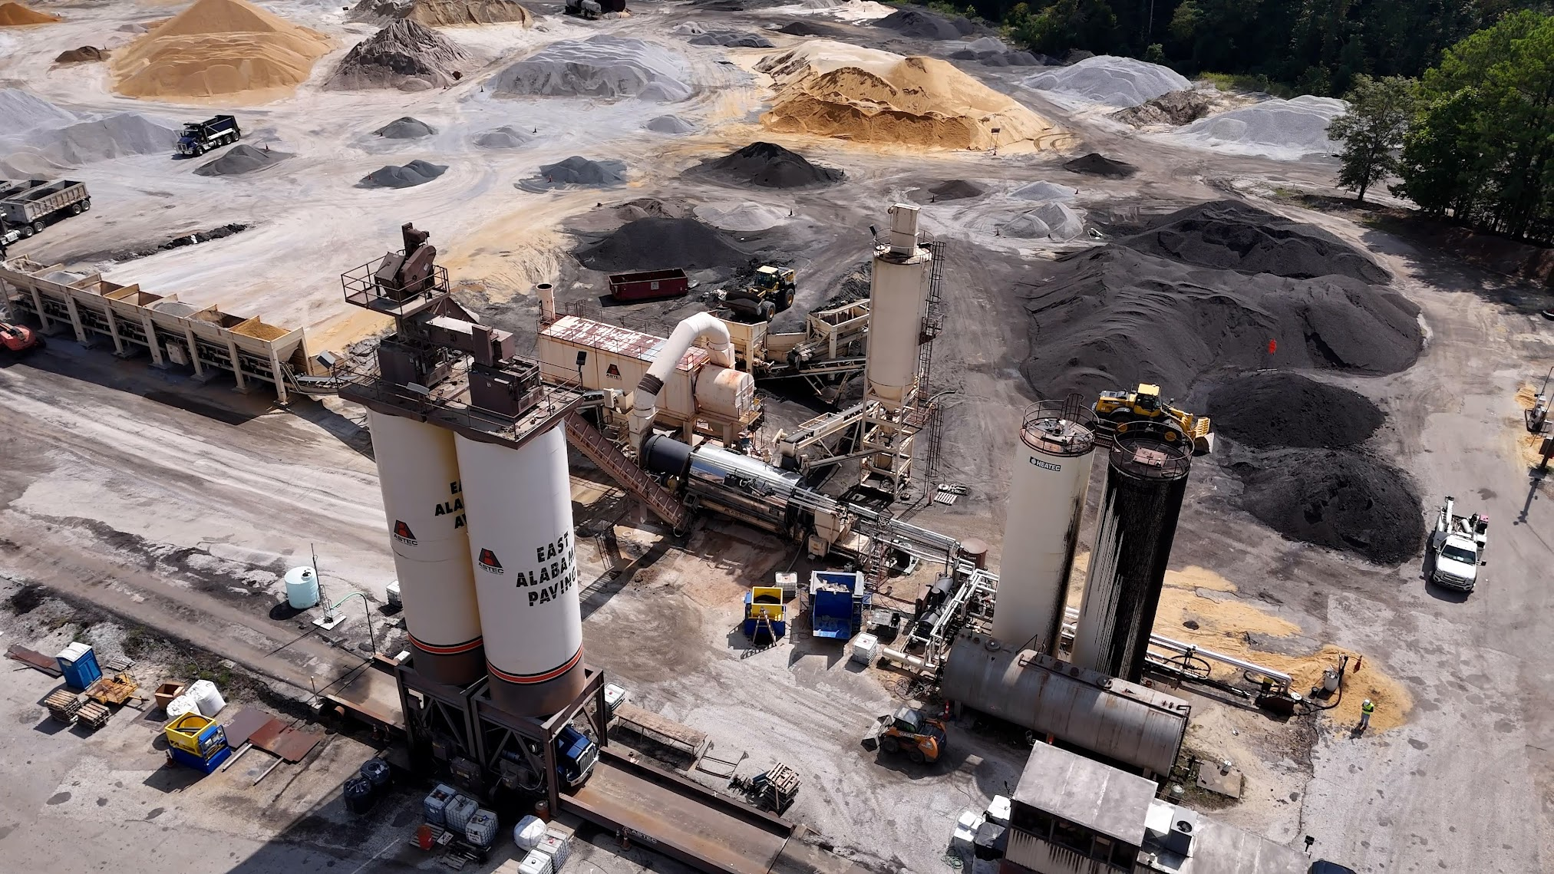

Slide 8
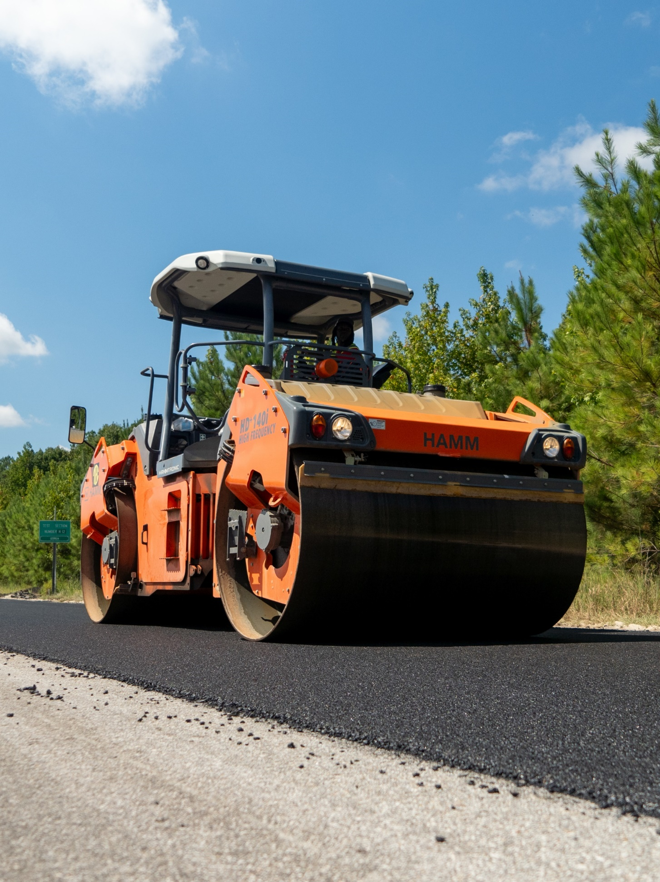
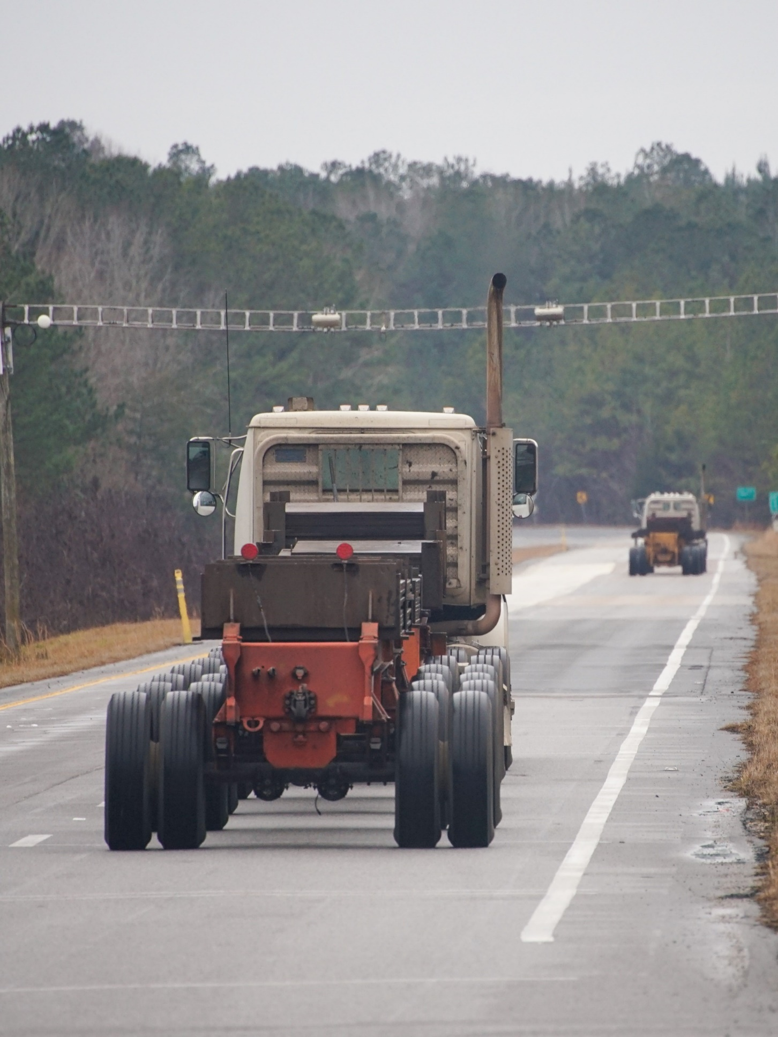
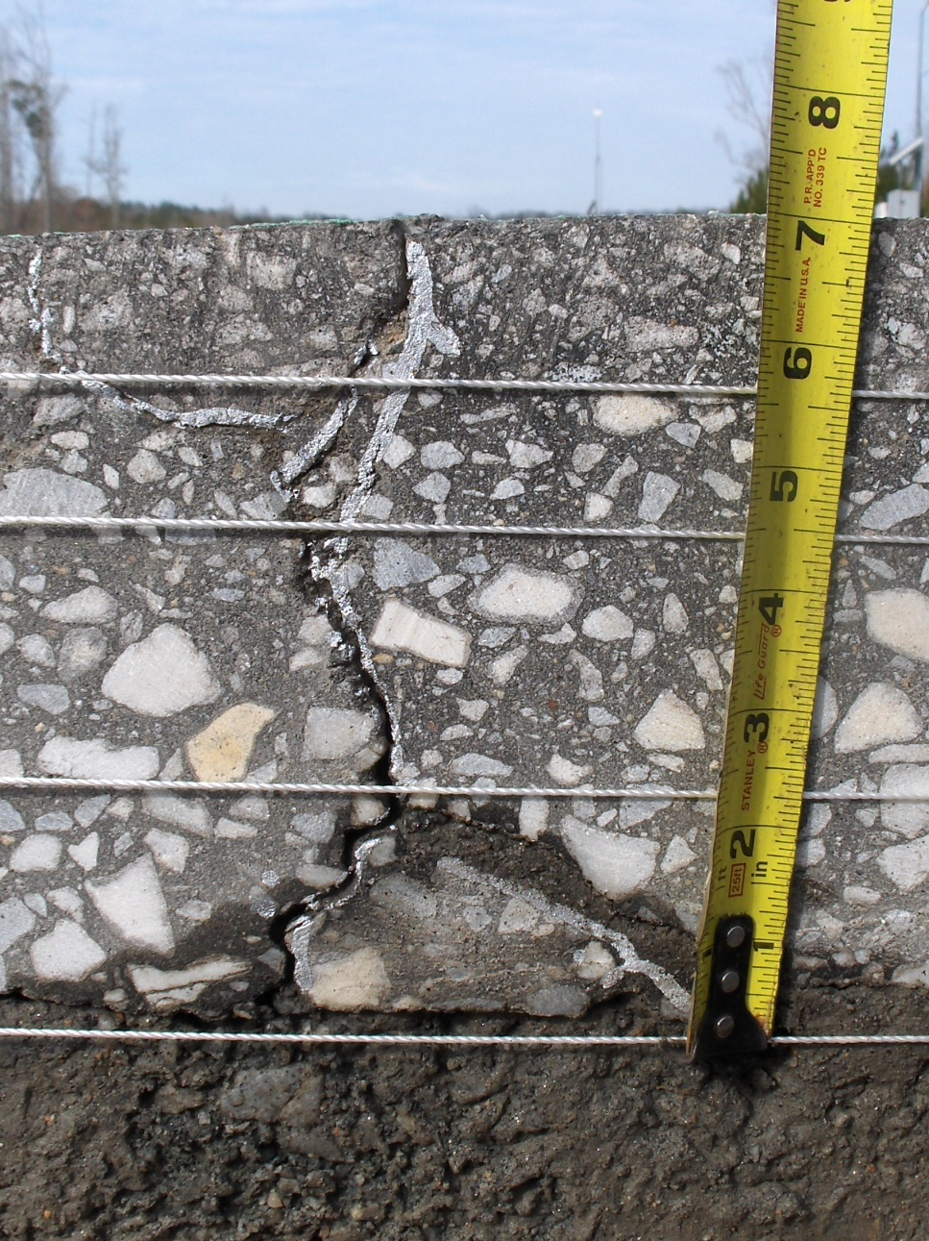
NCAT Test Track Research Cycle
Phase 1
Plan/Build Test Sections
Phase 2
Traffic
Phase 3
Forensic Analysis

Slide 9
ALDOT Higher RAP + BMD
(W8 & W9)

Slide 10
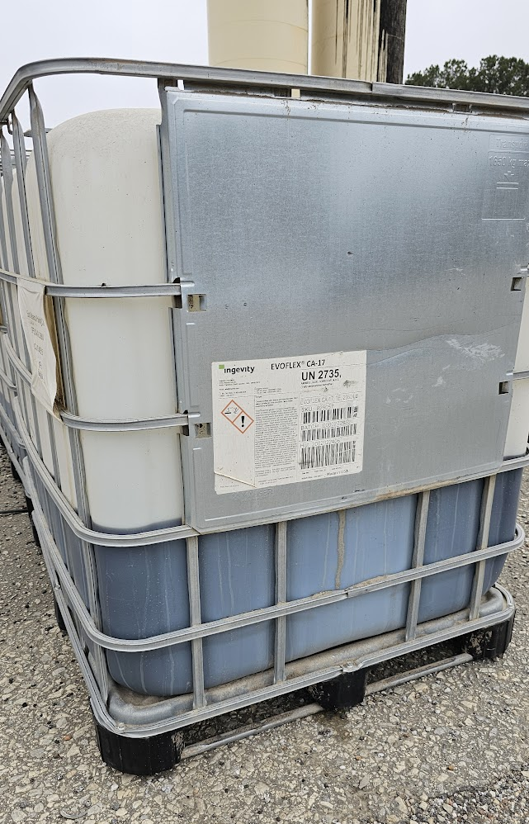
ALDOT BMD Sections
“BMD for all stakeholders”
  Improved durability
  Allowance for more RAP and innovation
Higher RAP (35%) + softer binder
  W8 – PG 67-22 + Recycling Agent (3-in-1)
  W9 – PG 58-28
½” ALDOT 424 mix (+ 15% RAP)

Slide 11
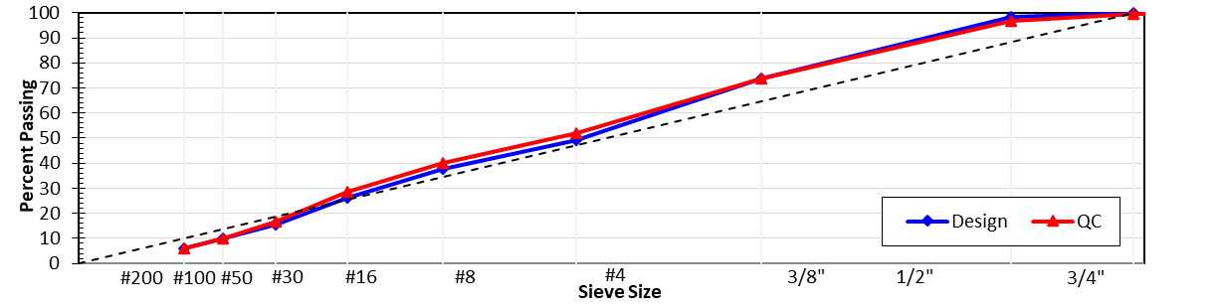
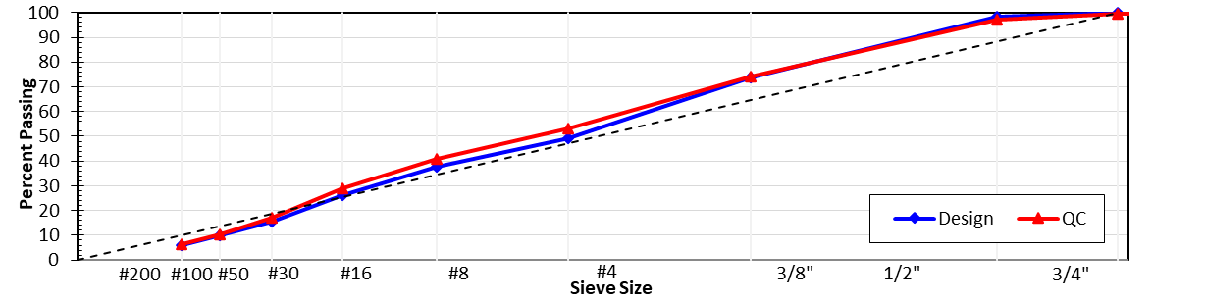

Materials and Mix Design
Granite 89s – 29%
Granite M10s – 17%
Sand – 19%
RAP – 35%
AC – 6.0%
Liquid additives:
W8 (Evo CA-17) – 2.5%
W9 (Evo. P25) – 0.5%
W8
W9

Slide 12
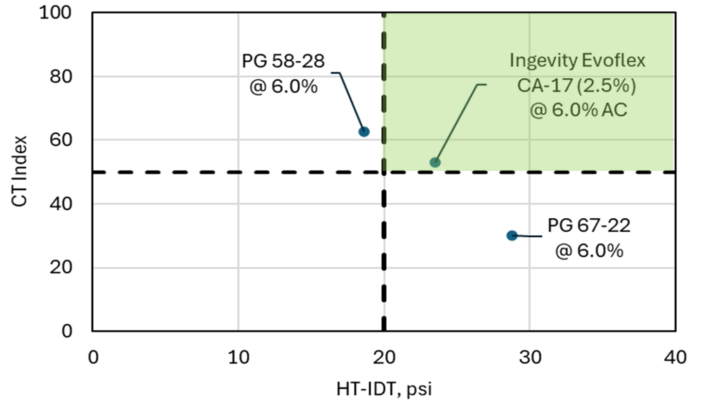
BMD Results (design)
Improving Cracking
Ndes = 60
Va% = 4.0%
VMA > 16
Improving Rutting

Slide 13
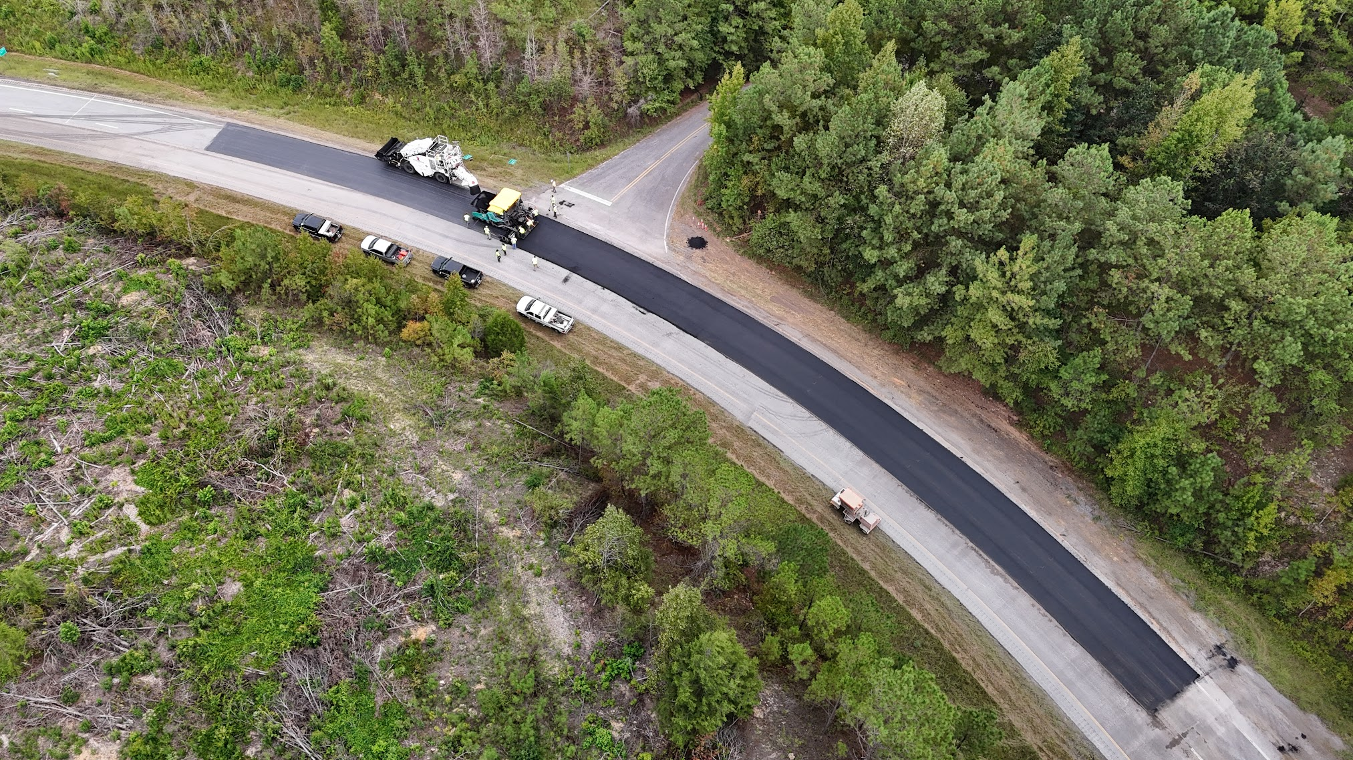
Construction

Slide 14
Production Results
Shifts slightly finer
W8
W9

Slide 15
Notable QC/Acceptance Results
 | W8 (PG 67-22 + RA) | W9 (PG 58-28)
AC% | 6.1% | 6.1%
Air Voids, % | 2.6% | 2.3%
In-place Density, % | 94.1% | 93.6%
Thickness, in | 1.8” | 1.9”
Production Temp, °F | 305 °F | 305 °F

Slide 16
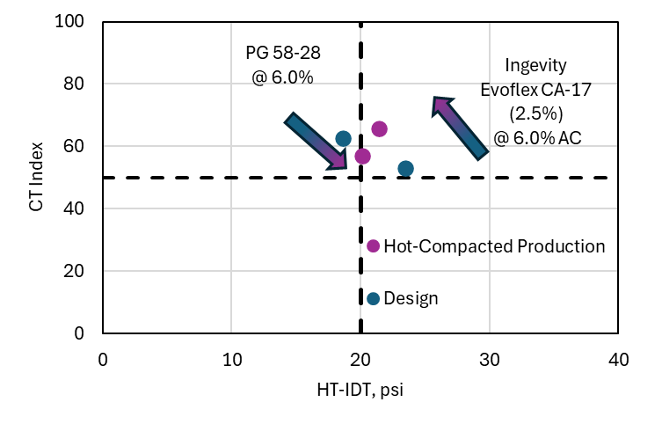
BMD During Production Results

Slide 17
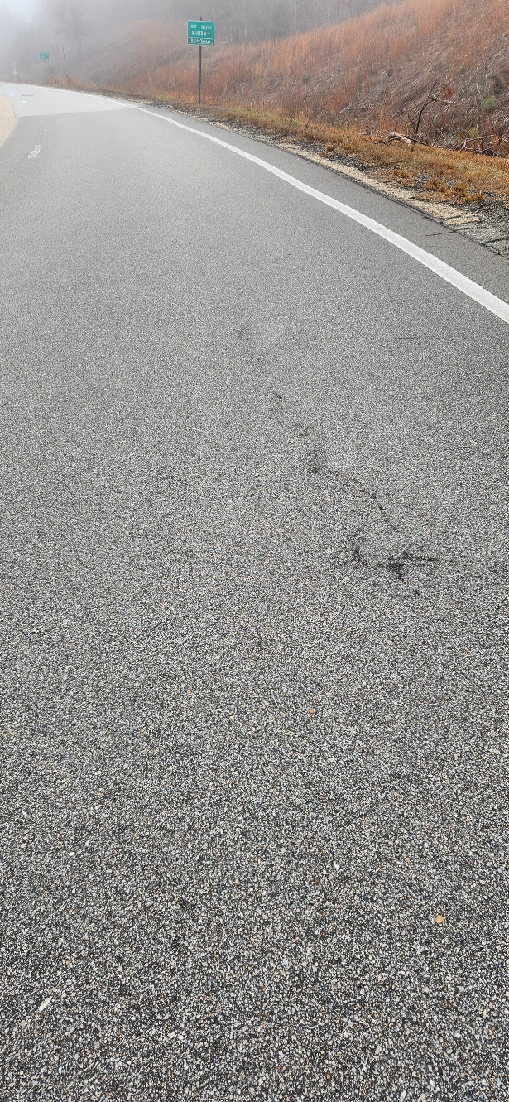
Early Performance @ 6M ESALs
Less than 0.1 inches (3 mm) of rutting
No significant smoothness changes
Slight texture increase (binder films wearing off)
Investigating a couple of unexpected cracks

Slide 18
Additives on the Test Track

Slide 19
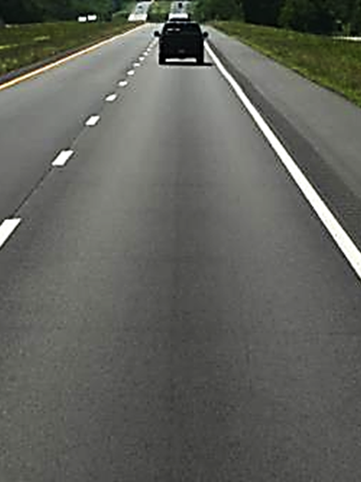
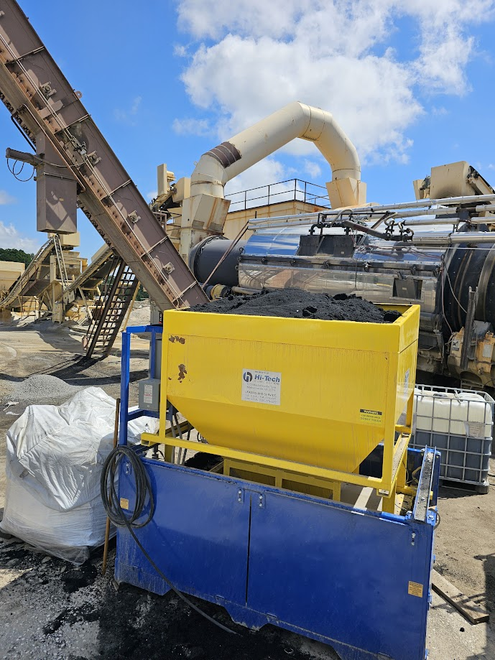
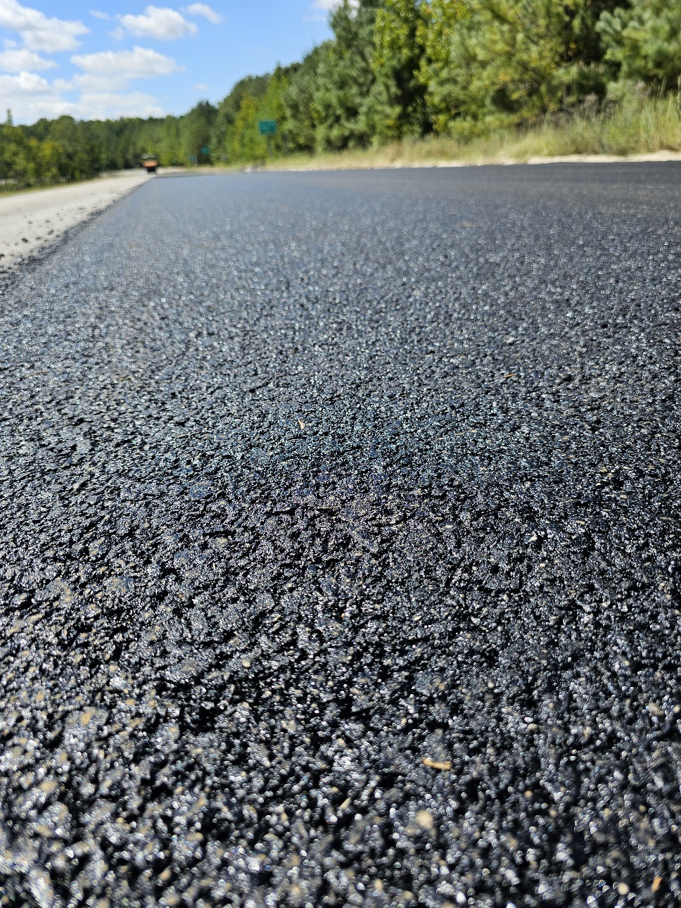
Dry Rubber ARGG (AR - N11)

Slide 20
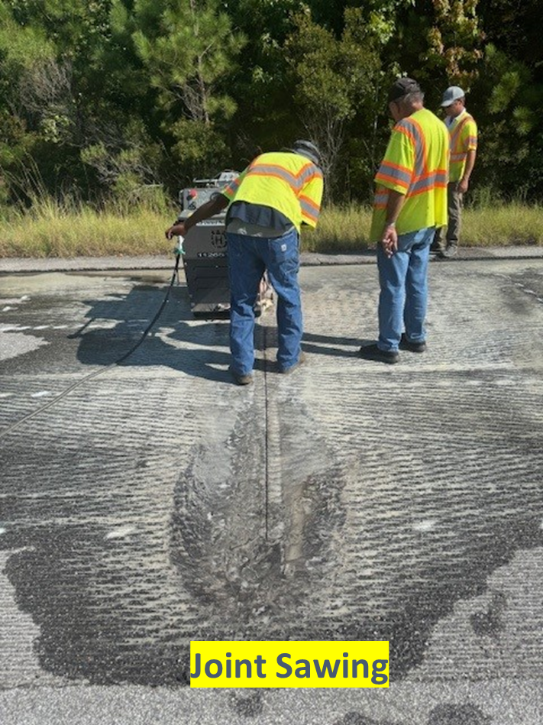
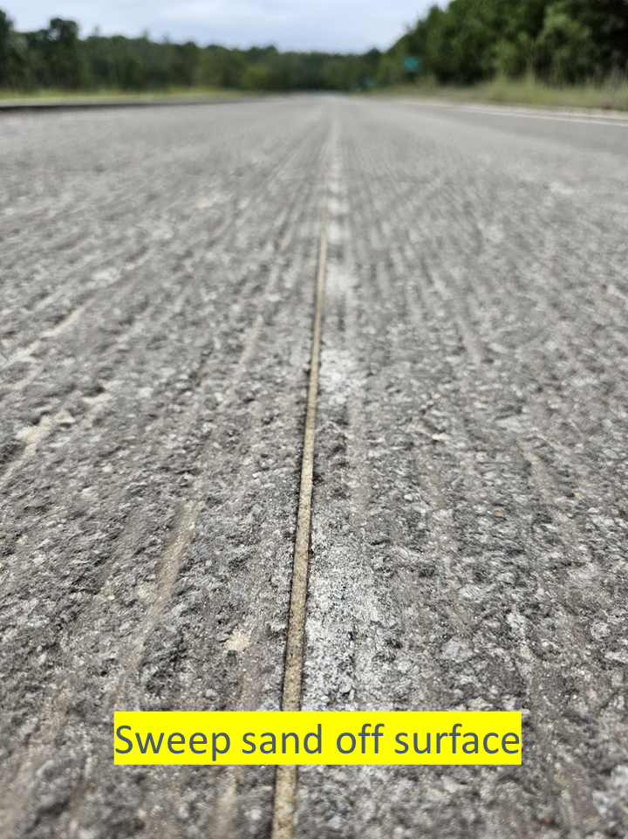
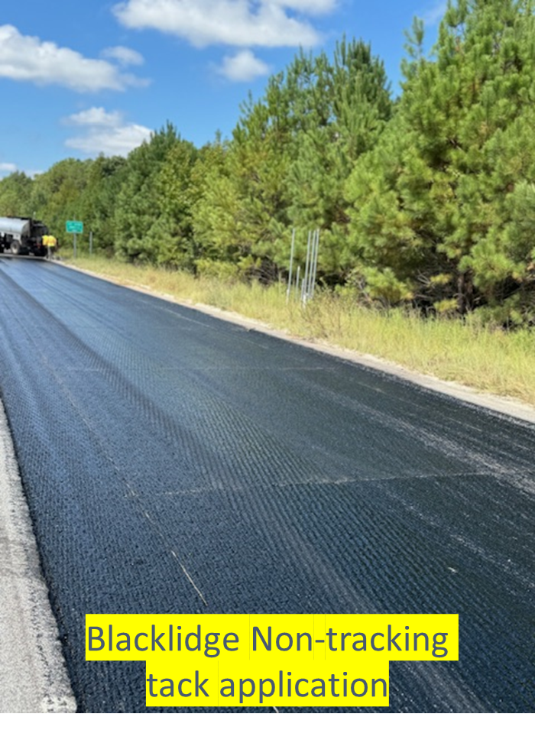
Surface Preparation Plan
Notes:
ARDOT looking for a crack-resistant surface layer to delay reflective cracks from poorly rubblized PCC.

Slide 21
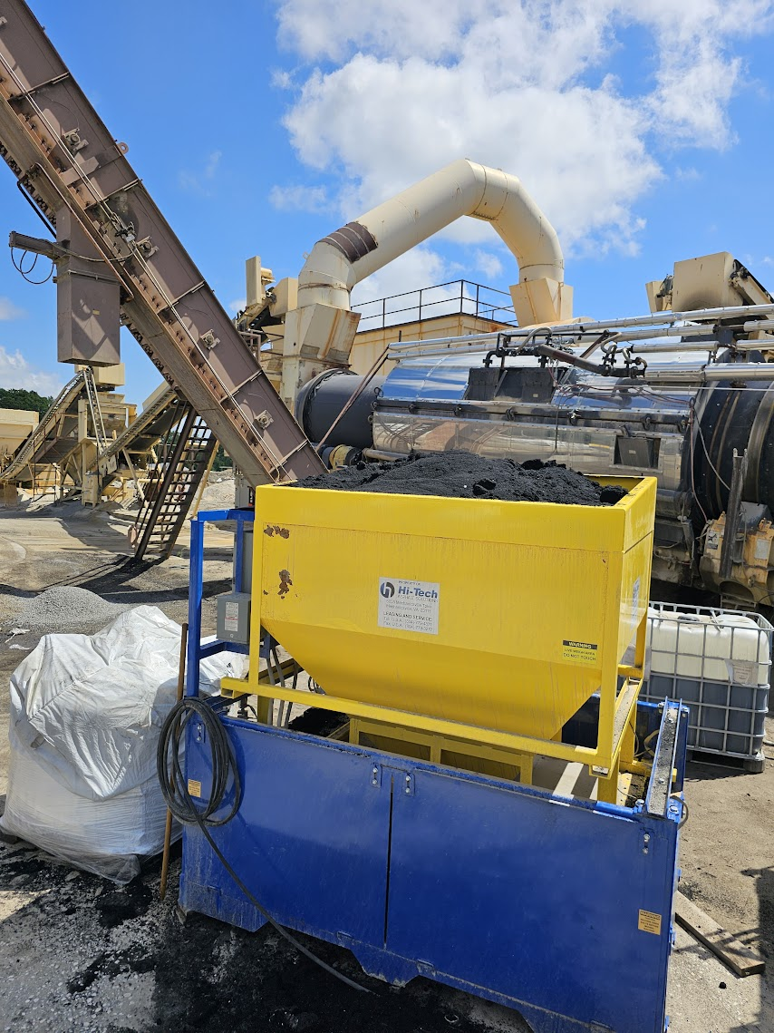
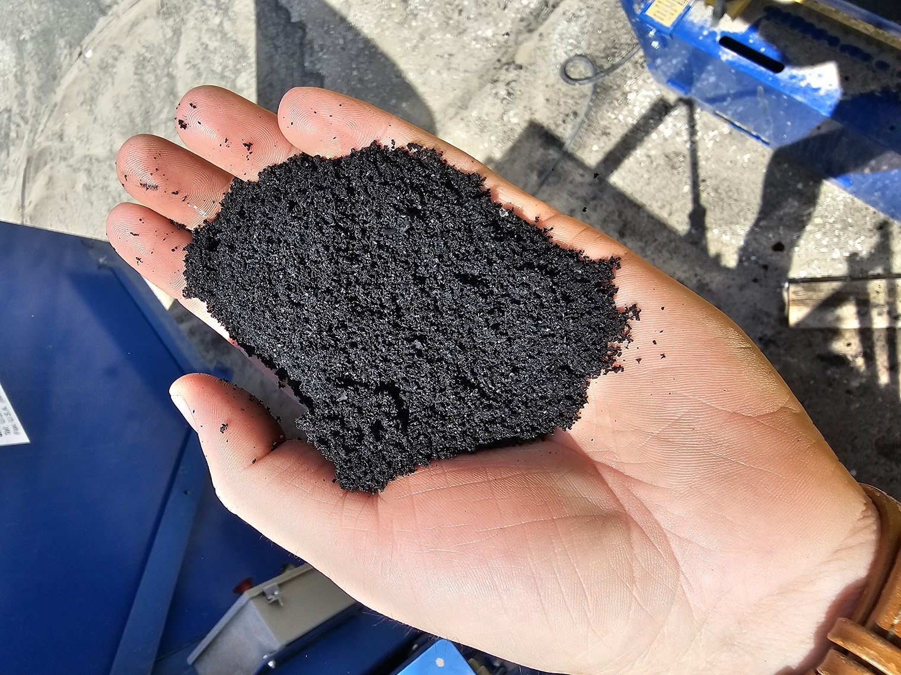
Dry Rubber – Liberty Tire
Smart Mix is a pre-swelled rubber with extender oil
Added at 20% by weight of virgin binder

Slide 22
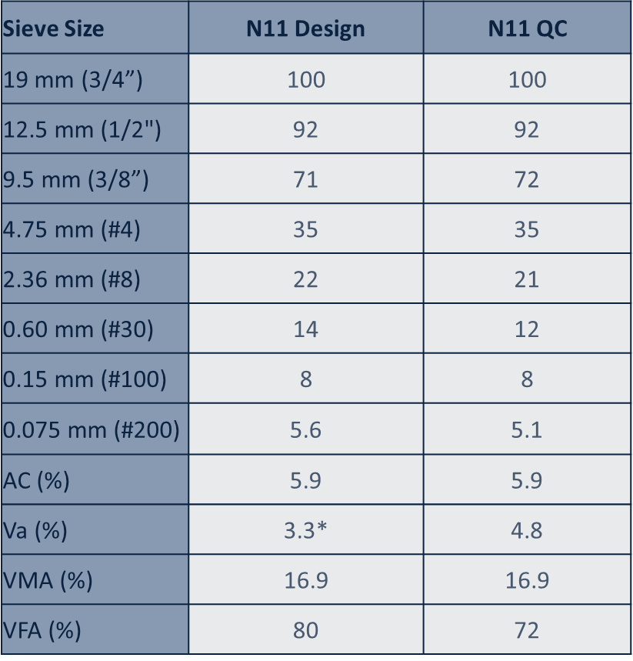
ARGG Mix Design
UTBWC Gradation (Gap-graded)
PG 70-22
Virgin Mix
5.9% AC + 1.2% Rubber

Slide 23
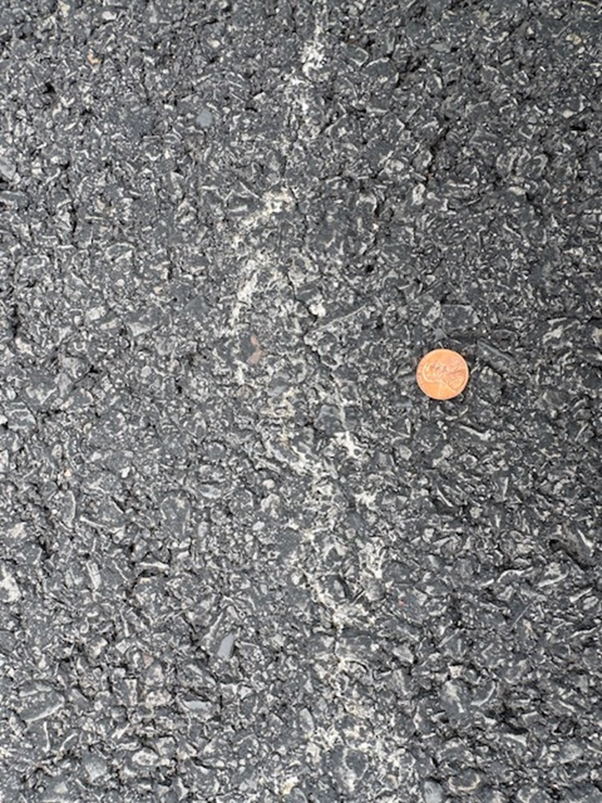
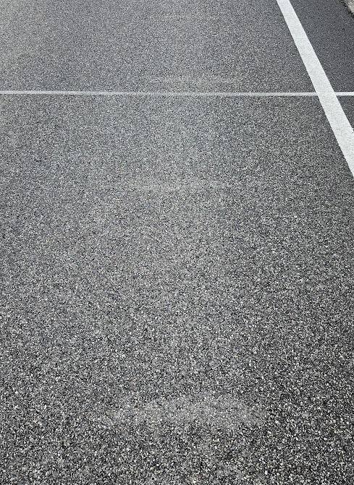
Sawcut performance @ ~2M ESALs
Dry ARGG Section
Other Sawcut Section

Slide 24
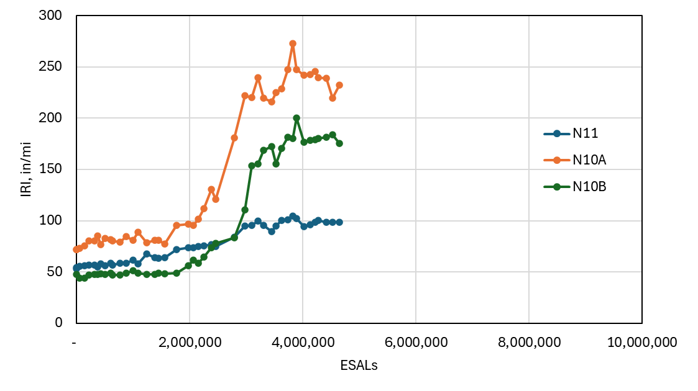
Smoothness Changes
Sawcut BMD sections with 58-28 binder
ARDOT Gap-Graded Dry Rubber Mix

Slide 25
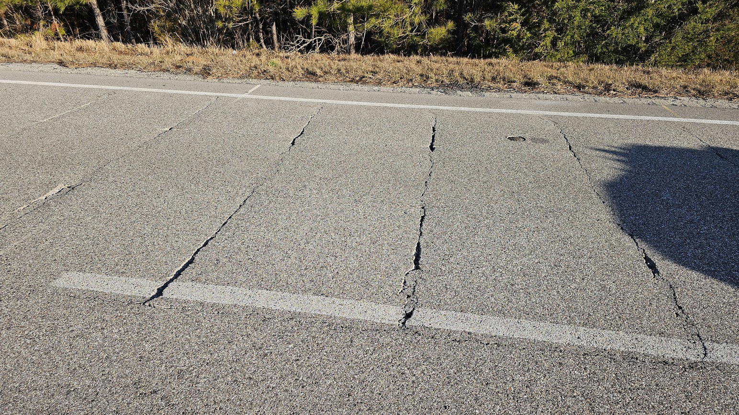
Sawcut performance @ 5M ESALs
Other Sawcut Section

Slide 26
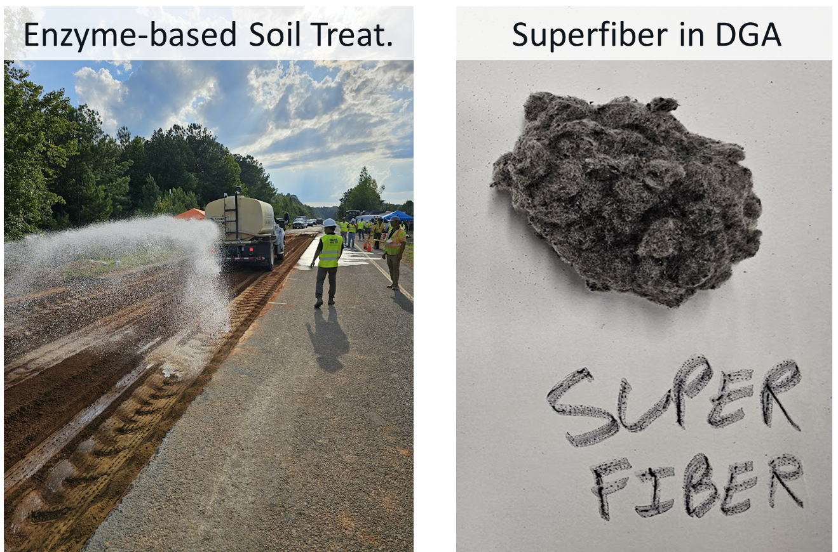
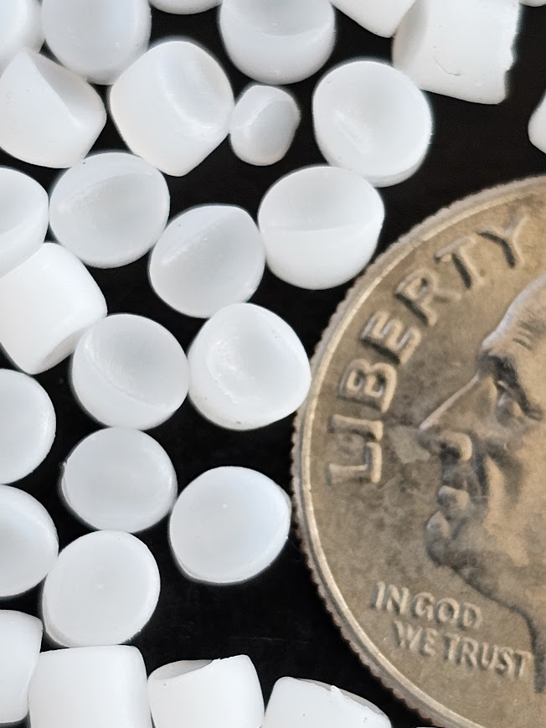
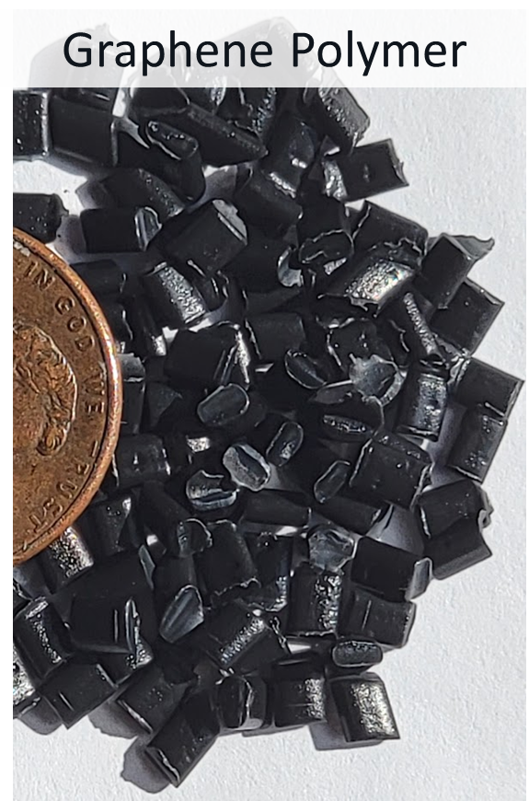
Other Additive* Examples
Catalloy Polymer

Slide 27
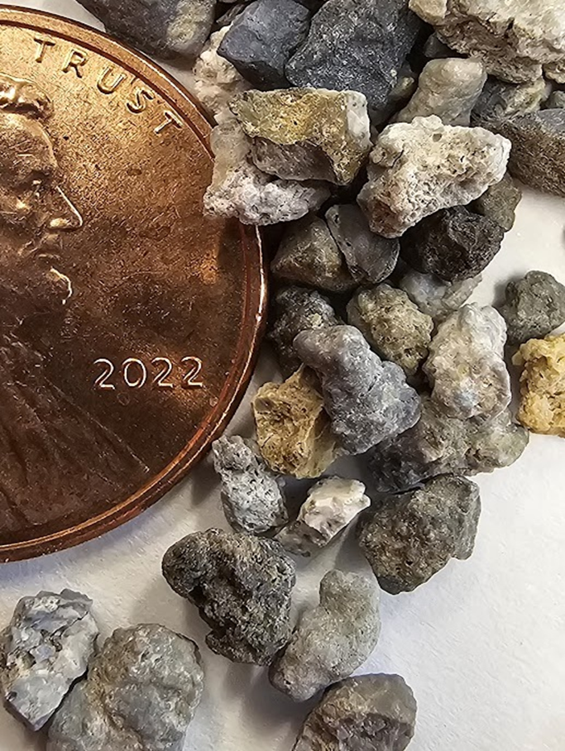
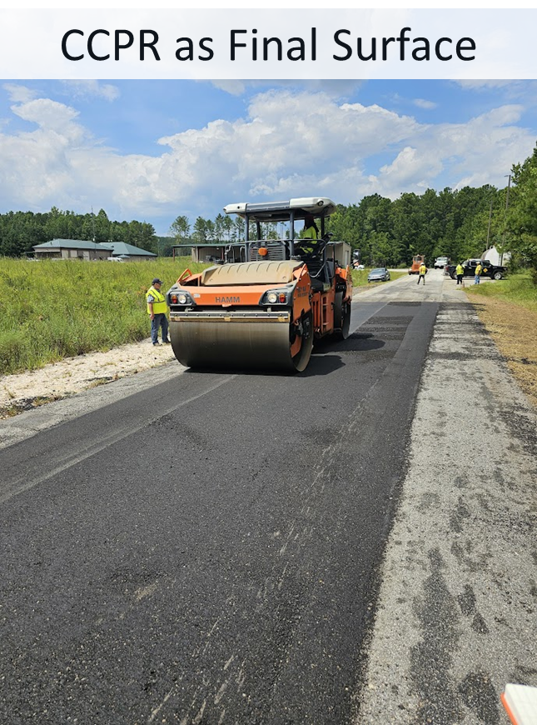
Other Additive* Examples
Bauxite in Thin Overlay

Slide 28
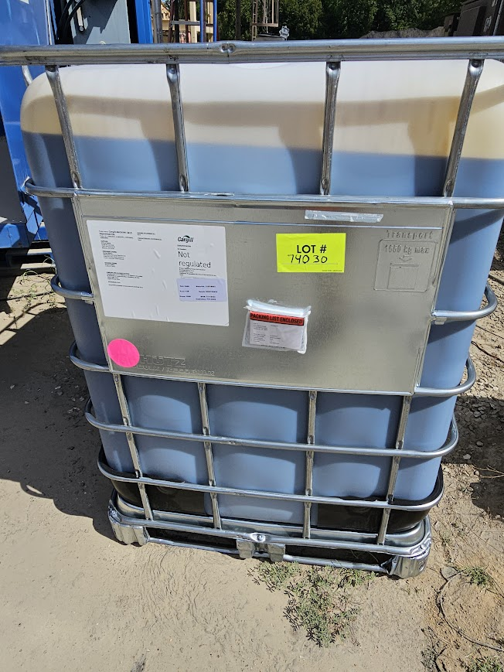
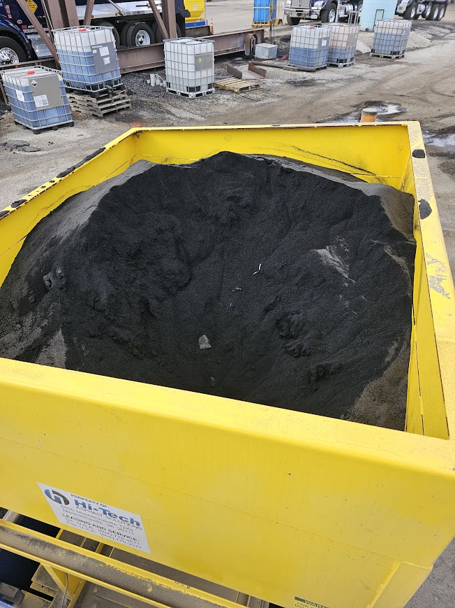
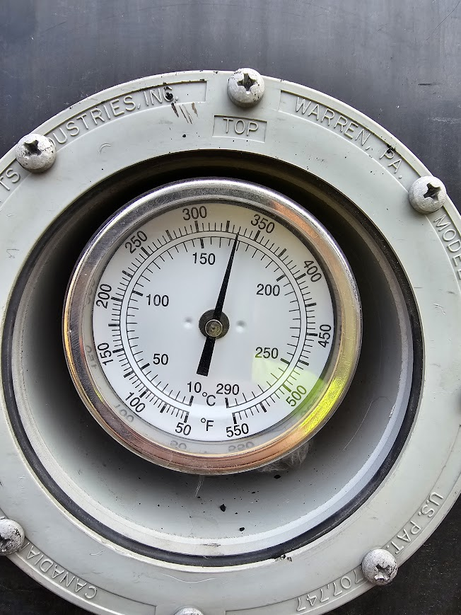
Other Additive* Examples
WMA + Rejuvenator
Dry Rubber in DGA/SMA
HP Binder

Slide 29
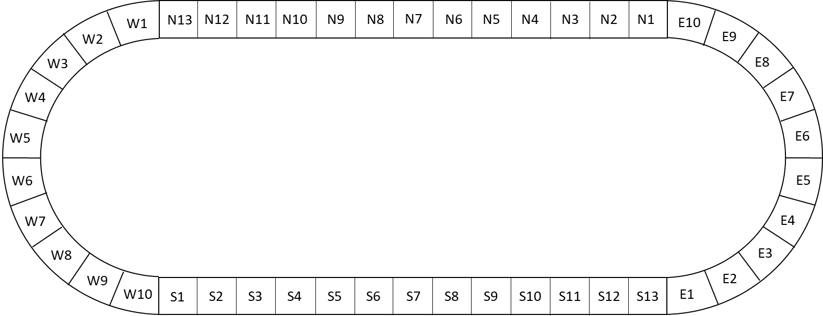



Additive Group Experiment

Slide 30


Slide 31
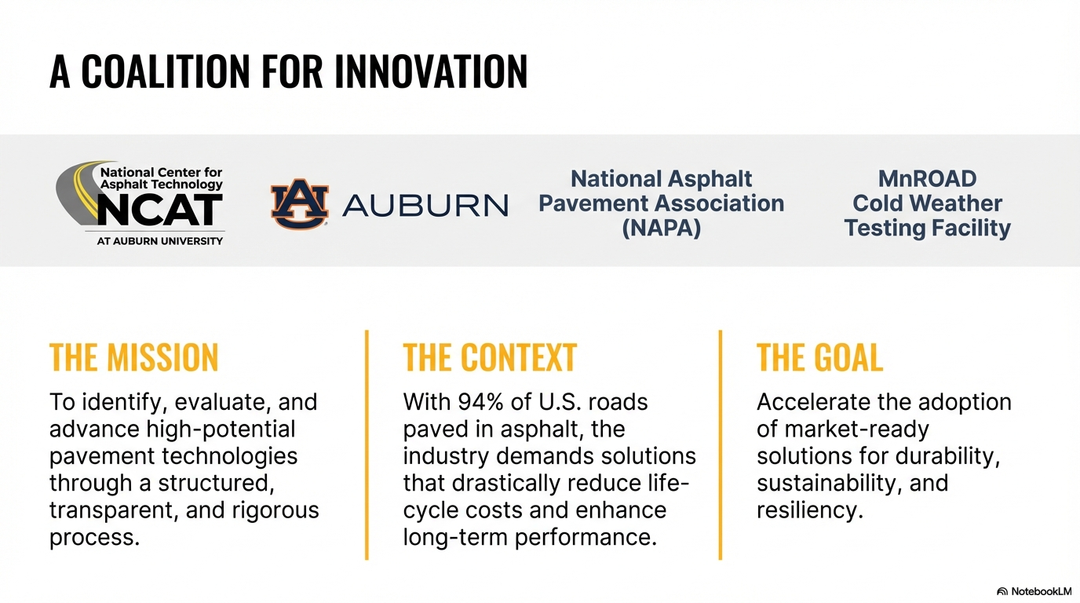




Slide 32
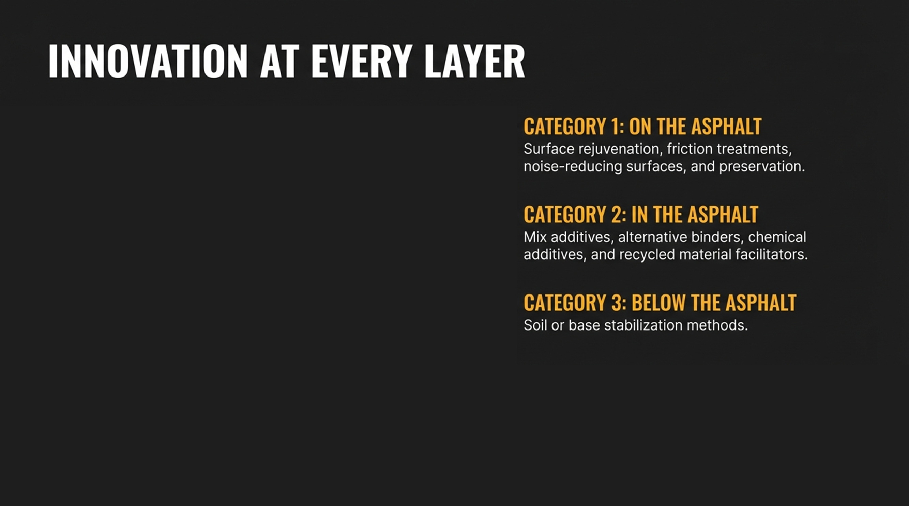
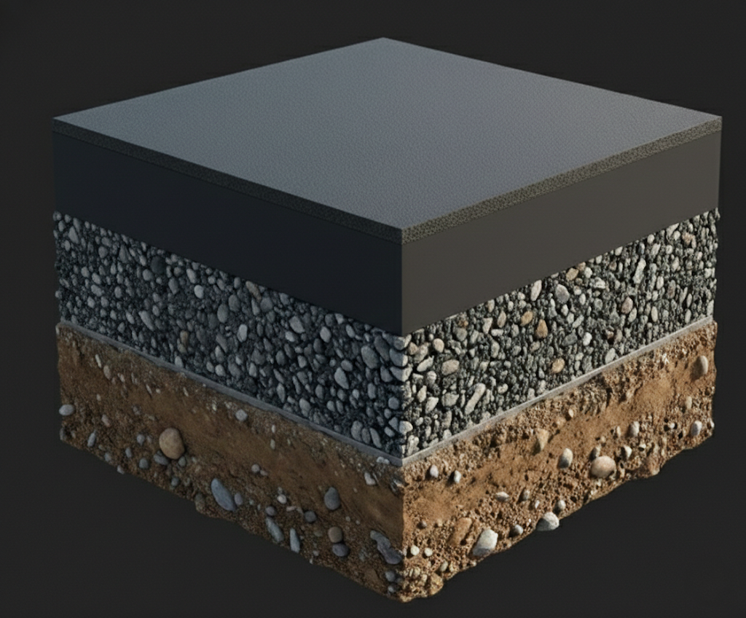

Slide 33
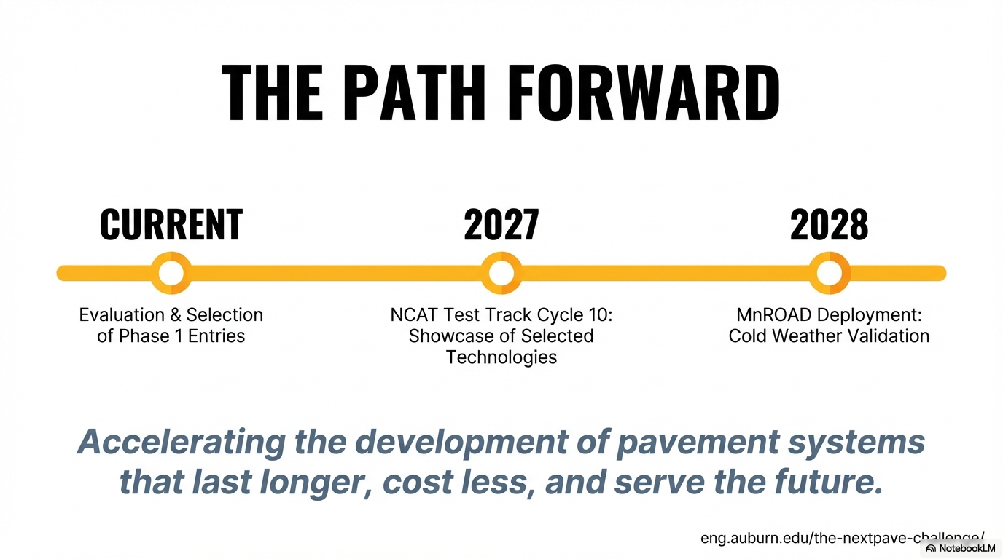
eng.auburn.edu/the-nextpave-challenge/

Slide 34


Slide 35
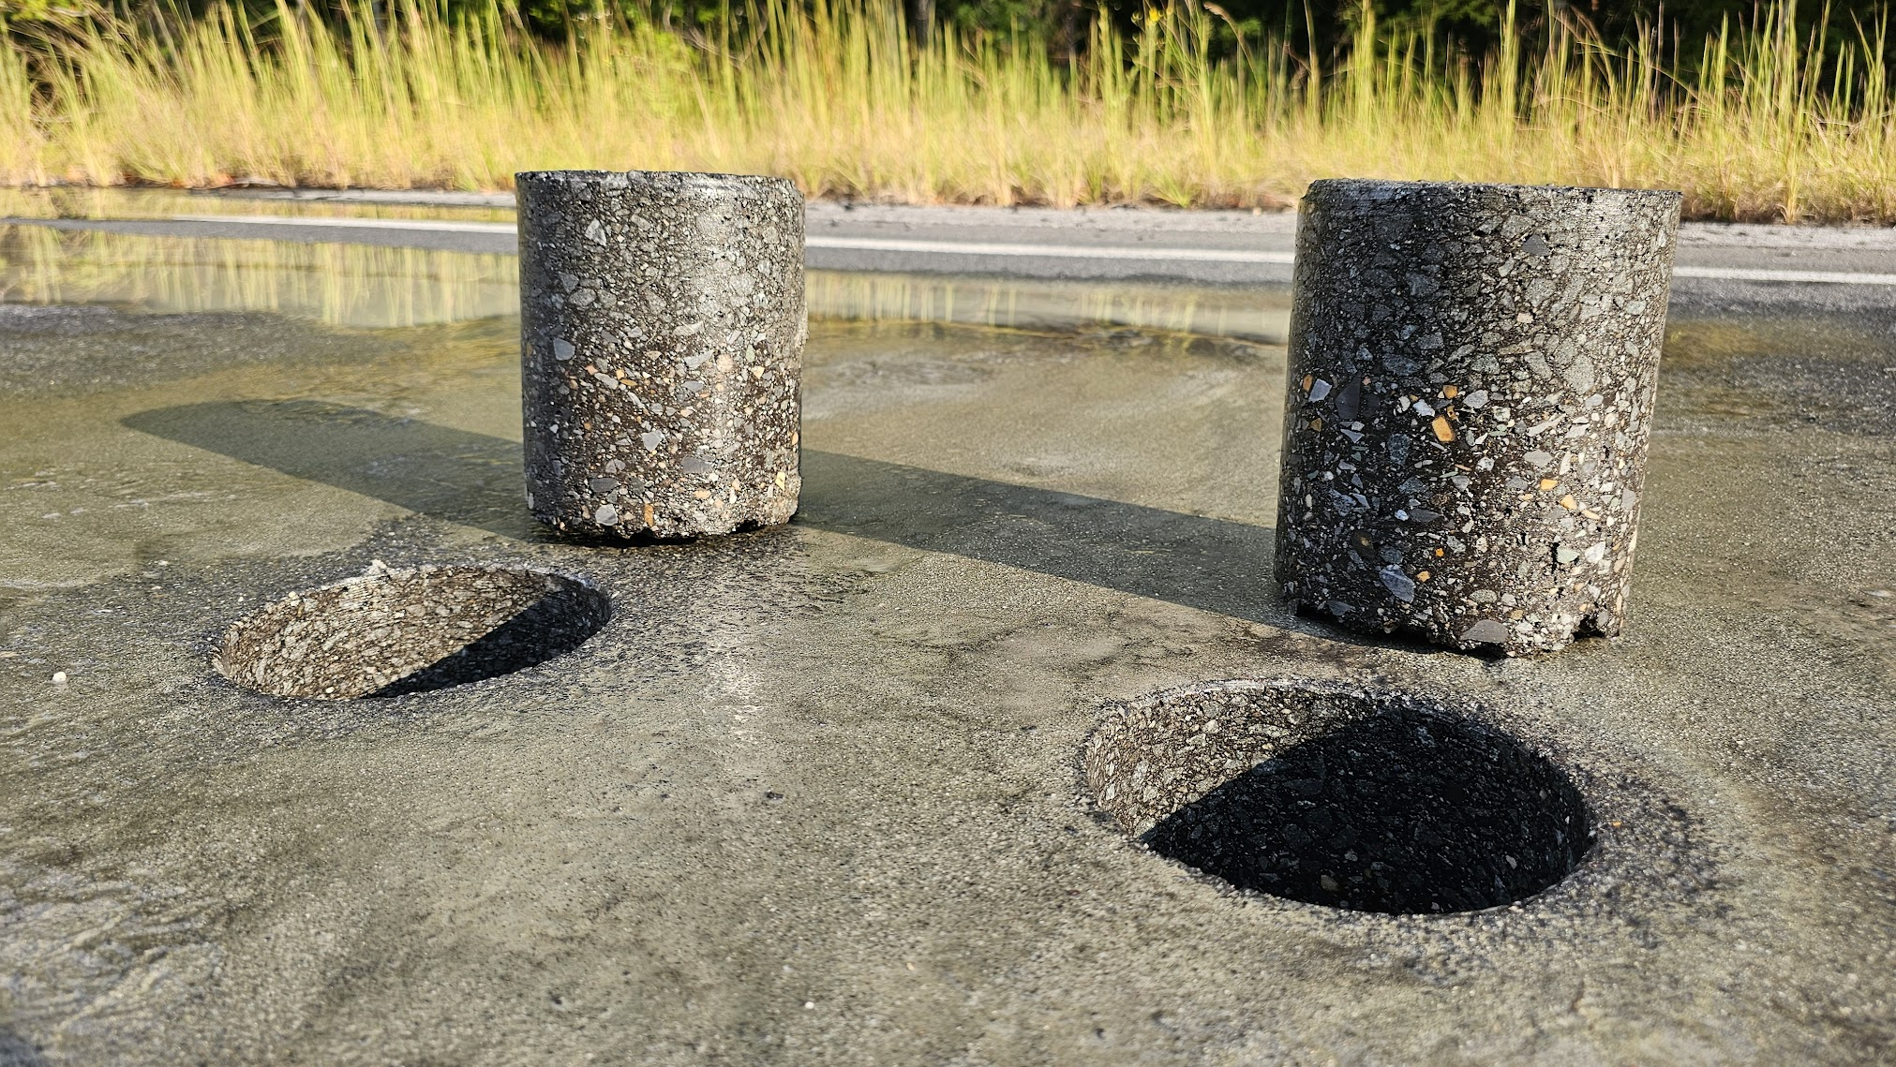

Thank you!!
Nathan Moore, P.E.
nathanmoore@auburn.edu

