Slide 1
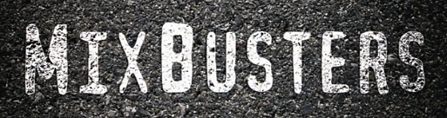
Buzz and Dave
and Dave

Slide 2
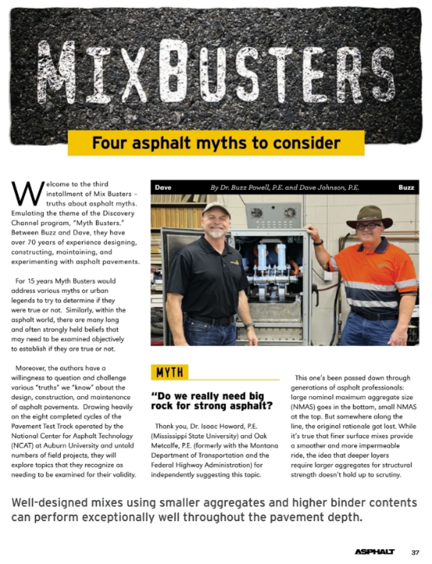






Slide 3
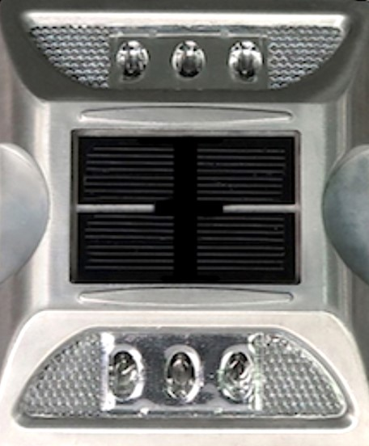
Four Installments to Date
Winter ‘24₃ – skipping tack, RAM cooling, ≤4 x NMAS
Spring ‘25₃ – coefficients, thick perpetual, lean binder
Summer ‘25₄ – big rock, low Va, friction agg, COAC
Fall ‘25₄ – fogging OGFC, complexity, ’93 Guide, PTRs.

Slide 4

Do you have access to Asphalt Magazine articles?

Slide 5

www.HeyNAPA.com
“I don't have direct access to external publications, including articles from Asphalt Magazine. However, I can provide information and answer questions related to asphalt paving, materials, and industry practices. If there's a specific topic or question you have in mind, please let me know, and I'll be happy to assist you with the information I have!”

Slide 6
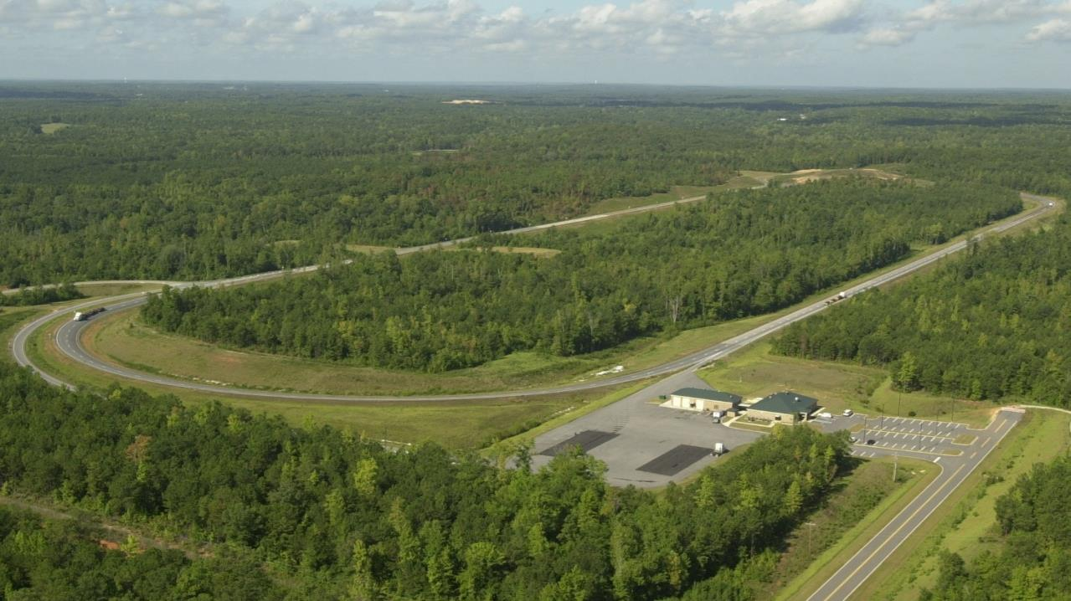


NCAT Pavement Test Track

Slide 7
Four Installments to Date
Winter ‘24₃ – skipping tack, RAM cooling, 4xNMAS
Spring ‘25₃ – coefficients, thick perpetual, lean binder
Summer ‘25₄ – big rock, low Va, friction agg, COAC
Fall ‘25₄ – fogging OGFC, complexity, ’93 Guide, PTRs.

Slide 8
Winter 2024
Paving thicker than 4 times NMAS hurts compaction
Higher recycled asphalt mix (RAM) cools faster
Tack coat can be skipped between multiple lifts.

Slide 9
What are the upper & lower limits on paving thicknesses?

Slide 10
HeyNAPA.com
Fine mix lifts should be placed 3 to 5 x NMAS
Coarse mix lifts should be placed 4 to 6 x NMAS
Justification is ability to compact & measure _{smooth}
“Thick lifts” are greater than 5_{fine} and 6_{coarse} x NMAS
½” mixes are “thick lift” when > 2½”_{fine} and 3”_{coarse}
3 Track sections₂₀₁₈ have ratios between 14 & 16!

Slide 11
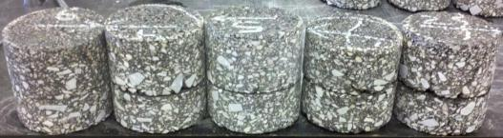
Tack Coat
Purpose of Each Layer | N5 Control | S5 Higher RAP | S6 RAP+RAS | S13 Recyc Tires
Durable, Rut Resistant Surface | 20% RAP₂₀ 67-22/82-16 DG | 25% RAP₁₁ 67-22/76-22 SMA | 5% RAS₂₁ 67-22/88-16 SMA | VIRGIN 82-22₁₂ SMA
Stiff, Strain Reducing Middle | 35% RAP₃₉ 67-22/88-10 DG | 50% RAP₄₁ 67-22/82-16 DG | 50% AGED₂₆₋₂₄ 67-22/94-10 DG | 35% RAP₃₇ 82-22₁₂ DG
Fatigue Resistant Base Layer | 35% RAP₃₉ 67-22/88-10 DG | 35% RAP₃₄ 94-28/94-10 DG | 25% RAP₂₄ +76-22/88-16 DG | VIRGIN 88-22₂₀ AZ
Green = Evotherm Q1 Additive, Blue = Astec Green Foamer

Slide 12
Spring 2025
Intermediate layer mixes can be leaner, stiffer
Layer coefficients should be the same for all mixes
Pavements must be very thick to be perpetual.

Slide 13
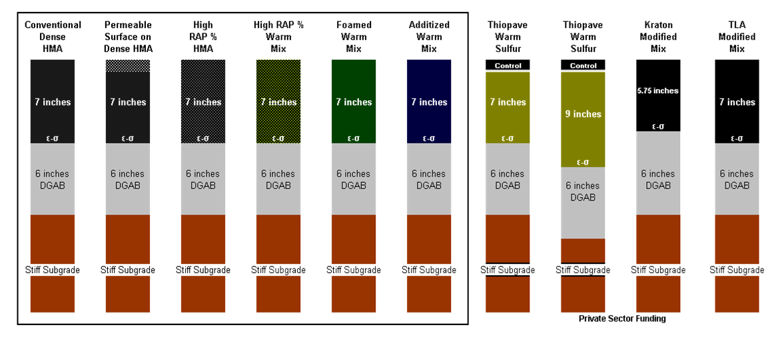
Thin Perpetual Pavements
5¾”

Slide 14
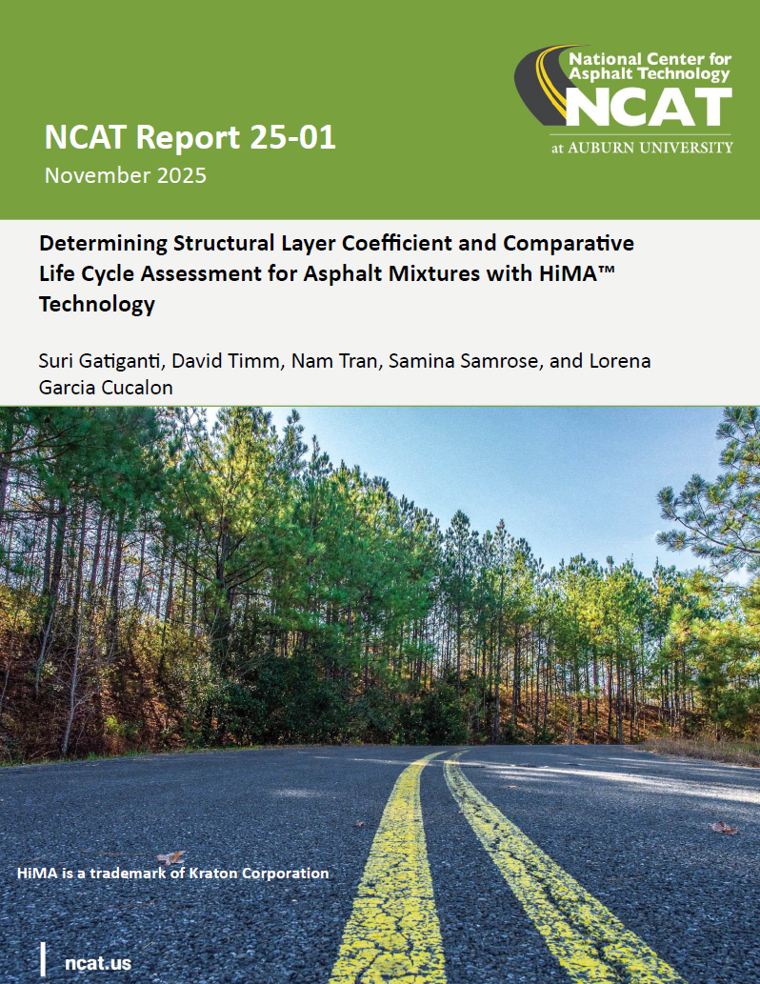
NCAT Report 25-01
x 1.7 !

Slide 15
Summer 2025
Big rocks are necessary for strong (lower) asphalt
Polishing sources should be banned from surface mix
RBA implementation requires changing volumetrics
Low Va & high VFA always risks rutting & bleeding.

Slide 16
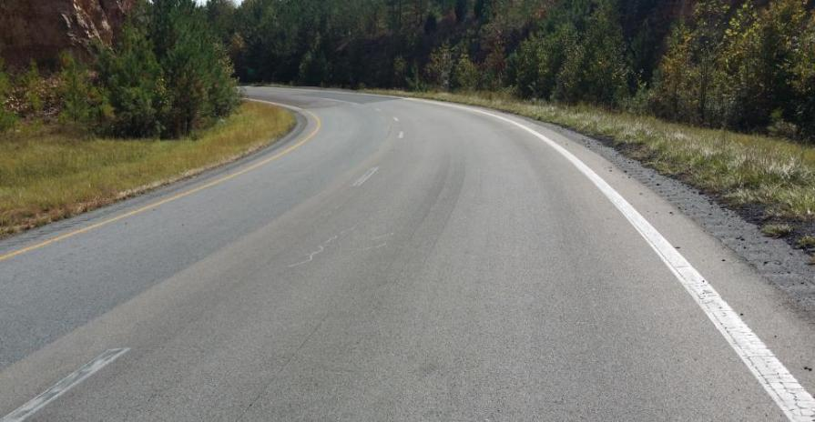
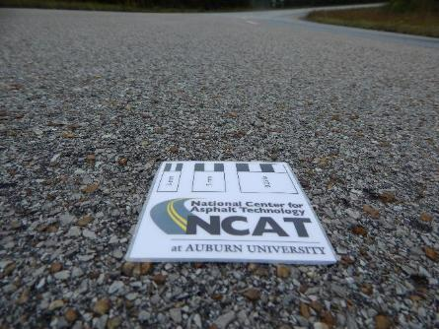
Friction and Safety

Slide 17
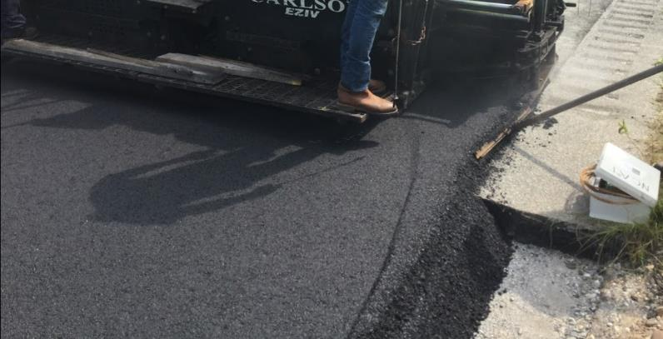
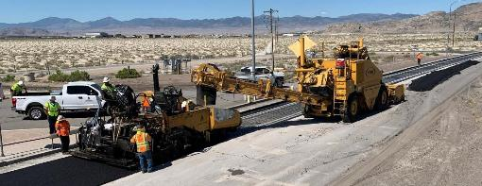
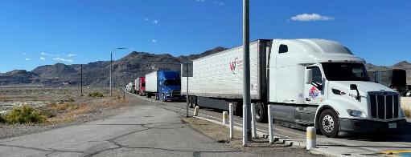
Low Void “HiMod” Mixes in Utah
Higher Density (~97% on 46 projects)
Better binder (≥5% polymer)
More binder (typically +20%)
15% RAP (sustainable).

Slide 18
Low Void “HiMod” Mixes in Utah
Bridge decks, rubblization overlays, SMA swaps
3” for interstate bridge deck preservation
5½“ on rubblization ($40M savings vs PCC rebuild!)
PCC advocate now flipping projects for cost savings
Up to 7” in a single lift in specialty applications
2” as switch from SMA standard overlay (less cost)
More expensive than DGA, less than SMA.

Slide 19
Fall 2025
Pavements designed thinner than ’93 Guide will fail
More complex specs are needed to improve quality
Rubber-tired rollers (PTRs) are not worth the cost
Fogging OGFC surfaces will reduce permeability.

Slide 20
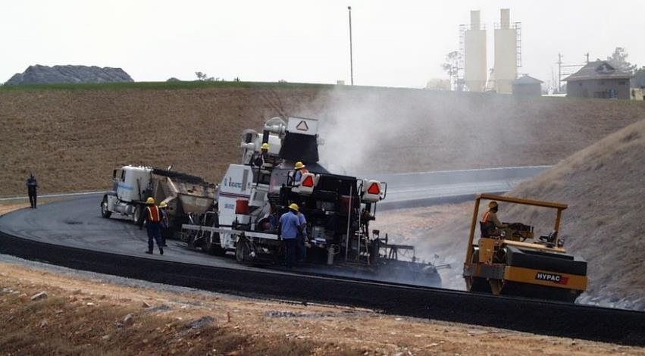
2000 NCAT Pavement Test Track
24”

Slide 21
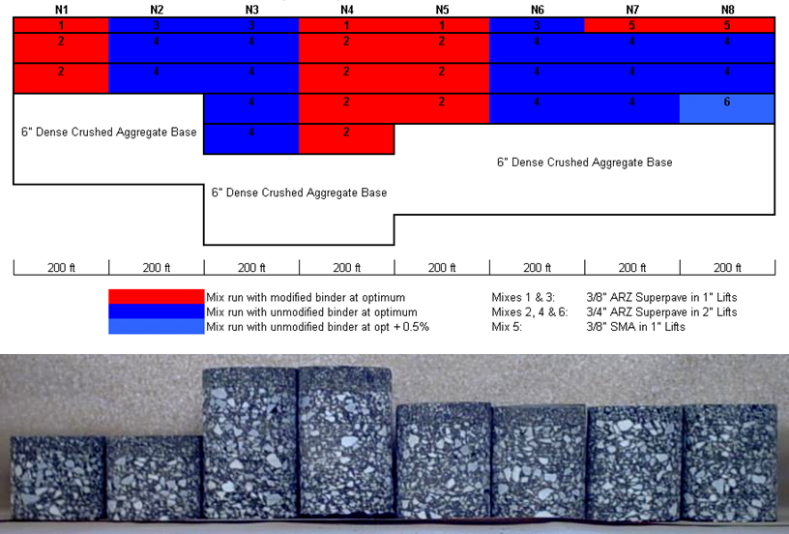
2003 NCAT Pavement Test Track
9”

Slide 22
2009 NCAT Pavement Test Track
5¾”

Slide 23


Simple BMD for AL Counties
https://www.ncat.us
Publications
NCAT Newsletter
Spring 2021
Volume 33
Number 1
Page 6.

Slide 24
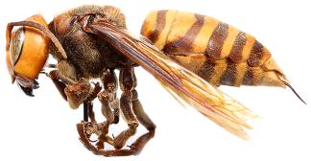
Mix Busters Big Takeaways
Better tack or elimination via thicklay paving
Higher layer coefficients from innovation
Perpetual asphalt at concrete thickness
BMD for Vb_{eff} quantity and quality
Specify performance with less words
1) Protect taxpayers and 2) incentivize innovation
Cracking, rutting, friction at lowest $/C _{BMD+f, LCA}
Requests: asphaltmixbuster@gmail.com

Slide 25

#BuzzOnAsphalt
#DriveAsphalt

