Slide 1

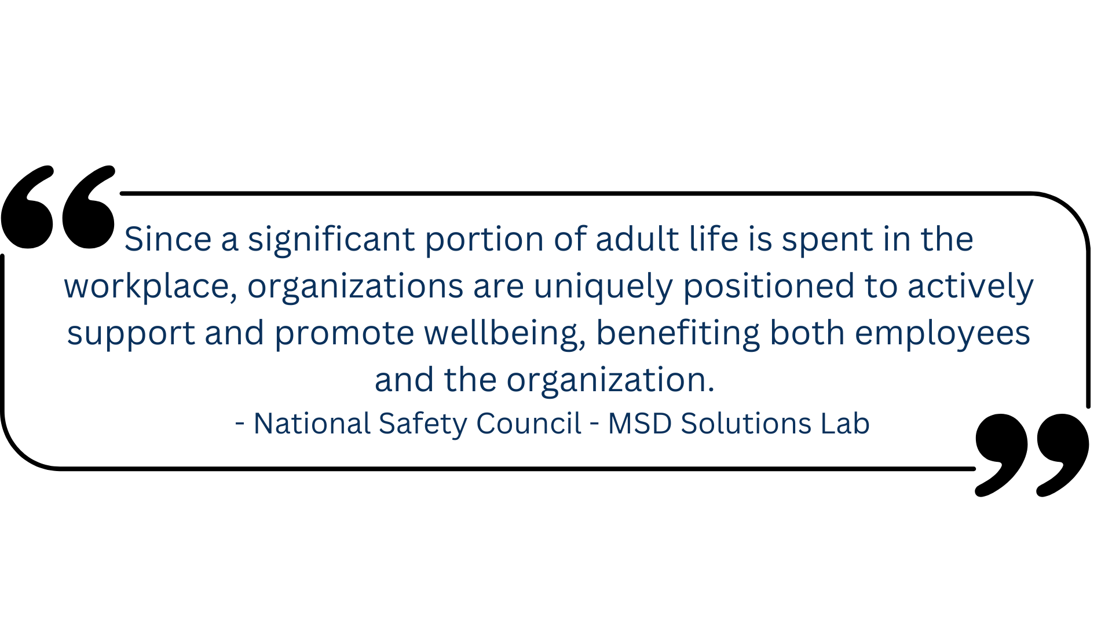

35th ANNUAL
ALABAMA ASPHALT PAVEMENT CONFERENCE
The Intersection of Safety, Wellness and Mental Health: Building a Supportive Environment
Chad McDougal, CIH, CSP, CWP
Vice President Safety, Health and Environmental
Vulcan Materials Company

Slide 2
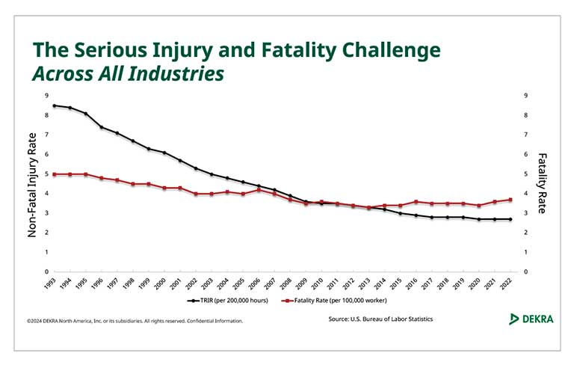
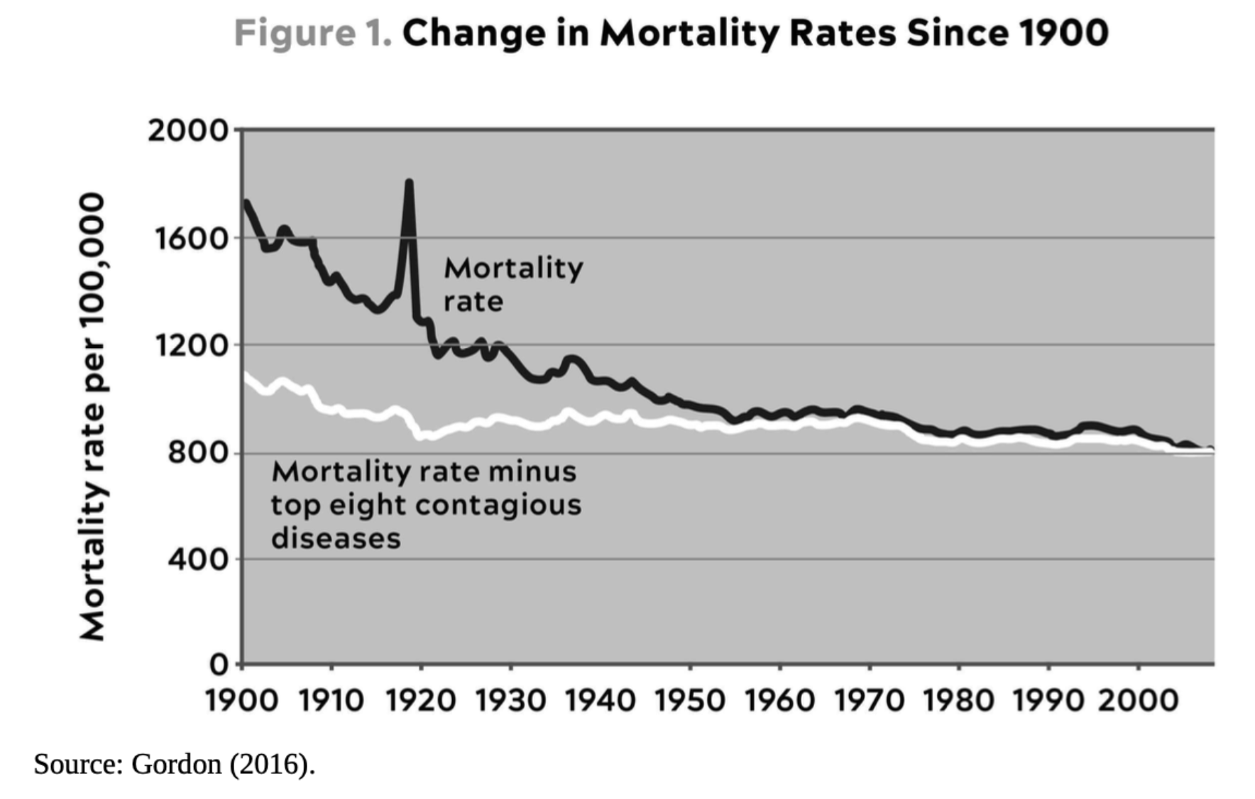
What We Currently Know – Fatality Rates
DEKRA, 2024
Book “Outlive” – Dr. Peter Attia

Slide 3


Slide 4
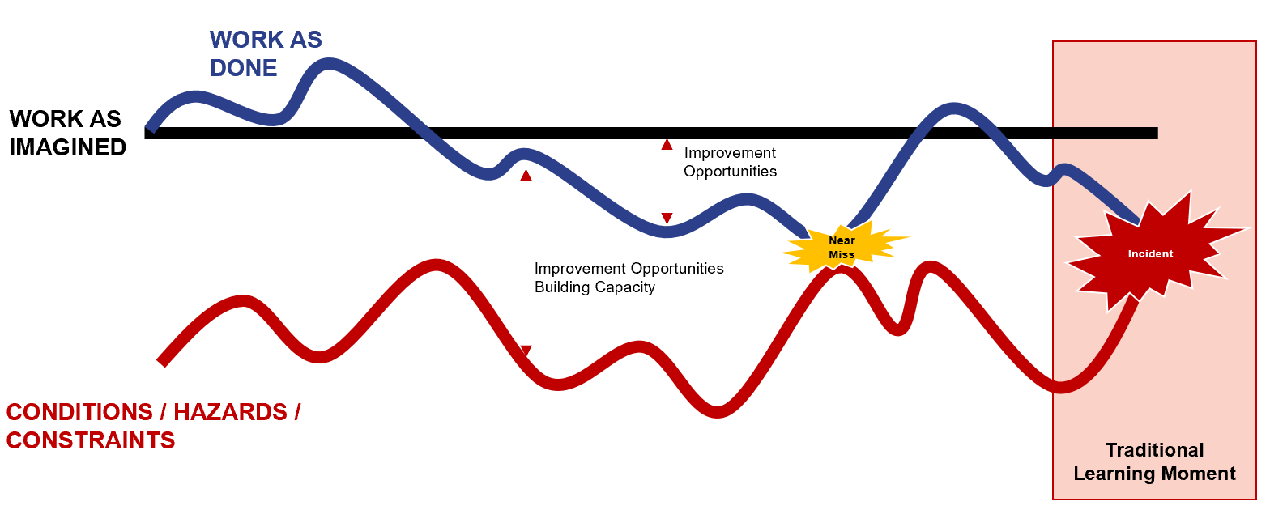
Work as Done vs. Work as Imagined

Slide 5


We Don’t Check our Distractions at the Gate!
We don’t just show up at work and check our distractions at the gate.
We bring many of our outside distractions and personal challenges with us to work.
These distractions can lead to a lack of engagement and concentration on work tasks.
This leads to an increased risk of incidents and overall decreased well-being.

Slide 6
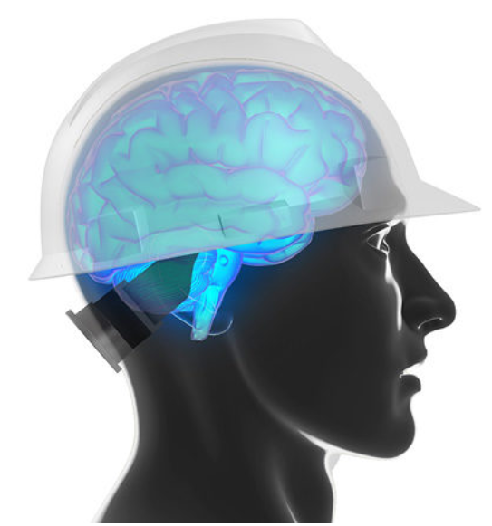
What’s Under the Hard Hat?
The focus has been on protecting the physical body of the worker.
Hard hats have reduced injuries to the outside of the head, but we haven’t done enough to take care of what’s going on under the hard hat – stress, emotional/mental issues, wellbeing, and distractions.
We need to focus our efforts on the mental wellbeing aspects.
It’s a shift in safety thinking from programs to a focus on our mindset: “What’s under the hard hat?”

Slide 7
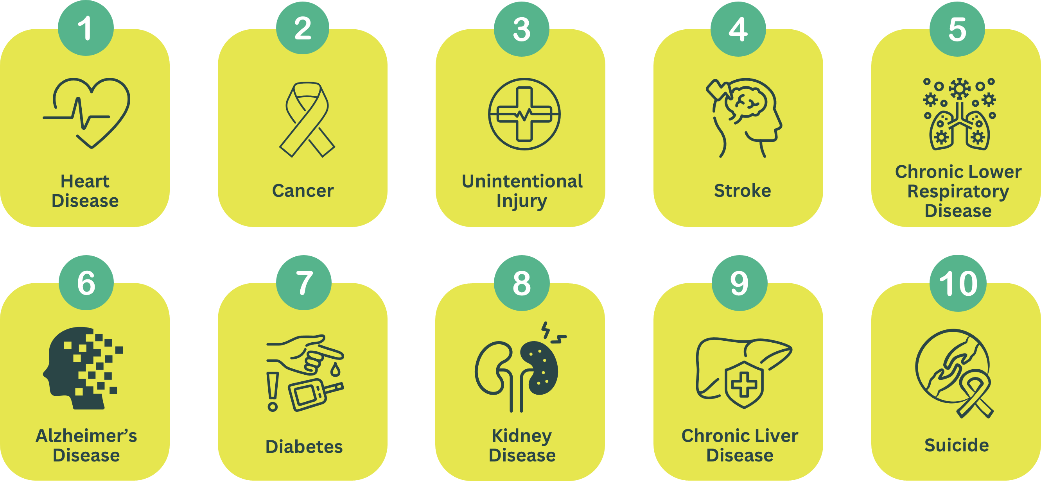
What We Currently Know - Leading Underlying Causes of Death in the US
2024 CDC Data

Slide 8
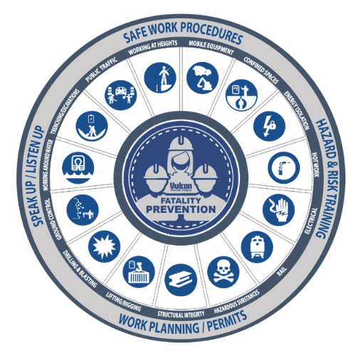
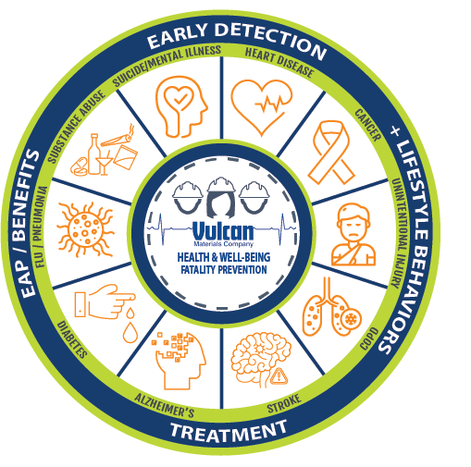
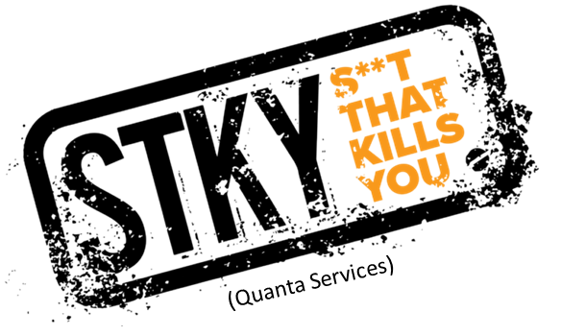
Vulcan’s Fatality Prevention Models

Slide 9
Vulcan’s Fatality Prevention Models
INCREASED RISK FOR FATALITIES

Slide 10
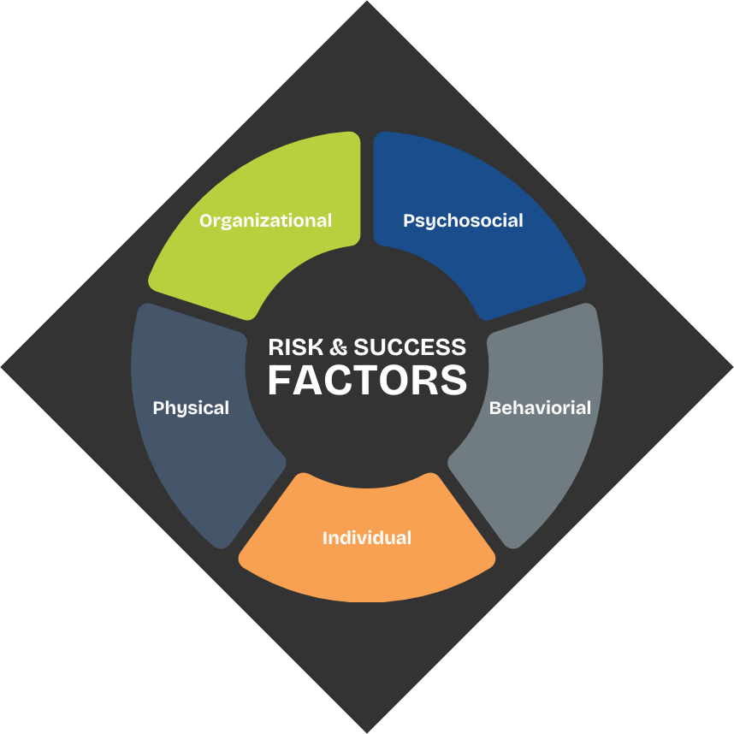
Vulcan’s Fatality Prevention Models

Slide 11
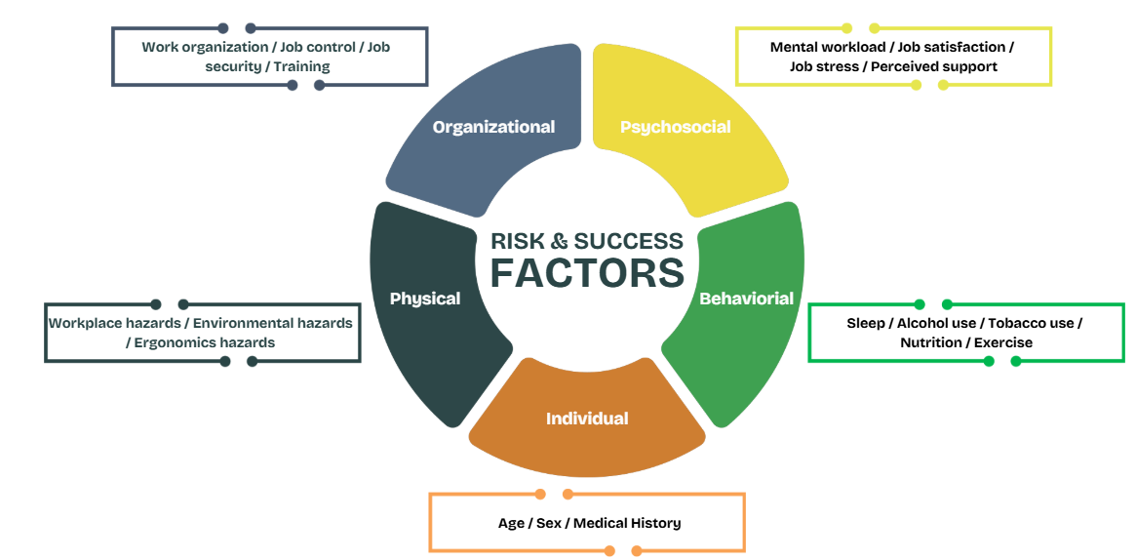
Risk & Success Factors
Adapted from “Conceptualization of MSD Risk Factors” – Accounting for Non-Physical Risk Factors in MSD Prevention NSC MSD Solutions Lab

Slide 12
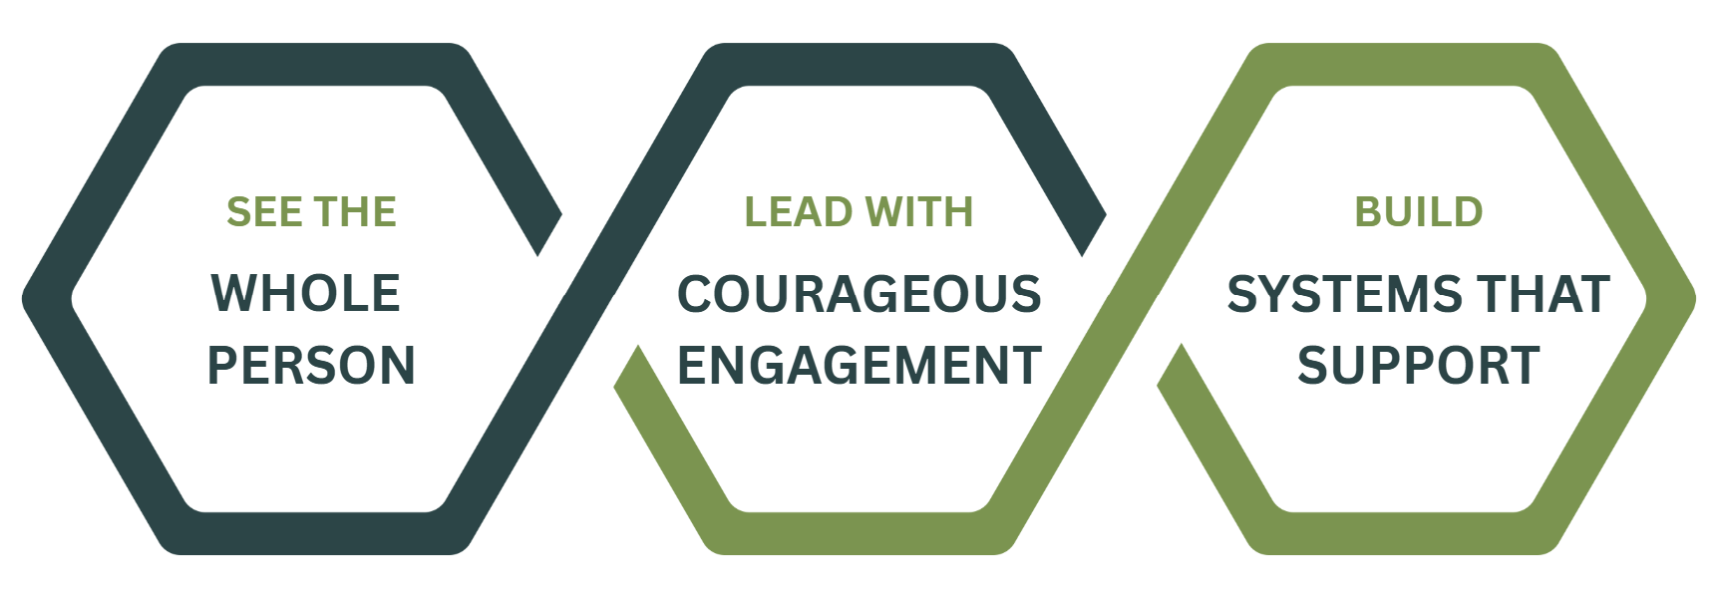



Building a Safe Space / Supportive Environment

Slide 13
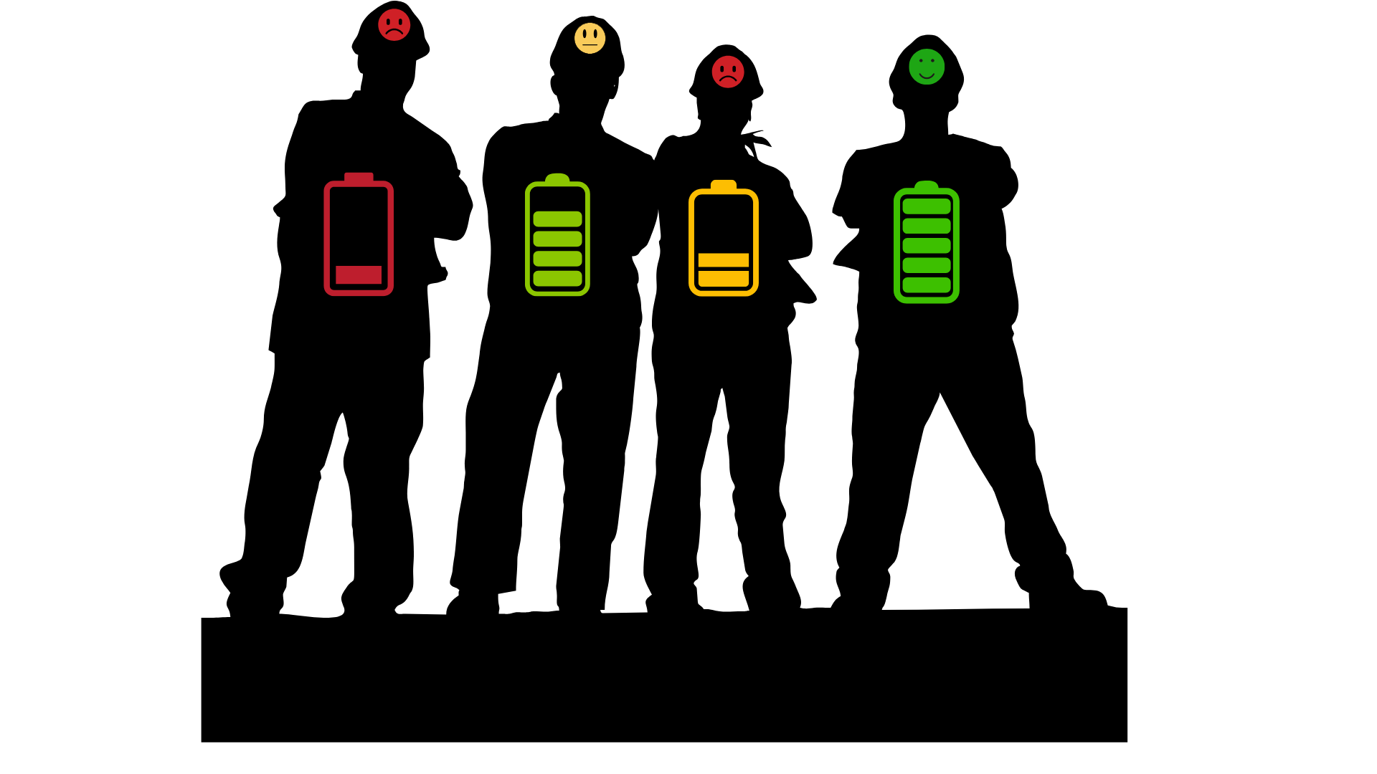
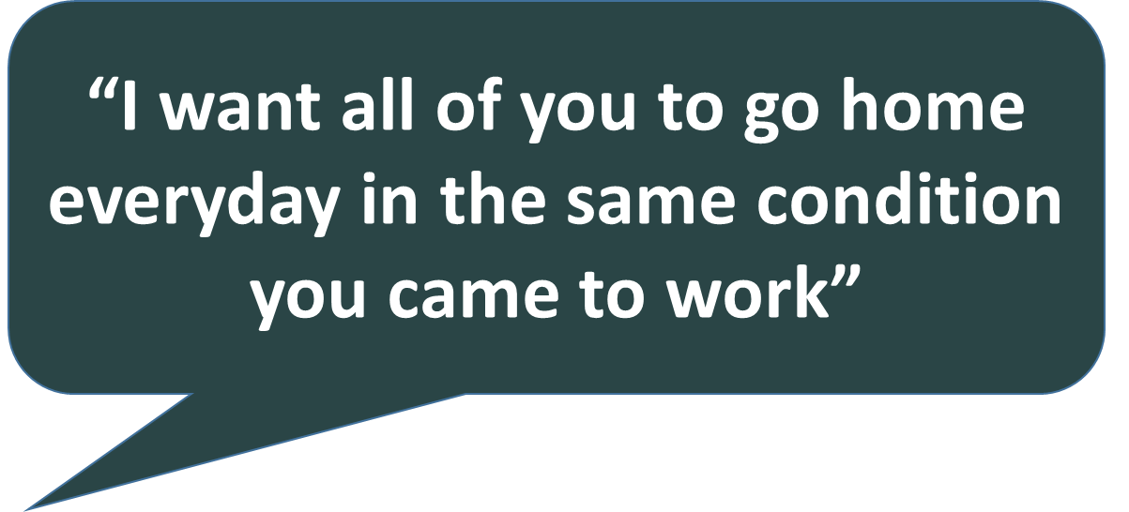


Start with What We Say

Slide 14

Start with What We Say
"Our goal is for you to go home every day even better than when you arrived—healthier in body and mind, more skilled in your craft, and feeling more supported as a person."
“We will help you thrive”
“We won’t hurt you”

Slide 15


Slide 16
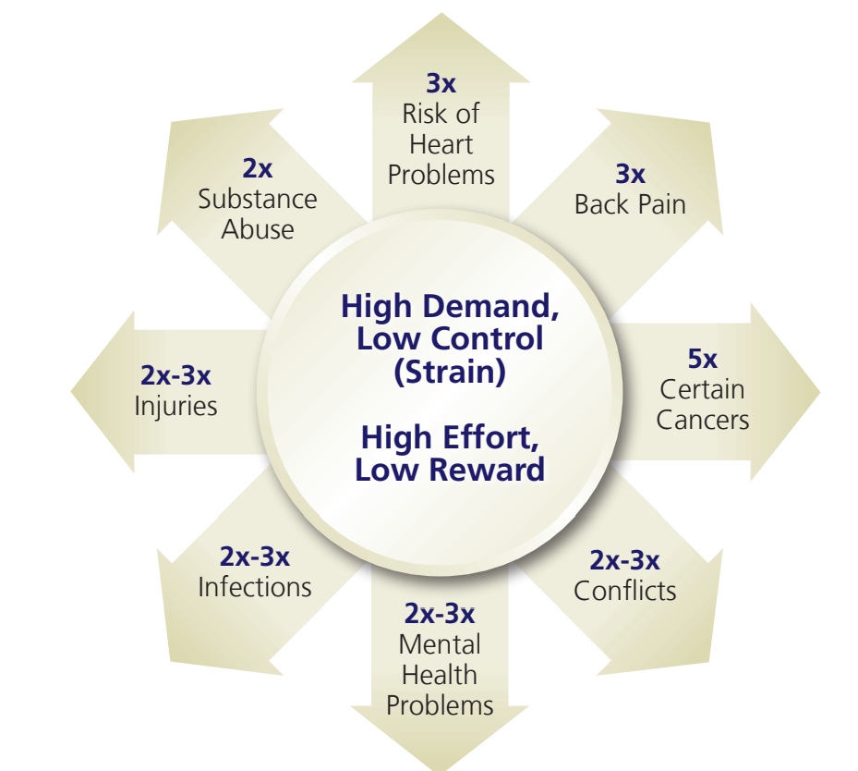
Organizational and Psychosocial Risks
Negative Outcomes
Exposure to psychosocial hazards can result in various negative outcomes, such as:
  Work-related stress and burnout
  Depression and anxiety disorders
  Post-traumatic stress disorder
  Musculoskeletal injuries and chronic diseases
  Work-related fatalities.
  Absenteeism and reduced productivity
  Suicide
  Opioid use disorders or overdose
Source: Conducting a Psychosocial Risk Assessment: A Guide for Employers – https://elker.com
Source: The Business Case for a Healthy Workplace - Industrial Prevention Association (2007)

Slide 17




Organizational and Psychosocial Risks
Control vs. Influence
OVERWHELMED
How Employees Come To Work
STRESSED
Work Conditions Encountered By Employees While At Work
COPING
CONTENT
Adapted from The Business Case for a Healthy Workplace - Industrial Prevention Association (2007)

Slide 18


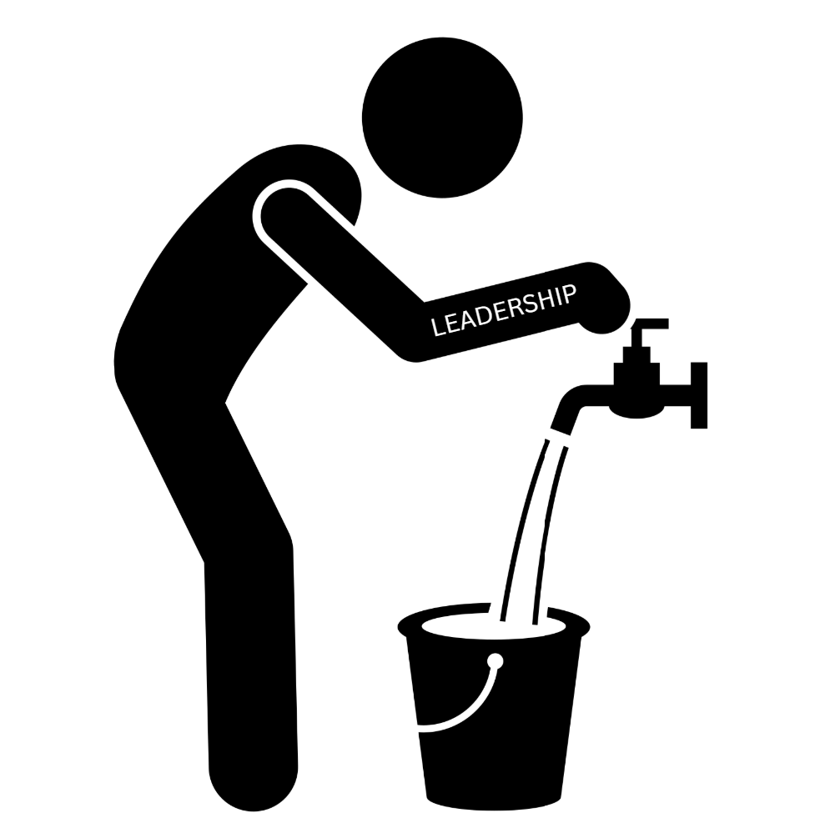
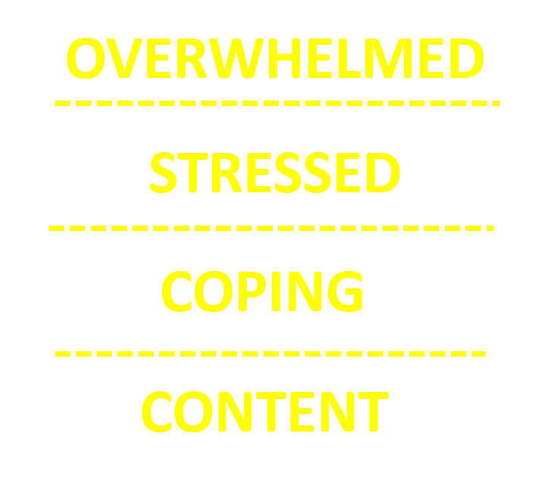
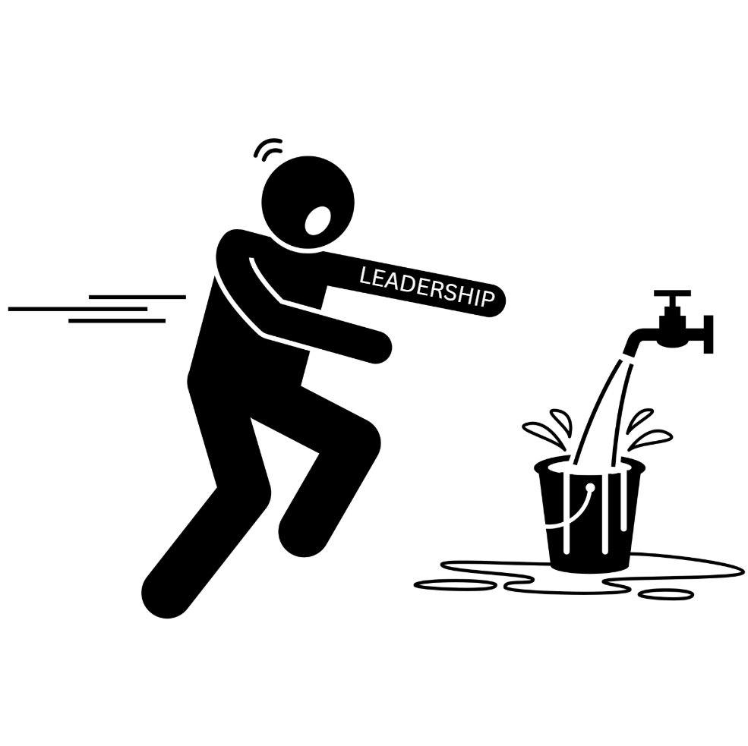
Organizational and Psychosocial Risks
Employee Engagement
Leaders CAN and SHOULD control the flow in the workplace.
From the Head Down?
From the Shoulders Down?

Slide 19
Organizational and Psychosocial Risks
Employee Engagement
From the Head Down?
Potential Areas of Engagement
SIF/critical control validations
Incident investigations
Safety meetings
Pre-work planning (JHA/JSA)
Surveys
From the Shoulders Down?

Slide 20

Organizational and Psychosocial Risks
Employee Engagement
Mental Health by Stealth
  Leverage existing safety channels
  Speak the language of the workers
  Embedded in leadership training
Shoulder-to-Shoulder
  Walk and talk
  Drive and talk
Done in the field where the work is performed.
Image Credit: Adobe Stock
¹Adapted from Suicide Prevention Among Leaders within the Construction Industry Presentation (2024) – Dr. Andy Walmsley www.toolsforyourmind.com– 2024 Construction Working Minds Conference

Slide 21

Organizational and Psychosocial Risks
Employee Engagement – Don’t forget about the Leaders
Our leaders are overwhelmed with competing priorities.
Being asked to get more done with less.
Dealing with mistakes, scheduling, supply chain, budgets, etc.
Long hours away from their family
Dealing with difficult workers
Dealing with injuries
Managing their boss(s)

Slide 22

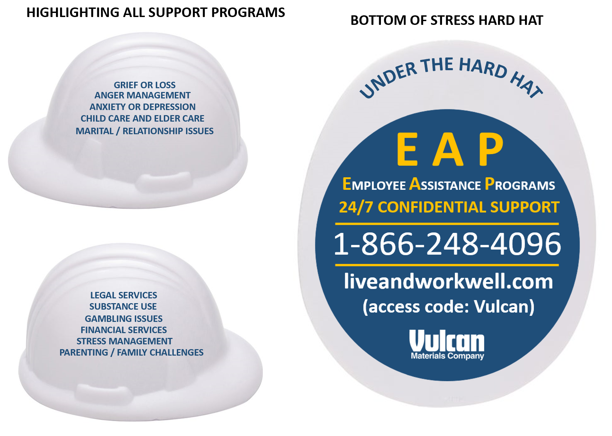
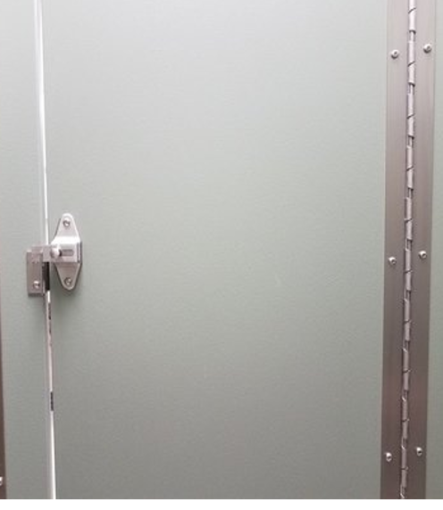


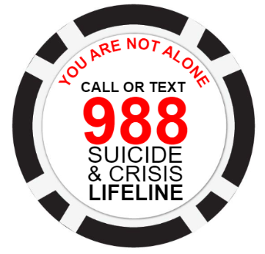
EAP Awareness

Slide 23
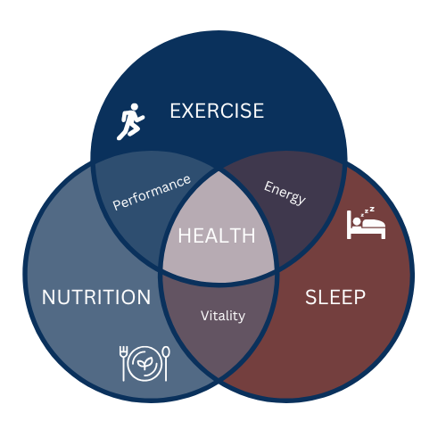
Behavioral and Individual Risks
IMPROVED MENTAL HEALTH
SMOKING CESSATION
ALCOHOL CONSUMPTION
STRESS REDUCTION
IMPROVED PHYSICAL HEALTH
SOCIAL

Slide 24
Behavioral and Individuals Risks
Meet People Where they Are
Fitness & movement support
  Different age groups and job functions may need different programs – no one size fits all.
Sleep & fatigue management
  CPAP machines and support, optimize work schedules and recovery time.
Nutrition support
  Offer healthy options at work and work functions, offer discounts on meal-prep meals, focus on nutritional factors that support sleep and fatigue management.
SMOKING CESSATION
ALCOHOL CONSUMPTION
STRESS REDUCTION
SOCIAL

Slide 25


Slide 26
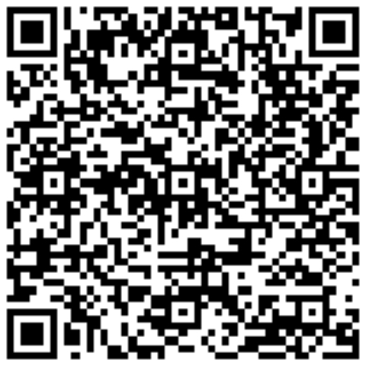
THANK YOU!!!
SCAN TO CONNCET

