Slide 1

Frontiers of AI Application in Highway Construction
Agenda:
- What is AI?
- What Are State DOTs doing about AI?
National Peer Exchange Highlights
- How Can Industry Prepare for AI? Contractor and Asphalt Producer Action Plan
Overview of AI Adoption and Implementation Strategies
March 12, 2026
Amlan Mukherjee, PhD, PE
Senior Director, Sustainability & Intelligent Construction

Slide 2
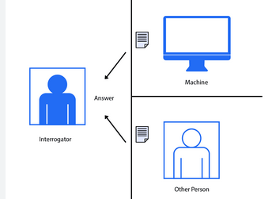

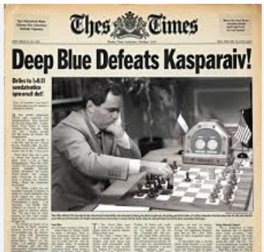
What is Artificial Intelligence?
1950
‘AI’ Term Introduced
at Dartmouth
1956
The Turing Test
Proposed
1997
Deep Blue Defeats
Gary Kasparov
Transformer
Architecture
Large Language
Models
2012
2017
2022
Deep Learning
Breakthrough

Slide 3
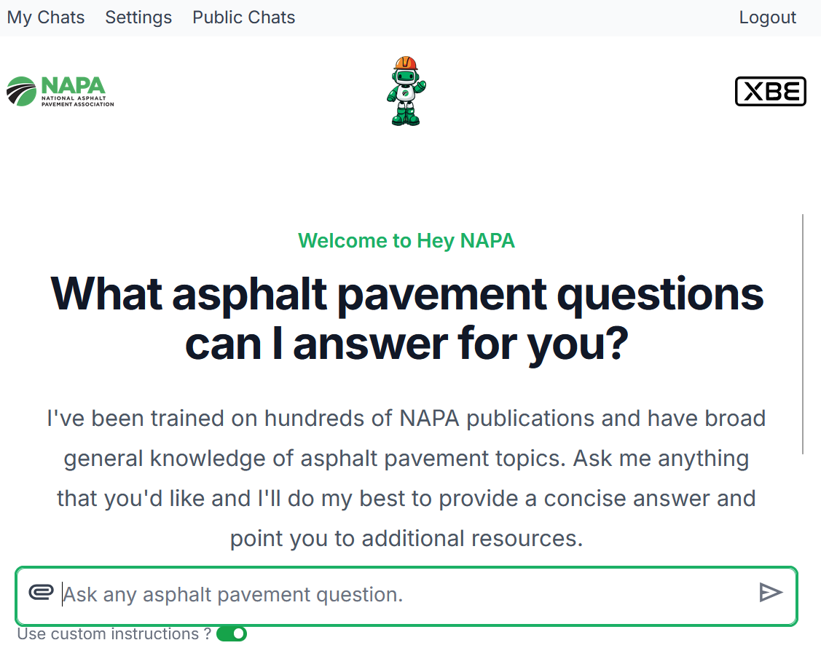

Slide 4
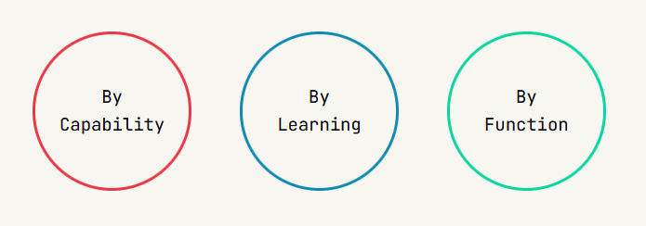









How Can We Classify Different Kinds of AI
What tasks can they perform?
Computer Vision
Robotics
Predictive Analytics
Simulation Systems
Generative AI
How intelligent are they?
Designed and trained for specific tasks. Domain specific, Large Language Models, Chat bots, Agents
Narrow AI
Human level intelligence capable of working across domains; Reasoning, Planning, Learning from Experience
General AI

Slide 5
How Can We Classify Different Kinds of AI
Type of Data
How the Data is Processed
Expected Outcomes
Labeled/ Unlabeled Data
Trial & Error: Reinforcement Learning
Predictions
Development of New Representations
Raw Unprocessed Data
Model Training
How do they learn?
Pattern Discovery
Mixed Data
Task Completion
Level of Supervision

Slide 6




A Sequence of Interactions – Plant to Pavement
Predictive Analytics
Robotics
Simulation Systems
Computer Vision

Slide 7
National Peer Exchange Highlights Urgent Need for AI in Transportation
Lessons From DOT Peer Exchange 2024

Slide 8
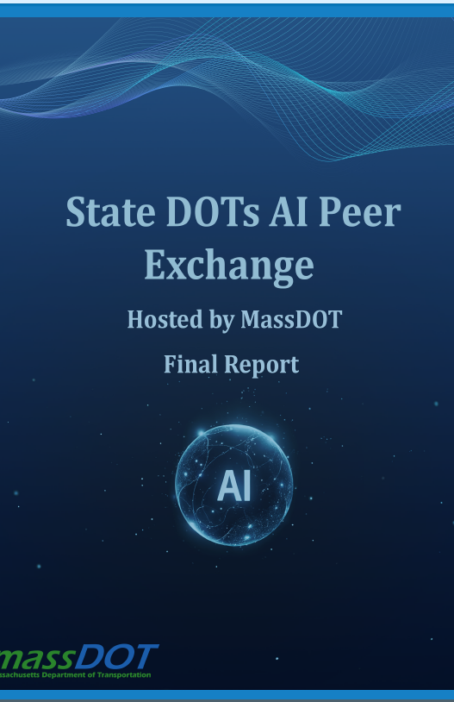
Key Challenges Identified: Expertise, Data Quality, Processes, And Policies
Lack of AI Expertise
  59% of agencies identify insufficient AI expertise as the biggest barrier to successful implementation.
Data Quality Concerns
  52% of agencies cite poor data quality as a critical concern affecting AI project outcomes.
Unclear or Untested Processes
  43% report having unclear or untested AI deployment processes, risking project delays or failure.
Lack of Standardized Policies
  26% lack standardized policies for AI deployment, leading to fragmented and risky implementation.
Notes:
The Massachusetts Department of Transportation (MassDOT), in partnership with Northeastern University, hosted the second peer exchange among state DOTs on October 1-2, 2025. Fourteen state Departments of transportation, along with the American Association of State Highway and Transportation Officials (AASHTO), the Transportation Research Board (TRB), and stakeholders such as the Federal Highway Administration (FHWA), private sector partners, and academic institutions convened in Boston for the second national DOT AI Peer Exchange.

Slide 9

Three Pillars for Successful AI Adoption in State DOTs
Strategic Frameworks & Governance
Updating procurement processes; streamlining pilot-to-deployment transitions and using innovative contracting methods.
Data Excellence
Eliminating data silos, establishing common data standards and creating shared data repositories.
Workforce Readiness
Coordinate on training programs, AI ethics guidelines, and knowledge sharing.
Notes:
Strategic Frameworks & Governance: Each DOT needs an AI strategy, but these should align nationally so that standards and approaches are interoperable . Some states (e.g. Texas and California) have invested heavily in strategic AI plans, conducting extensive interviews and focus groups to identify use cases (Texas identified 230 use cases; California gathered ~80 ideas). Others are still at early stages. A critical shared obstacle is outdated procurement processes – traditional multi-month procurement cycles can’t keep up with fast-moving AI tech. DOTs reported that procurement reform is essential, for example by streamlining pilot-to-deployment transitions and using innovative contracting methods.
Data Excellence: “Bad data in, bad data out” was a constant refrain. DOTs realized that data governance and quality are make-or-break for AI success . Many agencies still struggle with siloed, inconsistent datasets. Critical needs include breaking down data silos, establishing common data standards, and creating shared data repositories among agencies. Several leading states are investing in modern cloud data platforms (e.g. MassDOT, TxDOT, FDOT have moved to cloud-based data hubs). Data quality control frameworks with confidence thresholds are emerging (Kentucky’s virtual assistant requires a 90% confidence level before acting). Collectively, DOTs see that without trustworthy data, AI projects can flounder or produce misleading results. Thus, data management improvements are being baked into future requirements.
Workforce Readiness: Implementing AI is as much a people challenge as a tech challenge. DOTs are grappling with how to upskill their workforce and hire new talent in AI roles. Many HR classification systems lack modern AI-related job titles, hampering recruitment. According to the exchange, 71% of DOTs are experimenting with tools like OpenAI GPT or coding assistants for staff, but training approaches vary widely. Several agencies are uncertain which AI competencies to build in-house versus outsource. Recognizing these common issues, DOTs are starting to coordinate on training programs, AI ethics guidelines, and knowledge sharing. For example, some DOTs (UDOT in Utah) now mandate citation of sources for AI-generated content to ensure accountability. Others recommend it or have not defined it yet, indicating an area for alignment. Overall, there’s momentum to share best practices on job training, create communities of practice, and even develop new job classifications suited for AI work in transportation agencies.

Slide 10
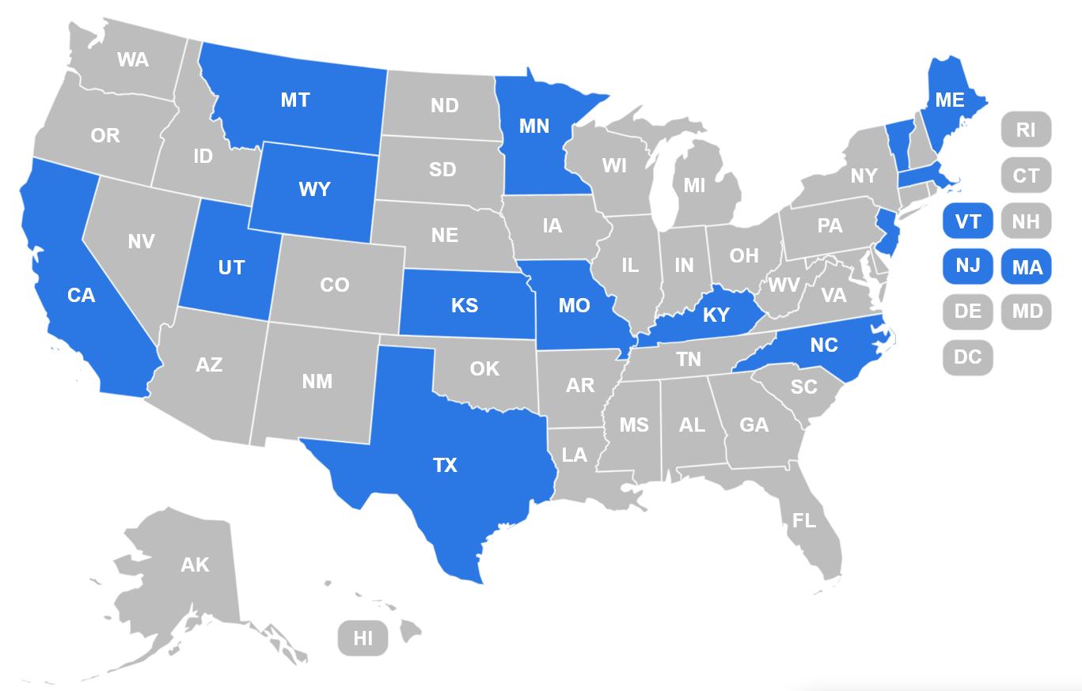
DOT Adoption Patterns
AI use cases: Data Analysis/Management (24%), Asset Management (21%), Safety (20%), Traffic Operations (19%)
71% are using Large Language Models or coding agents
41% want a “mixed” approach over the next 12 months: more autonomy for low-risk AI, more control for high-risk applications
24% want to build AI capability before deciding on governance structures
States with AI Policy in Place
Notes:
States in blue in the map have AI policies in place for DOTs. Typical policy efforts include:
Data and AI Governance Programs – NCDOT
NJDOT employees have access to the NJ AI Assistant, a generative artificial intelligence chatbot, contingent upon completing the “Responsible AI for Public Professionals” training to ensure its ethical use.
Montana DOT hired an AI officer that is a direct report to the Chief Information Officer.
Massachusetts IT is developing a risk assessment framework that surveys all DOT business units to assess AI readiness. AI software procurement mechanisms are still being finalized, but several groups, such as Geographic Information System (GIS) team, have already begun applying machine learning and AI workflows. These efforts are coordinated with statewide technology agencies, including the Executive Office of Technology Services and Security (EOTTSS), to ensure the safe and compliant acquisition of AI software.

Slide 11
How Can Industry Prepare for AI in Construction
Lessons From DOT Peer Exchange 2024

Slide 12
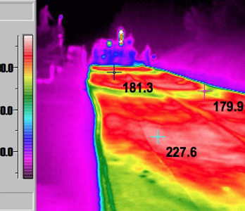
Contractor & Asphalt Producer Action Plan: Technology Investments
Upgrade fleets:
Intelligent compaction rollers
Thermal profiling
GPS-guided & AI enabled milling/paving systems, including Smart screeds
Automated Machine Guidance (AMG) and robotics to improve precision.
Drones and autonomous systems for paving and inspection.
Modernize asphalt plants:
Automated burner controls
Sensor-based material handling
Real-time mix adjustment systems
Notes:
AI is transforming highway construction and what contractors and asphalt producers need to do to stay ahead. State DOTs are embedding AI into their operations, and this is changing the expectations for how projects are delivered—from equipment to data to workforce skills.
DOTs are raising the bar on performance and quality, and AI-enabled machinery is becoming essential. Intelligent compaction rollers, smart screeds, and GPS-guided paving systems help meet tighter specs. At the plant level, automation improves consistency and reduces waste. Investing now ensures you’re ready for future bid requirements.

Slide 13

Contractor & Asphalt Producer Action Plan: Process Changes
Planning, Monitoring & Procurement
AI-based scheduling tools enable predictive planning and dynamic updates.
AI-powered inspection tools (e.g., computer vision) support remote compliance checks.
Contracts may require digital inspection records and automated analysis.
Procurement models are shifting toward pilot programs and performance-based contracts.
Notes:
Technology is only as good as the people using it. Contractors should train crews on AI-integrated equipment and designate tech champions to lead adoption. Hiring data-savvy staff or consultants can help manage analytics and compliance. And don’t forget to create internal AI policies—DOTs are doing it, and contractors should too.

Slide 14

Contractor & Asphalt Producer Action Plan: Data & Digital Readiness
Standardize data collection
Ensure compatibility with DOT platforms
Participate in pilot programs and data-sharing initiatives
Examples of Enhanced Data & Digital Deliverables
E-ticketing and real-time data logging are replacing paper workflows.
Digital as-builts and 3D models are becoming standard.
Intelligent QC/QA systems (e.g., compaction maps) are required.
Environmental Product Declarations (EPDs) are increasingly mandated.
Notes:
Data is becoming a deliverable. DOTs want e-ticketing, digital as-builts, and automated quality control. Contractors must standardize data collection and ensure compatibility with DOT platforms. Participating in pilot programs and industry data-sharing initiatives will help you stay aligned with evolving expectations.
This includes real-time tracking of materials, digital models of completed work, and automated quality control data. These data streams feed AI systems for analysis and decision-making.

Slide 15

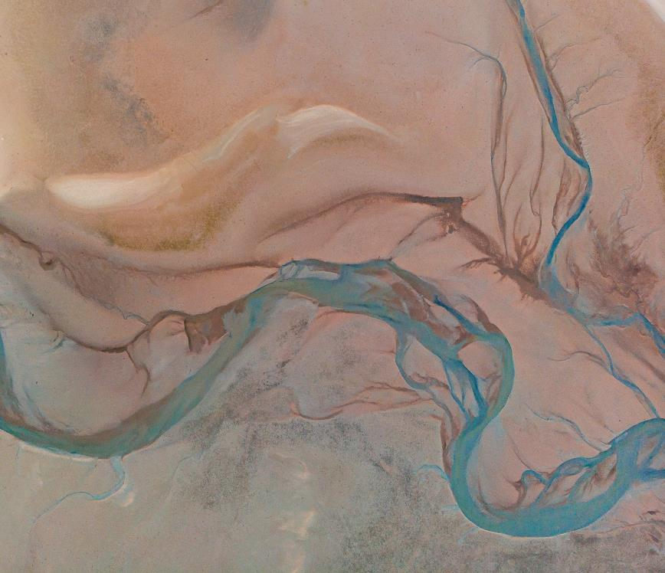
Contractor & Asphalt Producer Action Plan: Workforce & Skills
Training
Train crews on AI-enabled equipment
Designate tech champions internally
Hire data specialists or consultants
Create internal AI usage policies
Notes:
Technology is only as good as the people using it. Contractors should train crews on AI-integrated equipment and designate tech champions to lead adoption. Hiring data-savvy staff or consultants can help manage analytics and compliance. And don’t forget to create internal AI policies—DOTs are doing it, and contractors should too.
AI is changing how projects are managed. DOTs are using AI to monitor progress, inspect work, and evaluate contractor performance. This means contractors must be agile, data-driven, and transparent in their operations.

Slide 16




But where do you fit in?
Software
z
Strategic
Competitive
Advantage
Required
Voluntary
Operational
Competitive
Advantage
Hardware
Notes:
Consider where specific activities outlined in the previous slides fall within this grid. This could be an interactive activity.
Message:
Recognize that AI provides a competitive advantage and hence more organizations may be adopting it than apparent.
The advantage can be either through more automation at the construction site or asphalt plant operations; or it could be applications in software intelligence based in machine learning and predictive analytics to support strategic advantages during project bidding and other construction management processes.
DOTs are increasingly requiring more technology-based reporting including the adoption on open APIs for communication and reporting and potentially automated inspection.

Slide 17
Area | AI-Driven Requirement
Data Deliverables | Real-time logs, digital models, EPDs
Equipment | Smart rollers, guided pavers, drones
Quality Control | Intelligent compaction, automated QC/QA
Project Management | AI scheduling, remote inspection
Safety | Intrusion detection, AI risk assessments
Conclusion: Change Expectations
Notes:
What ever happens, expect and prepare for significant disruptive change.

