Slide 1
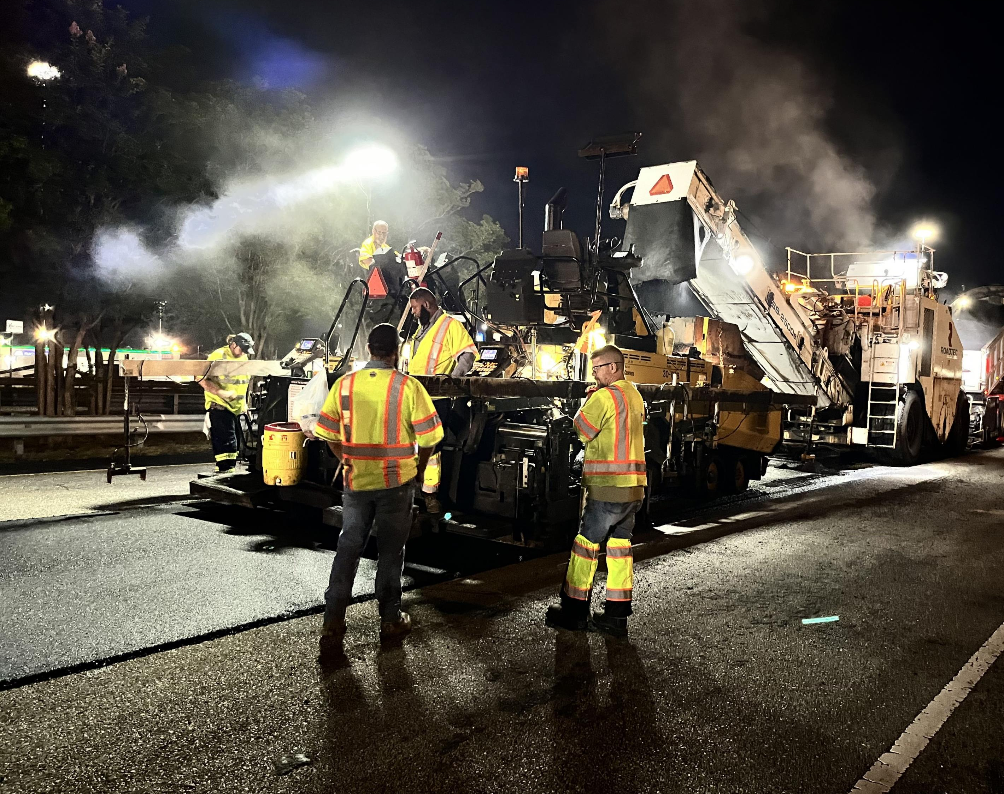


35th Annual
Alabama Asphalt Pavement Conference
March 11-12, 2026
Stacey N. Glass, P.E.
State Construction Engineer

Slide 2
Agenda
Maintenance Resurfacing Program
Project Close Out
  FQ/FE Subcommittee
2026 Anticipated Holiday Lane Closures
New 2026 Spec Book
  Note: CPM 240 WDs ILO 180 WDs included in 2026 book
e-Ticketing Update
  DBE Program Update

Slide 3
Fiscal Year 2026 Resurfacing Program
Interstate Maintenance (IM) – $190 Million
Federal-aid Maintenance (FM) Resurfacing – $270 Million

Slide 4
FY26 IM Resurfacing Program
$190M budgeted for IM FY26 program
Planned to let 21 projects
  3 projects have let as of the February letting
7 pavement preservation projects
  5 PM2 projects
  2 PM1 projects
  Covering 4 Areas
Notes:
5 PM2 Projects:
I-459 Jefferson Co.
I-59 Tuscaloosa & Sumter Co.
I-22 Walker Co.
I-85 Montgomery
3 PM1 Projects:
I-22 Marion Co.
I-65 Elmore Co.

Slide 5
FY26 IM Resurfacing Program
3 PMR (pavement minor rehabilitation) Projects
8 Other Projects
  1 safety project (split funding between IM and HSIP)
  1 guardrail project (split funding between IM and HSIP)
  4 sign replacement projects
  1 drainage project
  1 unclassified project
  1 bridge deck hydrodemo
  2 additional lane projects (IM funding resurfacing only)
Notes:
3 PMR Projects:
I-85 Montgomery Co.
I-65 Cullman Co.
I-65 Blount Co.
8 Other Projects:
1 safety project – horizontal curve project for Interstate ramps and side roads – Tuscaloosa Areawide
1 guardrail project – double faced guardrail installation and drainage – Chilton Co.
4 sign replacement projects
I-59 DeKalb Co.
I-65 Cullman Co.
I-565 Limestone & Madison Co.
1 drainage project – pipe rehabilitation – I-59 DeKalb & Etowah Co.
1 unclassified project – Wallace Tunnel upgrades – I-10 Mobile Co.
1 bridge deck hydrodemo – I-65 Morgan Co.
2 additional lane projects
I-85 Montgomery Co.
I-65 Mobile Co.

Slide 6
FY26 FM Resurfacing Program
Area | Annual Budget | Percentage
Guntersville | $34,091,000 | 12.63%
Tuscumbia | $24,474,000 | 9.06%
Birmingham | $20,947,000 | 7.76%
Alexander City | $25,121,000 | 9.30%
Tuscaloosa | $23,056,000 | 8.54%
Montgomery | $35,631,000 | 13.20%
Troy | $39,005,000 | 14.45%
Grove Hill | $23,071,000 | 8.54%
Mobile | $21,314,000 | 7.89%
Fayette | $23,290,000 | 8.63%
Total: | $270,000,000 | 100.00%

Slide 7
FY26 FM Resurfacing Program
$270M budgeted for FM FY26 program
Planned to let 97 projects
57 projects let as of February letting
40 projects to let before May deadline

Slide 8
FM Resurfacing Program
5 Year Summary
 | 2021 | 2022 | 2023 | 2024 | 2025
# PROJECTS | 107 | 106 | 99 | 92 | 96
# CL MILES | 611 | 640 | 535 | 534 | 556
# LANE MILES | 1673 | 1684 | 1496 | 1484 | 1562
PM 1 | 15 | 15 | 10 | 20 | 15
PM 2 | 71 | 76 | 69 | 61 | 66
PMR | 21 | 15 | 20 | 11 | 15

Slide 9
Project Closeout
Project Closeout Committee Results
  CIM 1-2025
  2022 GASPs (Completion Advertisement)
  2026 Specs (Construction Acceptance Inspection)
Final Quantity / Final Estimate (FQ/FE) Committee created
  Goal = improve timeframes from issuance of FQs, concurrence of FQs, and issuance of FEs

Slide 10
Project Closeout Committee Results
CIM 1-2025 - No payment without test reports/certifications
2022 GASP 22-GA0036 - 105.15 Completion Advertisement
    3 weeks to run add (newspaper, online, or courthouse)
    Also included in 2026 book

Slide 11
Project Closeout Committee Results
  2026 Spec Book Changes
  105.15(a) – Construction Acceptance Inspection
    Engineer notifies Contractor in writing once all pay items complete
      Contractor may request a project status review in writing
      One (1) written punch list within 21 CD at time of presumptive completion (ALDOT)
      28 calendar days in lieu of 4 weeks to complete deficiencies (Contractor)
      Routine maintenance from issuance of punch list to Maintenance Acceptance required in accordance with 105.13 and 107.17
      Any item not on the punch list, nor considered deficient, may be considered extra work

Slide 12
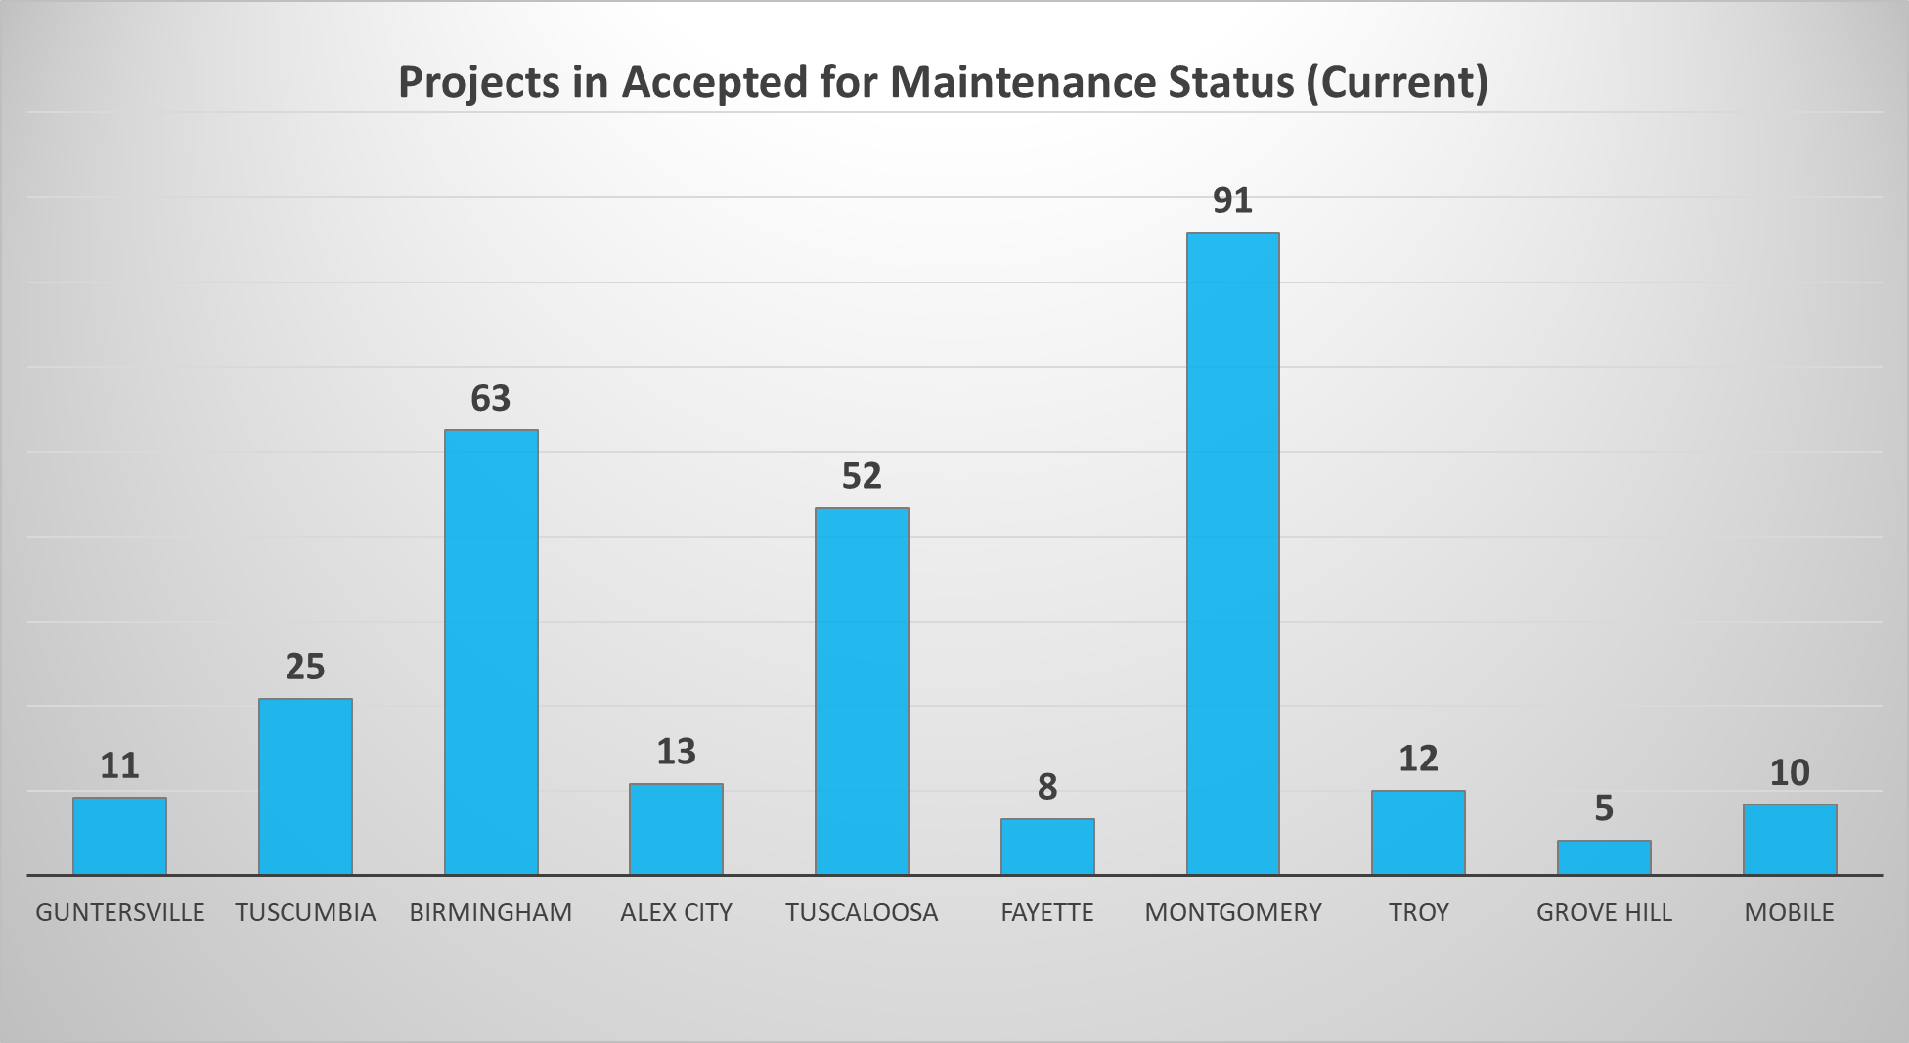
290 Projects currently in Closeout process

Slide 13
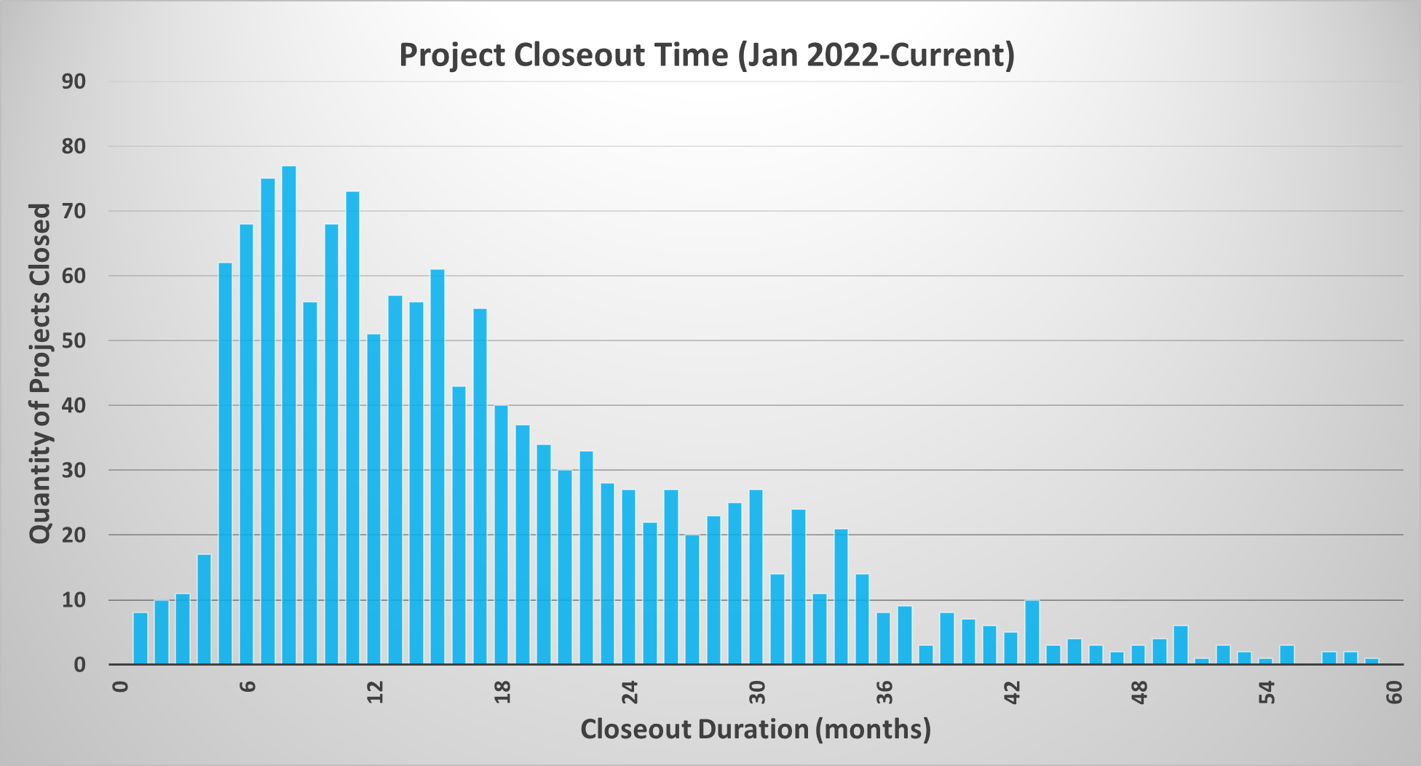
290 Projects currently in Closeout process
Over 60% of projects are
usually closed w/in 18 Months

Slide 14
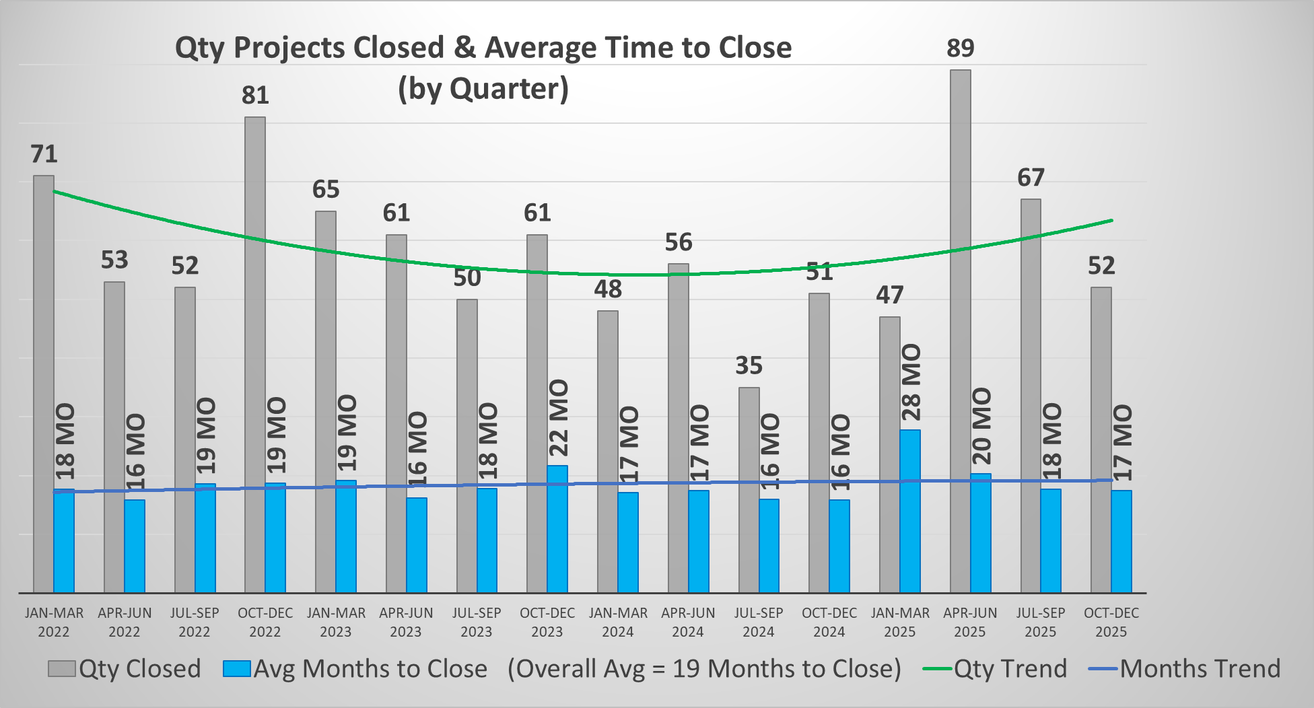
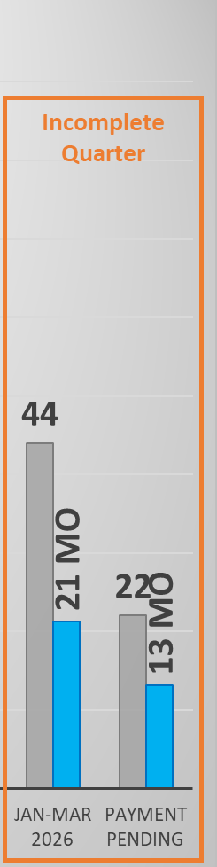
Qty trending Up
Time holding Steady

Slide 15
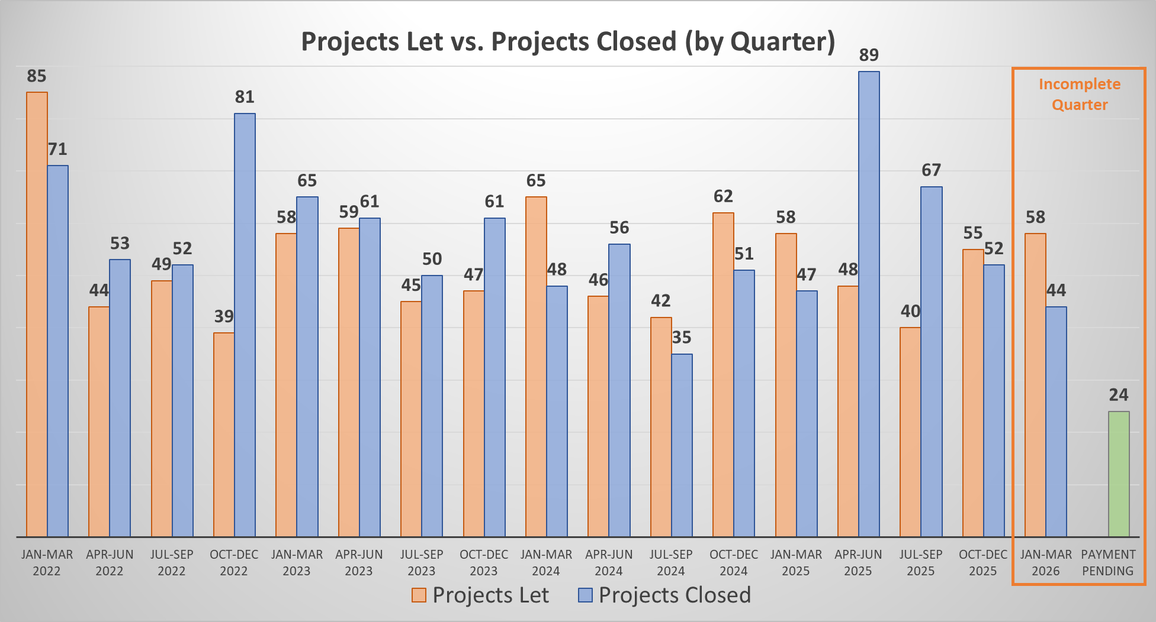
699 Let
731 Closed
(+32)
201 Let
276 Closed
(+75)

Slide 16
Project Closeout – FQ/FE Committe
Members
Stacey Glass Robert Shugart
Dudley Smith Wayne Tew
John Graham Cooper Calhoun
Jonathan Johnson Sam Fountain

Slide 17
Project Closeout – FQ/FE Committee
Current Spec Requirements
FQ issuance = 60 calendar days
FQ review/concurrence = 45 calendar days
FE issuance = timeframe not specified
FQ/FE Committee Topics
Do these timeframes work for all projects? Other DOTs?
Interim concurrence option for some pay items/scopes?
Create chart with varying timeframes due to scope of work, contract value, contract duration, etc.

Slide 18
Project Closeout – Basic Steps
# Projects Sampled = 131 | Avg Time (months)
Accepted for Maintenance
 | 5
Final Qty to Contractor
 | 3
Concurrence w/ Final Qty
 | 7
Final Estimate Paid
Closeout Total | 15

Slide 19
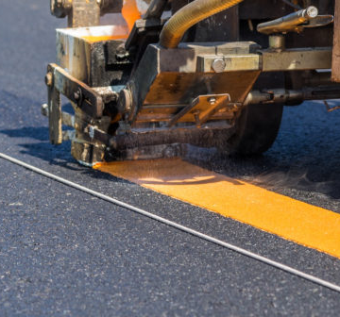
Striping Memo
Current update (2/28/2025)
  Provides guidance to hold time charges for 14 days once striping becomes the controlling item of work. Expires 12/31/2025

Slide 20
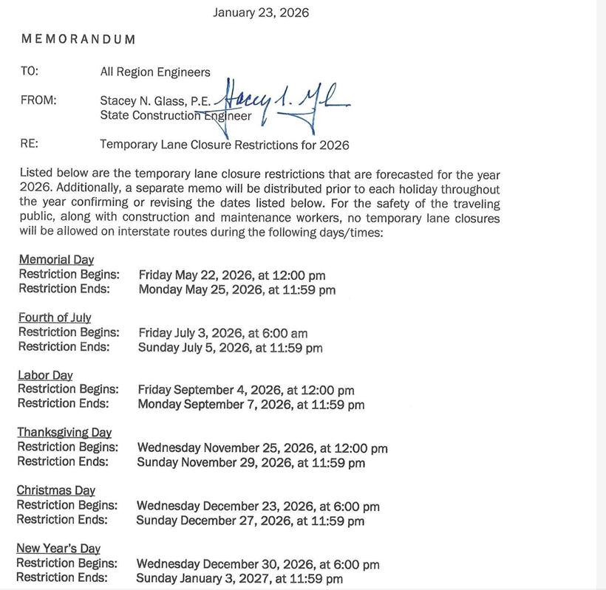
2026 Holiday Schedule for Lane Closures
Memorial Day
  Fri 5/22 at 12 PM to Mon 5/25 at 11:59 PM
July 4th
  Fri 7/3 at 6 AM to Sun 7/5 at 11:59 PM
Labor Day
  Fri 9/4 at 12 PM to Mon 9/7 at 11:59 PM
Thanksgiving
  Wed 11/25 at 12 PM to Sun 11/9 at 11:59 PM
Christmas
  Wed 12/23 at 6 PM to Sun 12/27 at 11:59 PM
New Year’s
  Wed 12/30/26 at 6 PM to Sun 1/3 at 11:59 PM

Slide 21
2025 GASPs since last AAPA Conference
GASP Number | Description | Date Effective
22-GA0008(2) | Asphalt Pavement | 11/1/25
22-GA0028(2) | Build America, Buy America Act | 10/1/25
22-GA0046(2) | Material Remixing Device | 11/1/25
22-GA0047 | Soldier Pile Retaining Wall | 7/1/25
22-GA0049 | Construction Signs | 9/1/25

Slide 22
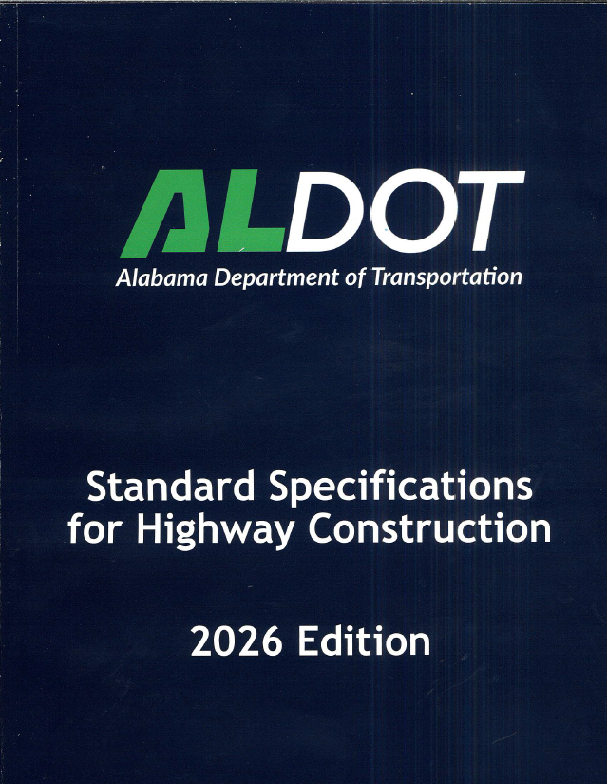
2026 Spec Book
To order a hard copy visit: ALDOT/Project Letting/Helpful Links/Construction Bureau (Specification Book) – 2026
6 GASPs currently

Slide 23
2026 GASPs
GASP Number | Description | Date Effective
26-GA0001 | Award and Execution of Contract (State Projects Only) | 1/1/26
26-GA0002 | Procurement Time | 1/1/26
26-GA0003 | Early Award | 1/1/26
26-GA0004 | Cross Slope on HMA Pavements (NHS) | 1/1/26
26-GA0005 | Cross Slope on HMA Pavements (Non-NHS) | 1/1/26
26-GA0006 | Intelligent Transportation Systems | 1/1/26

Slide 24
e-Ticketing Update
ALDOT's Construction Manual still requires paper tickets (printed e-tickets) at project closeout.
  Auditors approved removing the requirement, pending updates to reporting.
  This change will complete the transition to e-tickets.
Last major issue: Statewide data from producers on official pay items/descriptions remains inconsistent.
Solution: "Pay coding" feature is being rolled out.
  Inspector pay codes e-ticket at delivery, applying the official item name and description. While also allowing the splitting of tickets between items.

Slide 25
e-Ticketing Update
Currently in the process of connecting our CAMMS system to e-Ticketing system to push this item information for pay coding.
Paper tickets in closeout will be replaced with a detailed, itemized summary of ticket data.

Slide 26
DBE Program Update
Overview
October 3, 2025 Interim Final Rule (IFR)
Why IFR was issued?
IFR Key Impacts
ALDOT’s DBE Reevaluation docs

Slide 27
DBE Program Overview
Federally required under 49 CFR Part 26 (USDOT)
ALDOT implements and certifies through UCP (Unified Certification Program)
DBE contract goals on certain federally funded projects

Slide 28
DBE Program – Interim Final Rule
Issued October 3, 2025
Significant to DBE and ACDBE programs
Effective immediately
Eliminated race- and gender-based presumptions
Requires individuals demonstrate social and economic disadvantages
Requires re-evaluation of all existing DBE firms
What are others doing?

Slide 29
DBE Program – Why IFR was issued?
Recent court decisions challenging race-based programs
Major case determined racial presumptions likely violated constitutional equal-protection requirements
Similar rulings also questioned race-based eligibility
USDOT determined regulatory changes needed
IFR was issued immediately rather than long rulemaking process

Slide 30
DBE Program – IFR Key Impacts
Nationwide reevaluations of all DBE firms
Personal narrative required
Certification review process
Suspension of DBE goal setting
DBE program still exists, changed how firms qualify

Slide 31
DBE Program – IFR Key Impacts
Firms have two options:
Submit reevaluation materials for ALUCP review
Submit voluntary decertification affidavit if participation is no longer desired
* Note: Failure to submit within required timeframe will remain ineligible for credit.

Slide 32
DBE Program – ALDOT’s Re-evaluation docs
ALDOT DBE Reevaluation packet
  Personal Narrative (PN)
  Personal Net Worth (PNW) Statement
  Business Tax Returns
  Declaration of Eligibility (DOE)
  What are other states doing?

Slide 33
DBE Program – Other DOTs
Montana
  Reevalutions nearing completion
  Approx. 54% reduction in DBE
  Massachusetts, Connecticut, Kansas, Rhode Island
  Reevalutions not started
  Developing plan for implementation
  Texas, Georgia, Tennessee
  Modified B2G now software to manage reevaluation documentation
  Pennsylvania
  Requested documents February 5, 2026

Slide 34
DBE Program – Other DOTs
Louisiana
  Reevalutions underway
  Mississippi
  Started accepting personal narratives in January 2026.
  Expecting to reactivate program by June 1, 2026
  Florida
  In 2026, FDOT will begin implementation of a small business development program as a response to the USDOT IFR.
  Alabama
  Packet is created. When submitted, 45 day deadline to repond. Need to evaluate currently certified firms. Possibly setting goals by November 2026, maybe sooner.

Slide 35
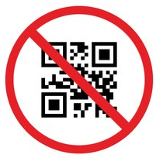
Questions
Stacey Glass
ALDOT State Construction Engineer
Office: (334) 242-6209
Cell: (334) 850-4872
Email: glasss@dot.state.al.us

