Slide 1




PRESENTED BY:
Houston Blackwood- Workforce Director

Slide 2

TrainForAlabama.com
Scan Here To Get This Presentation

Slide 3



  Division of the Alabama Community College System
  Create Skills for Success courses
  Rapid, industry-recognized non-credit training in high-demand fields
  Building a skilled workforce for Alabamians by Alabamians

Slide 4








TASK FORCE
INDUSTRY
ASKS
HANDS-ON
LAB PLAN
THE
PROCESS
ONLINE THEORY

Slide 5




ONLINE THEORY
HANDS-ON LAB
REGISTRATION
COLLEGE CREDIT
CONNECTION TO EMPLOYERS
COURSE

Slide 6








Brought to you by the Innovation Center
Industry Sectors Served
Transportation
Construction
Hospitality
Retail
Healthcare
Telecommunications
Manufacturing
Over Businesses Involved

Slide 7




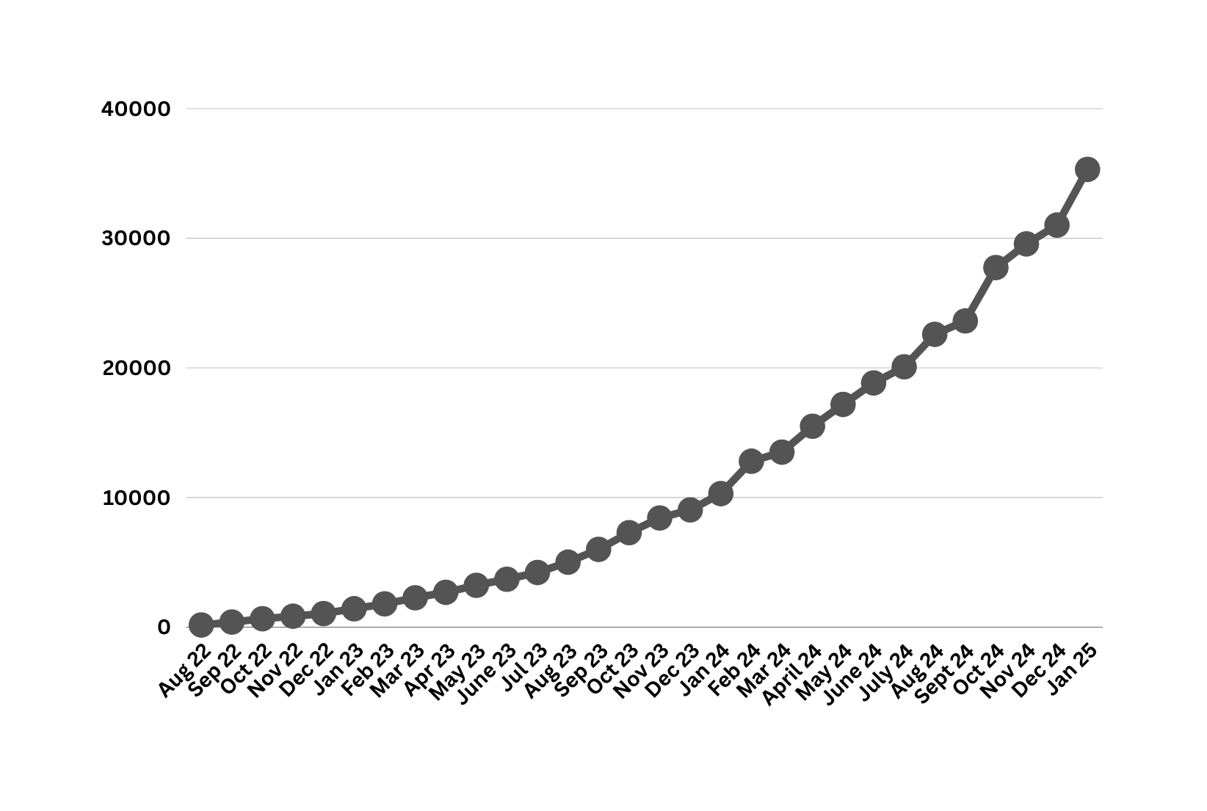


THE COMMUNITY-JOB READY!
2022-NOW - TOTAL ENROLLED
14,020
Credentials earned

Slide 8


COURSE CATALOG
  CDL A
  CDL A Theory Only
  CDL B
  CDL B Theory Only
  CDL B Passenger School Bus
  CDL B Passenger School Bus Theory Only
  CDL B + Passenger Theory Only
  CDL B + Passenger
  Passenger + School Bus
  Passenger
  Passenger Theory Only
  School Bus
  School Bus Theory Only
  CDL Behind the Wheel Only
  Hazmat
  Excavator
17. Skid Steer
18. Bulldozer
19. Asphalt Roller
20. Fiber Optics Tech and Installer
21. Manufactured Home Installer Helper
22. Food and Beverage
23. Hotel Operations
24. Retail Meat Cutter
25. Mental Health Worker
26. Carpentry Helper
27. Electrical Helper
28. Land Survey Technician
29. Community Health Worker
30. Customer Service
31. Barista
32. Veterinary Assistant
33. Ambulance Operator/EVOC
34. Flooring Installation Technician
35. Motor Grader Operator
36. Forklift Operator
37. Concrete Mixer Truck Driver
38. Plumbing Assistant
39. Nursery Landscape Worker
40. Machine Operator
41. Nursing Support Technician (NST)
42. Biotechnician
43. Dual Enrollment Orientation
44. Water Treatment Operator Grade 2
45. FAME Mentorship
46. Propane Technician
47. Asphalt Lab Technician

Slide 9
HEO Completers
  Bulldozer – 1350
  Excavator – 3364
  Roller – 4587
  Skid Steer - 11421

Slide 10

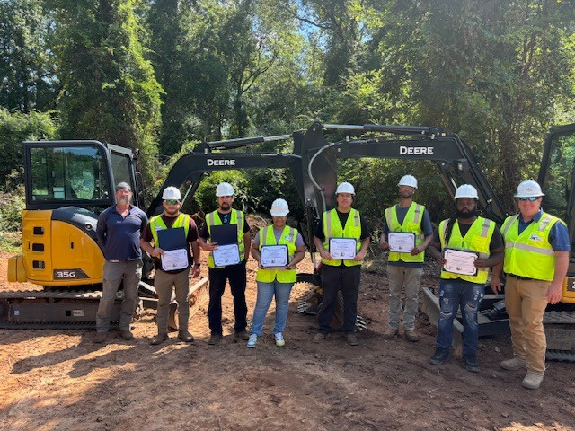

High Schools
106 School Systems offered Skills for Success courses
251 schools/Career Technical Education Centers

Slide 11

COURSES IN DEVELOPMENT
Screed Operator
Paver Operator
Operator Tech Automotive
Drone Operator
Shuttlebuggy
Roof Framing
Customer Relations
Decentralized and onsite Wastewater Treatment Operator
Heavy Equipment Mechanic Assistant

Slide 12
Asphalt Lab Tech
  Skills
  Understand and follow lab safety procedures and guidelines for conducting asphalt and aggregate sampling and tests.
  Identify equipment used in asphalt lab testing.
  Maintain laboratory equipment in proper working order, perform calibrations, and ensure cleanliness and safety in the lab.
  Understand the process of aggregate sampling.
  Perform asphalt mix and aggregate tests including gradation (sieve analysis), specific gravity (Gmm, Gmb), percent water absorption, and moisture content.
  Perform basic math calculations required for asphalt laboratory testing and evaluation.
  Be familiar with required AASHTO, ASTM, and ALDOT standards and specifications.
  Accurately document test results.

Slide 13
Asphalt Lab Tech
  Lab Activities
  Safety
  Equipment Identification, Calibration, Inspection
  Sample Size Reduction for Coarse and Fine Aggregates
  Student Performs Aggregate Gradation Testing (Sieve Analysis)
  Student Performs Coarse and Fine Aggregate Testing for Specific Gravity, Moisture Content, and Absorption Levels
  Student Performs Asphalt Mixture Testing for Maximum and Bulk Specific Gravity

Slide 14
Asphalt Lab Tech
  Status
  Ready for Pilot
  Central Alabama Community College will host
  Dunn Construction Asphalt Laboratory will be used
  NEEDS- Instructor

Slide 15
Screed
  Skills
  Explain screed controls, their functions, and purposes in operations.
  Follow safety protocols and PPE requirements to meet industry standards.
  Demonstrate OSHA knowledge and its impact on paving operations.
  Analyze mat defects, document causes, and implement remedies for quality.
  Assemble and disassemble auger extensions for accurate material flow control.
  Operate augers to regulate material flow based on specifications.
  Assess drainage patterns to prevent water pooling and birdbaths.
  Align longitudinal joints precisely for smooth and consistent pavement edges.
  Set up, adjust, and remove paving electronics for calibrated operations.
  Operate screed controls to verify functionality and prevent mat damage.
  Interpret gauge and sensor data to enhance paving accuracy.

Slide 16
Screed
  Skills
  Troubleshoot malfunctions, document findings, and implement corrective actions effectively.
  Predict material flow issues and proactively adjust to ensure efficiency.
  Communicate clearly with crew members to ensure smooth paving workflows.
  Collaborate with the team to maintain quality and achieve goals.
  Remove and clean mix from equipment to maintain functionality.
  Inspect, clean, and prepare equipment for the next day’s use.
  Document maintenance and checks to ensure compliance and accountability.
  Assess equipment condition daily to address maintenance needs promptly.
  Critique projects to identify improvements and recommend necessary adjustments.
  Propose innovations to enhance efficiency, reduce costs, and improve quality.
  Know and understand all basic paving principles
  Constantly measure material to ensure adequate thickness.

Slide 17
Screed
  Lab Activities
  Perform/Practice Identification of Screed Components
  Perform/Practice Safety Protocols and PPE Requirements
  Perform/Practice Screed Operation Procedures
  Perform/Practice Post-Operation Procedures
  Perform/Practice Common Troubleshooting
  Status
  20% complete
  Task Force Reviewing Skills and Lab Plan

Slide 18
Paver
Skills
Understand safety procedures in paver operation.
Understand construction site safety.
Demonstrate an awareness of personnel, obstructions, and obstacles while operating a paver.
Identify major operational components of the paver.
Identify critical safety areas of the paver, pinch points, crush areas, moving chain conveyors, turning augers.
Perform a pre-operation inspection.
Perform minor servicing and maintenance and refer major problems to the supervisor.
Safely operate the paver.
Follow paver proper start-up and shut-down procedures.
Safely control the paver speed (rate of placement) and alignment.

Slide 19
Paver
Skills
Ensure that an adequate/proper amount of material is placed in the hopper.
Thorough understanding of all aspects of the paving industry, including
preparatory work, grades, drainage, paving patterns, aggregate size, job
specifications, oil consistencies, compaction, and other details related to
Asphalt paving.
Take physical measurements of the material being placed (stick method) and use formulas to calculate spread rate.
Safely control and operate the screed on an asphalt paving machine.
Make adjustments to the paver screed based on project requirements and measurements.
Control material taken into the paver and the depths of material distributed through the machine.
Ability to add, subtract, multiply, and divide in all units of measure using
whole numbers, common fractions, and decimals.

Slide 20
Paver
Lab Activities
Perform Safety Procedures and Protocols
Identifies all Operational Components
Perform/Practice a Pre-Operation Inspection
Perform/Practice Basic Operational Maneuvers
Perform/Practice Material Management/Loads
Perform/Practice Paving Techniques
Status
20% complete
Task Force Reviewing Skills and Lab Plan

Slide 21
Shuttlebuggy
Skills
Explain the controls, functions, and operational intent of the Shuttle Buggy, focusing on their role in paving efficiency.
Apply safety protocols, including speed control, maintaining proper distance from the paver, and securing the machine during parking, to adhere to industry standards.
Operate the boom and manage material flow into the paver's hopper box to maintain continuous and efficient paving operations.
Monitor material temperatures and adjust delivery speed to meet project specifications and crew feedback, ensuring uniform paving.
Adjust machine settings and material flow to prevent hopper clogging and maintain uninterrupted operations.
Diagnose and resolve minor mechanical or operational issues to minimize downtime and maintain material consistency.
Identify and mitigate issues related to segregation of asphalt materials during transfer to ensure pavement quality.

Slide 22
Shuttlebuggy
Skills
Evaluate material flow and implement adjustments to handle variations in asphalt consistency or composition.
Communicate with the paving crew to synchronize material delivery and ensure continuous operations.
Coordinate with truck drivers to streamline material delivery and minimize delays in the paving process.
Operate and interpret data from GPS or automated systems to optimize material delivery and ensure accuracy.
Utilize onboard diagnostic tools to monitor machine performance and proactively identify maintenance needs.
Record operational data, such as material quantities and performance metrics, to support project reporting and quality assurance
Perform routine maintenance checks to identify and address potential issues, ensuring safe and efficient machine operation.
Inspect and clean all components of the Shuttle Buggy, including the hopper and conveyor system, to ensure it is ready for the next use and prolong equipment lifespan.

Slide 23
Shuttlebuggy
Lab Activities
Perform/Practice Identifying Components
Perform/Practice PPE and Safety Procedures
Perform/Practice Main Operator Procedures
Perform/Practice Dump Operator Procedures and Loading the MTV for Transportation
Perform/Practice Post-Operation Procedures and Common Troubleshooting
Status
20% complete
Task Force Reviewing Skills and Lab Plan

Slide 24






www.trainforalabama.com

Slide 25


TrainForAlabama.com
Scan Here To Submit A Request for New Training Development
Scan Here to Find Your Local Workforce Contact

Slide 26
TrainForAlabama.com
Scan Here To Get This Presentation

