Slide 1
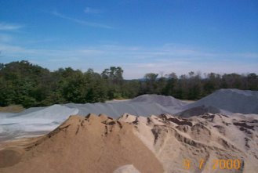
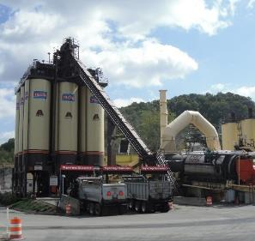
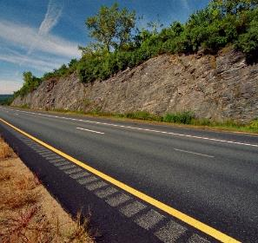
HMA Quality Control Best Practices and Ethics

Slide 2

What is Quality?
Meeting the Job Requirements
  Established specifications have to be met.
  Assumes specifications yield quality!
Satisfying the Customer
  Recognizes that it may not be sufficient to just meet the minimum specified requirements.
Maintaining a Level of Goodness
  Zero or “x” defects

Slide 3
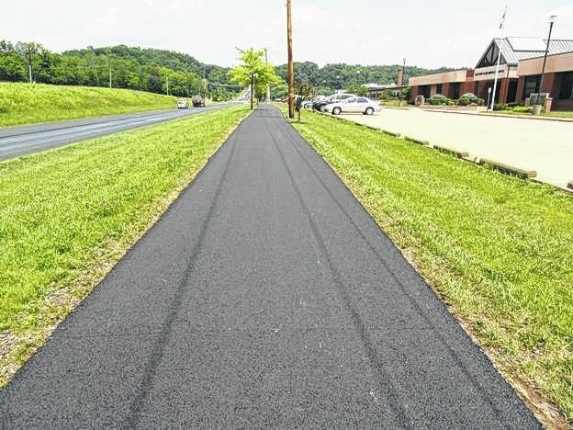
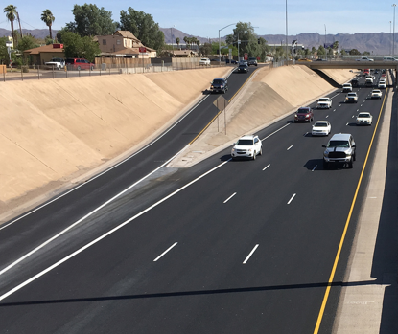


Can (Should) the Quality of These Be the Same?
YES!

Slide 4
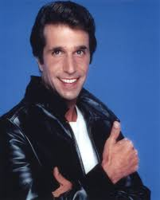
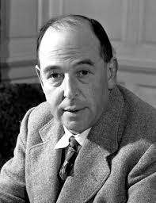
Meeting Customer Expectations
You got a Rep to protect
  Customers expect a high-quality product
Exhibit Integrity
  Doing the right thing regardless of who is watching-C.S. Lewis

Slide 5
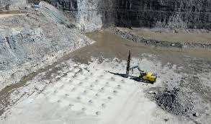
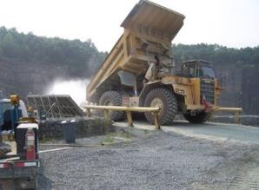
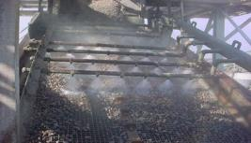
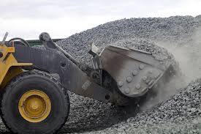
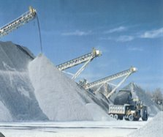
Variability in Aggregate Production
Extraction and Crushing (controllable)
  Shot pattern
  Crusher selection and operation
  Crusher feed/product grading
  Production rate (consistent), (controllable)
  Operating modes (controllable)
Screening (controllable)
  Screen type / inclination
  Efficiency
Fines processing (controllable)
  Sand screw / air classifier
Equipment Maintenance (controllable)
  Crusher / shaker wear
Stockpile Management (controllable)
Loading Trucks (controllable)

Slide 6
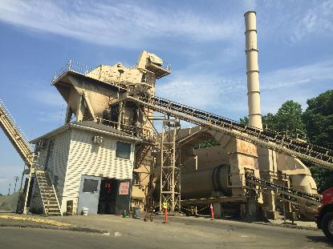
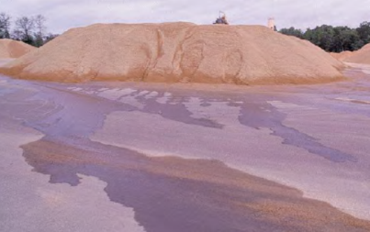
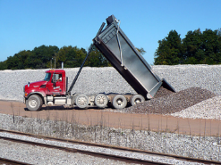
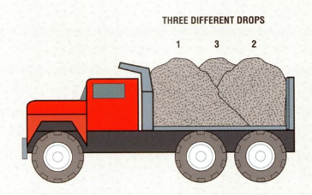
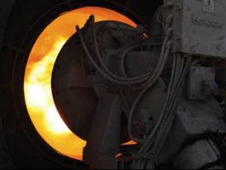
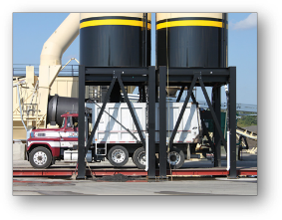
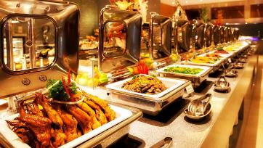
Variability at the Asphalt Plant
Calibration / Material Feed
Stockpile Moisture / Management
Mix Changes / Adjustment
Load Out
Production temperature
Inconsistent storage time
Excessive mix switchovers

Slide 7
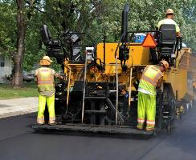
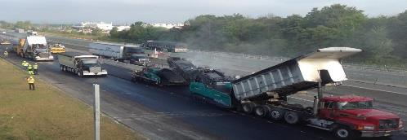
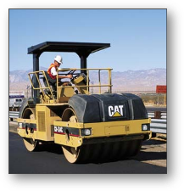
Variability on the Roadway
Methods
  Following SOP’s?
Truck Setup
Equipment Setup & Execution
  Distributor
  MTV?
  Paver
    Speed
  Rollers
    Number and Type
    Adherence to Pattern
Maintenance of Equipment

Slide 8


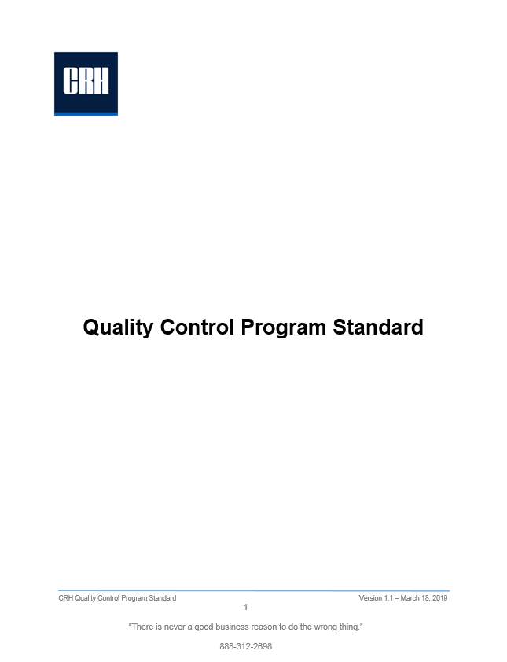
How to Mitigate Variability?
Implement a Quality Control Plan (QCP)
  American Society of Testing & Materials (ASTM)
    D3666
  American Association of State Highway & Transportation Officials (AASHTO)
    R18
  Corps of Engineers, FAA, Other Agency
  Internal QCP
What is a QCP?
  Organization
  Equipment List/Calibration/Maintenance Schedule
  Methods by which you Operate
    Tests and Frequency
    Recording/Retention of Data
    What to do when something goes wrong

Slide 9
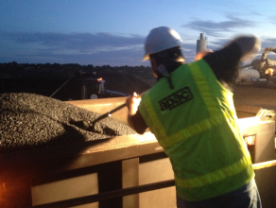

What is Quality Control?
The system used by a Contractor to monitor, assess and adjust their production or placement processes to ensure that the final product will meet the specified level of quality.
QC is the Contractor’s responsibility
QC includes sampling, testing, inspection, and corrective action (where required) to maintain continuous control of a production or placement process.

Slide 10

Quality Control is a Continuous Improvement Process
Test
Analyze
Action
Produce / Place
Sample
QC is a continuous improvement process.
Goals…
  Limit variability
  Increase accuracy
You can’t improve on what you don’t measure
QC

Slide 11

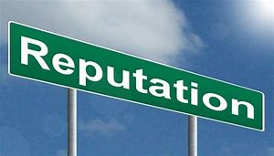
The Benefit / Cost of Quality Control is High
Benefit of QC = Successful Project (Economics + Performance) for Owner and Producer
Cost of QC = Cost of Control + Cost of Failure Not to Control
  Cost of Control is easy calculated and often used as a deciding financial metric by which to make decisions.
  Cost of Failure Not to Control is more difficult to calculate, but can be very large.
    Examples
      Loss of reputation
      Loss of customer base
      Loss of employee pride

Slide 12
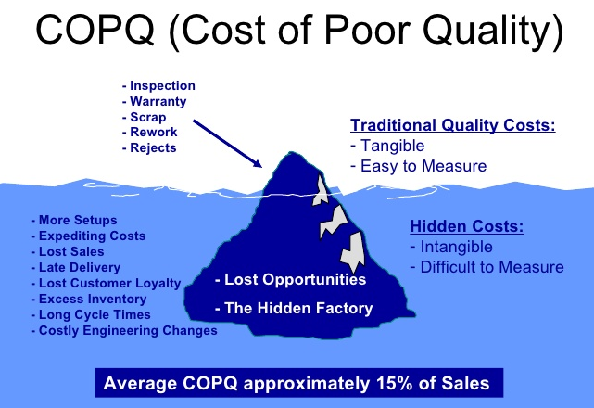
http://sixsigmapro.blogspot.com/2015/06/what-is-cost-of-poor-quality-copq.html

Slide 13
Variability is the Enemy, Consistency is your Friend
Consistency allows you to make adjustments
  Sampling
  Testing Utilize Standard Methods – ASTM / AASHTO
  Data Management
Apply these Methods/Practices/Policies in all aspects of the operation
  Mix Design / Quality Control
  Plant Production
  Construction
Quality occurs when all three work together!

Slide 14
Some Best Practices
Incoming Aggregates/RAP
  Gradation/Gsb/Asphalt Content
  Stockpile Management
    Segregation/Contamination
    Excessive chunks/Highwalls
Plant Walkabouts
  Control House
    Production Temp/Speed
  Cold Feed Bins/Belts
QC Check/Process Control Samples
  AC Check/Spin a pill
    Quality Control Technician, not Quality Monitor Technician
Communicate Results

Slide 15
More Best Practices
Roadway Operation Observation
  Paver Set-up
  Truck Temp/Dumping
    Hopper/Insert Level
  Paver Speed
    Head of Material
  Roller Set-up and Pattern
    Amplitude/Frequecy
    Adherence to the Pattern
Check Cores/Gauge Calibration
  Should have at least 1 check core/day
  Gauge checks across the full width of the mat
Communicate Results/Findings

Slide 16
Even More Best Practices
Propper Planning – A screwup on your part doesn’t mean an emergency on my part
  Plant Management
    Multiple Jobs/FOB Customers
  Truck Setup
    Number of Trucks
    Time
  Equipment / Crew Setup
    Arrival Time
COMMUNICATION!!!!

Slide 17
So, What About Ethics?
Ethics
  Moral principles that govern a person's behavior or the conducting of an activity
  Do what you say you’re going to do
Our Customers depend on us to provide goods or services that meet their expectations
There can be legal ramifications if we don’t do what we’re supposed to be doing
Not just for QC Folks

Slide 18
Finally…
Plan your work, work your plan
Follow the plan
  Make adjustments as necessary
  Communicate the adjustments
Pay attention
Remember your training
Don’t do stupid stuff
COMMUNICATE!!!!!

Slide 19


Thank You / Questions
http://www.pennyauctionwatch.com/
Alex Murphree
Quality Manager
APAC – Alabama, Inc.

