Slide 1


Enhancing RAP/RAS Mix Performance with BMD:
Case Study from Alabama
Suri Gatiganti, Ph.D.
Assistant Research Professor, NCAT

Slide 2



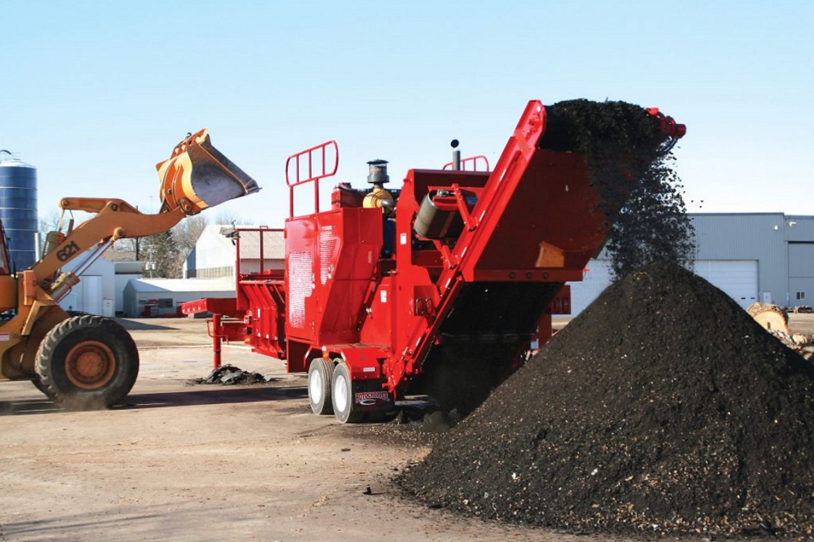
Background (Benefits of RAS)
Environmental:
Divert Reclaimed Asphalt Singles (RAS) from landfill
In 2022:
  641,000 tons of unprocessed RAS was saved for future use.
  390,000 cubic yards in landfill.
  $37 million in gate fess for disposal
Engineering:
High binder content in RAS materials
Enhance mix properties with angular fine aggregate and fiber
However, there are major performance challenges
Environmental
Engineering
Economical
Economical:
Available material and cost savings
In 2022:
  Saved $99 million by using RAS
  134,000 tons (approximately 740,000 barrels) of virgin binder
  336,000 tons of aggregate.
Reference: NAPA’s Recycled Material Usage Report
Notes:
Environmental: In 2022, 641,000 tons of unprocessed RAS was saved for future use. Equivalent to 390,000 cubic yards in landfill and more than $37 million in gate fess for disposal
Economical: In 2022 the Industry saved $99 million by using RAS. Which reduced 134,000 tons (approximately 740,000 barrels) of virgin binder and 336,000 tons of aggregate.

Slide 3
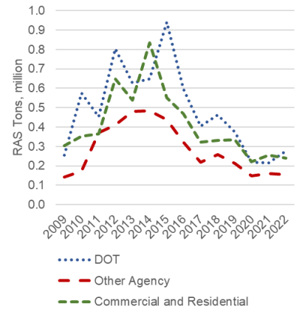
Background (Challenges)
RAS is a highly oxidized material
  Can weaken the cracking resistance of asphalt mixes
Since 2014, the usage of RAS has been reduced by 65%.
Can we design asphalt mixtures with RAS without compromising performance?
  Taking advantage of Balanced Mix Design (BMD)?
Reference: Williams et al. 2021

Slide 4
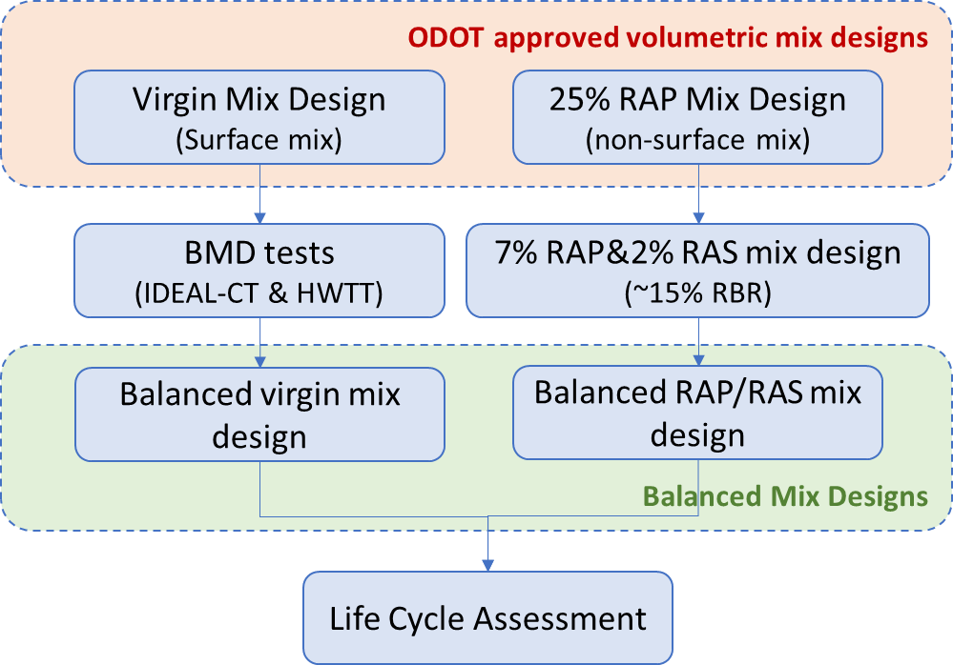
Background (Oklahoma Case Study)
ODOT volumetric mix design does not allow RAS in surface mixes
ODOT BMD specification on surface mixes
  No RAS in surface-course mixtures
Explore the feasibility of designing RAP/RAS surface mixes with balanced performance.

Slide 5
Background (Oklahoma Case Study)
BMD Tests and Criteria
Hamburg Wheel Tracking Test (HWTT)
AASHTO T 324
at 50°C
Short-term aged: Loose mix 135ºC for 4 hours
10,000 passes to reach 12.5 mm rut depth
Short-term aged: Loose mix 135ºC for 4 hours
Indirect Tensile Cracking Test (IDEAL-CT)
ASTM D8225
Conditioning: 2 hours, 25°C in environmental chamber
CT_{index} ≥ 100
Reference: NAPA BMD resource guide

Slide 6
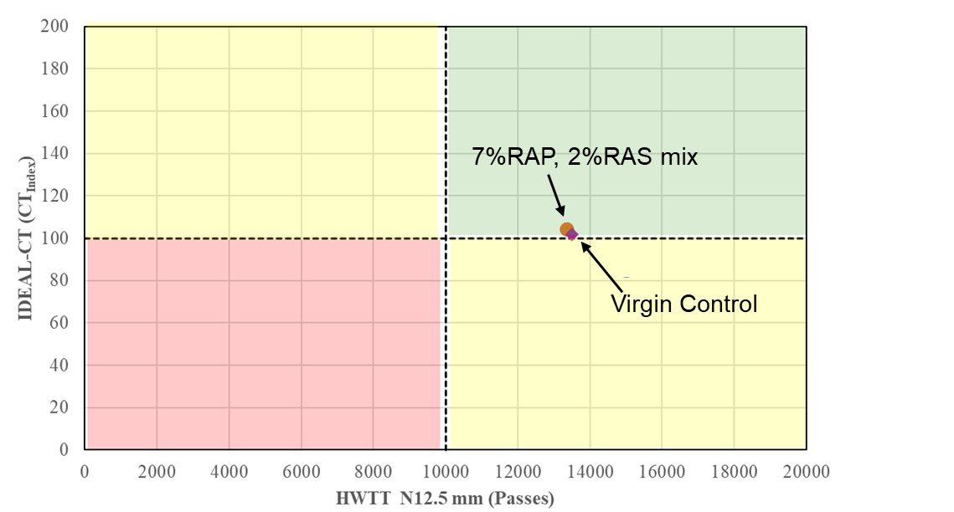
Background (Oklahoma Case Study)
Volumetric mix designs failed in BMD
  Virgin (control) mix
  7%RAP, 2%RAS mix
Strategies that worked for RAP/RAS mix
  Lower design air voids (+0.3% binder)
  Softer binder (PG64-22 → PG58-28)
  +0.5%LAS
JMF |  | Virgin BMD | RAP/RAS BMD
Combined Gradation | 1" | 100.0 | 100.0
 | 3/4" | 100.0 | 100.0
 | 1/2" | 96.5 | 96.4
 | 3/8" | 81.6 | 81.2
 | #4 | 56.9 | 55.6
 | #8 | 43.9 | 42.5
 | #16 | 33.9 | 31.2
 | #30 | 25.2 | 22.3
 | #50 | 15.8 | 14.2
 | #100 | 7.9 | 7.6
 | #200 | 3.4 | 3.7
Virgin Binder |  | PG 64-22 | PG 58-28
Additive |  | None | 0.5% LAS
Design Gyration |  | 50 | 50
Asphalt Content, % |  | 5.35 | 5.6
Virgin Asphalt Content, % |  | 5.35 | 4.86
RAP Asphalt Content, % |  | - | 0.35
RAS Asphalt Content, % |  | - | 0.39
RBR, % |  | - | 13.3
Air Voids, % |  | 3.0 | 3.0
VMA, % |  | 14.6 | 15.1
VFA, % |  | 79.7 | 80.3
Dust/asphalt ratio |  | 0.68 | 0.70
0.5% lower virgin binder

Slide 7
Background & Objective
ALDOT specification on surface mixes
  Up to 20% RAP
  Up to 20% RAP/RAS (combined), but RAS cannot exceed 3%
    Up to 17% RAP, 3% RAS
Explore the feasibility of designing RAP/RAS surface mixes with higher RAS contents (from 3% to 5%) and balanced performance

Slide 8
Study Scope
Received two ALDOT-approved volumetric mix designs
  20% RAP mix (control)
  17% RAP, 3% RAS mix
Developed a volumetric mix design with 15% RAP and 5% RAS using the same aggregate stockpiles
Optimized the both mix designs with BMD
  20% RAP mix (control)
  15% RAP, 5% RAS mix

Slide 9
Volumetric Mix Design Comparison
Mix Design | 20% RAP (Contractor) | 15% RAP, 5% RAS (NCAT)
Virgin Binder | PG 67-22 | PG 67-22
Additive (% total binder) | 0.5 ASA | 0.5 ASA
Total AC (%) | 5.5 | 6.0
Virgin AC (%) | 4.5 | 4.25
RBR (%) | 18.2 | 29.2
V_{a} (%) | 4.0 | 3.5
VMA (%) | 15.5 | 16.0
VFA (%) | 74.2 | 78.2
DP | 1.10 | 1.10
Notes:
ASA: Evotherm M1

Slide 10

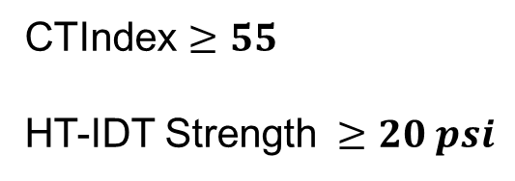
ALDOT BMD Specification
BMD for local roads (special provision)
BMD approach: C
  Allows some of the volumetric requirements to be relaxed.
BMD Performance Tests: IDEAL-CT and HT-IDT
  On Short-Term Aged (STA) samples for 2 hours at 275º F
Select Gradation and AC
Conduct Performance Tests
Measure Volumetrics Properties
CTIndex $≥55$
HT-IDT Strength $≥20 psi$

Slide 11
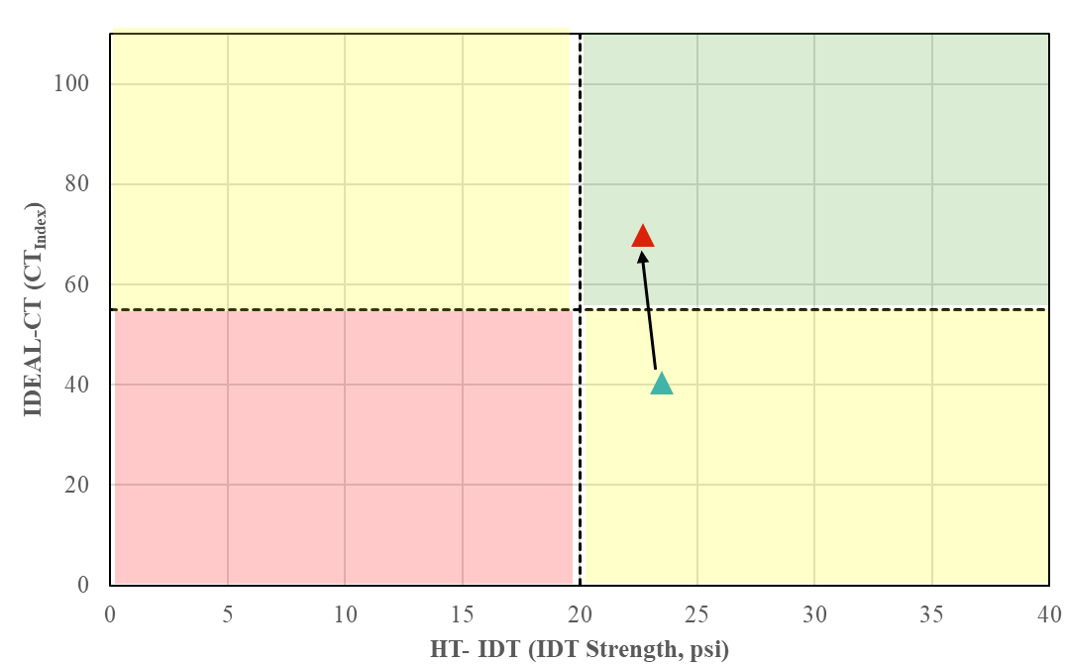
BMD Modification (20% RAP Mix-Control)
Volumetric mix design failed in BMD
Strategies that worked for 20% RAP mix
  Increase 0.3% AC
Failed rutting test
Passed cracking test
Passed rutting test
Passed cracking test
5.8% AC, PG 67-22
(BMD Optimized)
5.5% AC, PG 67-22
(Volumetric mix design)
Failed rutting test
Failed cracking test
Passed rutting test
Failed cracking test

Slide 12
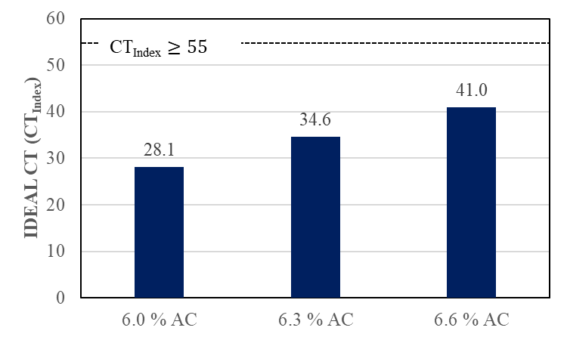
BMD Modification (RAP/RAS Mix)
Volumetric mix design failed in BMD
  15%RAP & 5%RAS
BMD Modifications Used
  Increase asphalt content
    Did Not work
15% RAP and 5% RAS
(Volumetric mix design)
CT_{Index}= 28.1
HT-IDT Strength= 36.1 psi

Slide 13
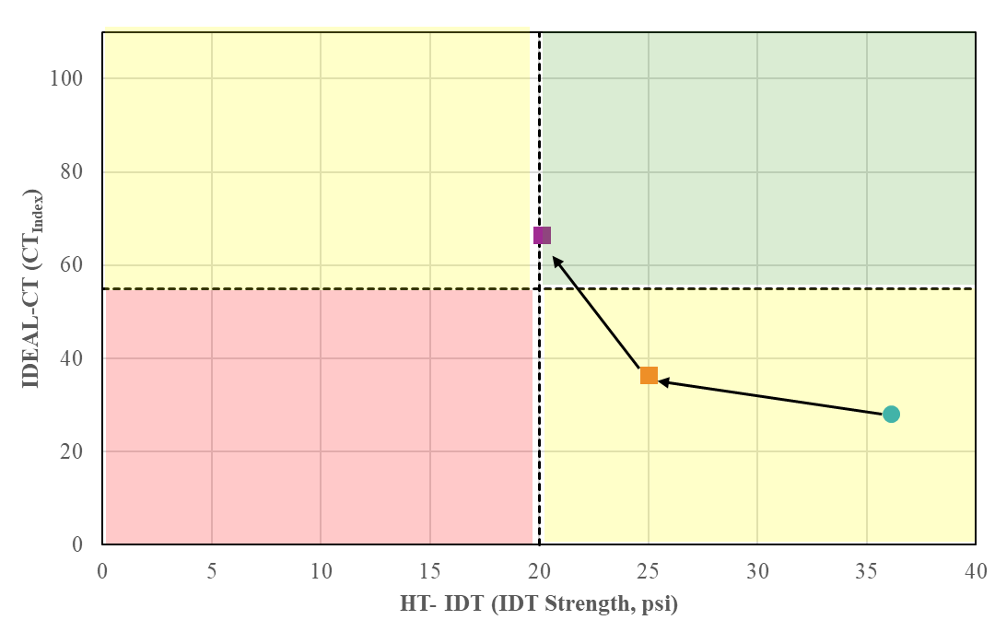
BMD Modification (RAP/RAS Mix)
Volumetric mix design failed in BMD
  15%RAP & 5%RAS
BMD Modifications Used
  Increase asphalt content
    Did Not work
  Use a softer binder at different asphalt contents
    Worked out
6.5 % AC, PG 52-34
(BMD optimized)
6.0 % AC, PG 52-34
6.0% AC, PG 67-22
(Volumetric mix design)

Slide 14
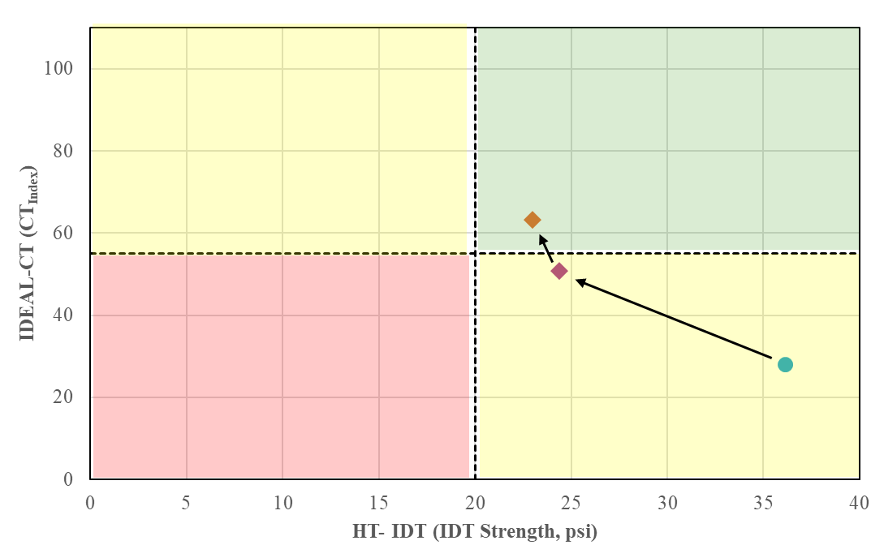
BMD Modification (RAP/RAS Mix)
Volumetric mix design failed in BMD
  15%RAP & 5%RAS
BMD Modifications Used
  Increase asphalt content
    Did Not work
  Use a softer binder at different asphalt contents
    Worked out
  Add a recycling agent at different dosages
    Worked out
6.0% AC, PG 67-22, 7.8% RA
(BMD optimized)
6.0% AC, PG 67-22, 6.8% RA
6.0% AC, PG 67-22
(Volumetric mix design)

Slide 15
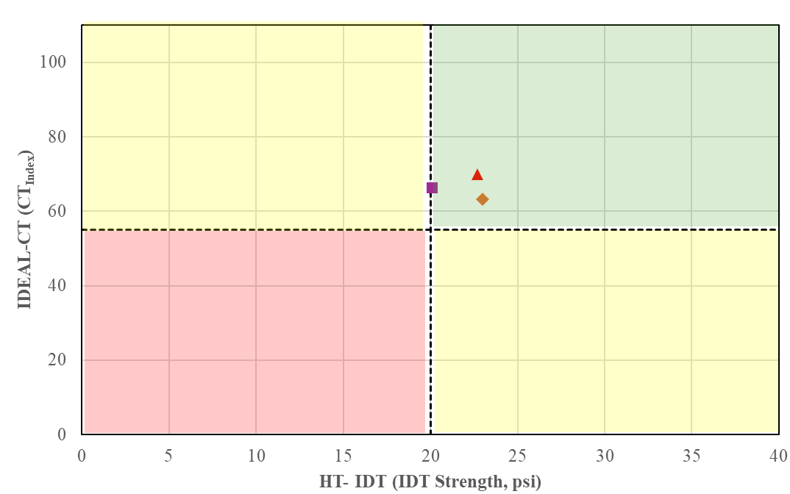
BMD Optimization Summary
Two Strategies worked effectively for RAP/RAS mix:
  Used a softer binder and increased AC by 0.5%
  Added a recycling agent (RA)
20% RAP mix
17%RAP & 5%RAS mix
(Softer binder)
Mix Design | 20% RAP | 15% RAP, 5% RAS
Virgin Binder | PG 67-22 | PG 52-28/34 | PG 67-22
Additive (% total binder) | 0.5 ASA | 0.5 ASA | 0.5 ASA, 5.5 RA
Total AC (%) | 5.8 | 6.5 | 6.0
Virgin AC (%) | 4.8 | 4.8 | 4.3
RBR (%) | 17.2 | 26.9 | 29.2
V_{a} (%) | 3.2 | 2.3 | 3.5
VMA (%) | 16.3 | 16.7 | 16.0
VFA (%) | 80.4 | 85.8 | 78.2
DP | 1.0 | 1.0 | 1.1
17%RAP & 5%RAS mix
(Recycling agent)

Slide 16
Summary and Conclusions
It is feasible to design RAP/RAS mixes with satisfactory performance using BMD
  With 15%RAP, 5% RAS compared to 20%RAP mix
Strategies that best worked in this study
  Use a softer binder and increased AC by 0.5%
  Add a recycling agent
Other strategies such as change in gradation, use of other recycling agents, etc. can be used
  To design RAS mixes with satisfactory performance and better economics

Slide 17
Dr. Suri Gatiganti
Assistant Research Professor
National Center for Asphalt Technology
szg0094@auburn.edu

