Slide 1
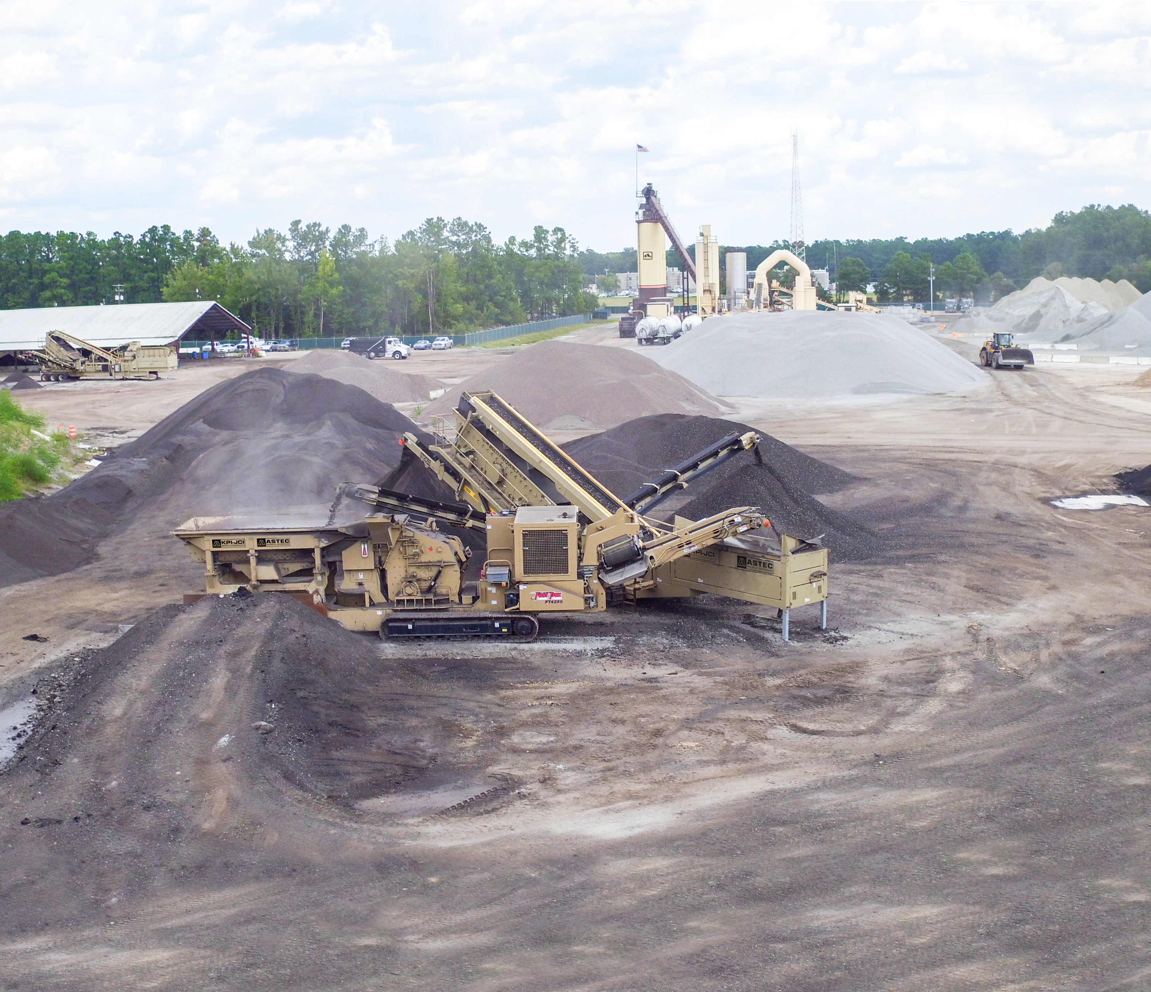
Achieving Optimal RAP Gradation in Processing

Slide 2
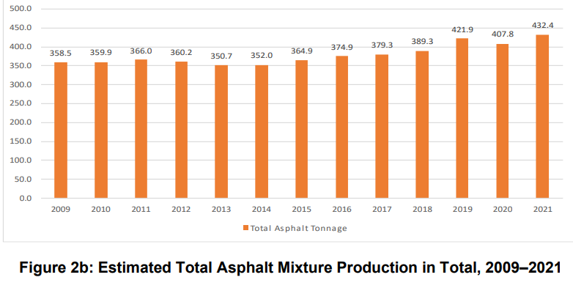
Asphalt Production
From 2020 to 2021, the estimated total amount of asphalt mixture produced in the United States increased from 407.8 million tons to 432.4 million tons, an increase of 6 percent.

Slide 3
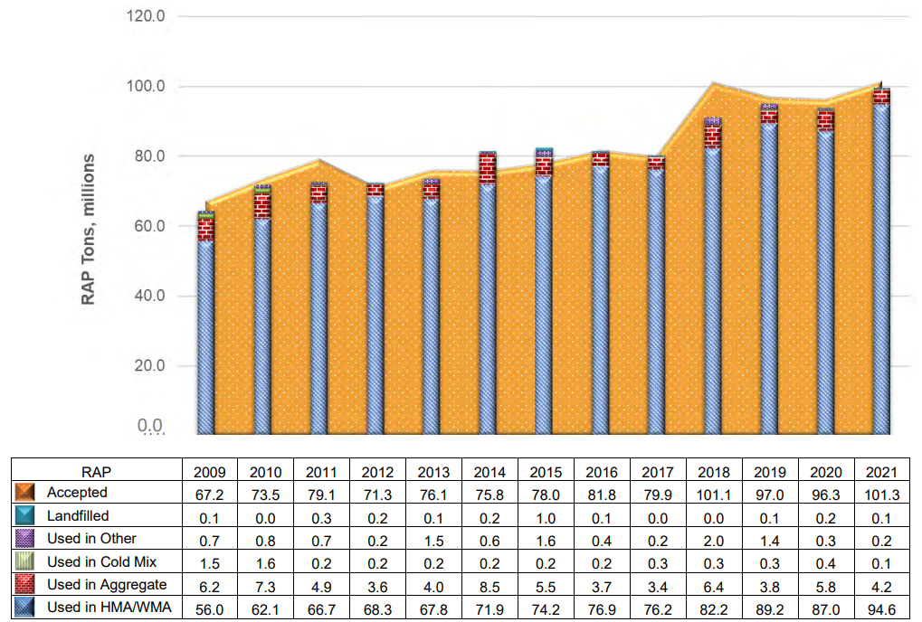
RAP Usage

Slide 4
RAP: Market and History
The total estimated tons of RAP used in asphalt mixtures was 94.6 million tons in 2021. This represents a 68.9 percent increase from the total estimated tons of RAP used in 2009. Since 2009, total asphalt mixture tonnage has increased only 20.6 percent.
RAP usage during the 2021 construction season is estimated to have reduced the need for 4.7 million tons (26 million barrels) of asphalt binder and more than 89 million tons of aggregate with a total estimated value of more than $3.4 billion.
*Data from NAPA annual Asphalt Pavement Industry Survey

Slide 5
RAP: Market and History
• The total estimated amount of RAP stockpiled nationwide at the end of the 2021 construction season was about 137 million tons.
• Fractionated RAP represents about 25 percent of RAP use nationwide, and the tons of RAP mixtures produced using softer binders are estimated at 22 percent while tons produced using recycling agents is estimated at 5 percent.
*Data from NAPA annual Asphalt Pavement Industry Survey

Slide 6
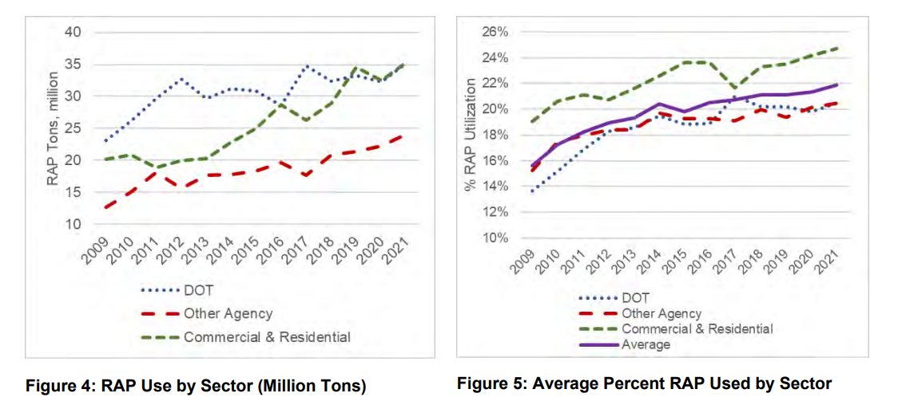
RAP: Market and History
*Data from NAPA annual Asphalt Pavement Industry Survey

Slide 7
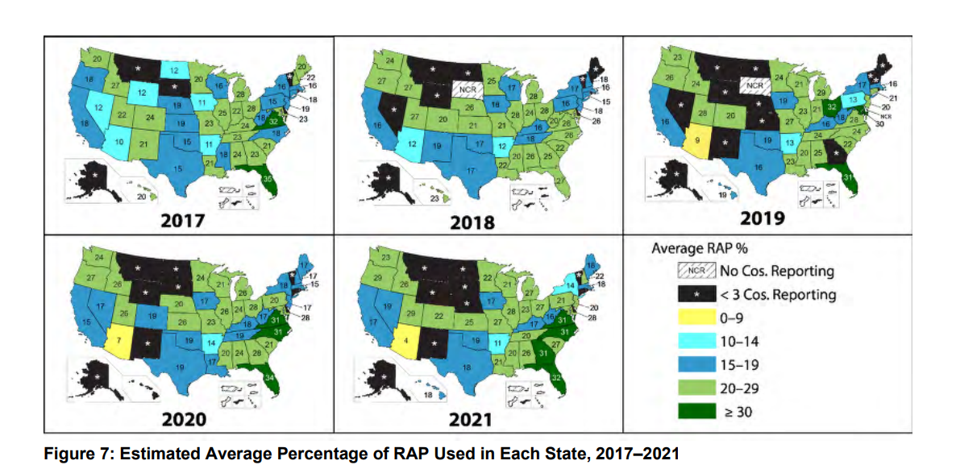
RAP: Market and History
*Data from NAPA annual Asphalt Pavement Industry Survey

Slide 8
RAP: Fractionating vs Recycling

Slide 9
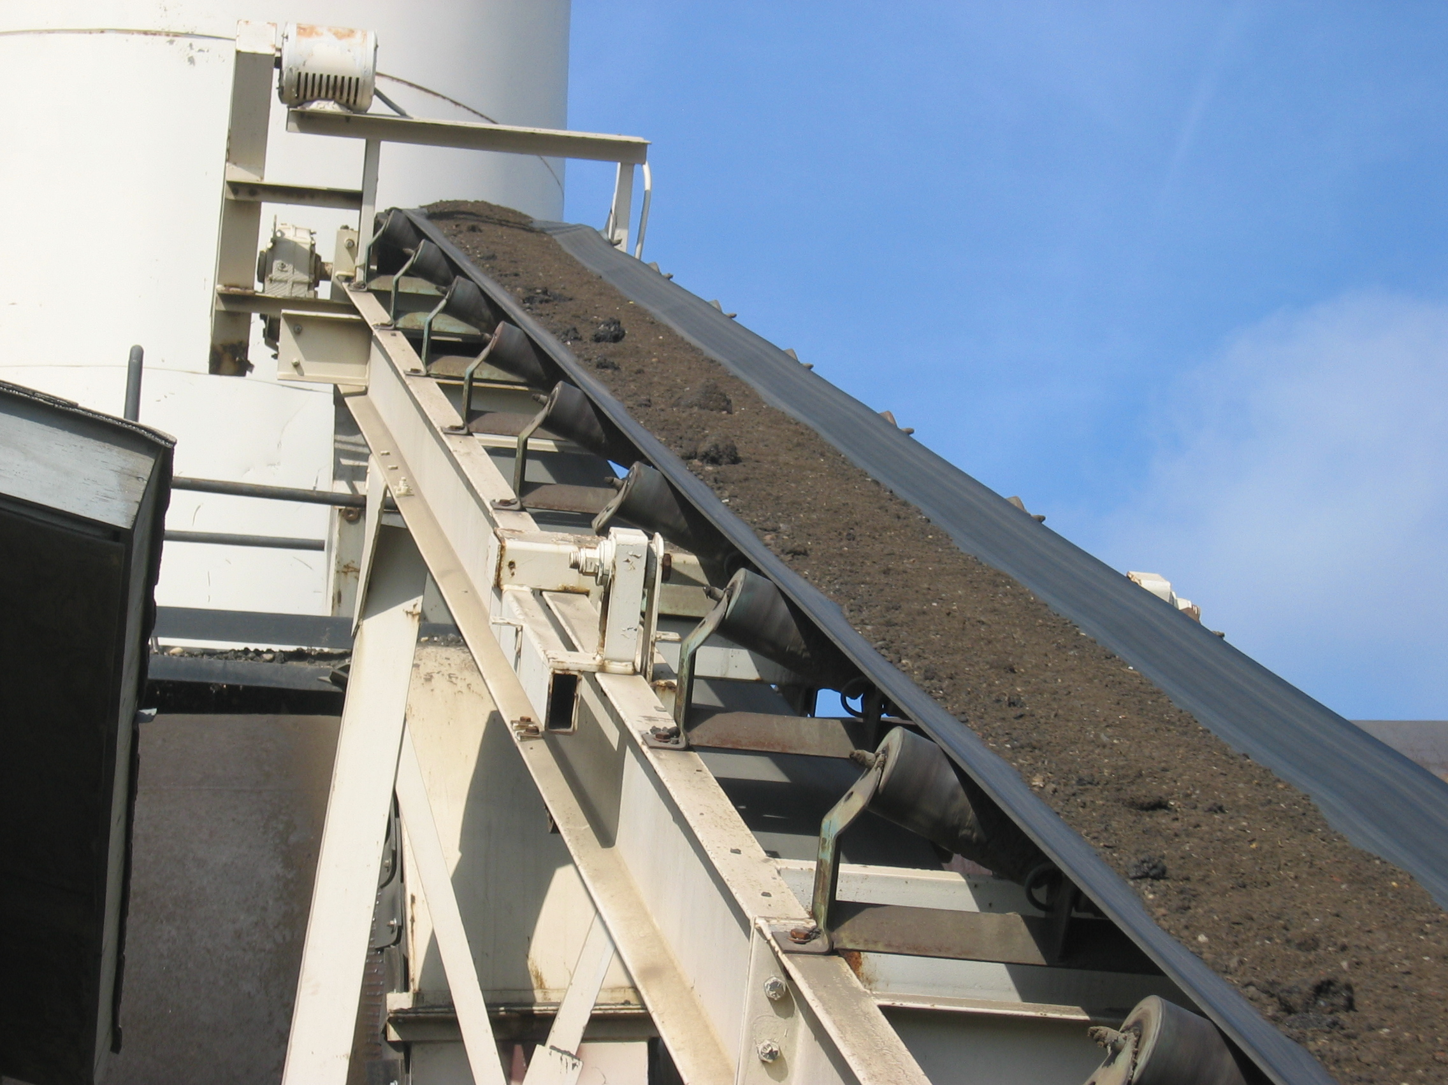
RAP: Problems with Single Sizing
Difficult controlling gradation in mixes containing greater than 20% RAP
Stockpiled RAP can segregate and join back together
Tough to get uniform mix

Slide 10
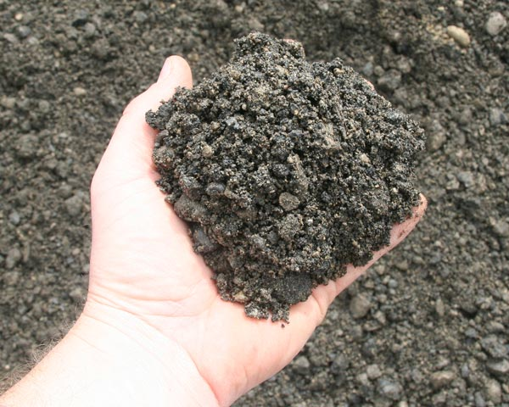
RAP: Problems with Single Sizing

Slide 11
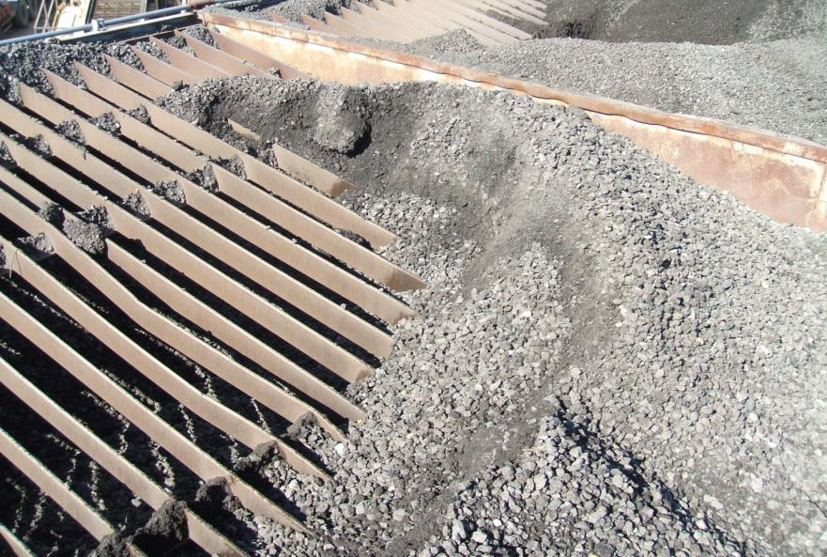
RAP: Problems with Single Sizing
¾” (19mm) RAP Bin

Slide 12
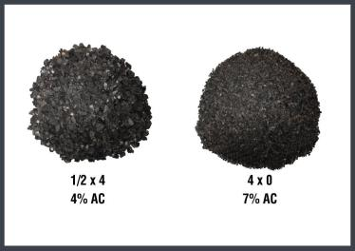
Will this make a difference?
20% RAP Mix:
0.2 x 7.5% AC = 1.5% AC
0.2 x 3.5% AC = 0.7% AC
0.8% Potential AC swing
½” x No.4
3.5% AC
No.4 x 0
7.5% AC
40% RAP Mix, 1.6% AC Swing

Slide 13
RAP: Obstacles to Fractionating
Reluctance to make changes
Lack of focus
Lack of research
Lack of trained personnel
Unsure of return on investment
Putting out fires

Slide 14
RAP: Fractionating vs. Recycling
Best use of products given
Crushing and screening
Breaking apart the bond (liberate)
Treating RAP gradation same as virgin mix

Slide 15
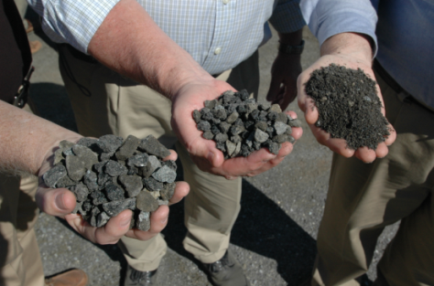
RAP: How Fractionating adds Value
Takes Advantage Of Higher Asphalt Content In “Fine” RAP
Provides Scarce/High Dollar Size Aggregate Material
RAP is worth what it replaces
Allows You To Adjust mix designs

Slide 16
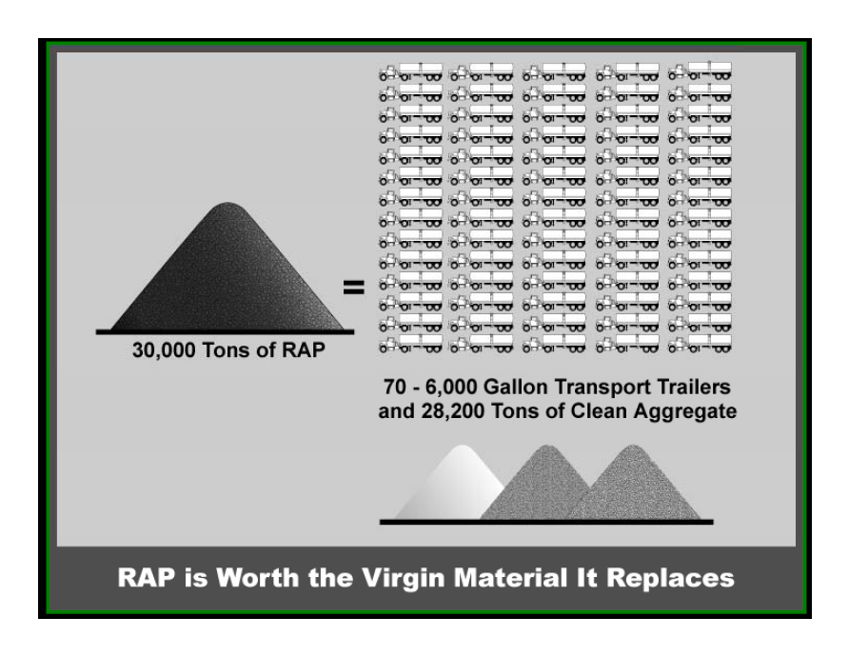

Slide 17
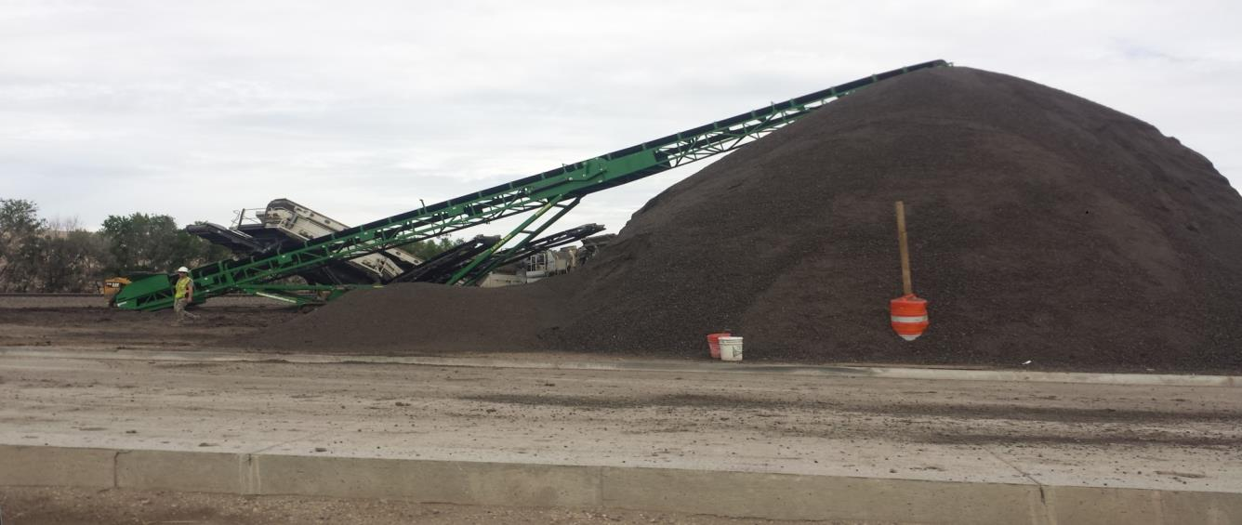
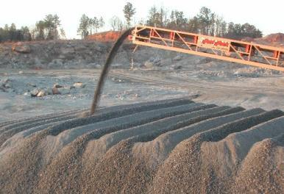
RAP: Handling
Majority have no special RAP stockpiling
You need RAP stockpiles to be placed on a sloped surface to aid in draining
You need RAP stockpiles to be placed on a paved surface to minimize contamination
RAP stockpiles should be placed under cover to minimize moisture and sunlight exposure

Slide 18
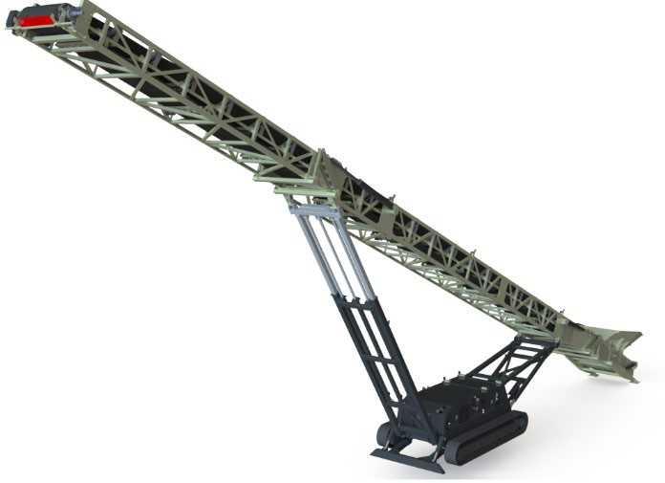
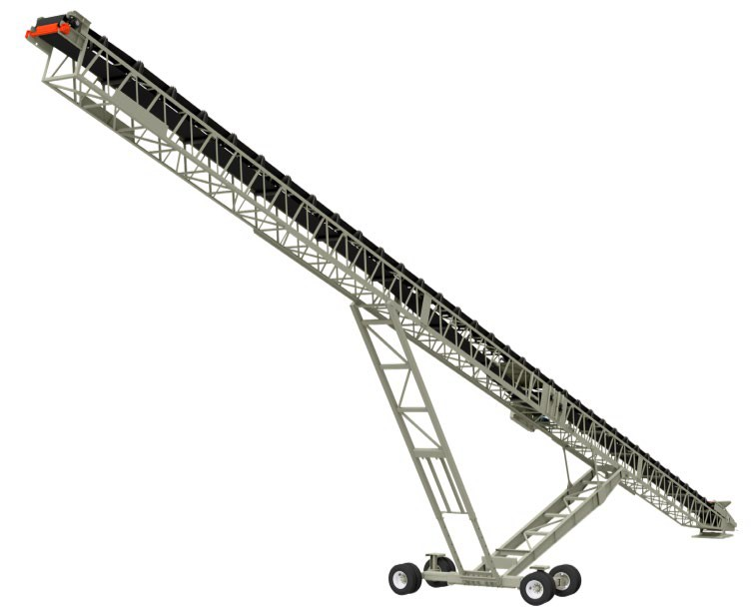
Mobile & Portable Conveyors
On-site mobility with radial options for easy stockpiling

Slide 19

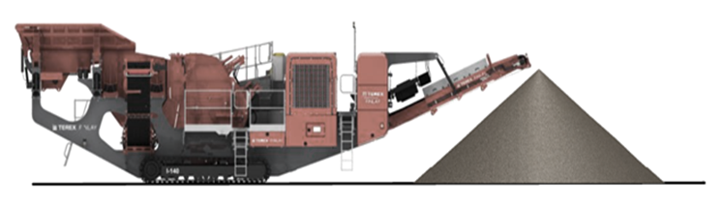
Track Conveyors
Tracked conveyor solutions = 15 Times more capacity
Or at 150 TPH = 2 Days running before you need to reposition
UP TO 70% CHEAPER TO OWN/OPERATE THAN WHEEL LOADER

Slide 20
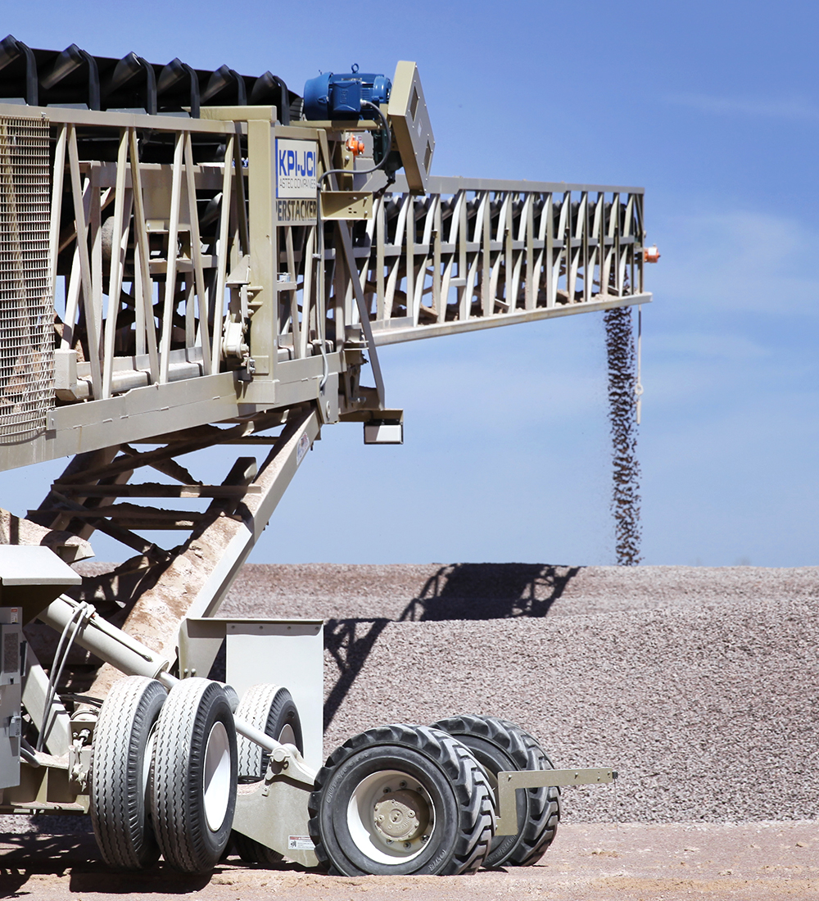
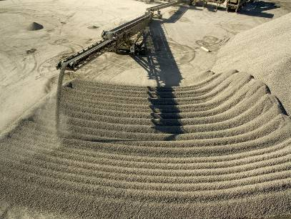
RAP: Handling
Larger Stockpile Capacity – The telescoping action of the Super Stacker makes it capable of creating stockpiles with 30% more capacity than a standard radial stacker of the same length.

Slide 21
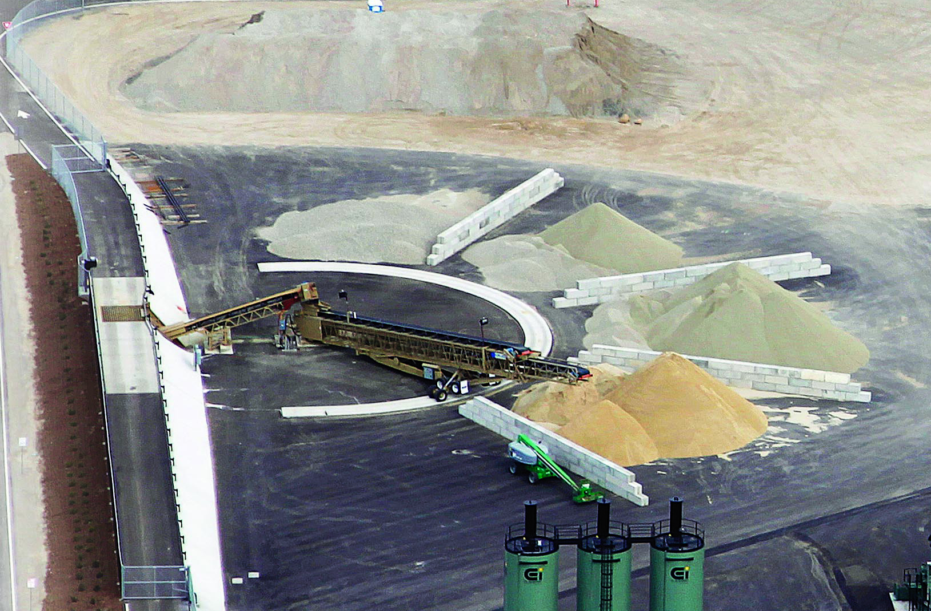
RAP: Handling

Slide 22
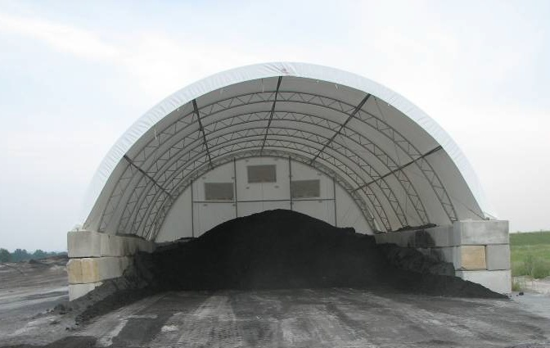
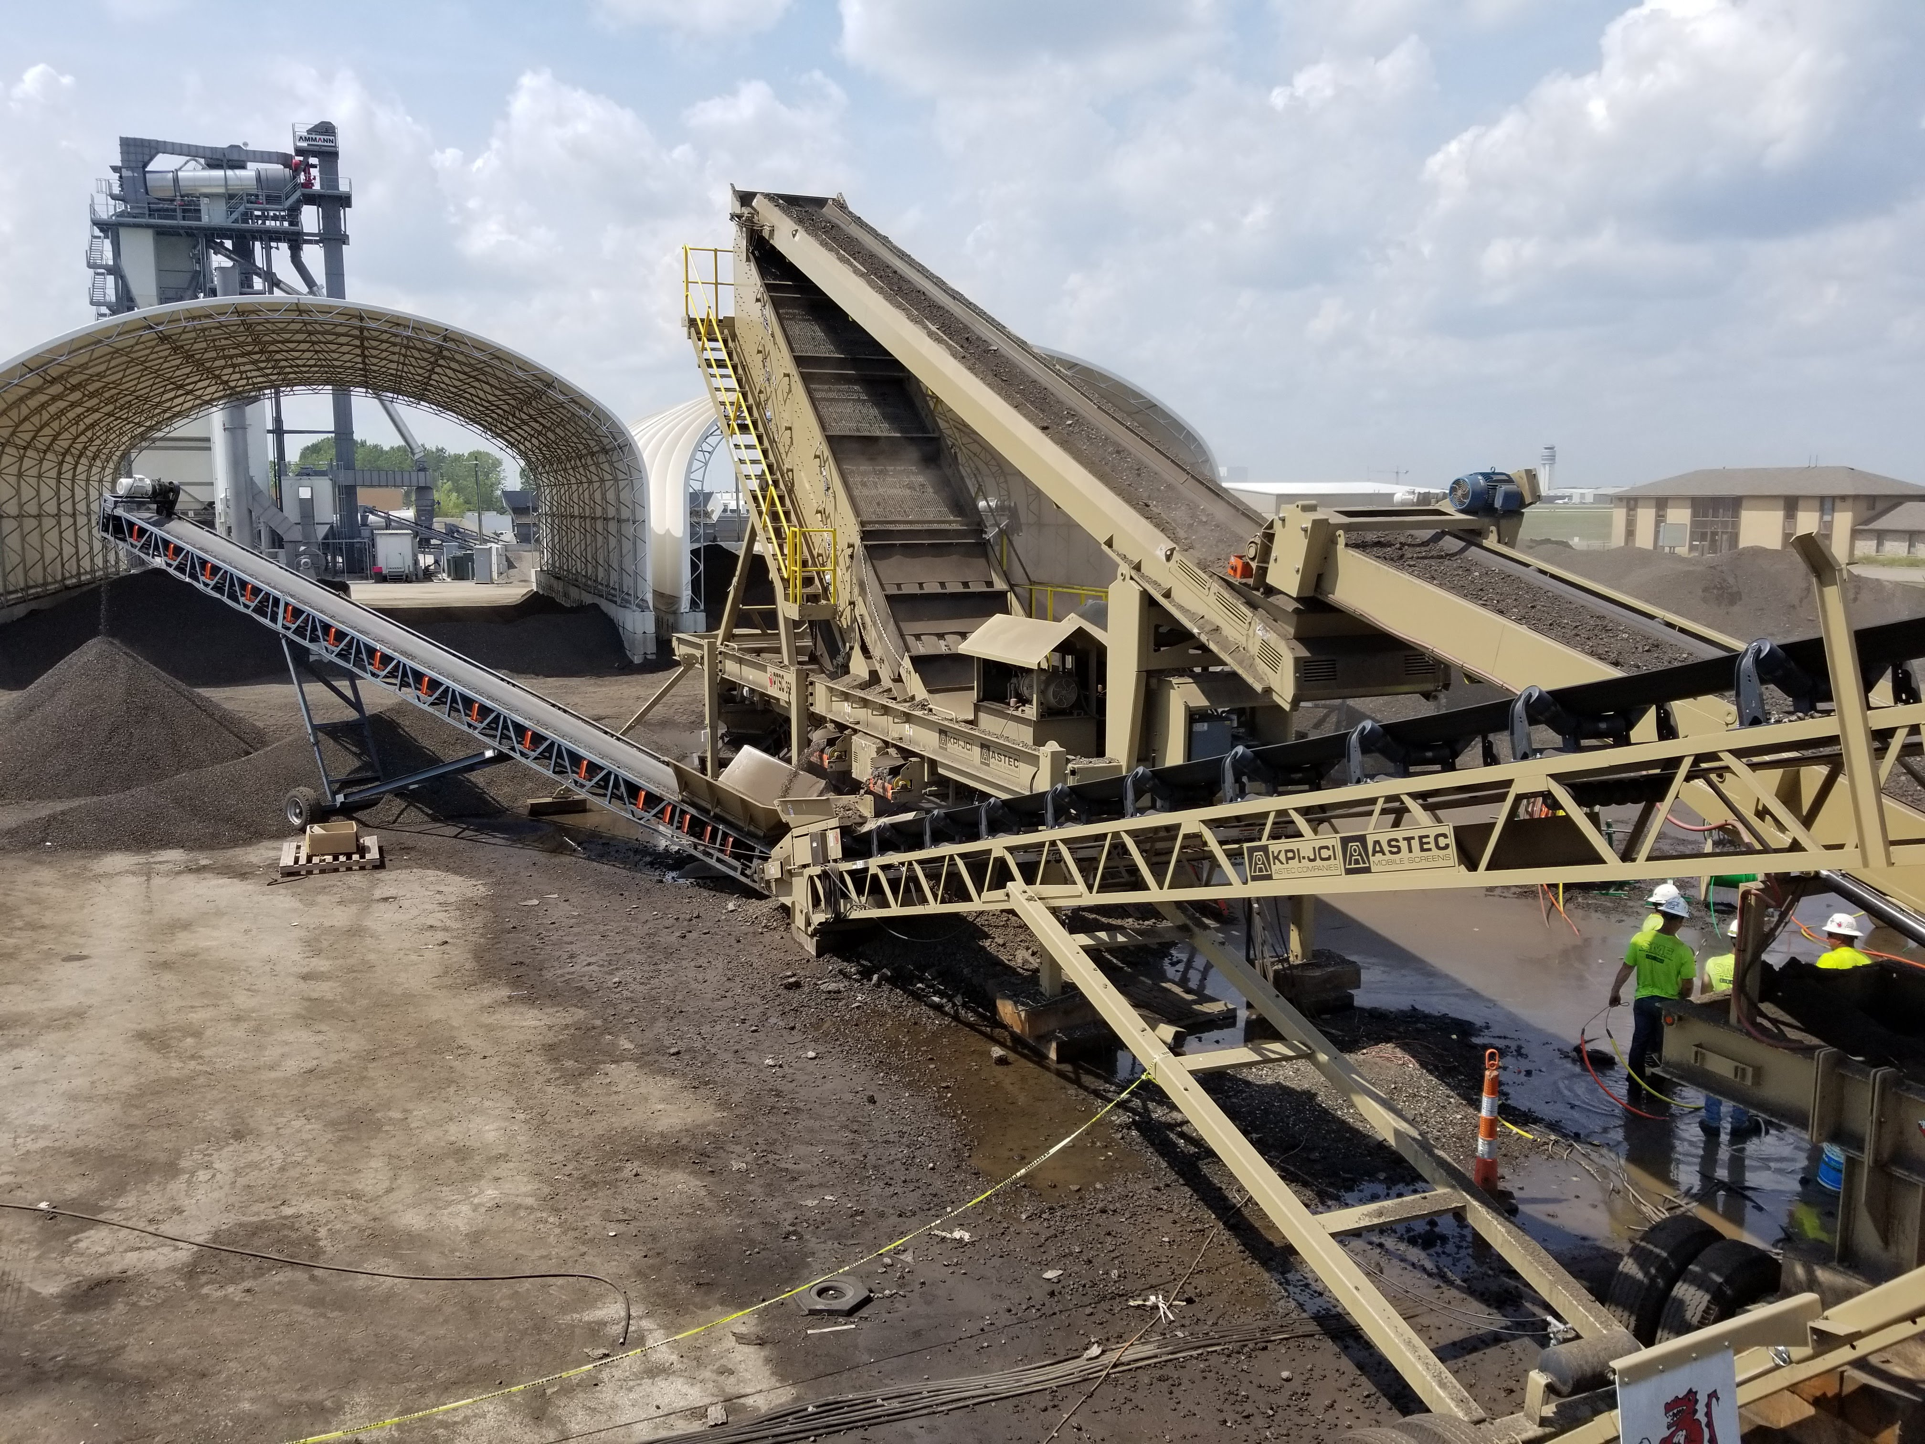
RAP Processing & Handling

Slide 23
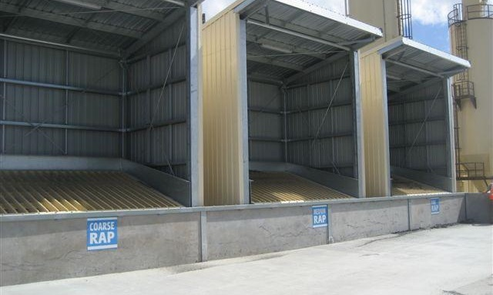
RAP: Handling

Slide 24
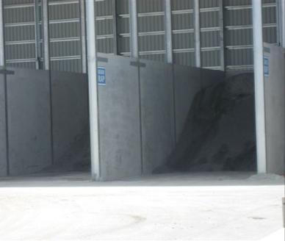
RAP: Maximizing Value
Take care of your RAP
Keep it clean and uncontaminated
Keep it dry:
Saves drying costs
Fractionates more readily
Can fractionate finer & faster
Use RAP fractions in most profitable ways

Slide 25
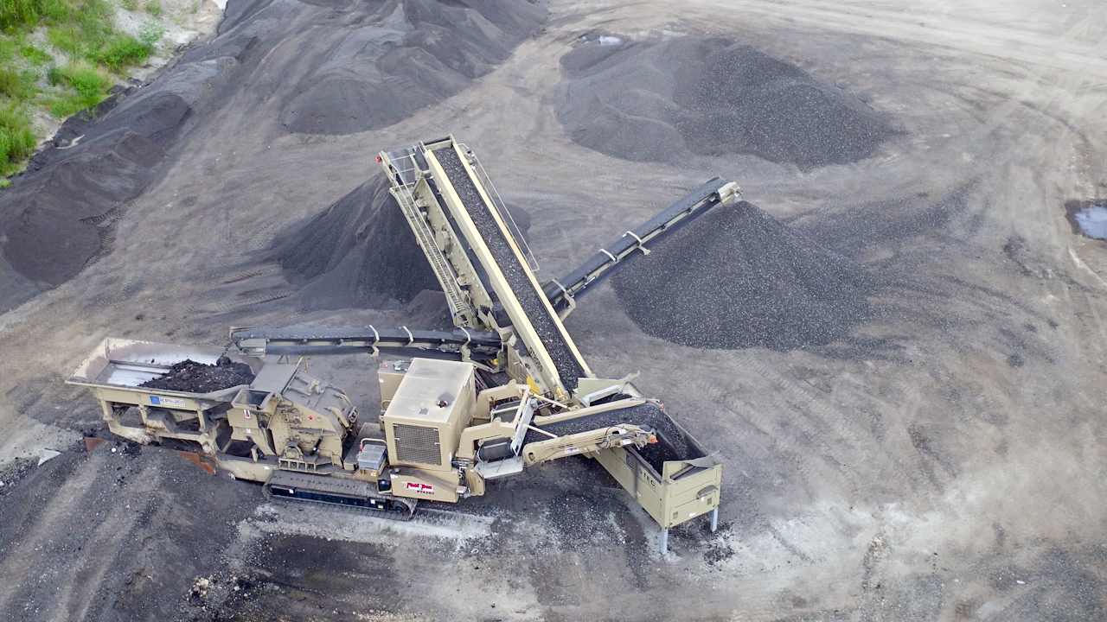
RAP: Processing Options

Slide 26
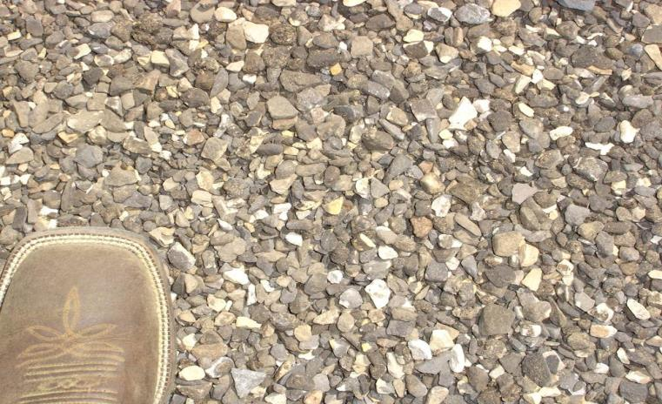
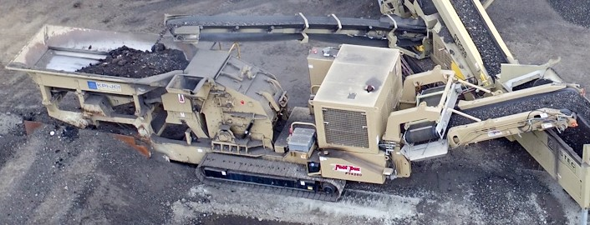
RAP: Crushing
Impactor designs meant to break apart the bond that won’t over-crush
Quick adjust aprons and hydraulic variable speed drive to adjust to conditions
Size crushers according to what is needed based on feed product and desired products

Slide 27

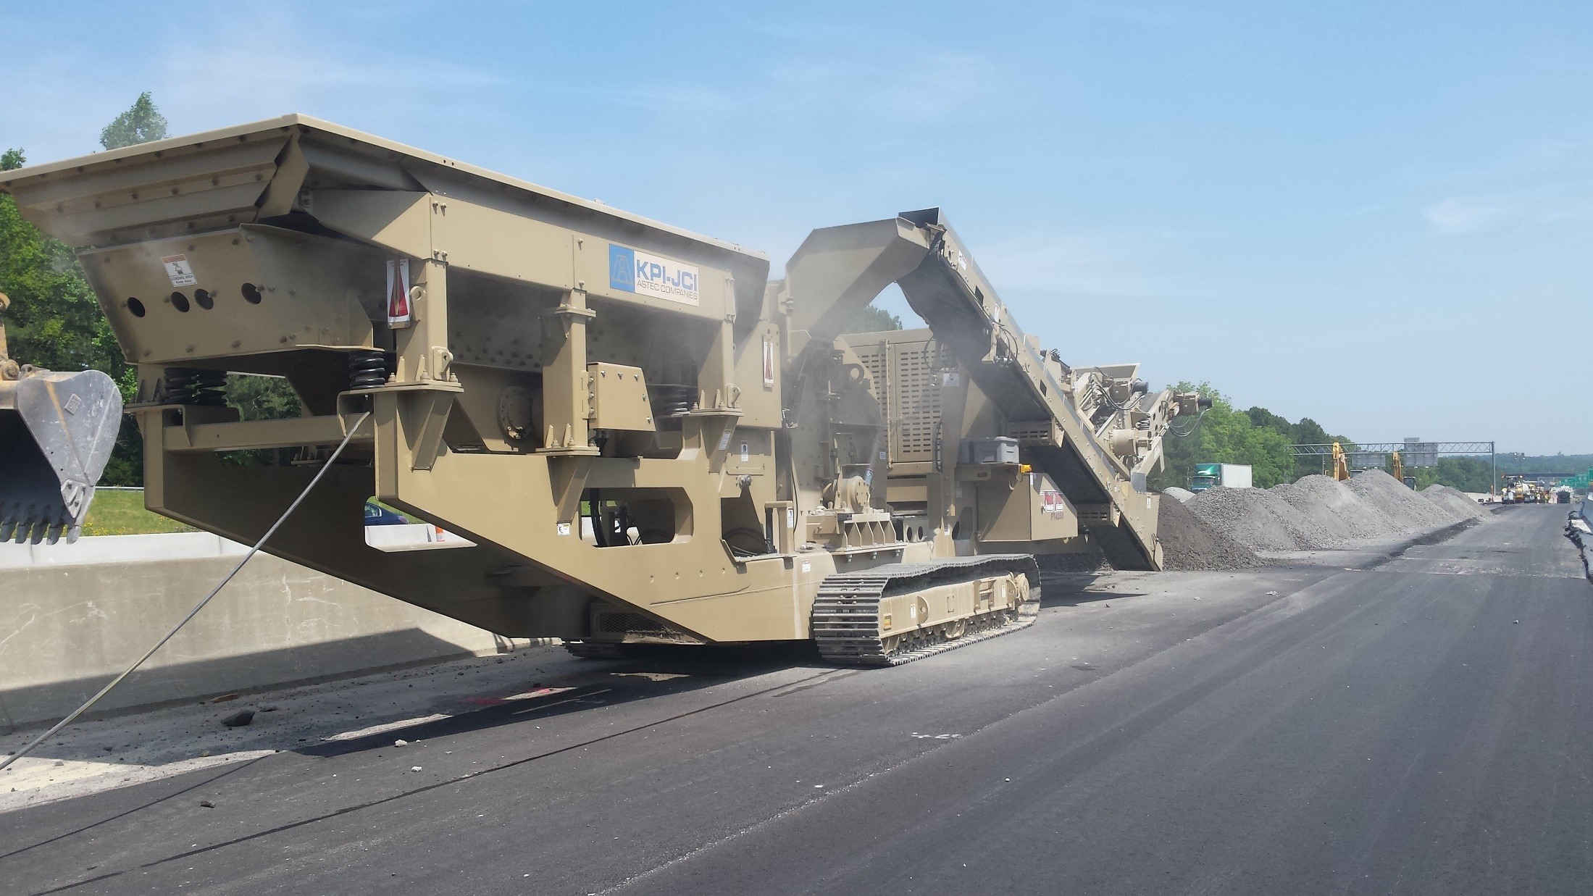
RAP: Horizontal Shaft Impactors
Notes:
Generally chosen because of high reduction ratio and capacity
Pioneer currently has three models available:
4233, 42 50 & 5260

Slide 28
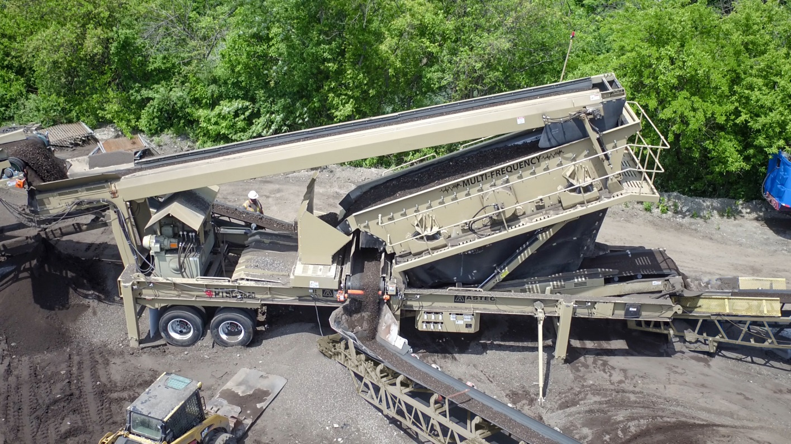
RAP: Screening
Coarse material requires more amplitude and less frequency
Fine material requires less amplitude and more frequency
Efficient screens will minimize the amount of recirculation in turn meaning more rock stays coated
RAP is sticky and builds up quickly in screenboxes
Understand desired products and also communicate future opportunities

Slide 29
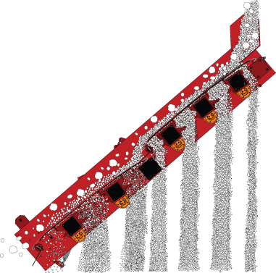
RAP: High Frequency Screens
Coarse material requires more amplitude and Less Frequency
Fine Material requires less amplitude and More Frequency
Utilizes aggressive screen vibration directly to screen media with almost no amplitude applied to side of box
High RPM allows material to stratify and separate at a much faster rate

Slide 30
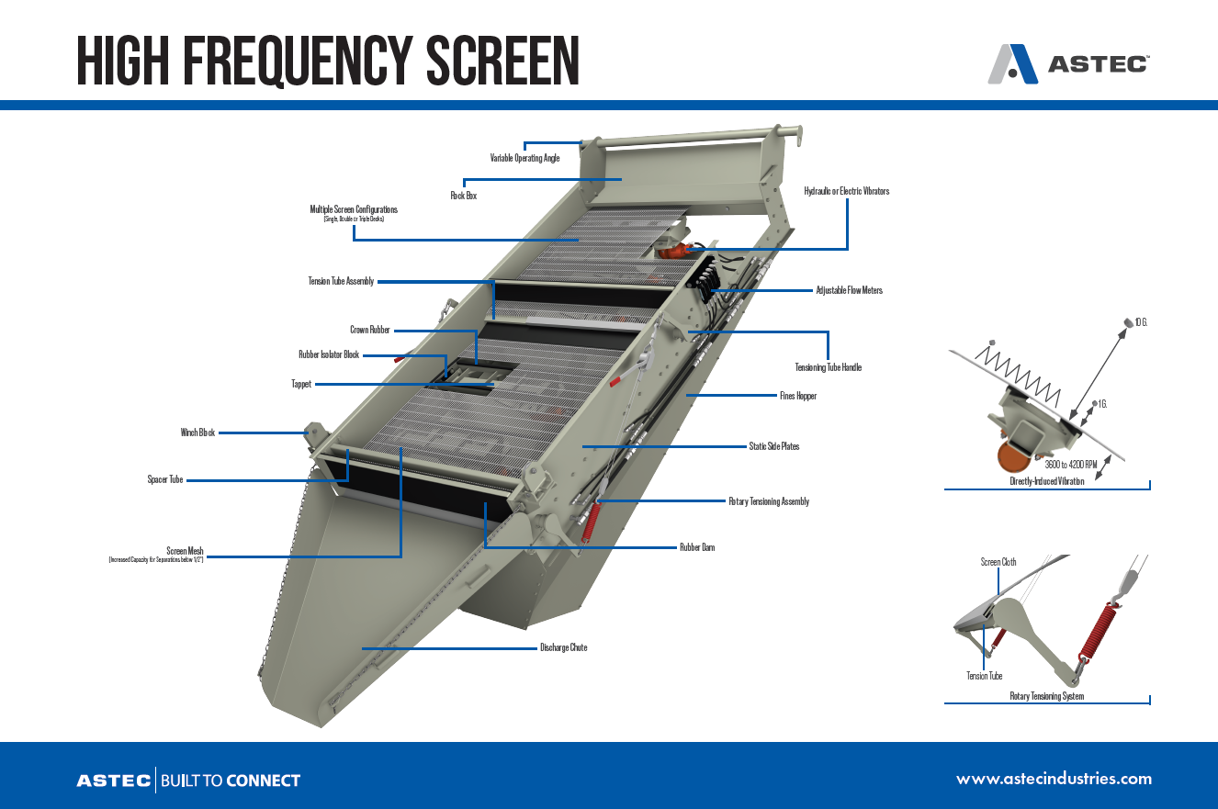
High Frequency Screens

Slide 31
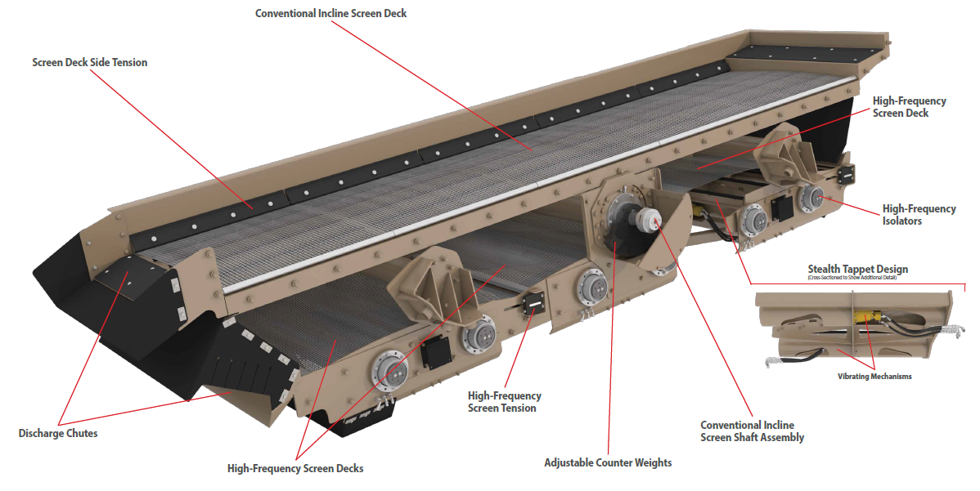
Multi Frequency screens

Slide 32
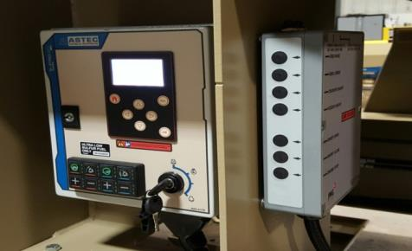
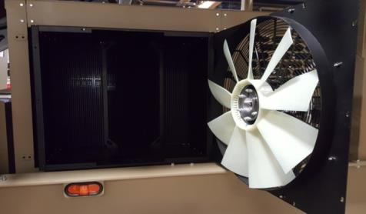
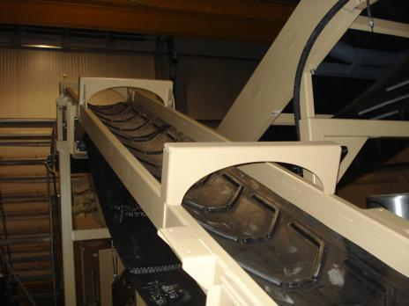
RAP: Processing
Look for designs that will help keep components clean
Clean equipment daily
Conveyor designs intended to handle slabby material
Machines that are easy to move
Machines that are easy to run

Slide 33
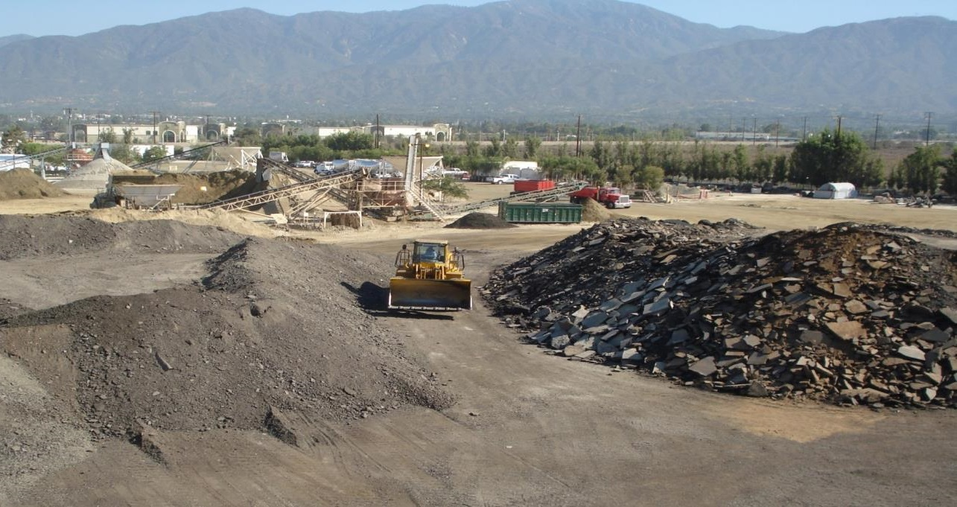
RAP: Processing
Ripped material goes to the impactor first
Millings go directly to the screen first

Slide 34
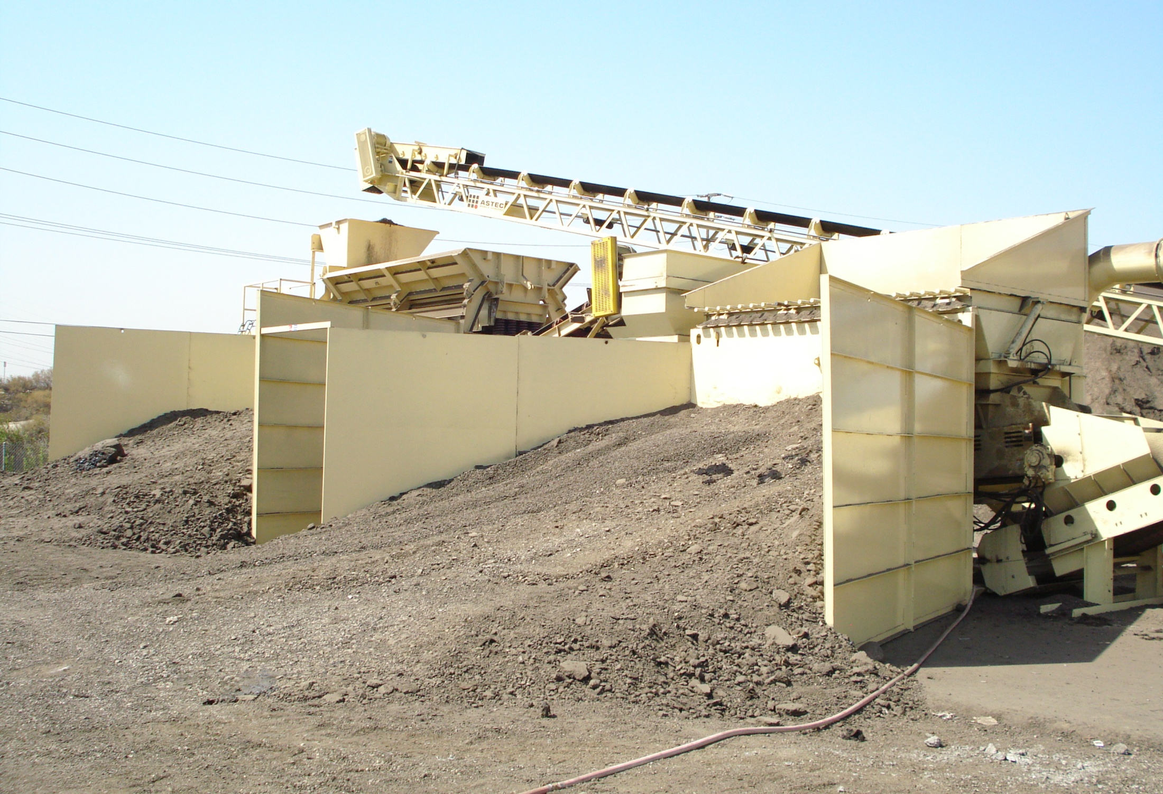
RAP: Processing
Ripped material goes in here
Millings go in here

Slide 35
RAP: Processing – Level One
Ideal for fractionating or making one size from millings
Self contained
Easily portable
Low operating cost
Low entry price for processing RAP.

Slide 36
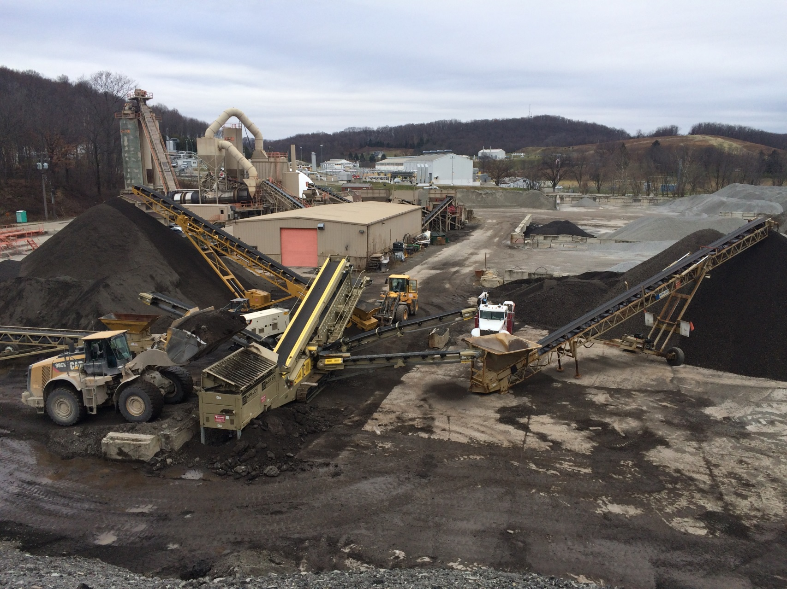
RAP: Processing – Level One

Slide 37
RAP: Processing – Level 2
Ideal for fractionating millings
Self contained
On-board HSI crusher
Easily portable
Two or three products
Closed circuit

Slide 38
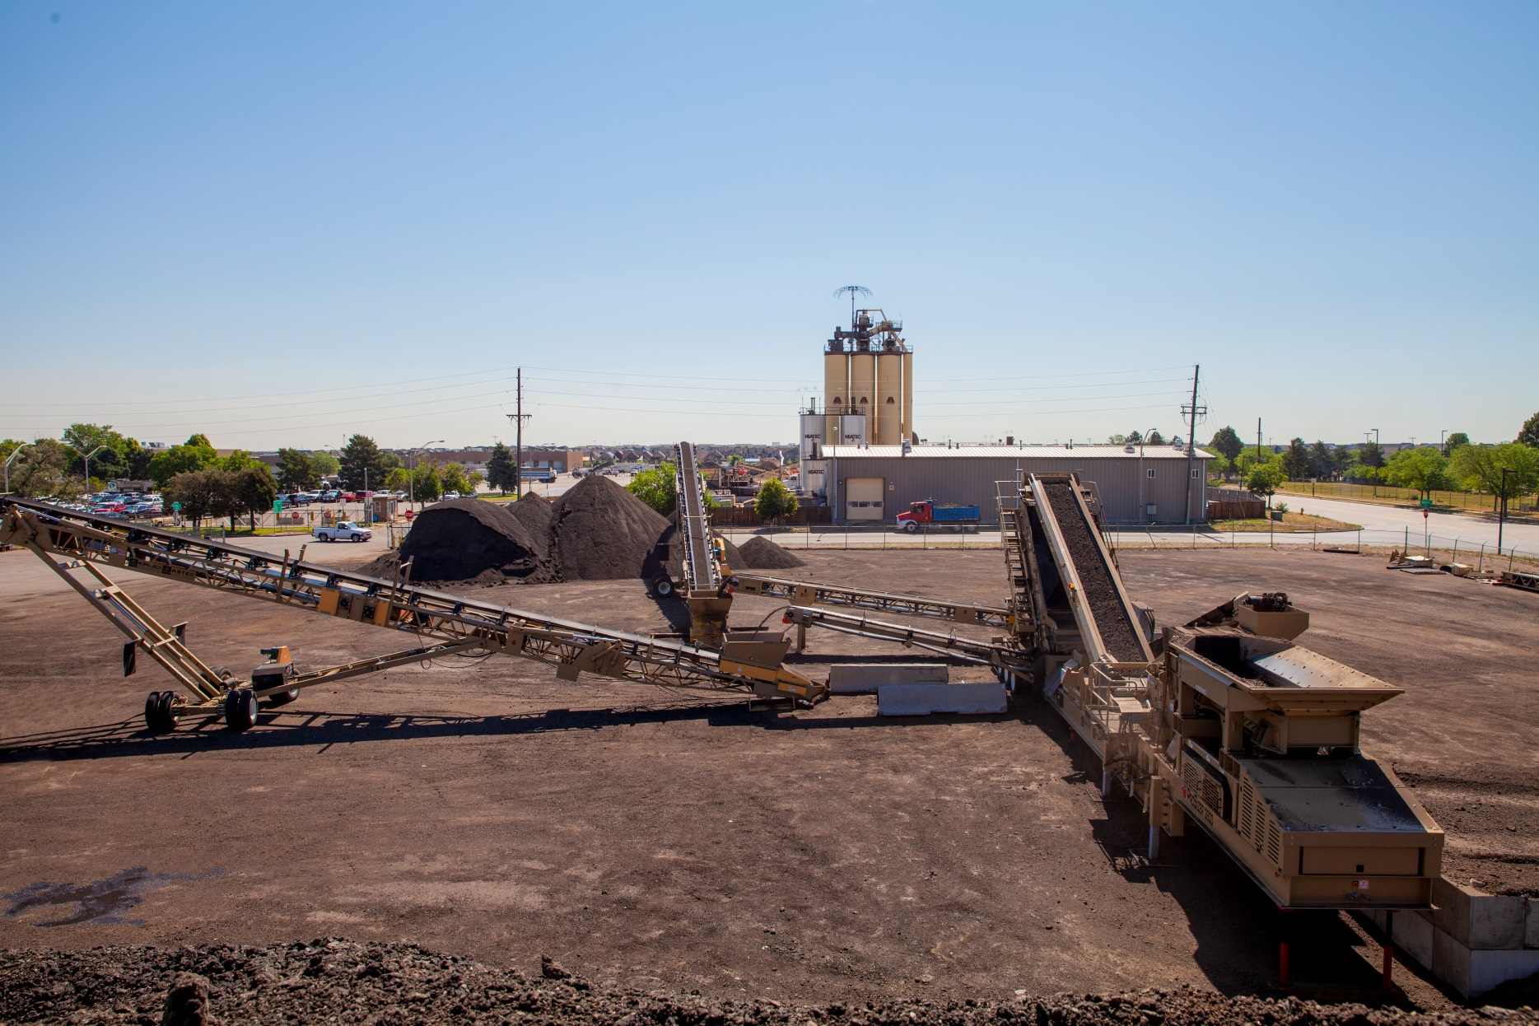
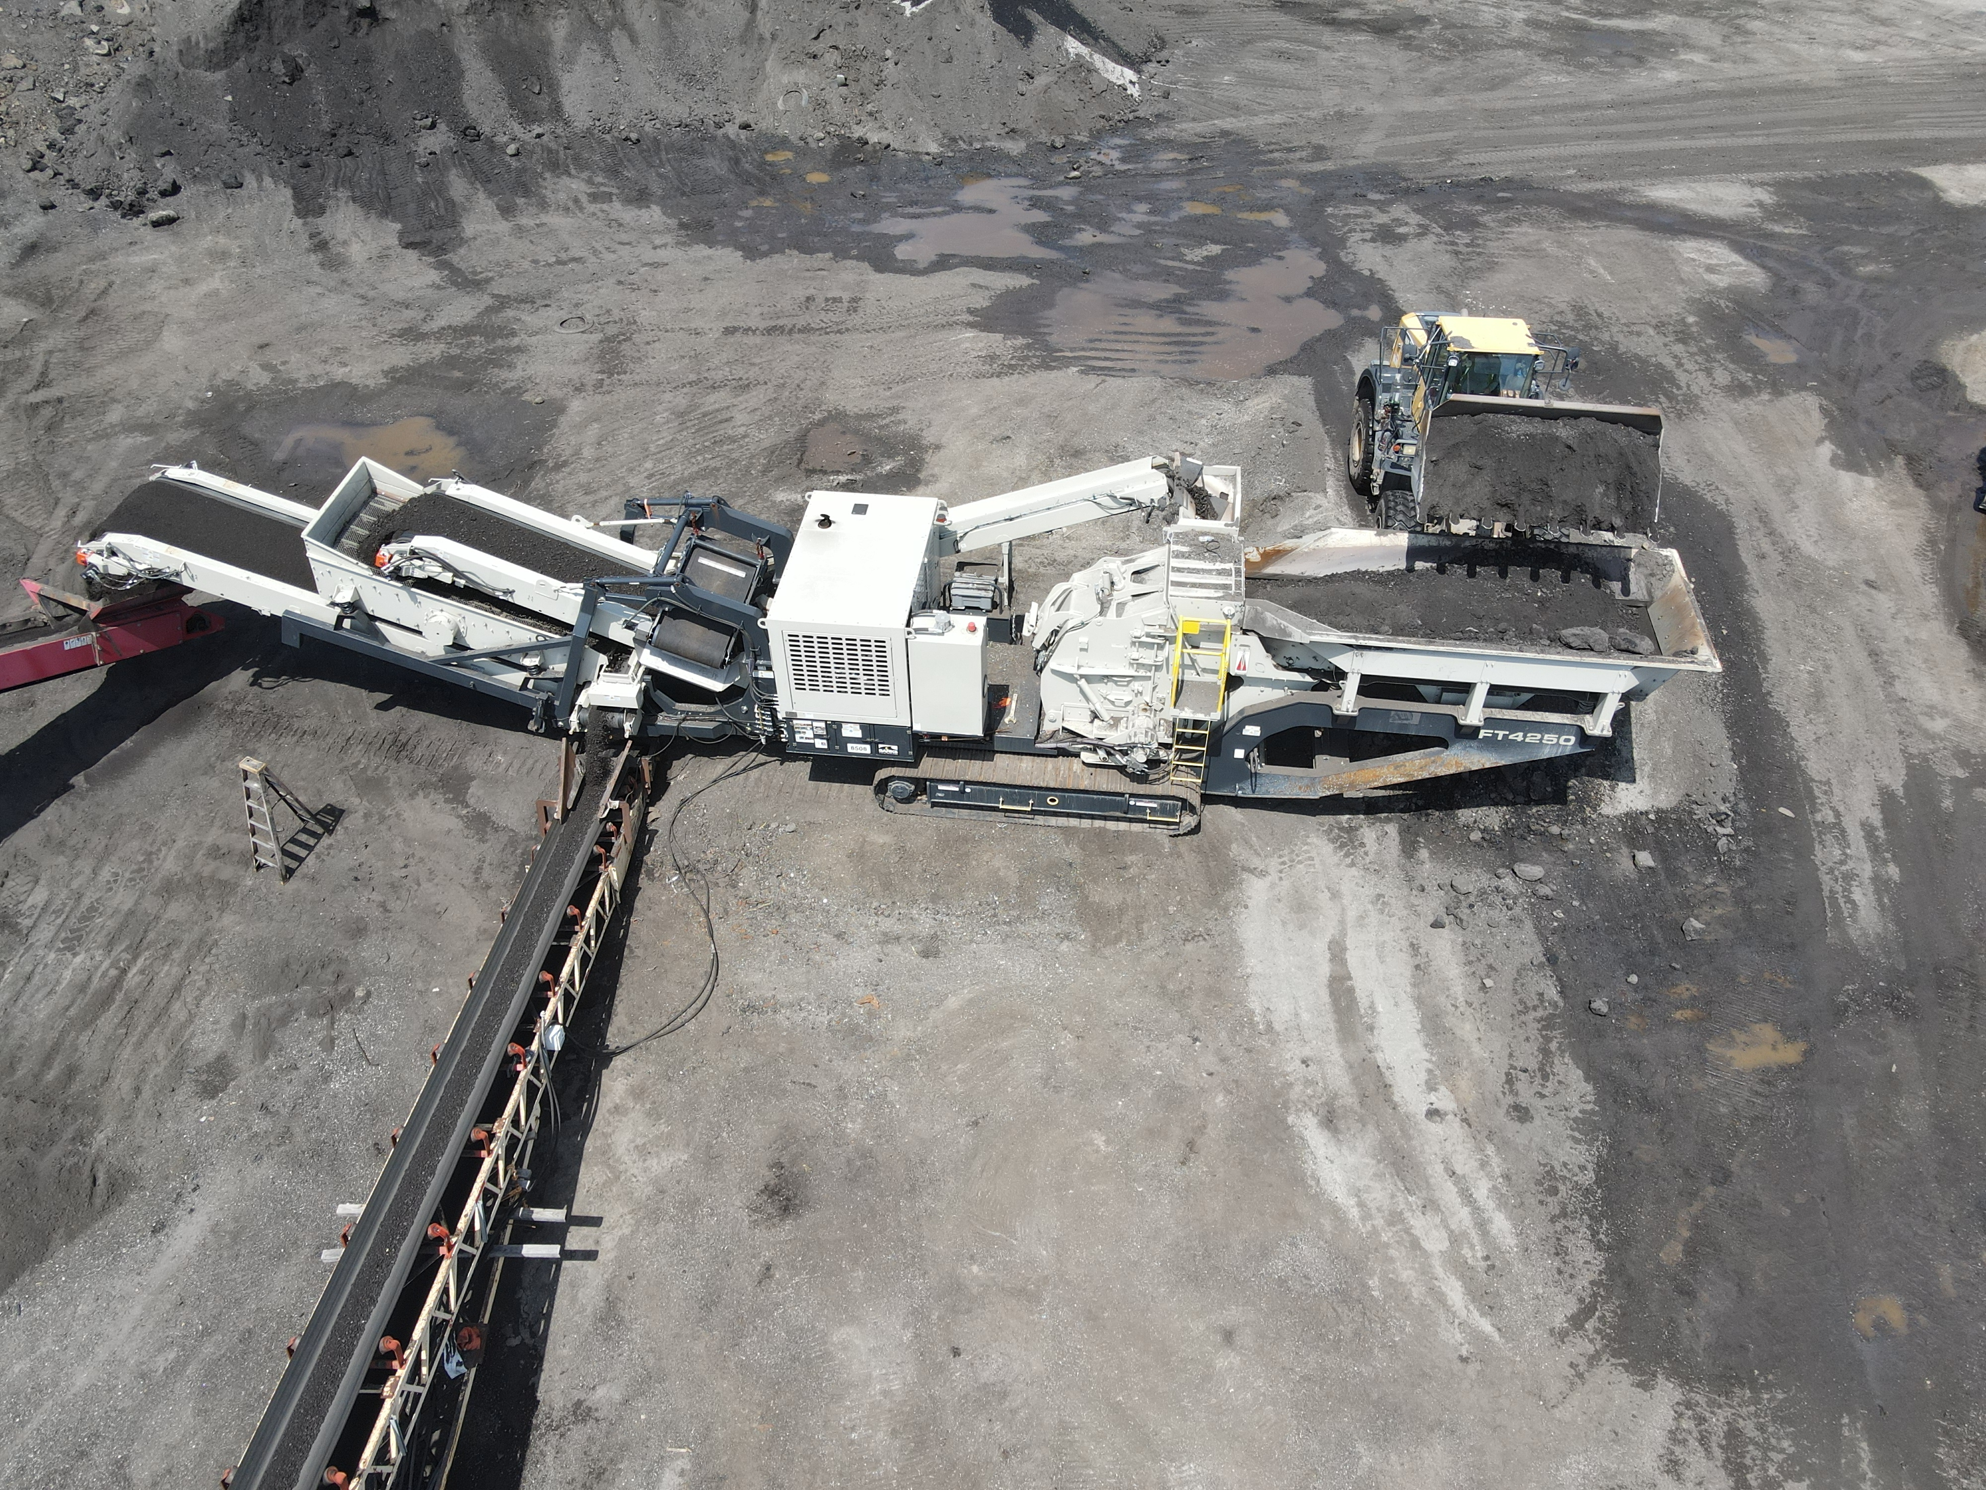
RAP: Processing – Level 2

Slide 39
RAP: Processing – Level 2

Slide 40
RAP: Processing – Level 3
Will handle any Material size
Multiple configurations
Fractionating
One-size Recycling
Closed Circuit
Open Circuit
High tonnages
Site mobile
Has uses in other materials
Concrete
Aggregate

Slide 41
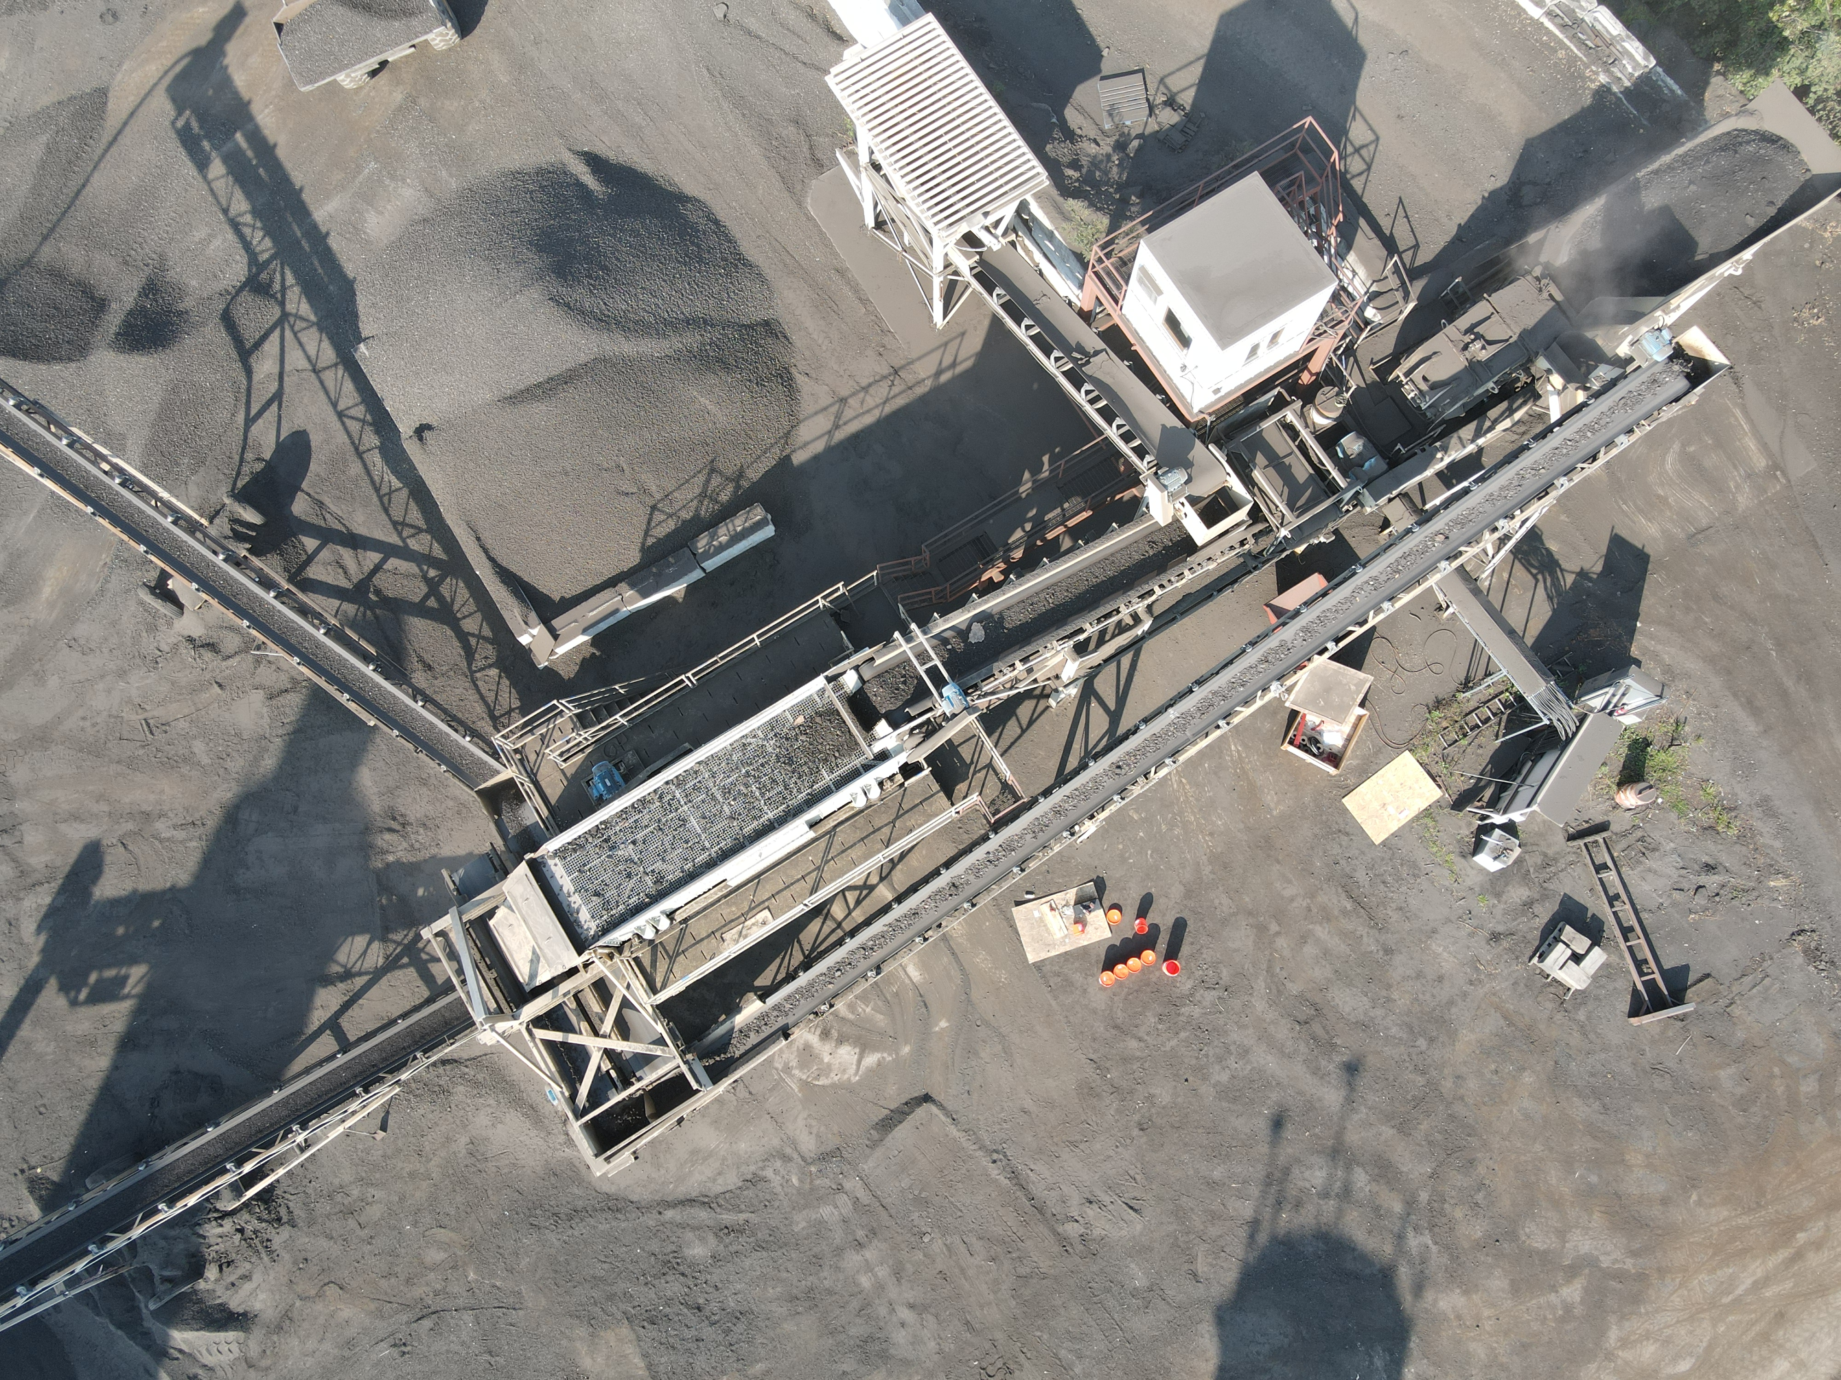
RAP: Processing – Level 3

Slide 42
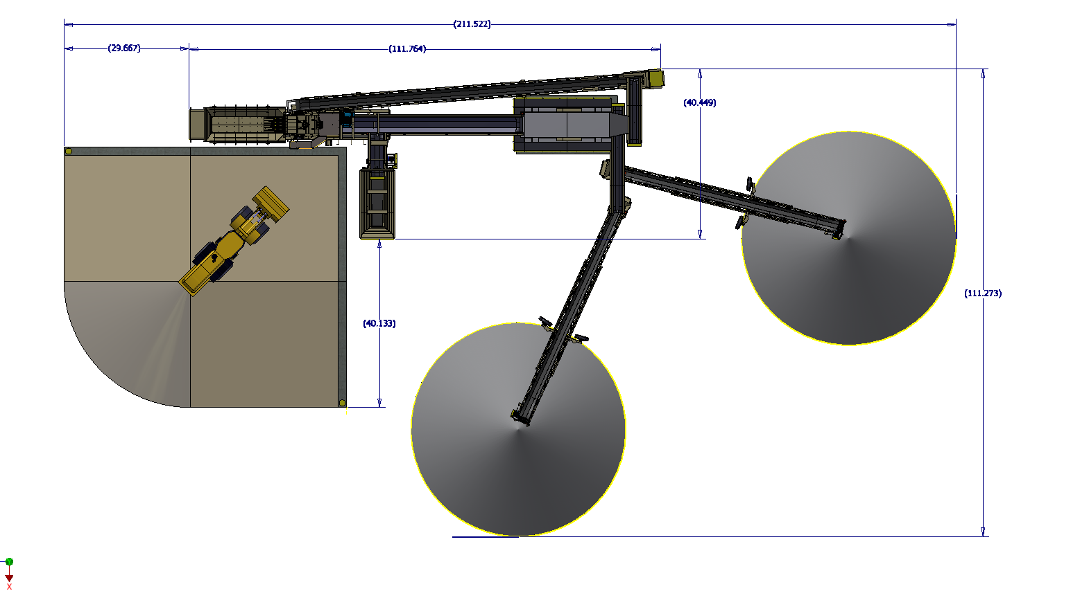
Stationary System

Slide 43
RAP: Processing – Level 4
Great for One-Site Operations
Customized to Fit Your Needs
Self Contained or Line Power
Various Tonnage and Feed Size Configurations
On-demand Sizing
Easy Access and Serviceability

Slide 44
RAP: Processing – Level 4 (Fractionating)
Produce up to five sizes
Portable/Electric
Allows an increase in RAP usage
Offers similar control as virgin product

Slide 45
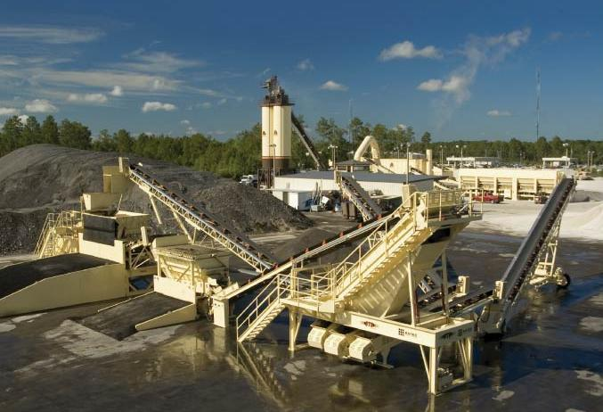
RAP: Processing – Level 4 (Fractionating)

Slide 46
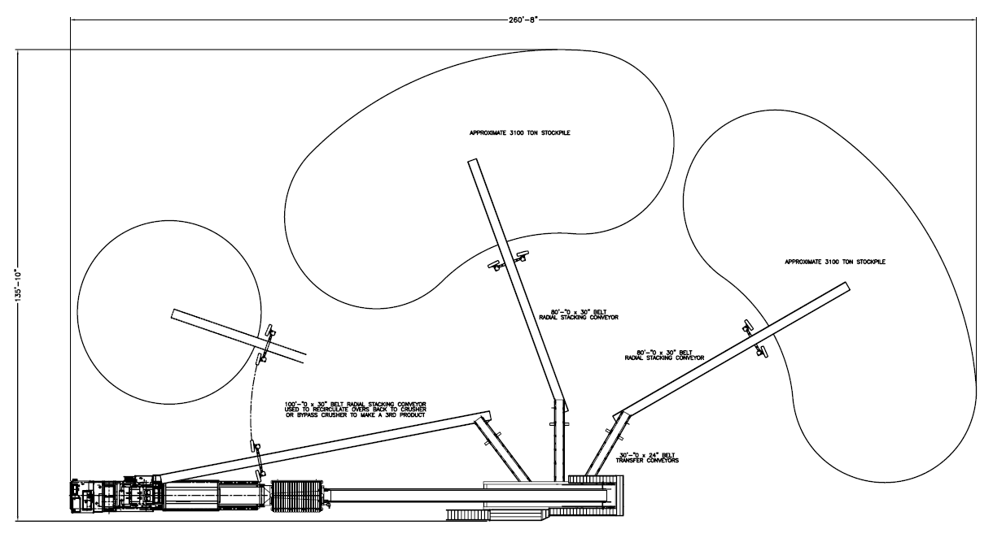
RAP: Processing – Level 4 (Fractionating)
Ripped material goes in here
Millings go in here

Slide 47
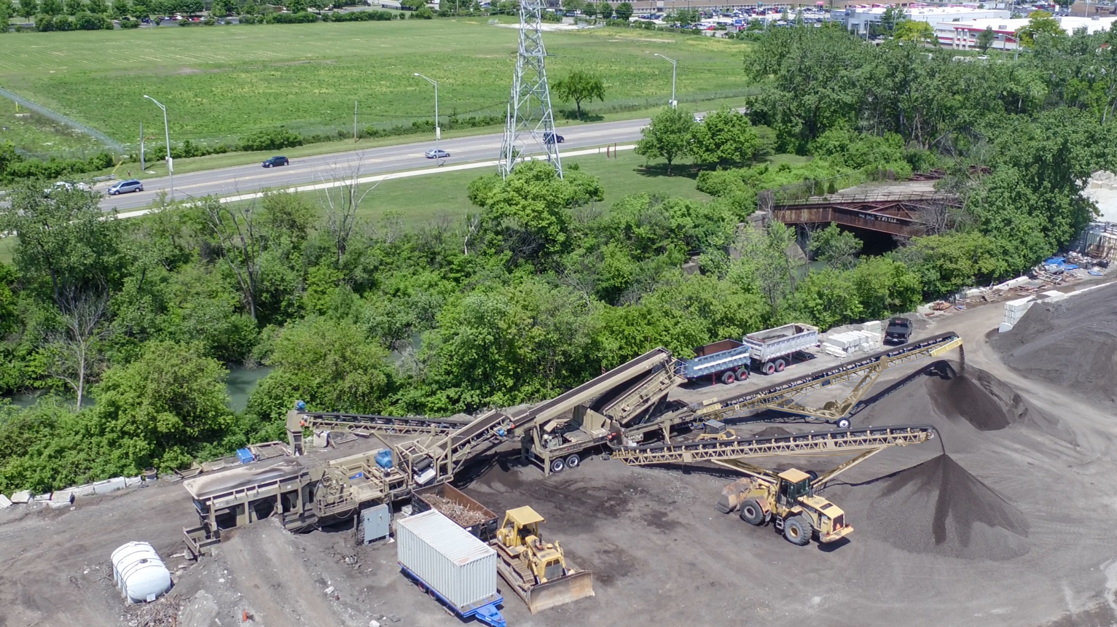
RAP: Processing – Level 4

Slide 48
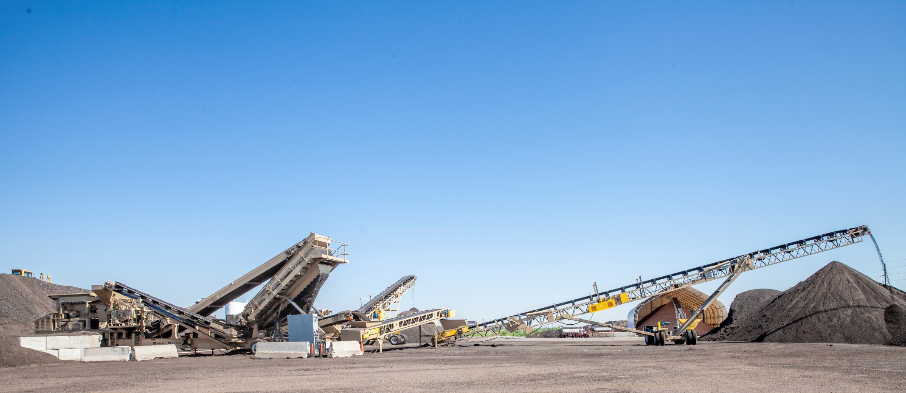
Questions

