Slide 1
Materials Update
2025 AAPA Conference
Birmingham, AL March 5th & 6th
Scott George, P.E.
ALDOT State Materials and Tests Engineer

Slide 2
OGFC Mix Design
Implementation Letter
Currently 5 mix designs approved

Slide 3
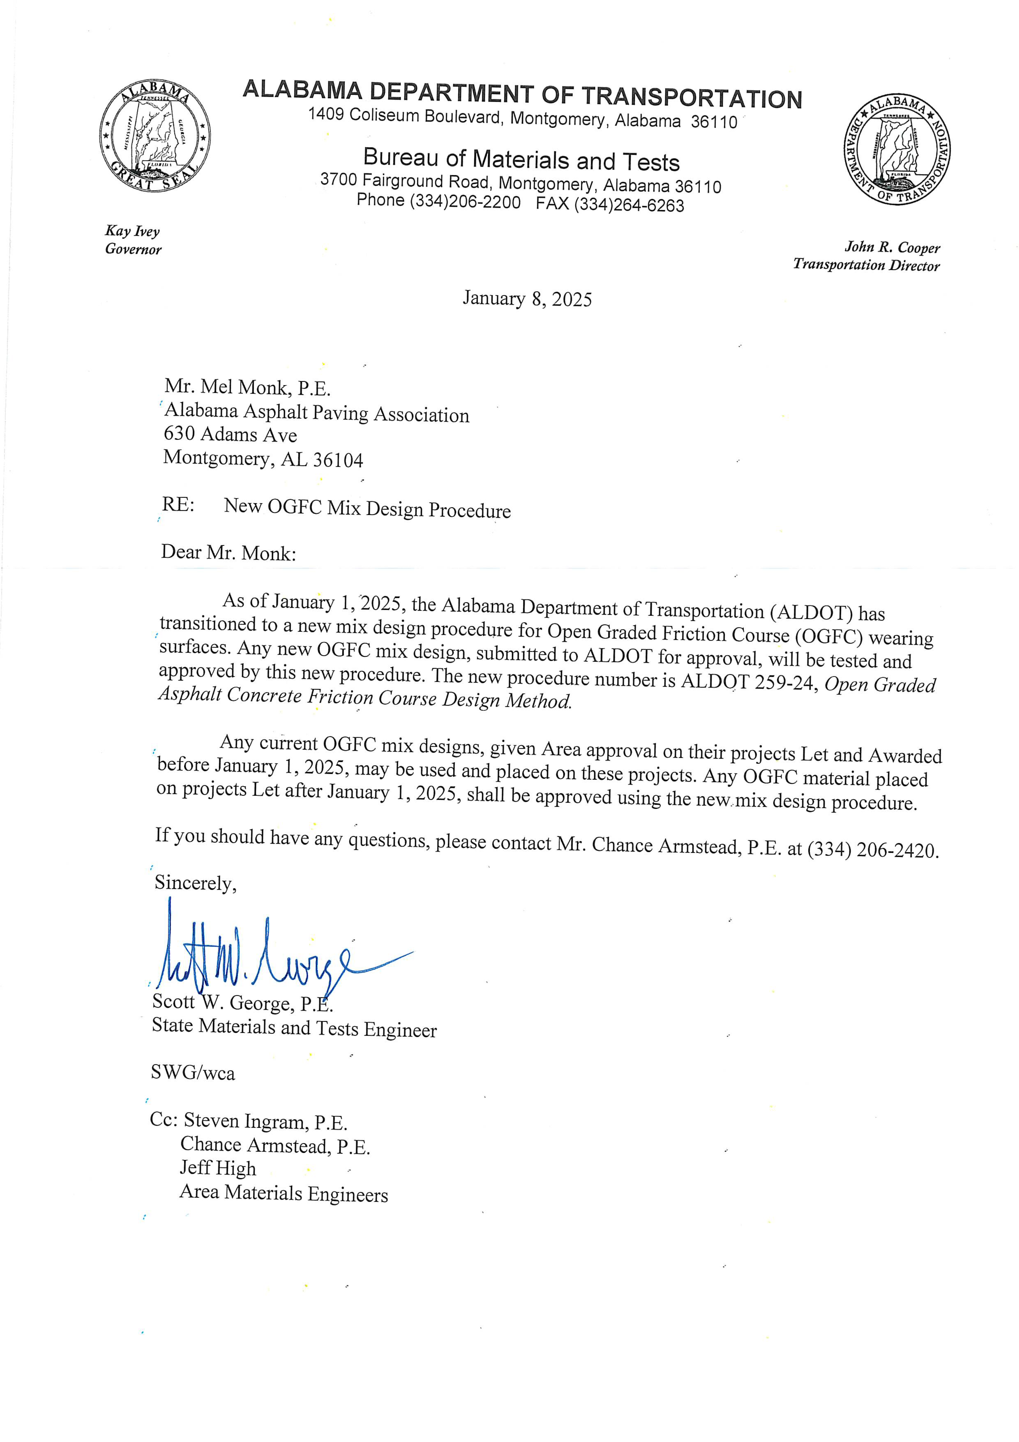
OGFC Mix Design

Slide 4
76-22 E Changes
Minimum Polymer Content 3.5%
J_{nr3.2}

Slide 5

SMA Gradation
3/8” SMA- Proposed Gradation Changes
  3/8” sieve 98% - 100% passing
  #4 sieve 75% - 100% passing
  #200 sieve 6% - 10% passing

Slide 6
Referee Testing
Add language that requires referee samples to be submitted to the central lab within 15 days of lot production.
Bureau has 15 days to report results of the referee tests.

Slide 7
Questions?

