Slide 1
ALDOT FUNDING UPDATE/ REBUILD ALABAMA ACT
Edward N. Austin, PE
Chief Engineer
Alabama Department of Transportation
March 5, 2025

Slide 2
PRESENTATION OVERVIEW
Federal Funding Program
Highway Tax Revenue Budget
Past Years Budget Performance and Letting Details
Rebuild Alabama Act (RAA) Highlights

Slide 3
FEDERAL PROGRAM UPDATE

Slide 4
FEDERAL TRANSPORTATION HIGHWAY BILL CONGRESSIONAL ACTIONS
Each year congress must approve the appropriations bill which allows spending of all federal funding. For the last four years, full year spending authority was not reached without passing several continuing resolutions
FY-2022 March
FY-2023 January
FY-2024 March
FY-2025 latest Continuing Resolution expires 3/14/2025
When operating under a continuing resolution, ALDOT lets many projects using the Advanced Construction strategy to avoid delays in the letting schedule, however some projects can still be delayed

Slide 5
INFRASTRUCTURE INVESTMENT & JOBS ACT
Impacts of extended / multiple continuing resolutions:
ALDOT must keep an ample amount of state funds on hand to cover obligations until the projects can be converted to actual federal funds
Large increase of administrative work for ALDOT and FHWA staff
Possible limits to the amount of additional spending request (August Redistribution)
Delays to time sensitive projects such as resurfacing that must be accomplished during warmer weather and projects around school zones that must be done during the summer

Slide 6
ALDOT HIGHWAY TAX REVENUE BUDGET

Slide 7
FY2025 REVENUE ESTIMATES
Federal Funds IIJA Act (Legacy Programs) $ 1,010,691,000
Federal Funds IIJA Act (New Programs) $ 118,158,000
Federal Funds IIJA Act (APD) $ 73,875,000
State Public Road and Bridge Funds $ 550,000,000
Rebuild Alabama Act (2025) $ 240,000,000
Aeronautics $ 78,000,000
                TOTAL $ 2,070,724,000

Slide 8
FEDERAL FUNDS BUDGET
Aid to Others (MPO, TAP, CMAQ, NEVI) $ 158,111,000
New Programs (Carbon Reduction & PROTECT) $ 55,931,000
GARVEE Bond ATRIP Payment $ 63,898,000
GARVEE Bond CBD Payment $ 45,550,000
Capacity/System Enhancement $ 190,335,000
Interstate Maintenance $ 180,000,000
State Route Resurfacing $ 232,000,000
Bridge Replacement (Legacy + New) $ 136,000,000
Safety $ 47,000,000
Statewide Planning $ 20,024,000
            TOTAL $ 1,128,849,000

Slide 9
STATE ROAD AND BRIDGE FUNDS BUDGET
Match for Federal Aid $ 190,056,000
Match for GARVEE Bond Payment $ 3,806,000
State Maintenance $ 185,000,000
  Routine, Bridge, Traffic, Rdwy, Misc, Emergency
State Construction $ 18,000,000
State Resurfacing (PE for Federal Aid Projects) $ 5,000,000
Administrative Overhead $ 95,000,000
State Comptroller $ 569,000
Insurance and Maintenance $ 1,555,000
Division of Procurement $ 191,000
Division of Risk Management $ 2,352,000

Slide 10
STATE ROAD AND BRIDGE FUNDS BUDGET
Other Equipment $ 12,000,000
Land and Building $ 9,000,000
Transfer to ALEA $ 1,200,000
Industrial Access Apportionment $ 11,000,000
Captive County Insurance $ 75,000
State Parks Maintenance $ 500,000
County Engineers Salary Support $ 8,821,000
Revenue Department $ 2,975,000
State Personnel $ 2,900,000
TOTAL $ 550,000,000

Slide 11
RAA FUNDS BUDGET
ATRIP-II Program $ 40,000,000
Annual Grant Program $ 15,000,000
Federal Aid Exchange with Counties $ 26,800,000
Congestion Relief/Economic Development $ 139,000,000
Match for Federal Aid $ 19,200,000
System Preservation** $ 0
            TOTAL $ 240,000,000**
** Continuing to address system preservation without RAA funds will be dependent on availability of additional matching funds needed for IIJA

Slide 12
ALDOT FUNDS TO OTHERS (FY2025)
FEDERAL FUNDS
Aid to Locals (MPO, TAP, CMAQ) $ 141,724,000
GARVEE Bond ATRIP Payment $ 63,898,000
National Electric Vehicle (NEVI) $ 16,892,000
STATE FUNDS
Match for GARVEE Bond ATRIP Payment $ 2,156,000 Transfer to ALEA $ 1,200,000
Industrial Access Apportionment $ 11,000,000
Captive County Insurance $ 125,000
County Engineers Salary Support $ 8,630,000
State Park Maintenance $ 500,000

Slide 13
ALDOT FUNDS TO OTHERS (FY2025)
Revenue Department $ 2,974,000
State Personnel $ 2,853,000
RAA FUNDS
ATRIP-II Program $ 40,000,000
Annual Grant Program $ 15,000,000
Federal Aid Exchange $ 26,800,000
Total $ 333,121,000

Slide 14
PAST YEARS BUDGET PERFORMANCE AND LETTING DETAILS

Slide 15
AVERAGE BUDGET TARGET AMOUNTS
PREVIOUS 4 YEARS
FEDERAL FUNDS + STATE MATCH
Interstate Maintenance $194,000,000
Bridge Replacement $135,500,000
State Route Resurfacing $285,000,000
Capacity/System Enhancement $184,250,000
Safety $ 47,000,000
      TOTAL $845,750,000

Slide 16
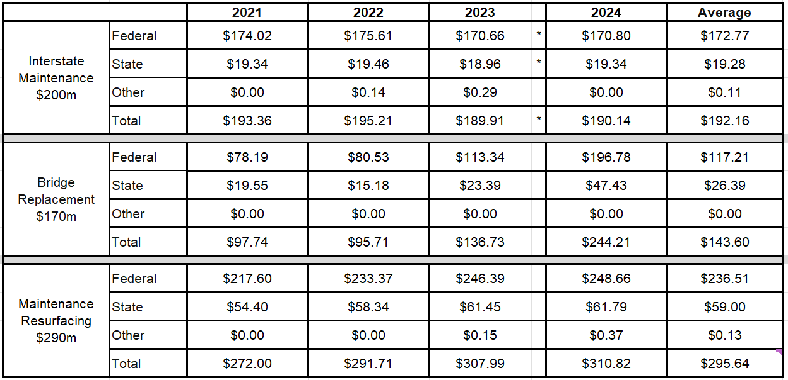
ACTUAL PROGRAM EXPENSES 2021-2024 ($ millions)

Slide 17
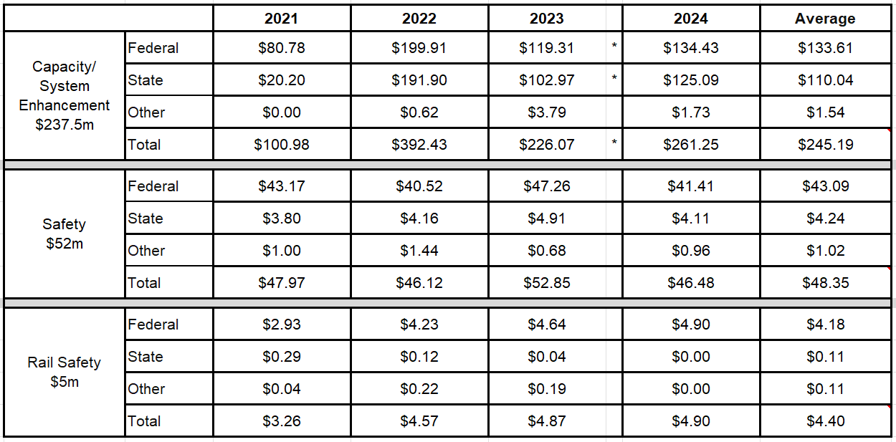
ACTUAL PROGRAM EXPENSES 2021-2024 ($ millions)

Slide 18
TARGET BUDGET COMPARISON
WITH LAST 4 YEAR AVERAGES
TARGET ACTUAL
Interstate Maintenance $194,000,000 $192,160,000
Bridge Replacement $135,500,000 $143,600,000
State Route Resurfacing $285,000,000 $295,640,000
Capacity/System Enhancement $184,250,000 $245,180,000
Safety $ 47,000,000 $ 48,360,000
      TOTAL $845,750,000 $924,940,000

Slide 19
LAST 4 YEARS LETTING
FY CONTRACTS AWARDED CONTRACT AMOUNT
2021 240 $698,650,410
2022 216 $873,645,675
2023 201 $788,480,700
  2024 201 $887,182,763

Slide 20
REBUILD ALABAMA ACT (RAA) HIGHLIGHTS

Slide 21
PROGRAMS OF LOCAL INTEREST
RAA created 2 application-based programs administered through ALDOT, ATRIP-II and the Annual Grant Program
Through 6 years of ATRIP-II (FY 2020-2025), 170 project awards for $220.8 million (must be let through ALDOT)
Through 5 years of Annual Grant Program (FY 2020-2024) ,219 project awards for $55.3 million (let locally or annual bid)
389 total project awards for $276M – 210 roadway improvements, 112 intersection improvements, 43 capacity projects and 24 bridge projects

Slide 22
ALDOT PROGRAM TYPES
3 program categories for RAA funds utilized by ALDOT:
      Congestion Relief - purpose is to add capacity to State routes, US routes and Interstate routes in highly congested areas
      Economic Development - purpose is to develop and improve transportation infrastructure enhancing economic development efforts, prioritizing projects in economically underserved areas
      System Preservation - purpose is to address the ongoing and growing preservation needs of state-maintained transportation infrastructure

Slide 23
CONGESTION RELIEF
High volume 2-lane roadway sections, overcrowded 4-lane interstate or state route sections, and missing gaps in a multi-lane roadway sections in locations where traffic counts justify consideration
Projects underway:
  Waterways Bridge in Baldwin County
  I-59 additional lanes from I-459 to Chalkville Mountain Rd
  I-565 additional lanes from County Line Rd to Wall Triana Blvd
Projects upcoming:
  I-59 Additional lanes from Fairfield Blvd. to Valley Rd.
  Eastern Connector in Gadsden (I-759 extension to US-431)

Slide 24
ECONOMIC DEVELOPMENT
2-lane roadways in counties without a 4-lane connection to an interstate or sections of roadways that have missing gaps in existing multi-lane corridors
Goal is to complement economic develop opportunities with transportation improvements in areas of the State economically underserved historically
Projects underway:
  Bridge widening on Huntsville-Brownsferry Rd at I-65 in Limestone County
    aligns with City of Huntsville project for Toyota/Mazda access
  SR-52 widening from near Malvern to Hartford
    Split into phases: first contract awarded Construction scheduled for completion in late 2026 or early 2027
  West Alabama Highway (WAH) from Thomasville to Moundville
    fills in the gap completing 4-lane corridor between Mobile and Tuscaloosa

Slide 25
WEST ALABAMA HIGHWAY
Linden Bypass portion of WAH addressed with two Design-Bid-Build projects, both have been let with construction ongoing
Remaining portion advancing utilizing a Progressive Design-Build procurement
Design Build Agreement (DBA) executed in November 2023
Preconstruction activities are ongoing at the co-location facility with construction expected to start later in 2025

Slide 26
??QUESTIONS??

