Slide 1
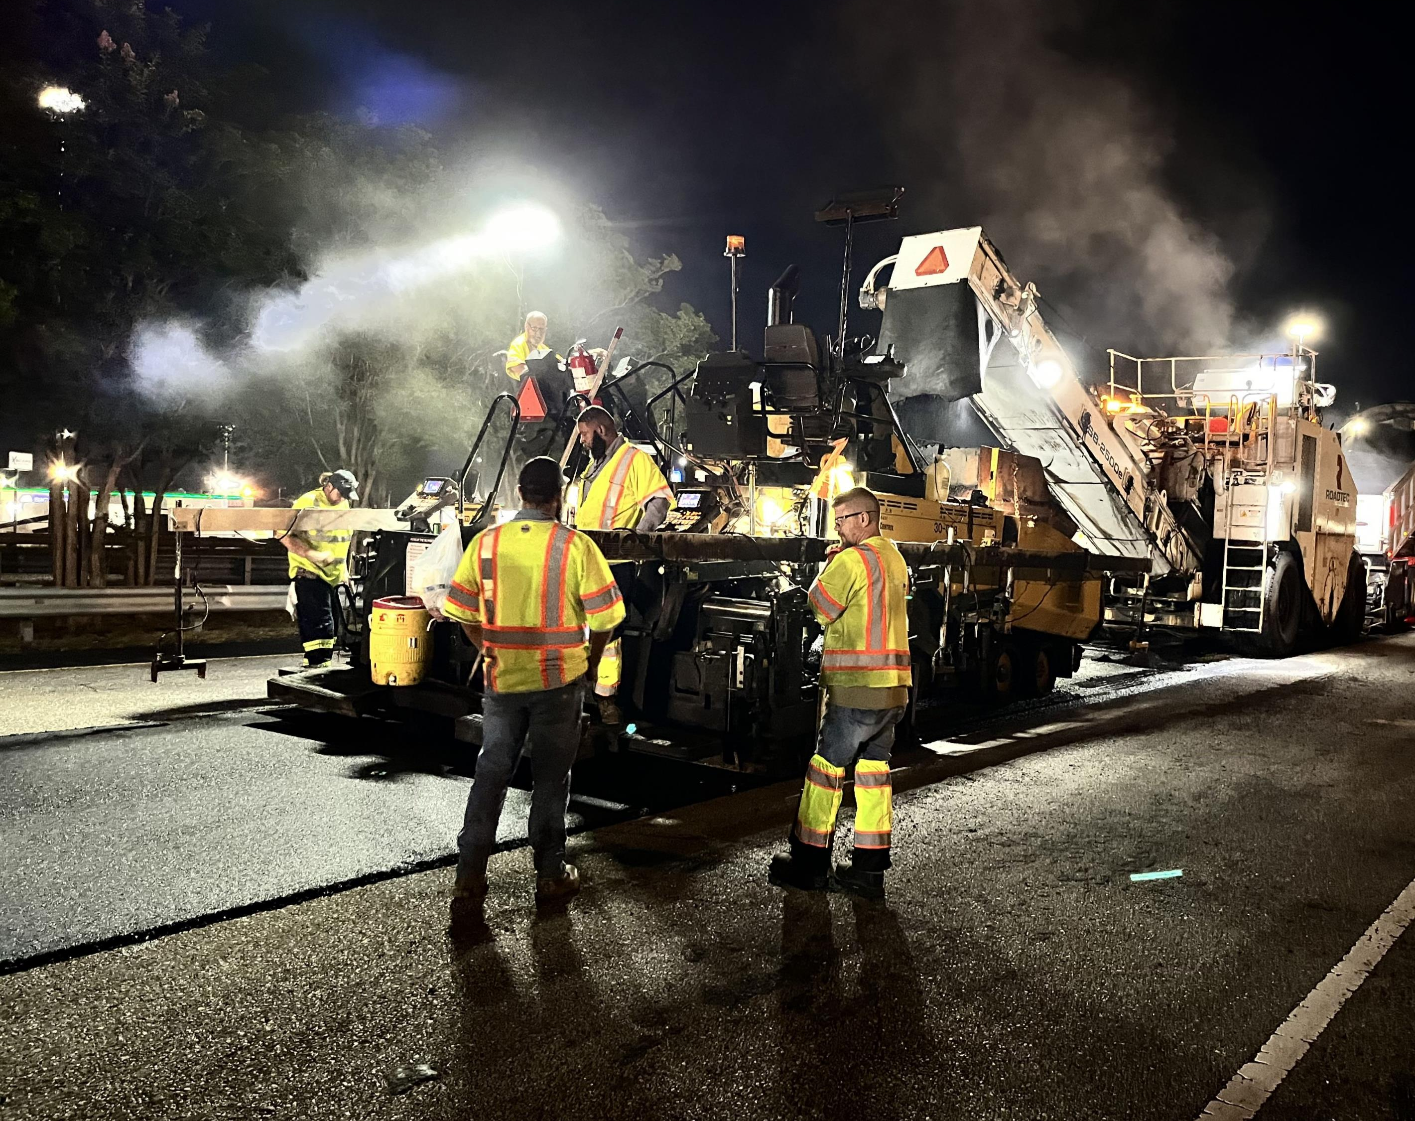


34th Annual
Alabama Asphalt Pavement Conference
March 5 – 6, 2025
Stacey N. Glass, P.E.
State Construction Engineer

Slide 2
Fiscal Year 2025 Resurfacing Program
Interstate Maintenance (IM) – $190 Million
Federal-aid Maintenance (FM) Resurfacing – $270 Million

Slide 3
FY25 IM Resurfacing Program
$190M budgeted for IM FY25 program
Planned to let 25 projects
  4 projects have let as of the February letting
15 pavement preservation projects
  11 PM2 projects
  4 PM1 projects
  Covering 7 Areas
Notes:
15 PM1/PM2 Projects:
IM-I065(548)/(549) Morgan, Cullman, and Limestone Counties (PM2)
IM-I085(388)/(389)/(390) Macon County (PM2)
IM-I065(560) Butler County (PM2)
IM-I065(561) Montgomery County (PM1)
IM-I085(XXX) Montgomery County (PM1)
IM-I010(XXX) Mobile County (PM2)
IM-I010(XXX) Baldwin County (PM2)
IM-I022(321) Walker County (PM1)
IM-I020(371) Calhoun and Cleburne Counties (PM2)
IM-I020(370) Talladega County (PM1)
IM-I459(XXX)/(XXX) Jefferson County (PM2)
11 PM2 projects
4 PM1 projects

Slide 4
FY25 IM Resurfacing Program
1 PMR (pavement minor rehabilitation) Project
  I-59 (MP 0.000 – MP 1.690) Sumter County
2 PVR (pavement rehabilitation – reconstruction) Projects
  I-459 (MP14.794 – MP 17.350) Jefferson County
  I-59 (MP 225.600 – MP 241.170; Southbound only) DeKalb County
7 Other Projects
  2 Additional Lane projects (IM funding covered the resurfacing of the existing roadway)
  5 Sign Replacement projects
Notes:
1 PMR Project:
IM-I059(453): MP 0.0 – 1.69; Sumter County
2 PVR Projects:
IM-I459(XXX); MP 14.794 – 17.350; Jefferson County
IM-I059(427); MP 225.6 – 241.17; Southbound only; DeKalb County
7 Other Projects:
2 projects IM funding was used to resurface the existing roadway within the Additional Lane projects
I-65; MP 231.0 – 233.8; Shelby County*
I-65; MP 236.1 – 239.3; Shelby County*
5 Sign Replacement projects
I-65 Limestone County*
I-65 Morgan County*
I-22 Fayette Areawide
I-22 Birmingham Areawide
I-85 Chambers County

Slide 5
FY25 FM Resurfacing Program
Area | Federal Aid (FM) | Percentage
Guntersville | $34,091,000 | 12.63%
Tuscumbia | $24,474,000 | 9.06%
Birmingham | $20,947,000 | 7.76%
Alexander City | $25,121,000 | 9.30%
Tuscaloosa | $23,056,000 | 8.54%
Montgomery | $35,631,000 | 13.20%
Troy | $39,005,000 | 14.45%
Grove Hill | $23,071,000 | 8.54%
Mobile | $21,314,000 | 7.89%
Fayette | $23,290,000 | 8.63%
Total: | $270,000,000 | 100.00%

Slide 6
FY25 FM Resurfacing Program
$270M budgeted for FM FY25 program
Planned to let 76 projects
49 projects let as of February letting
27 projects to let before May deadline

Slide 7
FM Resurfacing Program
5 Year Summary
 | 2021 | 2022 | 2023 | 2024 | 2025
# PROJECTS | 107 | 106 | 99 | 92 | 76
# CL MILES | 611 | 640 | 535 | 534 | 434
# LANE MILES | 1673 | 1684 | 1496 | 1484 | 1268
PM 1 | 15 | 15 | 10 | 20 | 10
PM 2 | 71 | 76 | 69 | 61 | 51
PMR | 21 | 15 | 20 | 11 | 15

Slide 8
Update on e-Ticketing
eTicketing for Asphalt is now mandatory on all ALDOT Let Projects (City/County Projects are optional).
Paper Tickets are still allowed, however eTicketing is preferred.
Rollout of Aggregate e-Ticketing ramping up this year.
Reminder: Be prepared to send test ticket by date of preconstruction conference or 14 days before first day of paving.
  This creates a connection to the portal and avoids delays on first day of paving/aggregate installation.
If project is missing in picklist on HaulHub, please contact either the Area Construction Engineer or Alec Harris.
Notes:
Aggregate e-Ticketing Test Projects ongoing:
RACRNH-RACRIM-I059(429) Birmingham
HSIP-5119(250) Montgomery
January letting:
NH-0008(612) & ATRP2-57-2024-398 Montgomery
IM-I059(448) & ATRP2-37-2022-037 Birmingham
BR-00063(507) Alex City

Slide 9
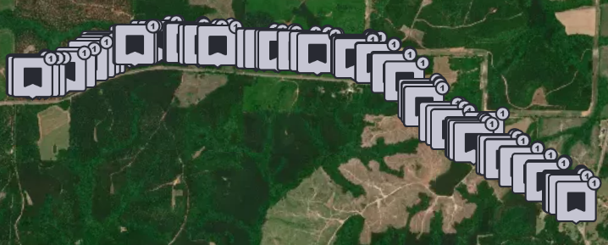
Update on e-Ticketing
Stationing and design files (alignment/utilities) coming in app.
Right now, map feature shows location of tickets being accepted.

Slide 10
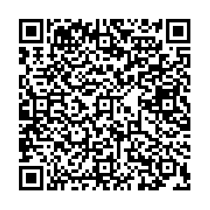
e-Ticketing Questions ?
Contact Alec Harris
  e-Construction Engineer
  ALDOT Construction Bureau
  Office: (334) 242-6042
  Email: harrisal@dot.state.al.us

Slide 11
Project Closeout Committee Goals/Objectives
Review current closeout requirements in the Specifications and the Construction Manual
Getting feedback from all Areas, forms used, etc.
Looking to update Specifications and Construction Manual requirements with Committee findings
Possible return of Form C-30 or equivalent form
Be on the lookout for an upcoming CIM for non-payment for materials without Test Reports or Certifications

Slide 12
Project Closeout Committee Members
Stacey Glass
Brad Williams
Dudley Smith
Cooper Calhoun
Robert Shugart
Terence Williamson
Wayne Tew
Sam Fountain
Travis Kilgore
Andrew Sampsell
Jordy Fleming

Slide 13
Draft Process
Define Step by Step Process from Specifications and Construction Manual
Establish realistic durations for activities not defined

Slide 14
Project Closeout Committee
Punchlist Language Update
Notice of Substantial Completion / Punchlist Process
  Current Specification allows either party to initiate substantial completion/punchlist process
  Proposed modifications to language for ALDOT to initiate the process

Slide 15
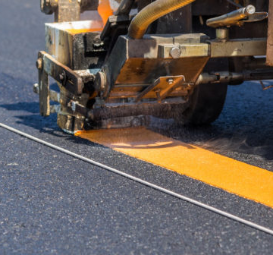
Striping Memo
Current update (2/28/2025)
  Provides guidance to hold time charges for 14 days once striping becomes the controlling item of work. Expires 12/31/2025

Slide 16
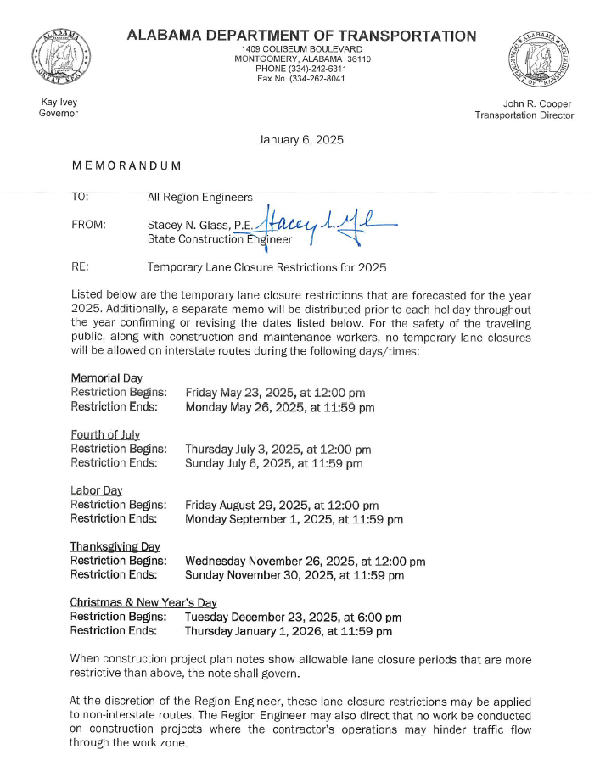
2025 Holiday Schedule for Lane Closures
Memorial Day
  Fri 5/23/25 at 12 PM through Mon 5/26/26 at 11:59 PM
July 4th
  Thurs 7/3/25 at 12 PM through Sun 7/6/25 at 11:59 PM
Labor Day
  Fri 8/29/25 at 12 PM through Mon 9/1/25 at 11:59 pm
Thanksgiving
  Wed 11/26/25 at 12 PM through Sun 11/30/25 at 11:59 PM
Christmas & New Year’s
  Tues 12/23/25 at 6:00 pm through Thurs 1/1/26 at 11:59 pm

Slide 17
GASPs Since Last AAPA Conference
Name | Section | Effective Date | Subject
22-GA0037 | 501 | 4/1/2024 | Structural Portland Cement Concrete
22-GA0013(2) | 710, 740, 880 | 6/1/2024 | Roadway Signs, Construction Signs, and Cones
22-GA0030 | 450 | 6/1/2024 | Portland Cement Concrete Pavement
22-GA0041 | 504 | 6/1/2024 | Steel Piling Encasement
22-GA0043 | 546 | 6/1/2024 | Micropiles
22-GA0039 | 433 | 8/1/2024 | Scrub Seal
22GA0009 | 650 | 12/1/2024 | Application of Topsoil
22-GA0042(2) | 506 | 12/1/2024 | Drilled Shaft Construction
22-GA0046 | 410 | 1/1/2025 | Material Remixing Device
22-LD0001(2) | 108 | 1/1/2025 | Liquidated Damages
22-GA0044(2) | 232,817 | 3/1/2025 | Lime Stabilized Roadbed

Slide 18
GASPs Since Last AAPA Conference
22-GA0039 – Scrub Seal
  Change of requirements for Emulsion
  Addition of aggregate embedment requirement
  Reference Emulsion Broom Sled
  Increase time requirement for second power sweeping from 2 to 72 hours
  Increase of curing period from 72 hours to 7 days

Slide 19
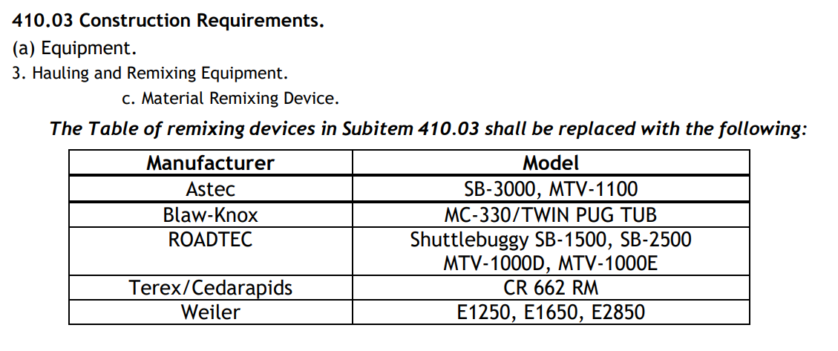
GASPs Since Last AAPA Conference
22-GA0046 – Material Remixing Device
  Added Astec MTV-1100

Slide 20
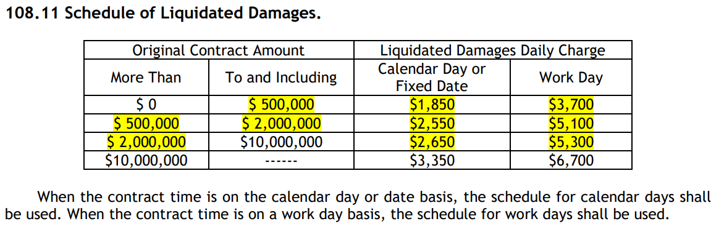
GASPs Since Last AAPA Conference
22-LD0001(2) – Liquidated Damages Update

Slide 21

CPM Schedule Update
Since January 2024 Letting, 33 projects required a CPM Schedule
Baseline Review by Construction Bureau
Monthly Updates at Area/Project Level
Very good results with CPM Schedule usage and monthly updates

Slide 22
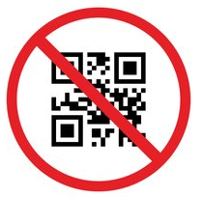
Questions
Stacey Glass
ALDOT State Construction Engineer
Office: (334) 242-6209
Cell: (334) 850-4872
Email: glasss@dot.state.al.us

