Slide 1


Thick Lift Paving In SC
Cliff Selkinghaus
SCDOT Asphalt Materials Manager
Credit: Jay Thompson – Former State Pavement Design Engineer

Slide 2
Lift Thickness
3 to 4 x NMA Size is common practice
Concerns: obtain uniform texture in the finished mat, compaction, drop off concerns, etc.

Slide 3
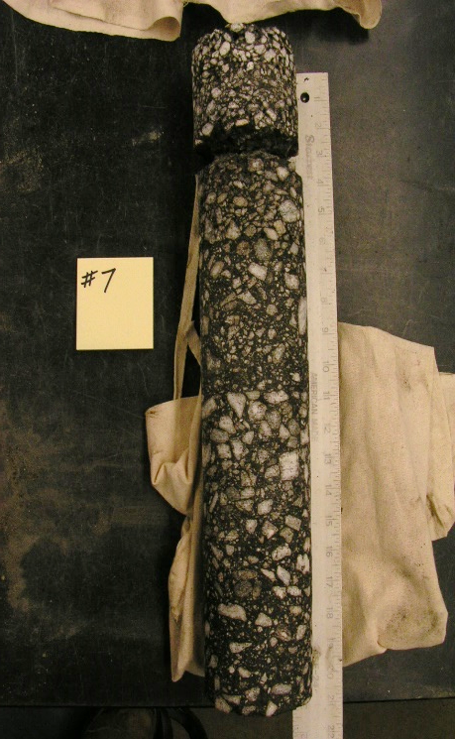
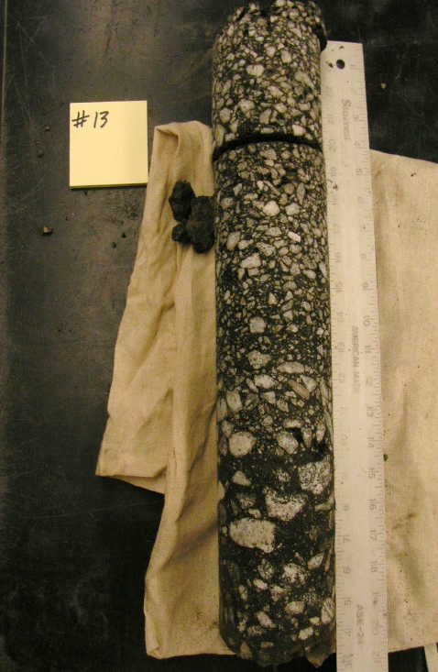
I-85 Spartanburg
Mile Marker 56 to 68
2014-2015
Left and Middle Lanes Only
Near Surface Distress
Average Depth of Asphalt 19 inches
16 of 18 Cores NB and 9 of 9 Cores SB distresses in upper 5 inches
The surface conditions of the locations where distress was limited to the upper 5 inches was fair, with relatively low severity or, in limited cases, no longitudinal wheel path cracking

Slide 4
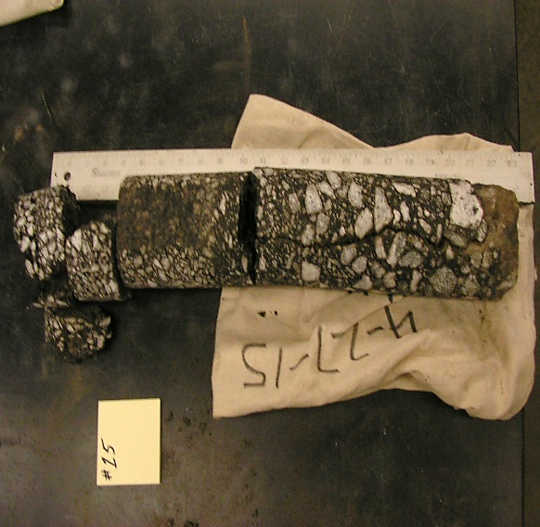
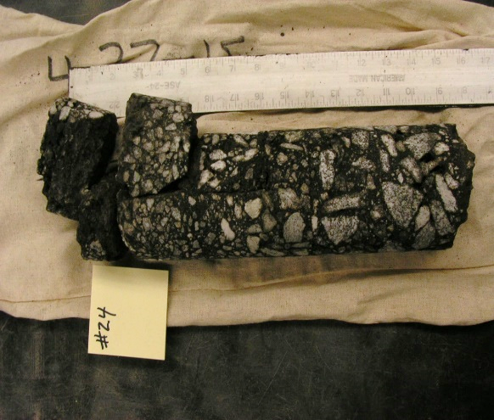
I-85 Spartanburg
Mile Markers 56 to 68
Right - Travel Lane Only
Failures within 8 inches:
9 of 18 SB and 5 of 9 cores NB exhibited similar variable material quality and failures extending to a depth of at least 8 inches.
Surface conditions were fair to poor, with well-defined longitudinal wheel path cracking.
Area prone to potholes almost every night.
Failures greater than 8 inches:
7 of 18 SB cores exhibited cracking and distress extending below 8 inches to full depth cracking and deterioration
3 of 18 SB and 1 of 9 NB cores were noted as being significantly cracked and deteriorated full depth
Surface conditions were similar to distresses within 8 inches and typically included 2 longitudinal wheel path cracks.

Slide 5

Design Limitations
Ultimately: 50+ years of 2-4” mill and fill caught up to us!
Structurally deficient. Existing SN was 7.45. Design required 8.20.
Cant build up significantly for additional structure.
Deterioration in upper 5 inches throughout.
50% or more of critical lane has distress 8 inches to full depth.
Traffic control limited to nightly closures and extended weekend closure.
Design was further altered post award (VE) working with contractor.
Reduced to 1 lift of 450 psy in left and middle lanes and 2 lifts of 495 psy in right lane.
Eliminated the need for Surface E – 4.75mm leveling course to address drop off restrictions of > 2”.
Required test strip to build confidence..
  Numerous concerns about compaction and the amount of production.
  Results turned out better than expected!

Slide 6
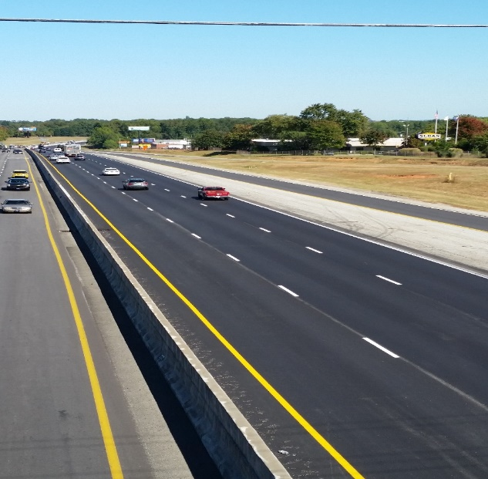
How Did it Ride?
After Intermediate
  Outside 99
  Center 94
  Inside 88
After some repair (micro mill select areas) and 2” of Surface A
  Right 51
  Middle 53
  Left 65

Slide 7
What mix did we use?
Intermediate B Special
Mix Design Objectives:
Place a mix that would hold up under traffic (stiffness) and serve as a riding course and fine enough in gradation to seal out water if left exposed for several months, or until next construction season until final surface and OGFC could be placed on top.
Make a mix that is easier to compact and obtain has much maximum density as possible.
Return to heavy traffic the next morning prior to rush hour on a High Volume Interstate.

Slide 8
Intermediate B Special
1) What mix could we use that would be good under traffic (Strength and Durability) and would be fine enough to seal out water if left exposed for months-years?
Use an older 12.5mm Superpave Surface, now called Intermediate B.
Use PG 64-22 vs. PG 76-22 – save $
Allows up to 30% Aged Binder (RAP)
Current Intermediate B Mix is typically placed at 2”depth. (4 x NMA size)

Slide 9
Intermediate B “Special”
2) How do we make the current Intermediate B mix to make it more durable and easier to compact?
Lower Design / Field Air Void Targets
4.00% to 2.75% (increase binder content)
Lower Gyrations 100 to 75 gyrations (increase binder content)
Still allow RAP to increase stiffness – adding rut resistance
Use WMA to aid in compaction process

Slide 10
Intermediate B “Special”
3) How do we obtain the lowest return to traffic temperature, reducing the chance of premature rutting and pavement damage?
Cessation temp was a major concern due to the depth of placement.
Use WMA Technology - WMA Chemical Process

Slide 11
Intermediate B “Special”
4) How do measure in place compaction and ensure we are confident in the contractor’s efforts?
SCDOT Concerns:
We did not want to cut full depth cores every night and leave holes that could not be compacted properly full depth.
Concerns with requiring the contractor to stop early enough so QC could cool the pavement down and cut cores and fill holes prior to opening to morning traffic.
Concerns with vertical edges -joints getting enough compaction.
Require a Test Section….

Slide 12
Intermediate B “Special”
Test Section Requirements….
Obtain full depth cores only in the test section and take gauges shots to establish offsets.
Cores and gauge shots taken in mainline and on within 6-12” of vertical joints.
Cores sliced into multiple layers to ensure density was obtained from bottom up..
Several different gauges used in case of malfunction and in anticipation of starting two milling-paving operations.
Nuclear and Electronic Gauges Used

Slide 13
Intermediate B “Special”
5) Require a Contractor QC Plan*
Required to make contractor produce an approved plan that would address concerns with:
Lane Closure Restrictions – High Traffic
Milling Operations
Backup asphalt plant - Available in case of breakdown
Cleanup – Sweeping operations – Deep hole to clean
Tack – Address concerns with break time - coverage
Paving – MTV and Trucks
* Ability to amend the QC plan nightly if needed to maximize production and quality.

Slide 14
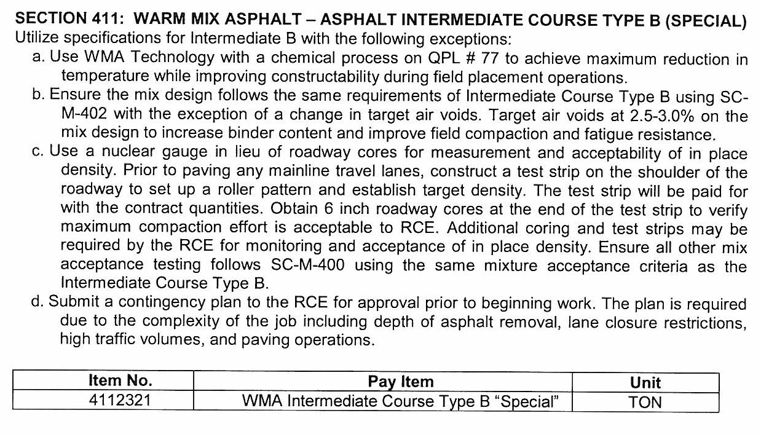
Intermediate B “Special”

Slide 15
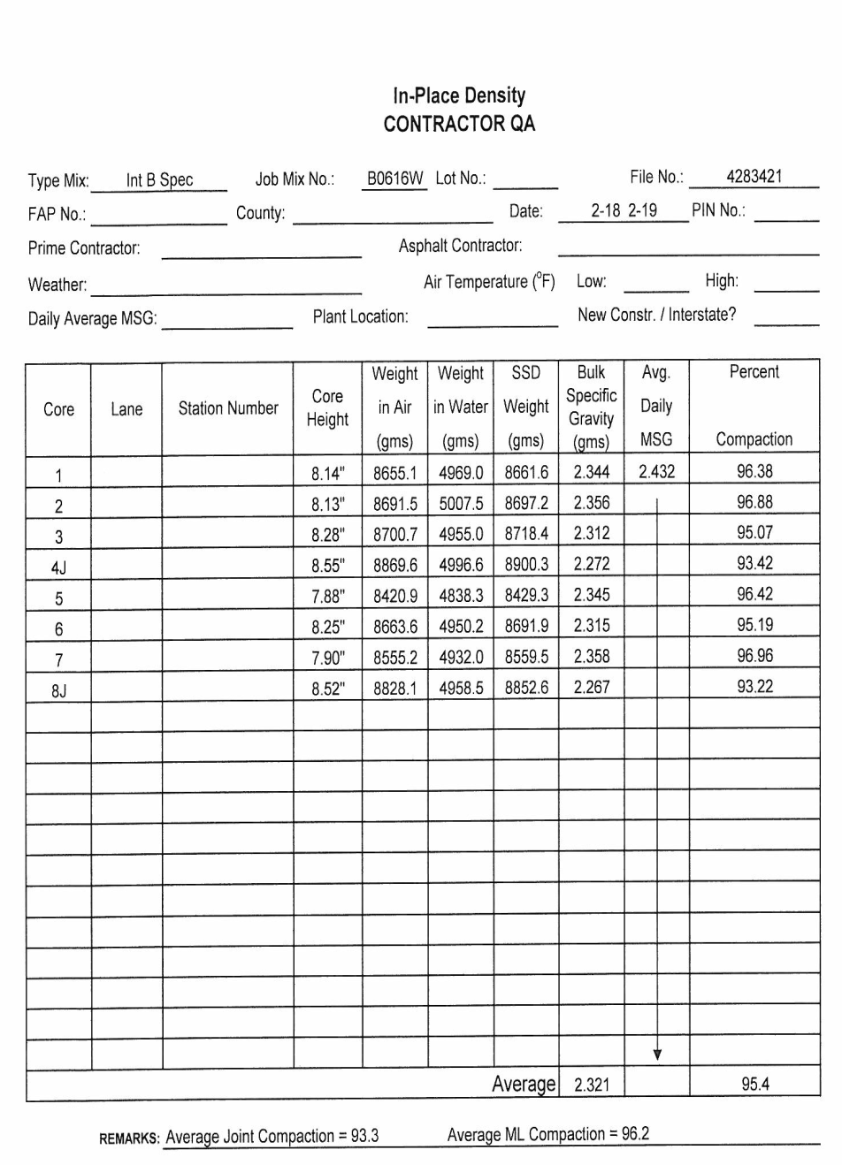
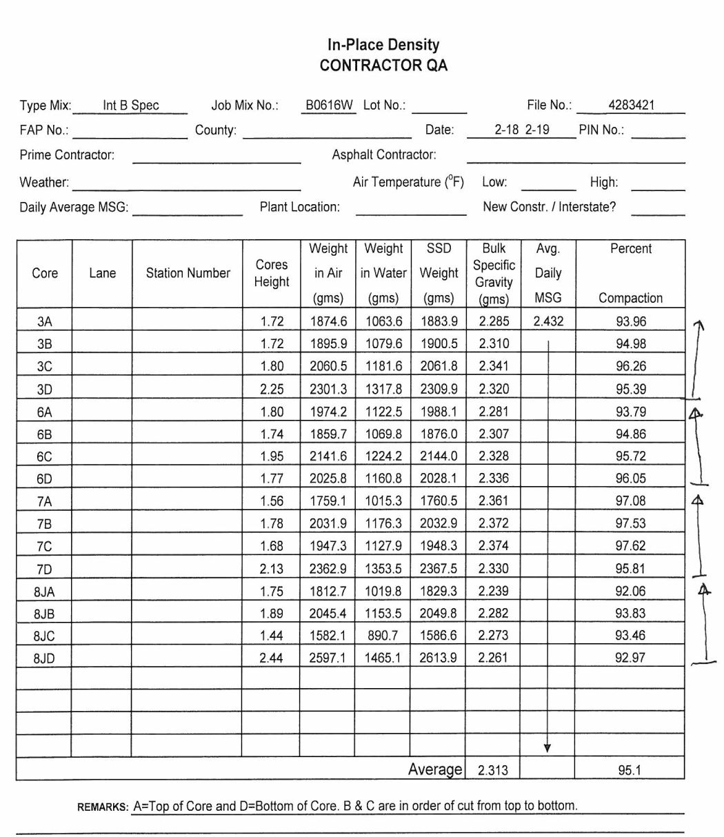
Intermediate B Special
(check density of whole core)
(check density profile -2” segments)

Slide 16
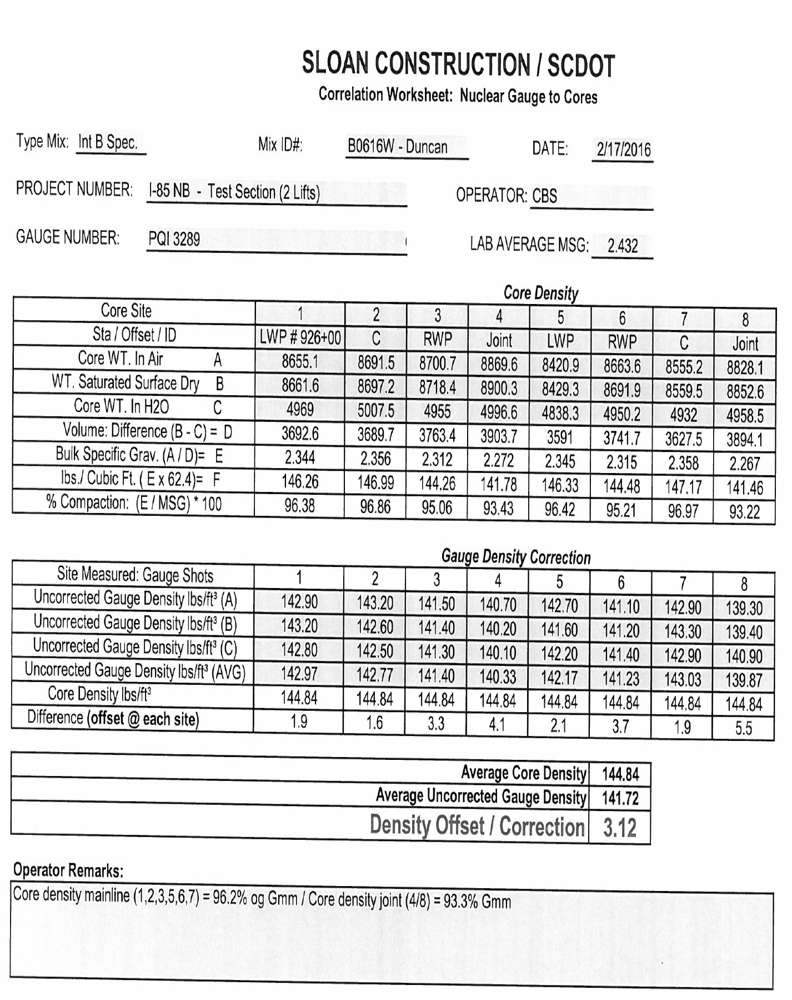
Intermediate B Special

Slide 17
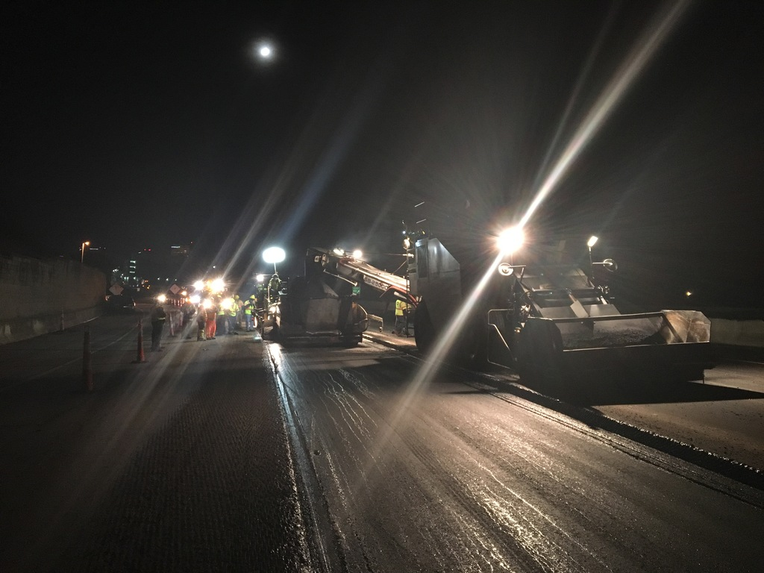
I-385 Greenville 2017-2018
Dual Lane Closure
Mill approx. 9” - >
Notice tack on vertical face - >

Slide 18
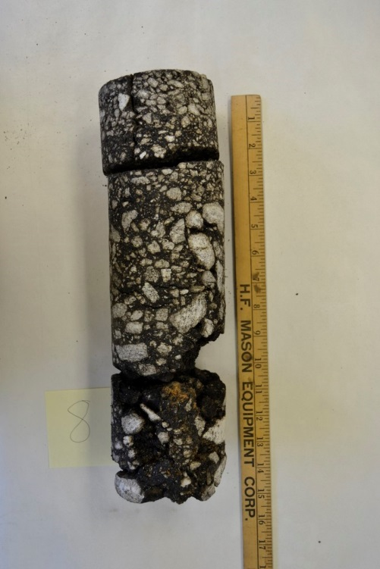
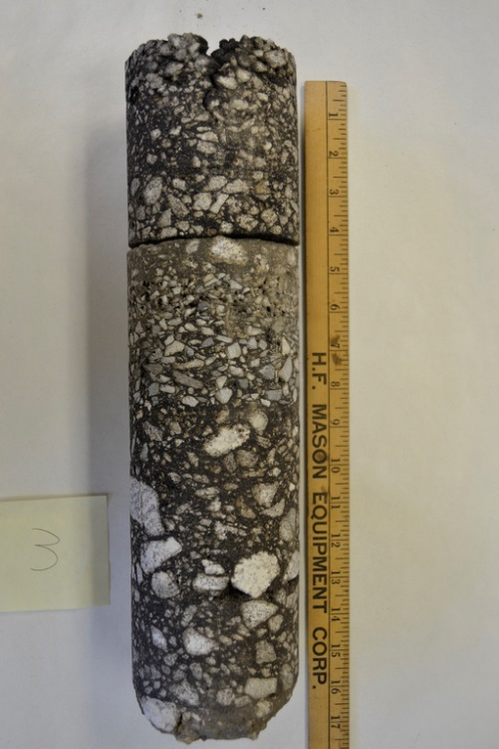
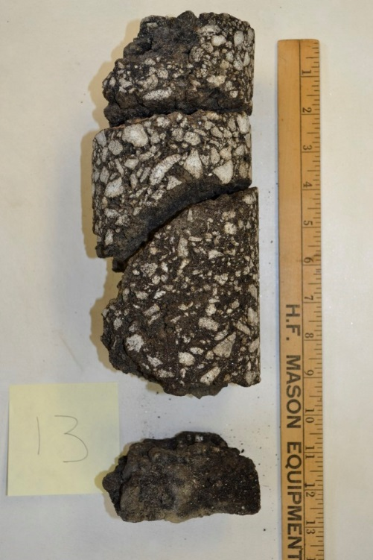
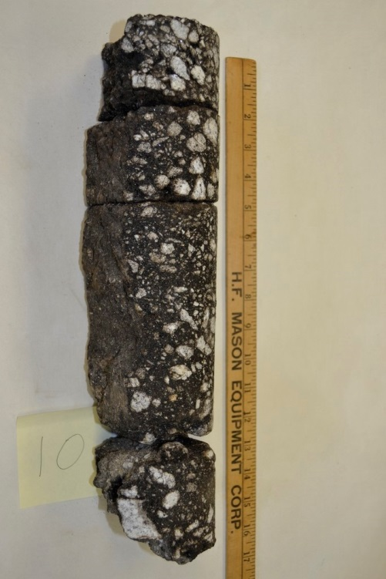
Overlay and widening section were not performing..
Mill and Fill 10” and place two lifts in same night…

Slide 19
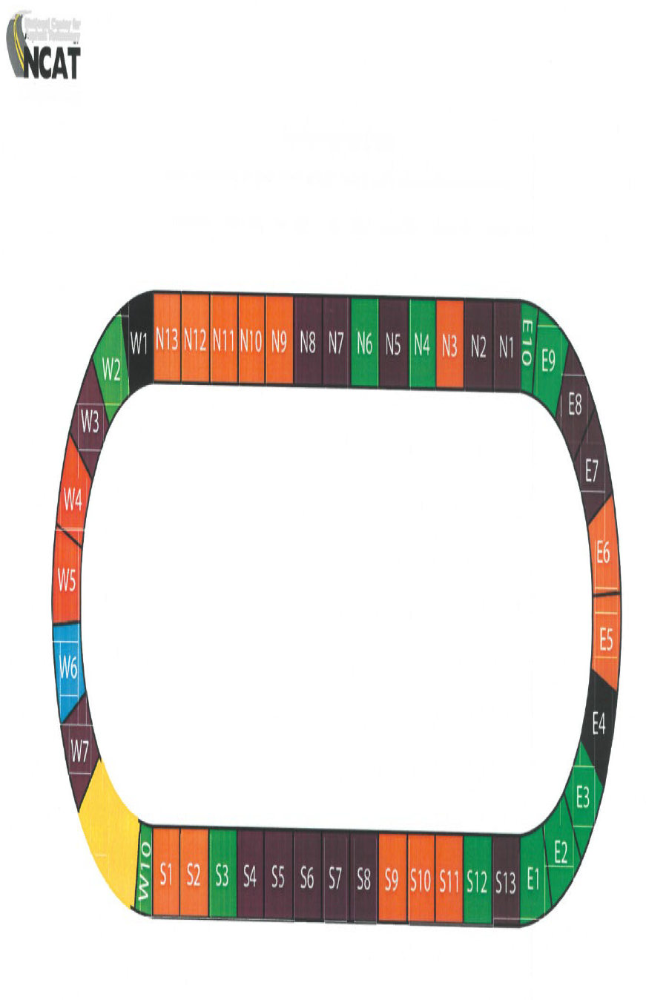
2018
SCDOT – NCAT
S-9
NCAT Test Track – 1.7 mile oval – Near Auburn, AL
SCDOT Section S-9

Slide 20
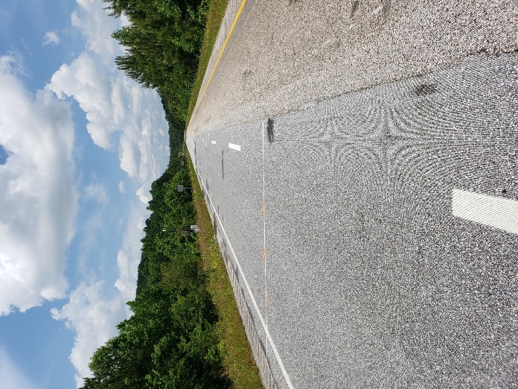
NCAT – S9 – 2018 Track
Single 8” lift – 2018 Track
Job was done during the day on track.
Daytime temps were in the 70-80s.
Instrumentation was installed to monitor stresses, and temperature probes used to collect time to cool.
Very short section – Difficult to level out production and laydown operations.
Compaction met or exceeded expectations.
Smoothness? – Had to perform some diamond grinding to achieve suitable ride.
Holding up very well, continued trafficking for another test cycle in 2021..

Slide 21
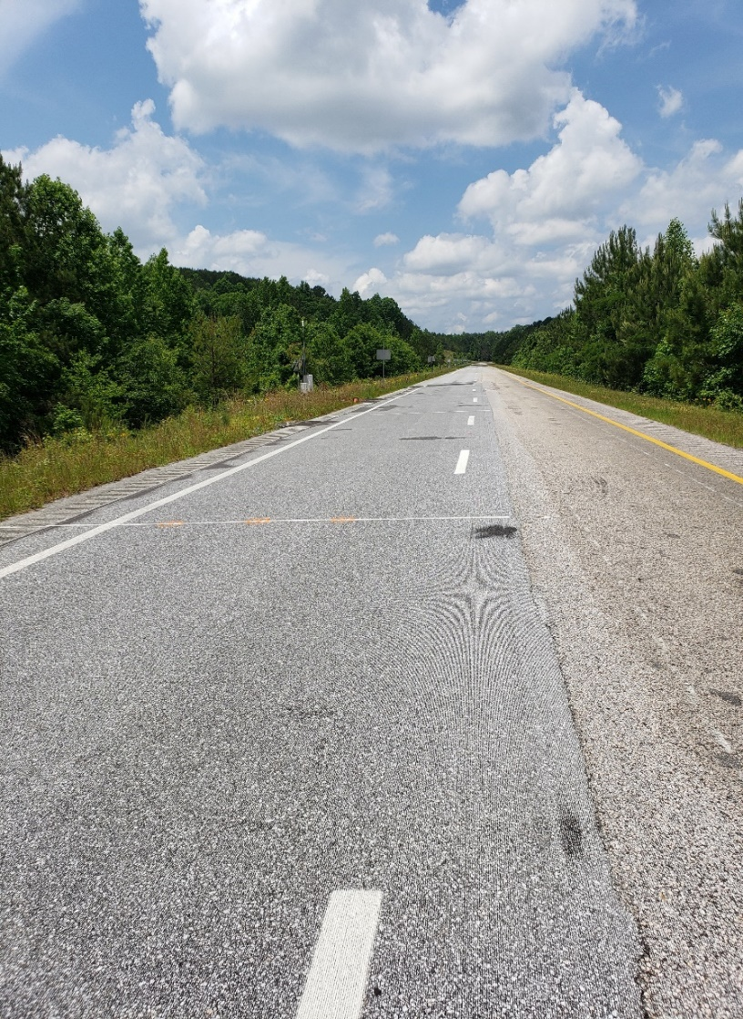
NCAT - SCDOT Funded Research
Diamond Grinded to get initial smoothness

Slide 22
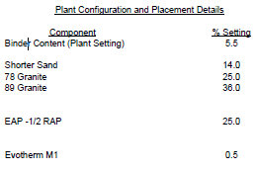
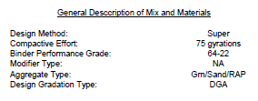
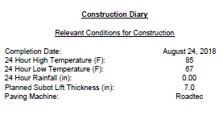
SCDOT – Section S-9

Slide 23
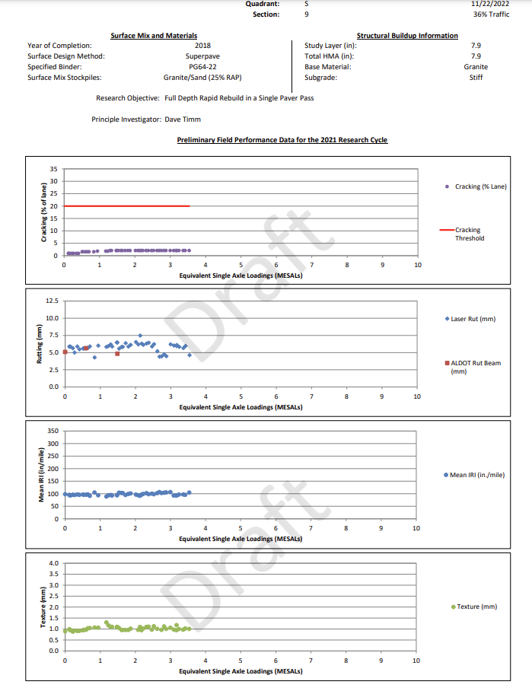
SCDOT – Section S-9
Report Date: 11-22-22
Traffic – 13.6 Million ESAL
Intermediate B Special
Single pass of paver
7.9” compacted
Cracking –2.5 %
Rutting ~ 6 mm
IRI ~ 100 in / mi.
Mean Texture Depth ~1.0 mm

Slide 24
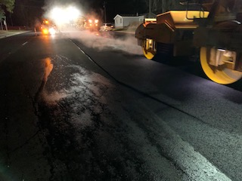
SC Hwy 544 - 2020
Single 5-6” lift.
Job was set up as nighttime lane closure..
Started in January – Nighttime temps were in the 30s-50s.
The road was a curb and gutter section (5 lanes), so we had confinement.
There was enough room for dual lane closure, so equipment could pull on and off without effecting new mixture.
Ended up with ride being near 90-100”/mile, but decided to do a full diamond grind (first time we have done that full width and on entire project) and got the ride to 30’s.
Paving company won several awards – SCAPA and IGA

Slide 25
SC Hwy 544 – 2022 (Second Section)
SCDOT
Type Mix: | Int B Spec. |  | Mix ID#: | H0518W |  |  | DATE: | 3/6/2022
PROJECT NUMBER: |  | 2659950 - Hwy 544 - |  |  | OPERATOR: |  | -
GAUGE NUMBER: |  |  |  |  | LAB AVERAGE MSG: |  |  | 2.465 | <- LOT 1
 |  |  | Core Density
Core Site 1 |  |  | 1 | 2 | 3 | 4 | 5 | Joint - 6 | Joint - 7
Sta / Offset / ID |  |  | 76+23 | 75+30 | 75+06 | 74+80 | 75+76 | 76+25 | 75+64
Gauge Shot |  |  | 133.9 | 136.3 | 136.9 | 133.5 | 132.7
Core WT. In Air A |  |  | 5830.9 | 6001.5 | 5807.3 | 5543.2 | 5263.6 | 3707.9 | 4392.6
WT. Saturated Surface Dry B |  |  | 5839.8 | 6006.5 | 5812.5 | 5546.4 | 5269.6 | 3752 | 4446.3
Core WT. In H2O C |  |  | 3361.1 | 3462.8 | 3351.6 | 3229.8 | 3039.3 | 2121.9 | 2487.9
Volume: Difference (B - C) = D |  |  | 2478.7 | 2543.7 | 2460.9 | 2316.6 | 2230.3 | 1630.1 | 1958.4
Bulk Specific Grav. (A / D)= E |  |  | 2.352 | 2.359 | 2.360 | 2.393 | 2.360 | 2.275 | 2.243
lbs./ Cubic Ft. ( E x 62.4)= F |  |  | 146.79 | 147.22 | 147.25 | 149.31 | 147.27 | 141.94 | 139.96
% Compaction: (E / MSG) * 100 |  |  | 95.43 | 95.71 | 95.73 | 97.07 | 95.74 | 92.28 | 90.99
Average % Compaction |  |  | 95.94 - Cores |  |  |  |  | 91.63- Cores |  | <= Original Joint Density – For info only
 |  |  | Gauge Density Correction
Site Measured: Gauge Shots |  |  | 1 | 2 | 3 | 4 | 5 | 6 | 7 | 8 | 9 | 10
Target Gauge Density lbs/ft³ |  |  | 133.40 | 133.70 | 134.00 | 134.10 | 136.00 | 134.00 | 133.50 | 133.90 | 133.80 | 134.50
Core Density lbs/ft³ |  |  | 147.57
Average Core Density |  |  |  |  |  |  |  | 147.57
Average Uncorrected Gauge Density (Core Locations) |  |  |  |  |  |  |  | 134.66
Density Offset / Correction |  |  |  |  |  |  |  | 12.91
Operator Remarks:
Roller Pattern (3-3-2) - Breakdown: 3 Vib. / Intermediate: (1 Vib. and 2 Static) / Finish: 2 Static ; Target Density 134.10

Slide 26
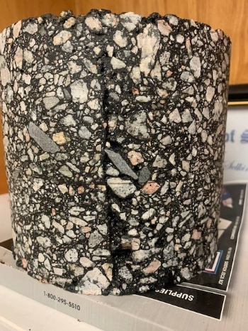
SC Hwy 544 – 2022 (Second Section)
SCDOT
Type Mix: | Int B Spec. |  | Mix ID#: | H0518W |  |  | DATE: | 3/20/2022
PROJECT NUMBER: |  | 2659950 - Hwy 544 - |  |  | OPERATOR: |  | -
GAUGE NUMBER: |  |  |  |  | LAB AVERAGE MSG: |  |  | 2.466 | <- LOT 8
 |  |  | Core Density
Core Site 1 |  |  |  |  |  |  |  | Joint - 1 | Joint - 2
Sta / Offset / ID
Gauge Shot
Core WT. In Air A |  |  |  |  |  |  |  | 5323.2 | 5446.1
WT. Saturated Surface Dry B |  |  |  |  |  |  |  | 5366 | 5480.9
Core WT. In H2O C |  |  |  |  |  |  |  | 3028.4 | 3101.1
Volume: Difference (B - C) = D |  |  |  |  |  |  |  | 2337.6 | 2379.8
Bulk Specific Grav. (A / D)= E |  |  |  |  |  |  |  | 2.277 | 2.288
lbs./ Cubic Ft. ( E x 62.4)= F |  |  |  |  |  |  |  | 142.10 | 142.80
% Compaction: (E / MSG) * 100 |  |  |  |  |  |  |  | 92.34 | 92.80
Average % Compaction |  |  |  |  |  |  |  | 92.57 |  | <= for info only
Operator Remarks:

Slide 27
Everything was going well until….
Holmestown Road – Horry County, SC - 2021
Single 5-6” lift.
Job was not set up as nighttime lane closure..
Started in April into May – Daytime temps were in 70-80˚+ F.
The road was not completely curb and gutter, so not entirely confined section.
Not enough room for dual lane closure, so not enough room to pull rollers off surface.
Ended up placing intermediate mix in two lifts and added a final thin lift surface to obtain satisfactory smooth ride.

Slide 28
Lessons Learned
Must have confinement on road
Need to consider to place in the cold months and/or at night to aid in cool down and return to traffic (cessation temp).
Really need dual lane closure, so you can keep trucks and MTV out of the cut and place for rollers to pull on and off.
Need for more trucks and keep paver moving at all times.
May need to perform some surface planning, diamond grinding, or place a thin lift surface to provide expected smoothness.

Slide 29
Lessons Learned
Test section – Get a comfort level with thick lifts, and ensure adequate compaction is achieved. Take cores to validate gauge readings are acceptable, and then use gauge for final density measurements.
Plan ahead to mill joints back an additional 1-2” into previous lane to ensure compaction to new pavement.
Use PG binder or hot applied tack coats to vertical milled edges to promote greater bond and compaction due to depth of placement in one lift.

Slide 30
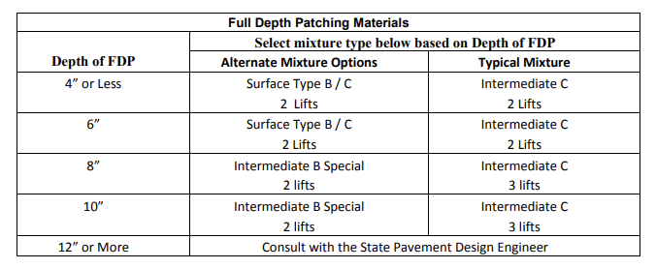
Full Depth Patching – Implementation of Thick Lift Option in SC

Slide 31


Thanks for Your Time!
Cliff Selkinghaus - SCAPA

