Slide 1
Presentation by
Jay Hansen
Executive Vice President
National Asphalt Pavement Association
Alabama Asphalt Pavement Association
March 15, 2018
Asphalt Pavement Industry
Update and Outlook

Slide 2
Represent asphalt mix producers and paving contractors at national level
1,100 members
21 members of staff
Highly qualified team
Guided by Strategic Plan
Advance innovation and quality
Advocate for highway and airport investment
Promote the use of asphalt pavements
Serve the industry
Partners
SAPA’s, NCAT, Chamber, Labor, Agencies, International
National Asphalt Pavement Association

Slide 3
Secured Hours of Service Relief
Crystalline Silica Agreement
PSA on Distracted Driving in Work Zone
NAPA Care Program Endowed
Work Zone Safety Asphalt Paving Module
FHWA Cooperative Agreement
Annual RAP, RAS, WMA Survey
PaveXpress
Emerald Eco-Label
Annual Meeting, World of Asphalt
Progress Report

Slide 4
MARKET DRIVERS
Asphalt paving tons nationally up about 2% in 2017.
Asphalt paving tons will grow in 2018 on strength of state highway funding and commercial/residential markets.
Growth in the market will also be determined by how much of the $10 billion in the new 2-year budget deal will be allocated to highways and bridges.
KEYS TO THE MARKET
Will Congress Move on a Trump Infrastructure Bill and a multi-year FAA bill?
Will states continue to increase their own revenues and tolls for transportation projects?
Will the Federal Reserve continue to hike interest rates in 2018?

Slide 5
FAST Act Authorizes $900 million increase for this construction season. In addition, highways and bridges will receive a portion of the $20 billion over 2 years (2018-2019) for infrastructure as part of the McConnell-Schumer-Ryan Budget deal.
?
?
?
2018 Highway Funding Level Will Grow
Notes:
If this meeting was held a week ago I could not say for sure what the funding level for the Federal-Aid Highway Program would be for this construction season. Congress had not passed any of its appropriations bills and the state transportation agencies were relying on short-term continuing resolutions to fund government programs including the Federal-Aid Highway Program.
So it was an unexpected surprise to see the congressional leadership finally do their job and allocate more funding for infrastructure. The deal reached last week would allocate $10 billion more for infrastructure. The Appropriators will have to decide how much of that will be allocated to the Federal-aid Highway Program. The bottom line is that our industry should see growth in the highway construction markets this year compared to last year due to the $900 million increase authorized by the FAST Act and the additional funds provided in the Budget Deal.
The next step will be for the House and Senate Appropriations to finalize the Transportation Appropriations Bill and reconcile the differences, and then roll It into an omnibus appropriations, probably in early March. At that time, the state highway agencies will know their full year budget and start awarding contracts.
And note this was a two year deal. This is excellent news for our industry and gives us the most certainty we have had in a long time.

Slide 6
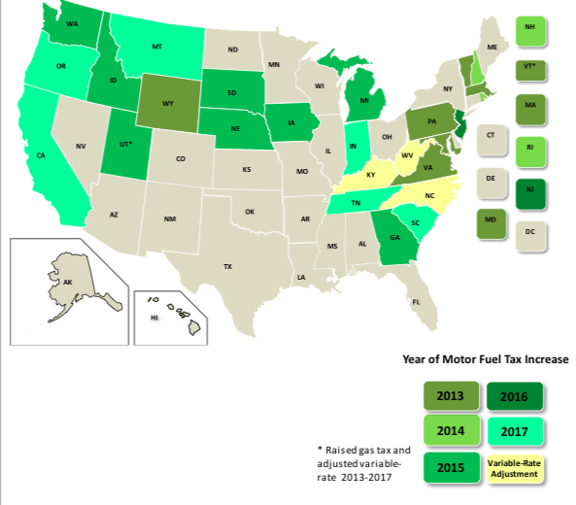
Since 2013, 26 states have increased or adjusted taxes on motor fuel to support needed transportation investments.
Motor Fuel Tax Increases: 2013-2017
Notes:
Another factor to consider when looking at the market for asphalt pavement, since 2013, 26 states have increased or adjusted taxes on motor fuel (8 of them last year) to support needed transportation investments including Tennessee and South Carolina, two deeply red states.
And its not just increases in the gas tax. Many states are looking at tolling as a powerful and effective way and a very specific way to pay for new infrastructure as well as generate funds to pay for existing infrastructure.
We are seeing a number of states that do not currently have tolls express an interest in doing so. States like Connecticut, Michigan, Wyoming and others.
Some states are beyond considering it. New toll roads or toll lanes are opening this year in Texas, Colorado, Florida, North Carolina and Virginia. Oregon will be adding congestion pricing to highways to help manage congestion in and around Portland later this year.
These are exciting trends that the industry should be supporting

Slide 7
$200 billion to leverage $1 – $1.8 trillion
No funding source identified
Allocation to highways not provided
Infrastructure grants limited to 20% federal match
Tolling allowed anywhere
“One Agency, One Decision” for environmental reviews
NAPA Reaction
Support President for moving ball forward
Need Congress to create a “different” proposal
Trump Infrastructure Plan

Slide 8
Highway Trust Fund Shortfall in 2021
Notes:
A serious issue that is not impacting the market yet - but it soon will- is the fact that revenues into the Highway Trust Fund are not keeping pace with spending.
NAPA tried very hard to get Congress to try and fix this revenue gap as part of the tax reform bill. The congressional leadership decided not to fix the Highway Trust Fund.
Obviously we are disappointed that Congress decided to take a pass on fixing the Highway Trust Fund but that does not mean we give up. We have to keep the pressure on Congress to reconsider this issue and come up with a viable solution to shore up the Highway Trust Fund.
Just last month The U. S. Chamber of Commerce called for an increase in the federal gas tax of 25-cents a gallon, phased in over five years. The business group and many others have long been calling for a boost in the gas tax, which is now 18.4 cents a gallon and hasn't been increased since 1993. NAPA is supporting that effort which will be a key talking point in the TCC Fly-In this May.

Slide 9
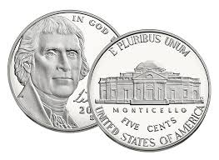
Fix the Highway Trust Fund
5 cents per year for 5 years plus indexing
Dedicate funding specifically for highways
Water, broadband, hospitals cannot suck up all funding.
Fund existing FAST Act programs
Prioritize NHS, Freight, Interstate Maintenance
Allocate funding to the states
Promote leverage but be realistic
Preserve state-matching requirements
Changes NAPA Wants

Slide 10
FY 2018 and FY 2019 Highway Funding
Honor the highway funding levels in the FAST Act
Trump Infrastructure Plan
Fix Highway Trust Fund
FAA Reauthorization Bill
Lift PFC’s cap
Industry Priorities

Slide 11
Keep Informed
Use NAPA Blog
In-District Activities
Meet the Member
Host a plant Tour
Attend Town Hall
Write an Op-ed
What We Can Do Together!
Notes:
After all of this you are probably wondering what you can do - You can;
Keep informed, by using NAPA’s government affairs website.
Meet with your members of Congress
Work with your local chamber and construction groups and get meetings set-up.
Use NAPA as a resource and provide feedback for us to use in meetings with Committees of jurisdiction on the aforementioned issues

