Slide 1

Work Zone Safety – The Oldcastle Journey
Chris May, VP of Safety and Environmental Operations
Notes:
OMG has three core values – Zero Fatalities, Zero Incidents, and an Employee Driven Safety Culture. Please make sure that the audience, who should include anyone who does or who may ever perform work in a construction zone, understands the importance that OMG places on this training.

Slide 2
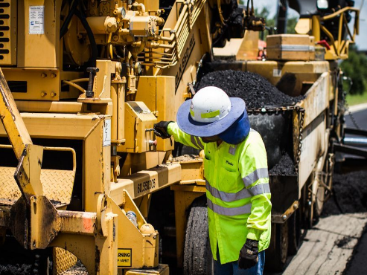
Nation Wide Work Zone Fatalities
According to the Work Zone safety website, over 100 highway construction workers are killed each year.
20,000+ are
Injured.

Slide 3
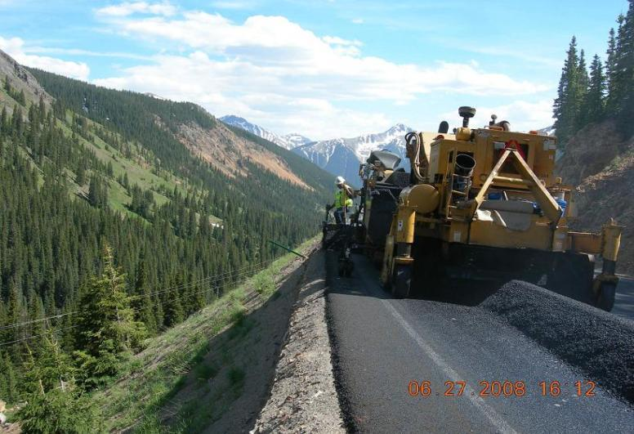
Would You Agree?
We face the challenge
of providing a safe workplace
for our employees
However, our work environment presents complex situations in which workers face multiple injury risks under conditions that may change without warning.

Slide 4
Work Zone Safety – Our Journey
Compliance
Risk Evaluation
“Beyond Compliance” – Best Practices
Technology

Slide 5
Compliance
MUTCD
OSHA
DOT
Manufacturer Specifications of Mobile Equipment

Slide 6
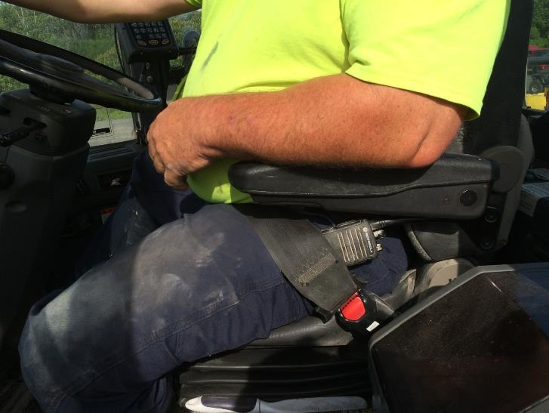
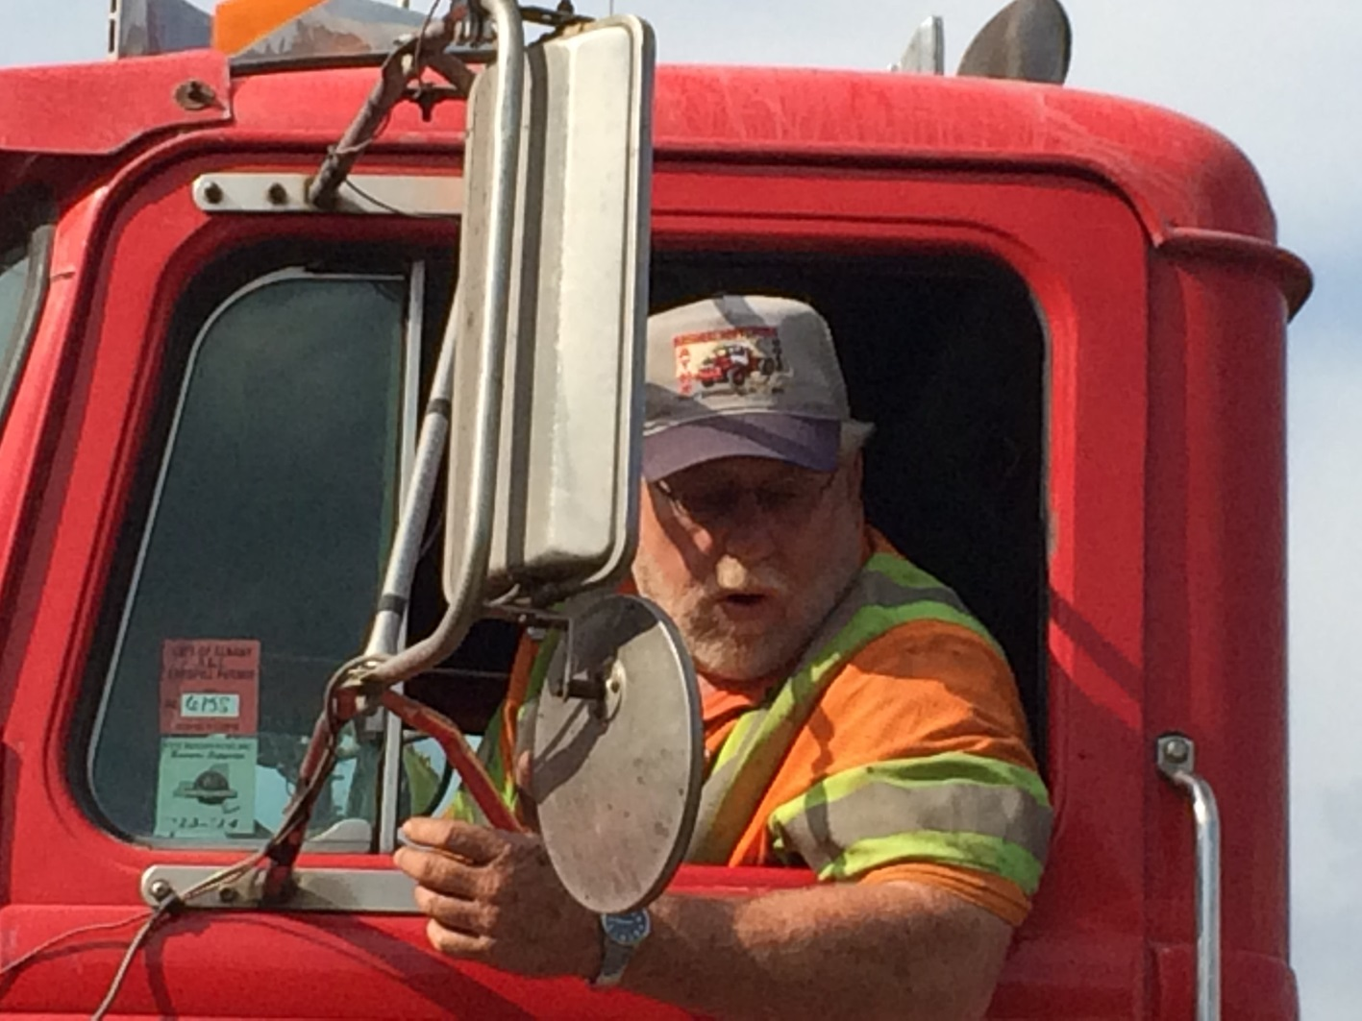
Seatbelts

Slide 7
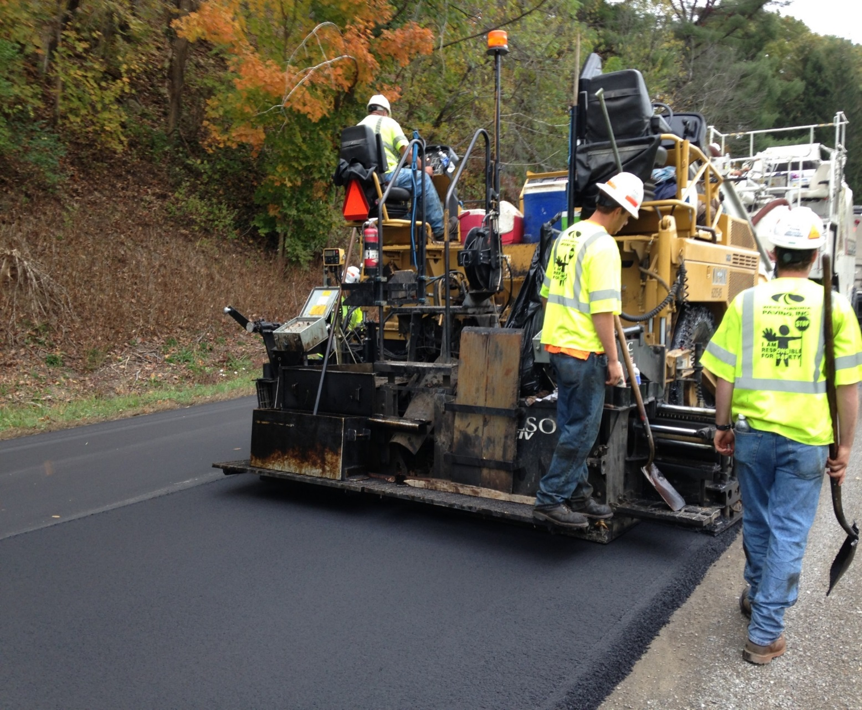
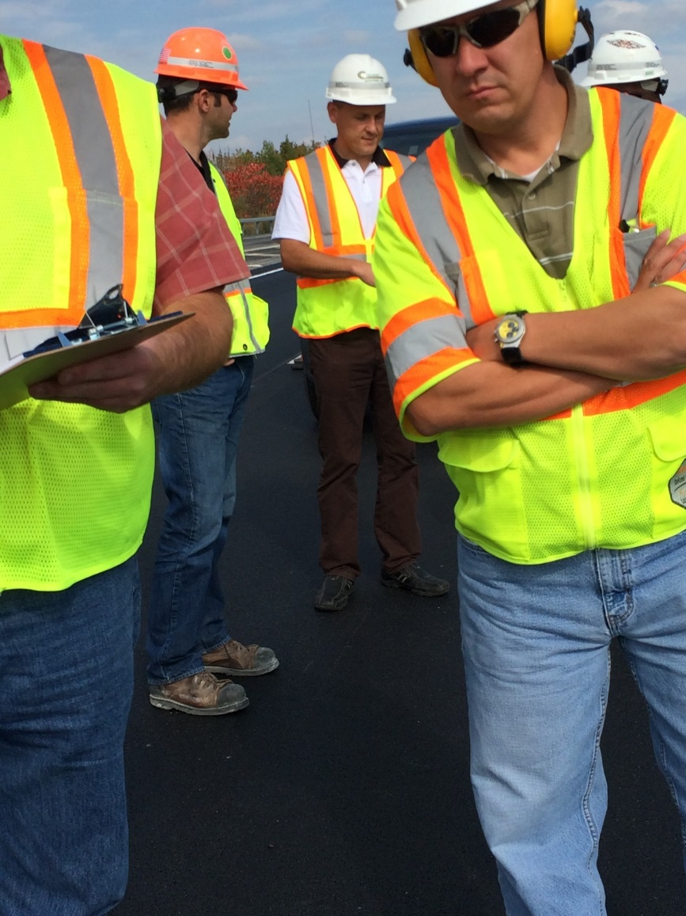
Proper PPE

Slide 8
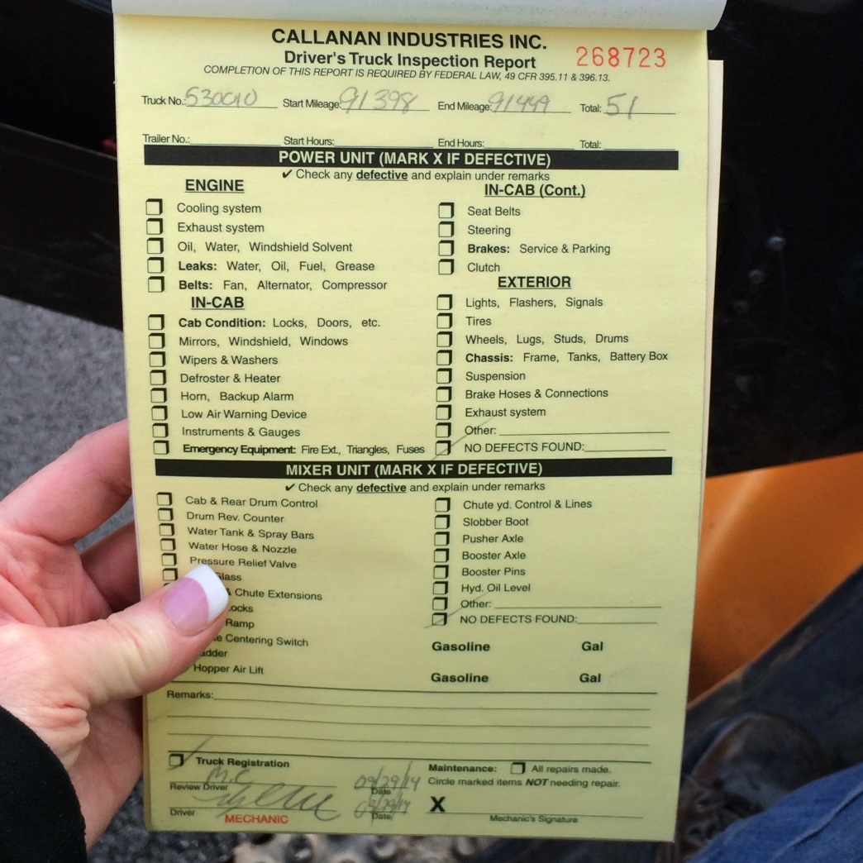
DOT Post Trip Inspections

Slide 9
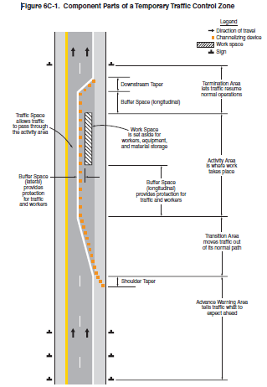
Setting up Proper Temporary Traffic Control Zones

Slide 10
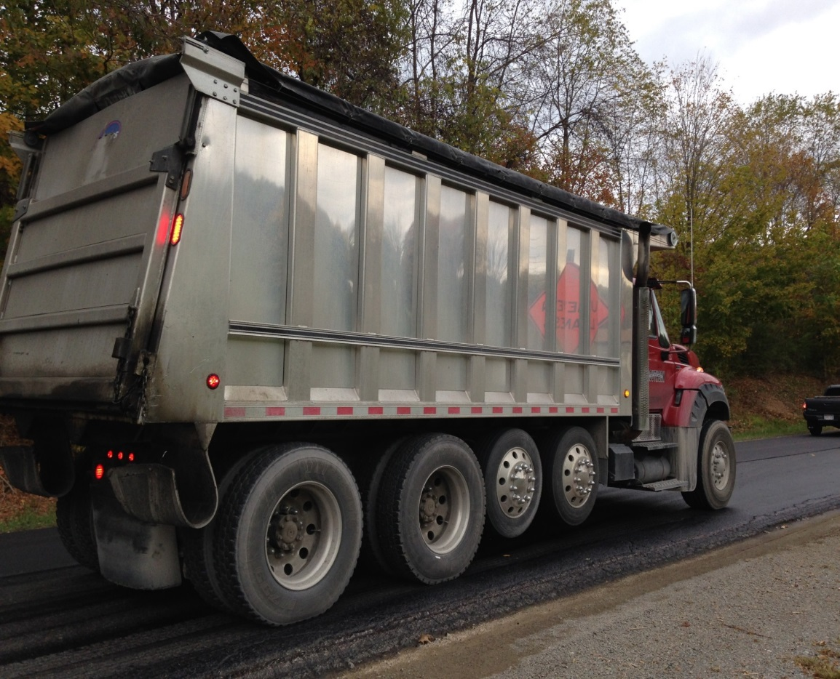
Back Up Alarms
Ensure back-up alarms are in good working condition
Notes:
In addition to the standard, ubiquitous backup alarm, other sounds are now available to provide more directed noise to warn workers when a vehicle is backing. These include “white noise” and broadband sound alarms that can be directed at the worker. Also, these alarms can be heard above ambient construction noise, but are not disturbing to the surrounding neighborhood. Air horns are useful for sounding a general alarm, notifying workers of an imminent danger.

Slide 11
Set the Parking Brake
OSHA 1926.600(a)(3)(ii) states:
Whenever the equipment is parked, the parking brake shall be set. Equipment parked on inclines shall have the wheels chocked and the parking brake set.
OSHA LOI states:
  Therefore, whenever a light duty pick-up truck is left parked and unattended on a construction jobsite, whether running or not, the parking brake must be set. If such truck is left parked and unattended on an incline, in addition to setting the parking brake, the wheels must be chocked.
  https://www.osha.gov/pls/oshaweb/owadisp.show_document?p_table=INTERPRETATIONS&p_id=25174

Slide 12
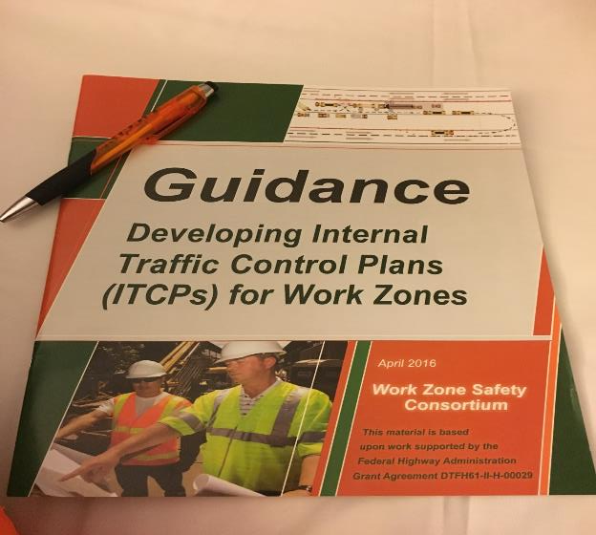
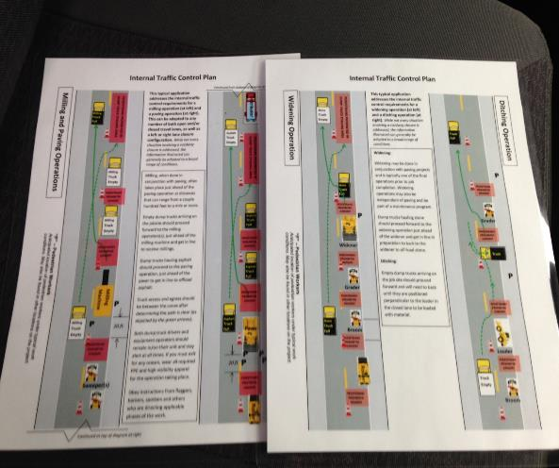
Internal Traffic Control Plan (ITCP)

Slide 13
Internal Traffic Control Plan - OSHA
An ITCP should:
  Reduce the need to back up equipment
  Limit access points to work zones
  Establish pedestrian-free areas where possible
  Establish work zone layouts commensurate with type of equipment
  Provide signs within the work zone to give guidance to pedestrians, equipment and trucks
  Design buffer spaces to protect pedestrians from errant vehicles or work zone equipment

Slide 14

Simple Compliance is Not Enough
Compliance alone is not enough
We need to also evaluate and adjust to the risks
How Do We Manage the Risks?

Slide 15
Training in 10 Factors that Influence Risk Tolerance
Overestimating Capability or Experience
Familiarity with the Task
Seriousness of Outcome
Voluntary Actions and Being in Control
Personal Experience with an Outcome
Cost of Non-Compliance
Confidence in the Equipment
Confidence in Protection and Rescue
Potential Profit & Gain from Actions
Role Models Accepting Risk
Notes:
Factor # 1 relates to a belief that ones physical ability, strength, agility, reaction time and reflexes can be utilized to prevent an incident. This is over estimating capability. This factor also relates to situations where an experienced worker will rely on their years of experience and their knowledge of the task as justification for doing the work a certain way ... a way that may in fact have higher risk.

Slide 16
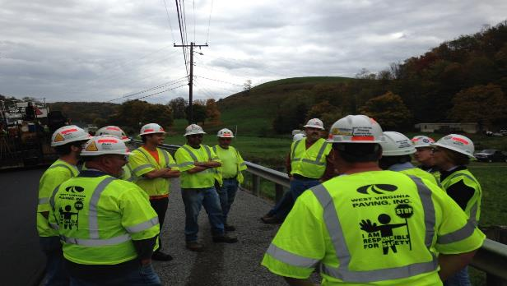
Assess the Risks
Always start the job/task (and as conditions change) with a safety huddle to discuss the task/job at hand and if/when necessary, a more formal risk assessment (TRACK, THINK, Take 5, JSA, etc.) in order to identify and either mitigate or eliminate hazards.

Slide 17
Risk Assessment & Reduction / Jobsite
Daily Work Zone Risk Assessment
  Proper PPE (high-vis clothing, reflective tape on hardhats, etc.)
  If night job, do we have the proper lighting?
  Ensure that traffic control is set up properly
  Ensure that truck drivers understand proper ingress and egress
  Which pieces of equipment are we using today?
  Dedicated spotters
  How does weather affect us today?
  How can we mitigate or eliminate the other risk(s)?

Slide 18
Risk Evaluation and Reduction / Off the Jobsite
Provide proper traffic control training for employees
Provide Work Zone Awareness Training for all
Meet with local and state law enforcement agencies to request additional visibility and enforcement presence.
Meet with state associations and DOT’s regarding lowering speed limits/other TC devices in work zones.
Communicate well with all contractors including contract trucking.

Slide 19
Going Beyond Compliance and Risk Assessment
Compliance is not enough
We can’t stop at Risk Assessment/Reduction
What else can we do to Protect our Workers?

Slide 20
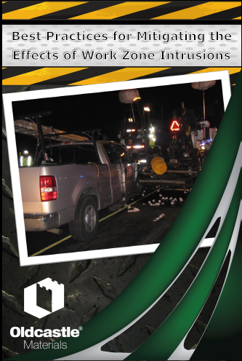

Slide 21
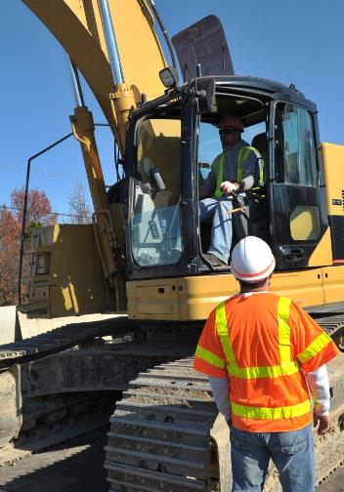
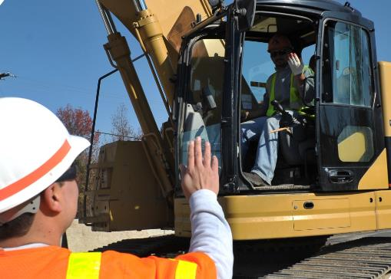
Keep Your Distance
If within 10 feet of moving equipment, wait for a clear signal from the operator before approaching equipment.
Notes:
It is difficult for workers to tell if the operator is looking at them or someone or something directly behind or in front of them. The worker may think the operator is looking at him or her and it is safe to approach when in fact the operator is focused on something else. Before approaching a vehicle, wait for a clear signal from the operator that you have permission to do so.

Slide 22
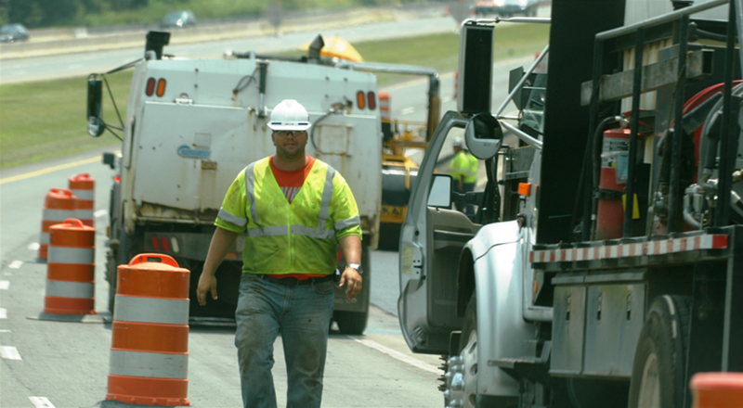
GOAL – Get Out and Look
Notes:
Before moving vehicles or equipment, the operator should walk around it to ensure no person or obstacle is in the blind areas. An alternative plan is for the operator to use a spotter.

Slide 23
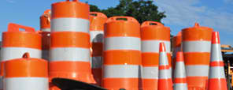
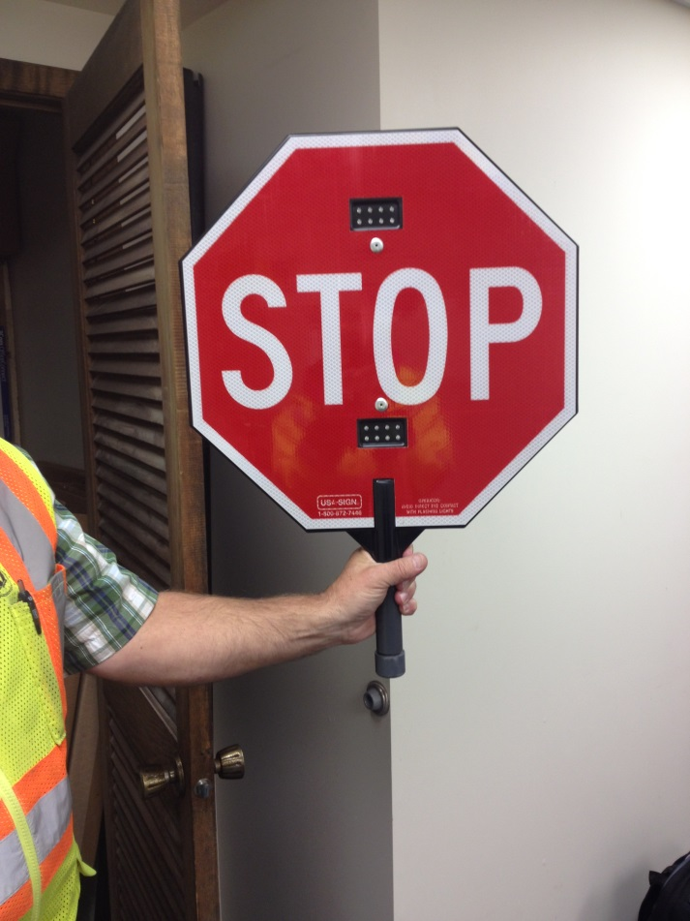
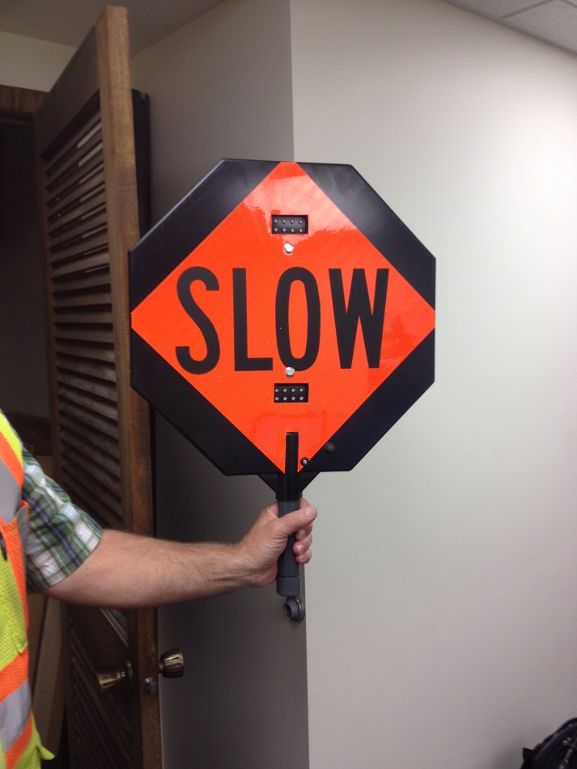
Lighted Stop/Slow Paddles

Slide 24
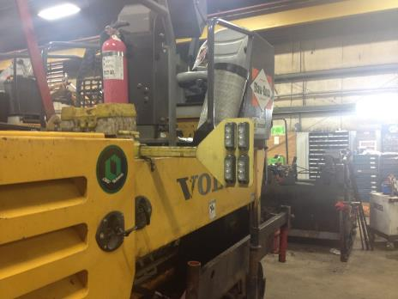
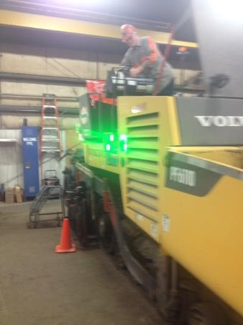
Paver Lights for Backing Trucks

Slide 25
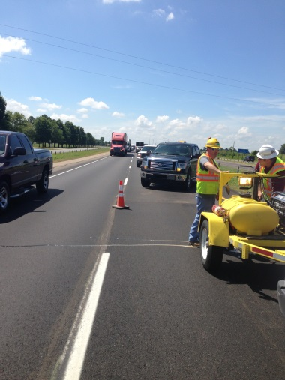
Angle vehicles to protect employees

Slide 26
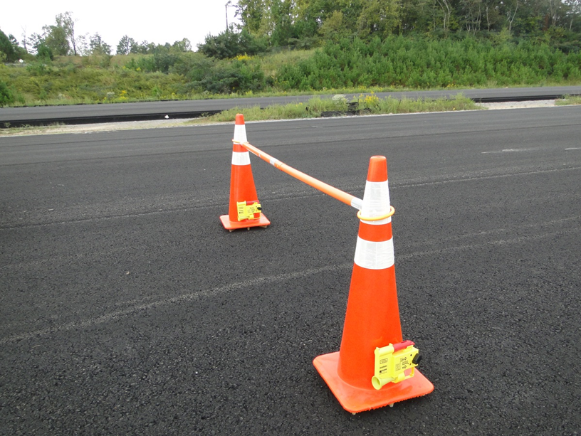
Mid-Lane Devices
Mid-lane devices
Consider the use of mid-lane devices. Mid-lane devices are channelizing devices (cones, barrels, etc.) placed traversely across the closed construction lanes at intervals (i.e. 1,000 ft.) to discourage traffic from driving through the closed lane.
Notes:
26

Slide 27
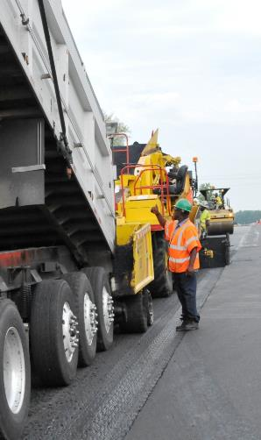
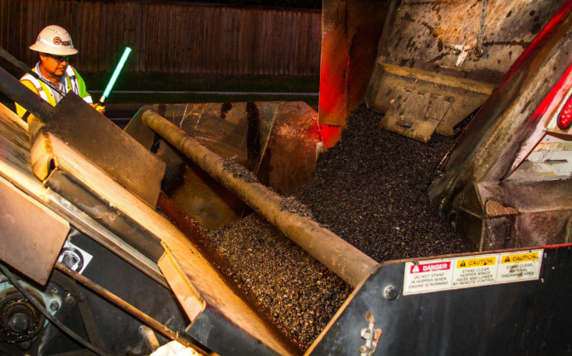
Spotters/Signal Persons
Spotters/Signal Persons should not have any other work duties when directing operators.
Notes:
Due to the nature of spotting responsibilities, the person performing this task should have NO other tasks when performing this operation. Spotters must not be distracted from their work, including by use of electronic devices, eating, etc.

Slide 28
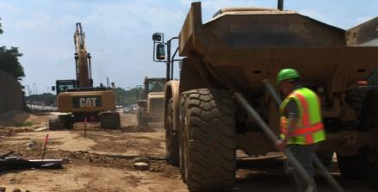
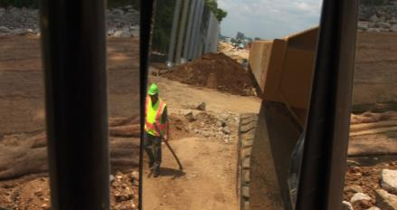
Eduction on Blind Spots
Blind Spots are the locations around equipment and vehicles where workers on foot are invisible to the operator through his windows and mirrors.
Behind the Vehicle
Outside Mirror Range
Notes:
A blind spot (or blind area) is the area around a vehicle or piece of construction equipment that is not visible to the operator, either by direct line-of-sight or indirectly by use of internal and external mirrors. Blind areas can be reduced by properly setting mirrors on equipment in a “mirror check station.”

Slide 29
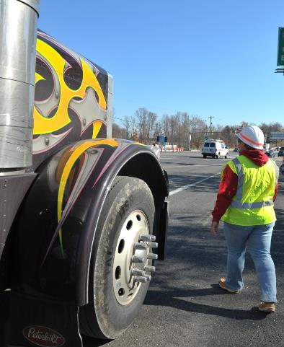
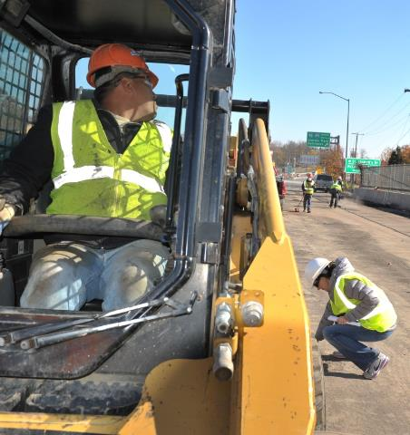
Blind Spots
Notes:
As a worker on foot, if you can’t see the driver and the driver can’t see you, you’re in a dangerous situation. Companies and projects should identify a specific side of the vehicle where a worker should walk for each operation. Consistency is important for safety.

Slide 30
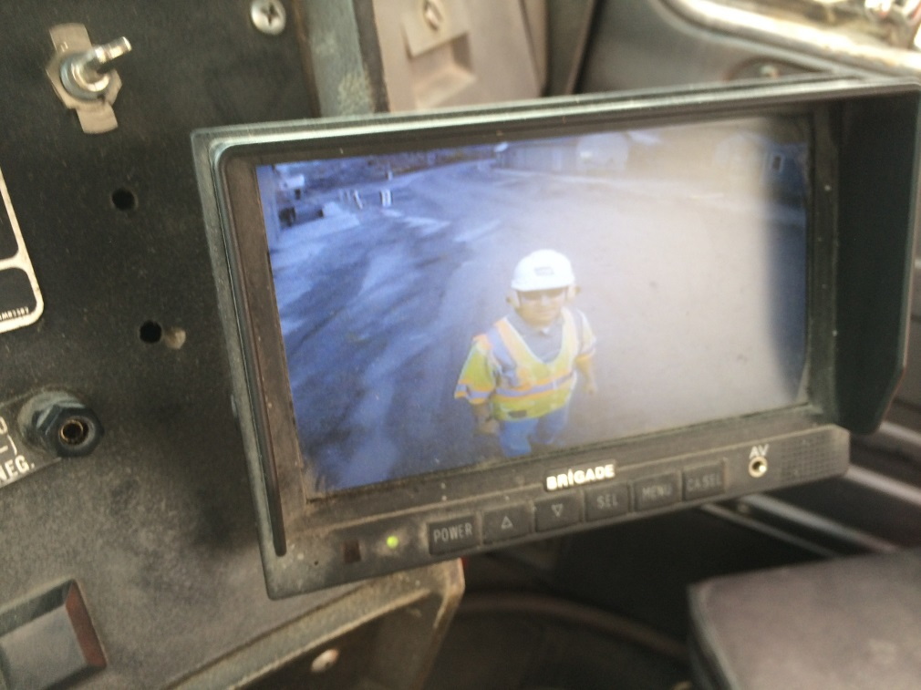
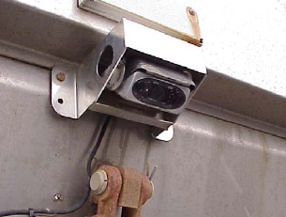
Utilize Electronic Aides
There are a variety of devices—old and new—that have been developed to warn drivers and operators when workers on foot are near, including:
Alarms
Cameras
Radar
Sonar
Notes:
In most work zone situations, there are technological solutions that can alert drivers and operators to the presence of workers on foot. These technologies include alarms, cameras, radar, sonar, and tag systems. Each of these technologies have unique deployment challenges, ranging from dirty lenses to high cost. As this equipment grows in use and experience, many of these challenges are being overcome.

Slide 31
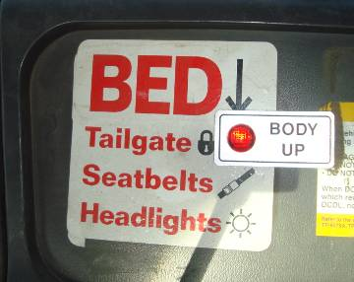
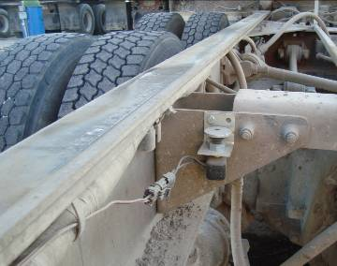
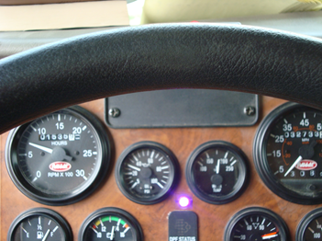
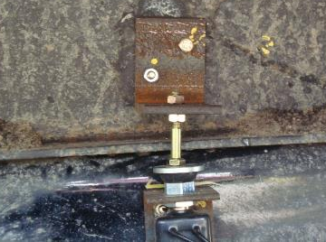
Bed Up Indicator Light

Slide 32
Communications with the Public
Use Portable Changeable Message Signs (PCMS) to inform motorists of conditions ahead such as closed ramps, detours, or other regulatory information.
Radio/TV spots for work zone safety.
Utilize DOT Public information system.

Slide 33
Communications
Identify emergency providers and meet with them prior to the start of the job to consider how emergency services will access the job.
Operators and Flaggers should have mobile radios so they can easily communicate with each other or their coworkers.

Slide 34
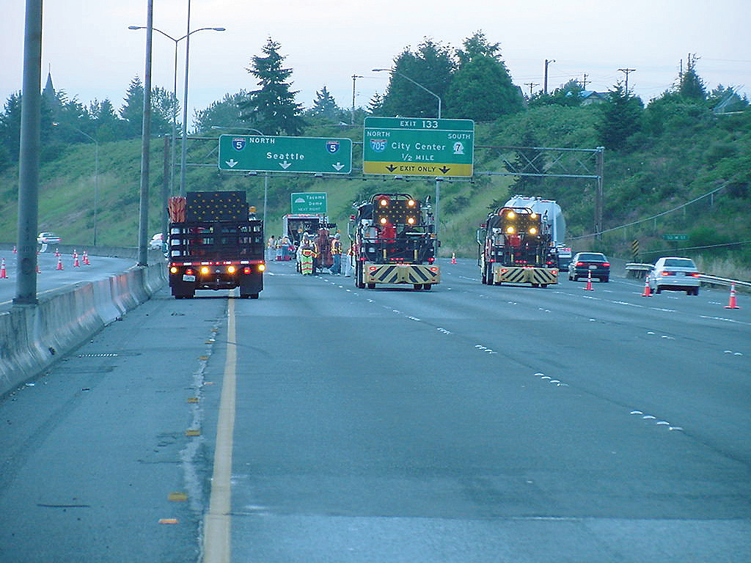
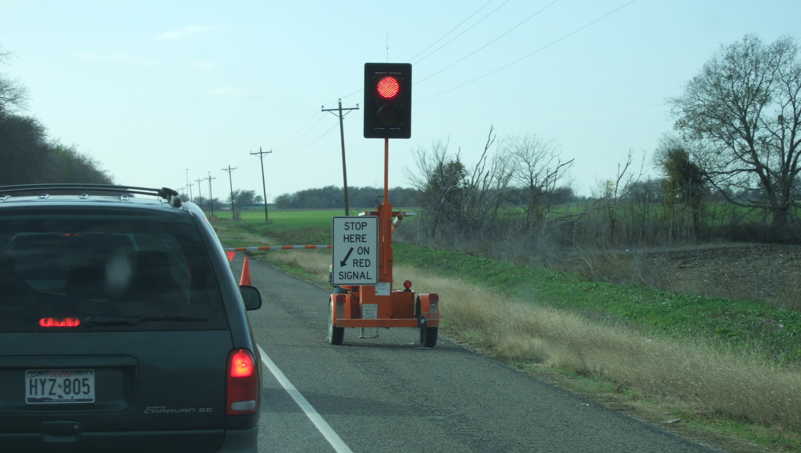
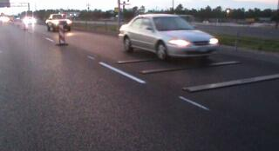
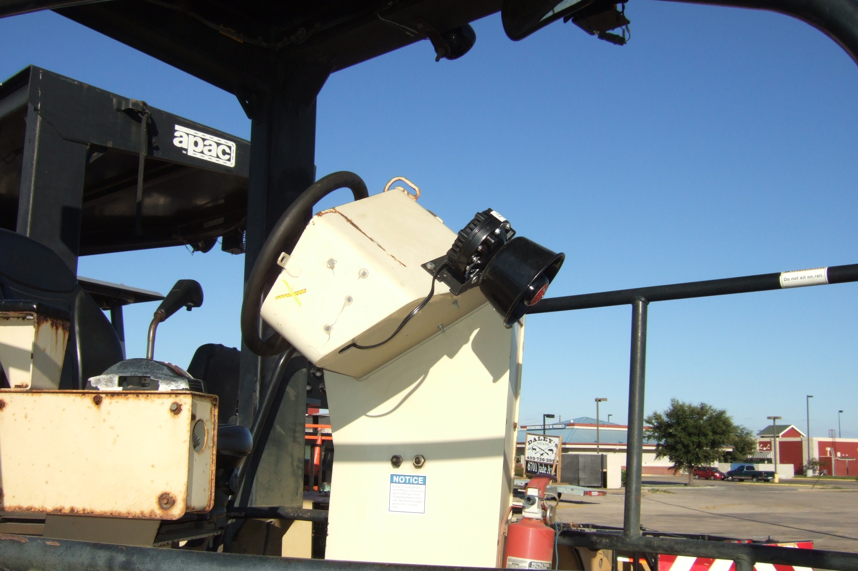
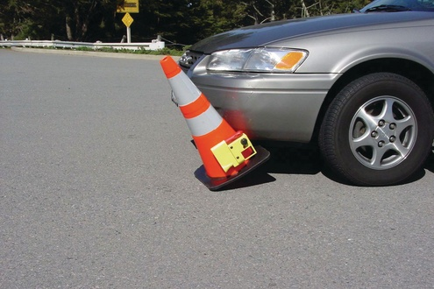
Work Zone Protection Devices

Slide 35
Next Steps…Going Beyond
Compliance is not enough
We can’t stop at Risk Assessment/Reduction
Utilizing Best Practices is a definite benefit, but…
What more can we do?

Slide 36
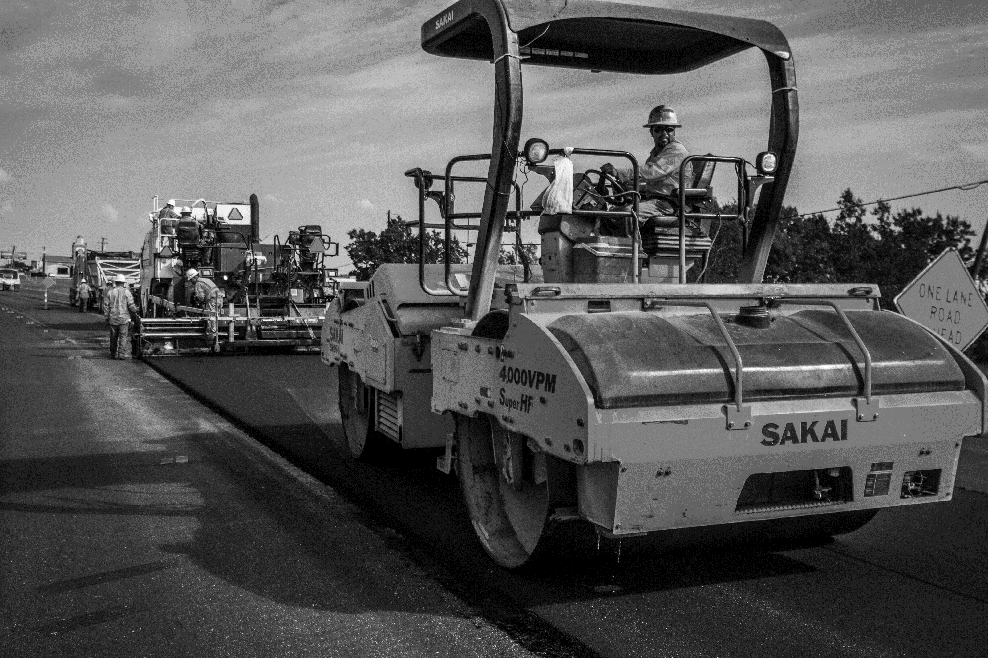

Utilizing Innovation and Technology

Slide 37
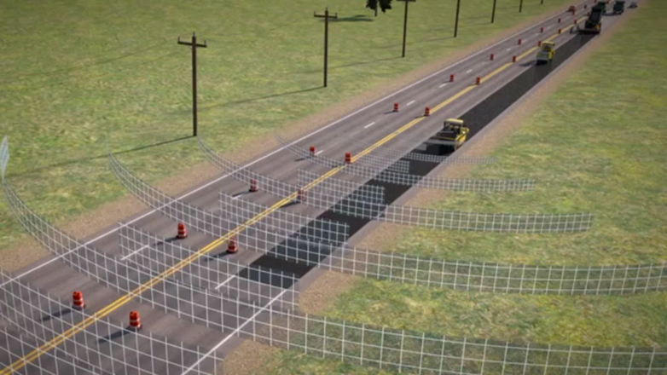

How does it work?
  We track all vehicles as they approach within 600’ of the Raven
  The radar measures speed, position and trajectory.
  The system alerts drivers and workers in unsafe circumstances exist.

Slide 38
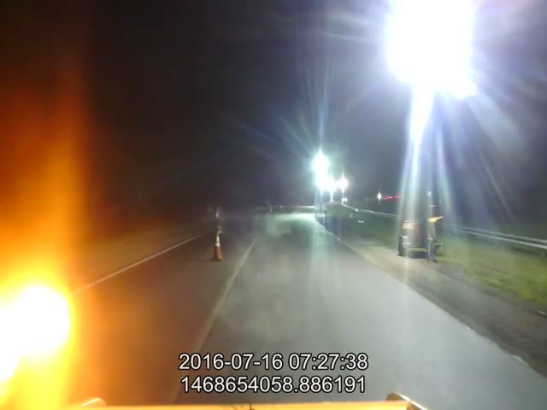
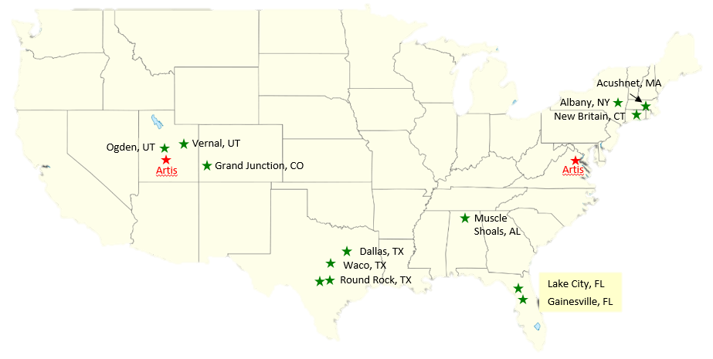
2016 Pilots a Big Success
2016 AWARE Pilots - 8 States / 15 Crews
IT WORKS! Now let’s make it super easy to use!
Callanan, NY Thruway

Slide 39

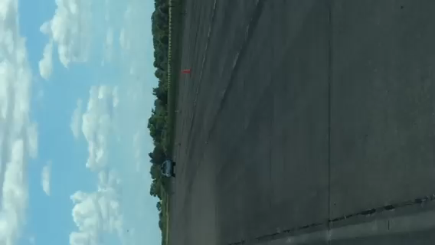
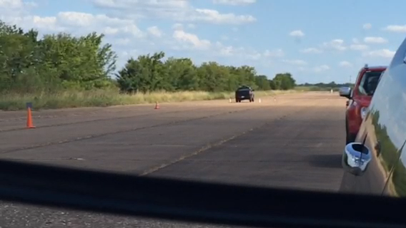
3rd Party Testing
Put our best foot forward
Tested Alarm Rate and False Alarm Rate
All tests have passed to date
We Proved it is Possible!

Slide 40

Next Steps
We Are Here
Continue Pilots
Broader Internal Rollout in Summer 2017
Plan to open to public 2018
FLUID PROCESS
UNDER CONSTRUCTION

Slide 41

Risk is everywhere !
We have to continually evolve. Our job is to be persistent in our work to provide employees with a safe work environment because…..

Slide 42
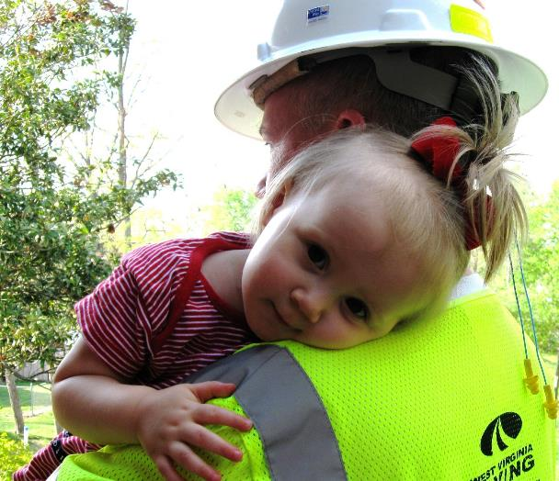
This is why we do it!

