Slide 1
RAS Research Update and Best Practices
Dr. J. Richard Willis
Alabama Asphalt Pavement Association Meeting
March 9, 2016
Notes:
Challenge in the industry today!

Slide 2
RAS History
First considered in the early 1980s
Research completed on Manufacturer’s Waste RAS
Preliminary specs in 1990s
Today: 11 million tons of shingles/yearly
  10 million Post-Consumer
  1 million Manufacturer’s Waste

Slide 3


It’s a Different Animal

Slide 4

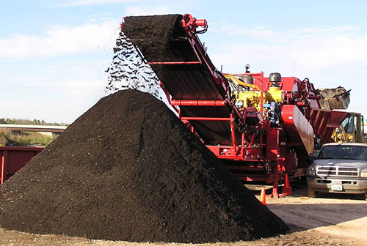
Things to Consider
RAP
3 – 6 % asphalt binder
94 – 97% stone
RAS
19 – 36% asphalt
2 – 15% fibers
20 – 38% mineral aggregate
8 – 40% mineral filler

Slide 5
RAS Binder Challenges
Lack of guidance on characterizing RAS binders
Many DSRs cannot test high temperature grade due to water boiling
Challenge with BBR testing
  Binder does not relax
Notes:
Changed Most to Many

Slide 6
RAS Binder Characterization Needs
What is the variability of high and low temperature characterization?
Can I extrapolate the high temperature grades?
How can I determine low temperature grades of binder?

Slide 7
Materials Used
Manufacturer’s Waste
  Michigan, Texas, New Hampshire
Post-Consumer
  Oregon, Michigan, Georgia

Slide 8
Methodology
Completed 3 extractions of each RAS binder
Run following methodology three times on each extraction
  Tested binder properties at 82, 88, and 94°C
  Determine critical high temperature grade through extrapolation
  Measure critical high temperature grade

Slide 9
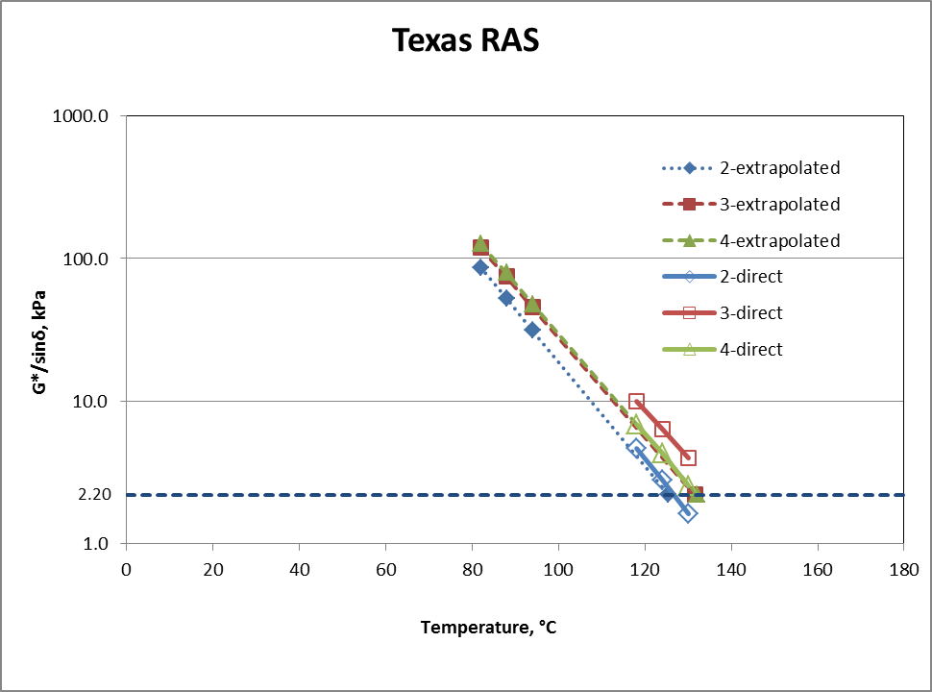

Slide 10
Measured vs Extrapolated
Dataset | Measured Data, °T |  | Extrapolated Data, °T |  | p-value
 | Average | Variance | Average | Variance
All Data | 147.5 | 150.4 | 146.2 | 626.1 | 0.73
Michigan MW | 137.7 | 30.6 | 132.9 | 19.1 | 0.06
Michigan TO | 155.4 | 69.2 | 167.8 | 1090.4 | 0.30
Oregon | 147.2 | 21.5 | 144.3 | 26.4 | 0.22
New Hampshire | 156.3 | 75.3 | 144.9 | 172.9 | 0.04
Georgia | 156.5 | 144.8 | 157.7 | 1641.3 | 0.93
Texas | 131.9 | 25.0 | 129.7 | 12.0 | 0.29
Post-Consumer | 147.9 | 184.5 | 147.5 | 647.4 | 0.94
Manufacturer’s Waste | 147.2 | 122.0 | 145.0 | 625.7 | 0.68
t-Test with unequal variances
Α = 5%
H_{o}: Measured = Extrapolated

Slide 11
How Much Binder is in the RAS?
Chemical extraction vs. Ignition Oven
  Chemical Extraction:
    Do I get all of the RAS?
  Ignition oven:
    Do I burn off other organic matter?
AASHTO – Must use chemical extraction
Virginia – Developed ignition oven correction factor

Slide 12
Asphalt Content Testing
Product | Average Ignition AC, % | Average TCE Extraction AC, % | Difference, %
WI – RAS | 30.75 | 25.77 | 4.98
AL – RAS | 22.77 | 18.92 | 3.85
TN – RAS | 18.77 | 17.73 | 1.04
NC – PC RAS | 18.64 | 16.84 | 1.8

Slide 13
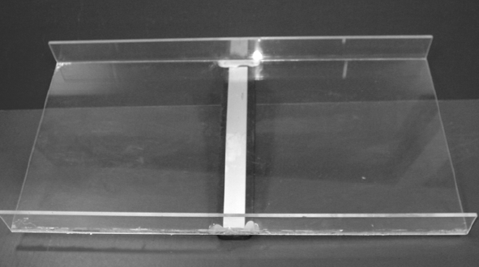
Deleterious Materials
Example specification (TEX-217-F Part III)
  Oven dry sample
  Sample 1000 g = W_{T}
  Weigh Pan and pour sample over pan
  Magnet on pan catches metal pieces in shingle
  Weigh metal pieces = M

Slide 14
Deleterious Materials
Sieves Used: 3/8”, No. 4, No. 8, No. 30
Shake sample for 10 minutes
Discard – No. 30 material
Test material retained on each sieve for deleterious materials (wood, paper, plastic, felt paper)
  Manual separation
Weigh material removed from RAS for each sieve
  Deleterious materials on 3/8” sieve =N_{3/8}

Slide 15

Deleterious Materials
$$P=\frac{M+N_{3/8}+N_{4}+N_{8}+N_{30}}{W_{T}}∗100$$
P = percent of deleterious matter by weight
M = weight of material retained by magnet, g
N# = weight of deleterious substance on sieve, g

Slide 16
Limits
Texas < 1.5%
Colorado (500-700 gram sample)
  Metals, rubber, glass, soil, brick < 3.0% on No. 4
  Paper, wood, plastic < 1.5% on No. 4

Slide 17
Mix Design

Slide 18
Shingle Binder Contribution
Organization | How Much RAS Binder Is Available for Mix?
AASHTO | Shingle Binder Availability
Alabama Department of Transportation | 100 of RAS binder
Iowa Department of Transportation | 66.7 percent of RAS binder
Missouri Department of Transportation | 100 Percent of RAS Binder
Texas Department of Transportation | 100 Percent of RAS Binder
Oregon Department of Transportation | 100 Percent of RAS Binder
What’s the truth?

Slide 19
What Can Affect Binder Availability?
Size of RAS
Where is the RAS introduced
Aggregate temperature
Binder temperature
Mixing time
Moisture content!
Schroer 2009

Slide 20
AASHTO Methodology
Perform volumetric mix design on a mix which contains all components but RAS
Perform a second mix design on a RAS mixture
  RAS added at ambient temperature to aggregate
    Should I heat the RAS overnight at 140F and then preheat for two hours at mix temp?
Determine the difference between the optimum asphalt content of virgin and RAS mixtures, Δ

Slide 21
AASHTO Methodology
If Δ is positive, RAS is contributing binder
Multiply the percentage of shingle binder in the RAS by the percent RAS in the mix = total available binder
Divide Δ by total binder available
Correct shingle asphalt binder availability factor

Slide 22
Limitations of Methodology
Assumes
  Differences in virgin and RAS mix is only due to shingle binder and not
    Fibers
    Aggregate
Townsend et al., 2007

Slide 23
Current Methods
AASHTO – Choose a value for binder availability
Other states – Design for lower air voids to increase asphalt content
It’s all about the asphalt

Slide 24
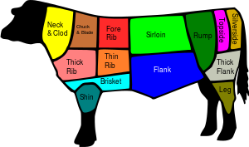
The Same, But Different

Slide 25
The Same, But Different
Schroer 2009

Slide 26
Melting Characteristics of RAS
Differential scanning calorimetry

Slide 27
Shingle Gradation
Oversized shingles affect
  Asphalt mobilized
  Mixture consistency
State | Percent Passing
 | ½” | 3/8” | #4 | No. 100 | No. 200
Texas | 100% | 95% | -- | -- | --
Missouri | -- | 100% | -- | -- | --
GA/VA/AASHTO | -- | 100% | -- | -- | --
Iowa | 100% | 98% | 90% | -- | --
Oregon | 100% | 90% | -- | -- | --
South Carolina | 100% | -- | 70.0 – 95.0% | 15% Max | 7% Max
Minnesota | 100% | -- | 90% | -- | --

Slide 28
Mix Design Must Be Tied to Performance
Performance Tests are going to be necessary as we move to more complicated mixtures
9-55
  Tie laboratory performance to field performance
  5 field projects
  Cracking Tests (Intermediate Temperature)
    Energy Ratio, Beam Fatigue, SCB (LTRC), SCB (IL), Overlay Tester,

Slide 29
Field performance

Slide 30
Can RAS Perform in a Mix?
YES!
But …

Slide 31
Field Performance Methods
Randomly select three 200-ft sections for each mix
  Rutting – Straight edge and wedge
  Cracking – Visual Inspection and LTPP DIM
  Raveling – ASTM E965

Slide 32
New Project #1
Appleton, Wisconsin
  September 10-12, 2013
  Mix design
    3% PC RAS, 14% RAP
    RAS Binder Ratio: 11.2%
    RAP Binder Ratio: 12.1%
  Mix iterations
    Control HMA, Zycotherm WMA, Rediset LQ WMA

Slide 33
New Project #1
October 10, 2014
  13 months after construction
Rut depths measured with straight edge and wedge
  No rutting
Cracking assessment
  No cracking in Rediset mixture
  All concrete had been rubbilized before placing asphalt

Slide 34
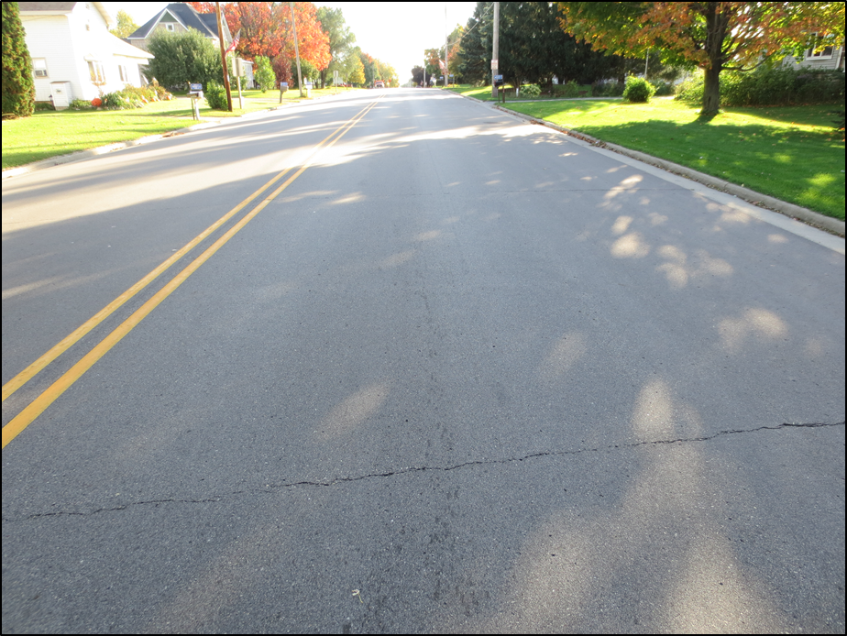
New Project #1 Cracking
Control Mixture
  One of three sections exhibited cracking
  Asphalt placed over concrete which had not been rubblized
  When placed over rubblized concrete, no cracking detected

Slide 35
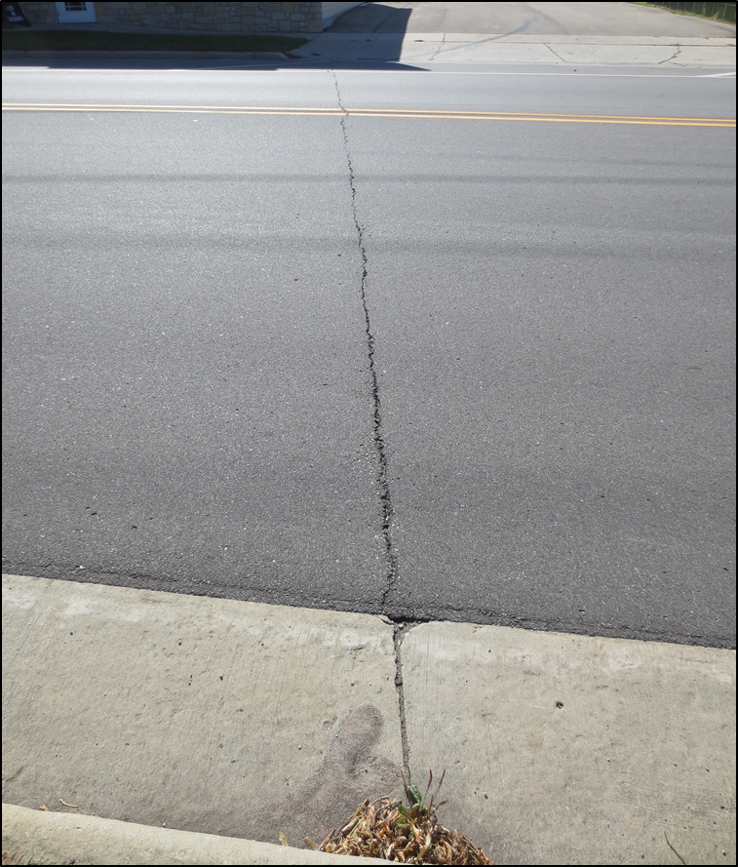
New Project #1 Cracking
Zycotherm Mixture
  One section exhibited cracking
  Asphalt placed over concrete which had not been rubblized
  Cracks lined up with joints

Slide 36
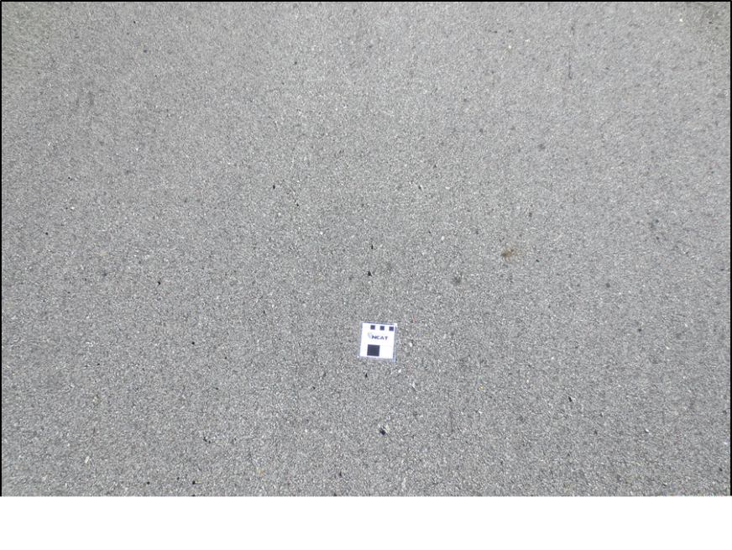
New Project #1: Raveling
Mix | Mean Texture Depth, mm | Standard Deviation, mm
Control | 0.386 | 0.024
Rediset | 0.389 | 0.041
Zycotherm | 0.373 | 0.001
Pop-outs are commonly seen in this area.

Slide 37
Field Projects
New Project #2 – Enterprise, AL
June 2014
Four mixtures
  RAP Binder Ratio: 13.5%
  RAS Binder Ratio: 19.6%
  Variables: Air Voids

Slide 38
Performance
1st Revisit: 11/19/15
  All four test sections look good
  One small crack in low air void HMA test section

Slide 39
Field Projects
New Project #3 – Tennessee
October 2014
Two mixtures
  RAP Binder Ratio: 10.9%
  RAS Binder Ratio: 11.7%
  Variable: HMA vs WMA

Slide 40
Performance
1st Revisit: 11/11/15
Both mixtures look good
No cracking in either test section

Slide 41
The Next Steps
While asphalt IS the most expensive mixture component, it is also critical for durability
Change our mindset to ensure performance
  Move away from binder tests
  Move towards mixture tests
  Ensure placing mixture in a place where it will succeed
  Rejuvenators

Slide 42
Thank you!
J. Richard Willis
(334) 844-7301
willi59@auburn.edu

