Slide 1
Specs & Construction Policies Update 28th Annual AAPA Conference
Skip Powe, P.E.
State Construction Engineer
Alabama Department of Transportation

Slide 2
Overview
Construction Status
Specification Changes
Proposed Specs
CIMs
Recent Changes/Issues
Points of Emphasis
On the Radar

Slide 3
Construction Status
March 2017
March 2018
Active:
382 Contracts
$1.74 Billion
Accepted:
732 Contracts
$2.21 Billion
Active:
399 Contracts
$2.31 Billion
Accepted:
675 Contracts
$2.23 Billion

Slide 4
Specification Changes
SP 12-0599(2) Asphalt Materials
Added Tack Coat materials
Cleaning pavement options and requirements
(Hint: Remember what Joel said yesterday)
Revised Tack application rates

Slide 5
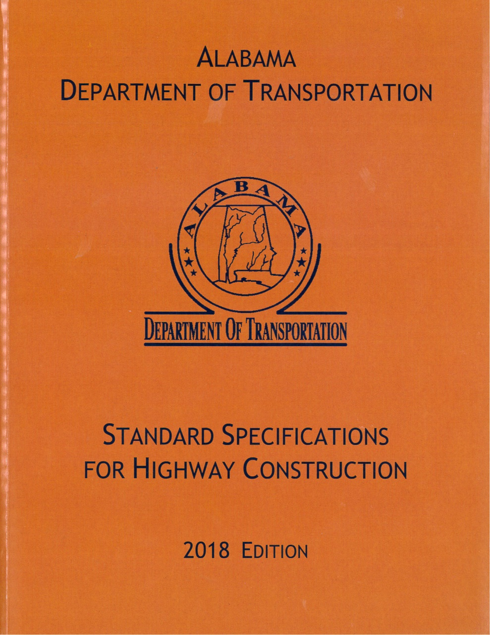
Specification Changes
2018 Standard Specifications

Slide 6
Proposed Specs
3 Special Provisions in development
Result of AAPA Liaison Committee proposals

Slide 7
Proposed Specs
Subarticle 105.12(a) – Load Restrictions
Survey of Southeastern States
ALDOT was only one with this spec
Change to only the excess is no payment

Slide 8
Proposed Specs
Item 109.01(h)2. Weight Measure for Pay Purposes
Independent Weight Check

Slide 9
Proposed Specs
Independent Weight Check (IWC)
Met with Dept. of Agriculture & Industries
Current scale requirements and technology make IWC unnecessary
Internal “electronic” seals can record issues
Current spec requires service checks every 4 months

Slide 10
Proposed Specs
Independent Weight Check (IWC)
Working with Ag & Industries to update all of Subarticle 109.01(h) to match state law
Delete IWC
Possibly go to 6 month testing/inspections
Submit copy of results to ALDOT

Slide 11
Proposed Specs
Transverse Joint Repair

Slide 12
Proposed Specs
Transverse Joint Repair
Article 410.06 Correction of Deficiencies & Defects
Lists options
Remedy to the extent practicable by rolling while material is still workable

Slide 13
Proposed Specs
Transverse Joint Repair
Liaison proposes no one wants to be careless and remob
Incur extra labor and equipment $$$ to grind joints
For FREE!!!
Considering trying this on non-WS layers
Also, talking to NCAT Test Track on lessons learned

Slide 14
CIMs
Construction Information Memorandum
Our Policies & Procedures
cc: Industry Associations, if it affects

Slide 15
CIMs
10-2017
1-2018

Slide 16
CIMs
10-2017 Article 405.03(c) Preparation of Existing Surface
Emphasized cleaning and drying surface
List of possible cleaning options
Limitations on vacuum trucks
Means & Methods vs Performance-based Specs

Slide 17
CIMs
1-2018 Sand Patch Test for Micro-Milled Surfaces
Test required since June 2015, but inconsistency among Areas
Issues with 1/16” max ridge-to-valley measurement
Impacts ride, exposure time to traffic, overlying layer
Costs; if > 1/16”, it is regular planing

Slide 18
Recent Changes/Issues
Besides specs, proposed specs and CIMs,
What recent changes and issues have we had?

Slide 19
Recent Changes/Issues
2018 Special Drawing
PM-705-6 Index No. 1033
Correction for Centerline Pavement Markers
1A (white/white) to 2C (white/red)
Was in 2017 book but error in 2018
Effective April letting, but CN says use Jan-March

Slide 20
Recent Changes/Issues
Striping Update
All know impact of last summer’s rain
Striping delays started early
Delay notice on 10/2/2017
Mild winter, but rainy and cool enough to keep pavement too wet

Slide 21
Recent Changes/Issues
Striping Update
Many jobs carried over
Coordinated with Areas, primes, and stripers
Prioritized interstates and high traffic routes due to traffic impact
Spring and warmer temps will help catch-up???

Slide 22
Recent Changes/Issues
Safety
Lack of emphasis for ALDOT folks for years
But, Contractors under OHSA
ALDOT now emphasizing better safety
Some new/updated Department measures

Slide 23
Recent Changes/Issues
Safety
Safety Vests (for all on-site)
Hard Hats (if overhead)
Other PPE (evaluating)
Awareness (emphasized, including parking)
Training (in development)
New policies for procedures (in development)

Slide 24
Recent Changes/Issues
e-Construction
Last year, talked about CAMMS
Want to get Contractors on board
On hold; all efforts to finish Materials module
July 1, 2018
Want to save annual licensing fees on SiteManager

Slide 25
Recent Changes/Issues
e-Construction
Also, talked about e-CN initiative
Goal is to reduce paper – save time & money
Major accomplishment in last year is iPads
Procured 254 iPads for projects

Slide 26
Recent Changes/Issues
e-Construction
Inspectors record work as it happens
Minimizes travel back to trailer at end of day
Saves on OT ($$$) to do paperwork
Gives inspectors back their personal time 😊

Slide 27
Recent Changes/Issues
e-Construction
Spec Book and Plans also in CAMMS
Gives inspectors more tools at their fingers
More functions being evaluated (i.e. e-Tickets)
Trying to do more with less

Slide 28
Points
of Emphasis

Slide 29
Points of Emphasis
OGFC Placement
Reminder – Density is not required
Only need to “seat” it
Several jobs lately that appear to be over-rolled
Water is still on surface

Slide 30
Points of Emphasis
OGFC Tack Coat
Supplied and placed by Blacklidge
Reminder of 10/18/2017 email
If Blacklidge places, they must have a Sublet
Don’t want to repeat this or get free work

Slide 31
Points of Emphasis
3-2015 Post-Letting Modifications of Section 408
Reminder
Time to cover planing/micro-mill is now 7/30
If let as planing and you request to change to micro-milling

Slide 32
Points of Emphasis
3-2015 Post-Letting Modifications of Section 408
Either:
1. Will hold you to the 7 days to cover
2. Need a price reduction for something:
Mob, micro-mill, or the asphalt layer
Due to change in # of Mobs, standby, production rates

Slide 33
Points of Emphasis
GFO 3-15 Plan Quantities for Tack Coat
Have numerous issues with Tack plan qtys
Guidance on rates to use for Emulsified
If Prime historically uses PG, then rates for it
New guidelines for rates for OGFC Tack

Slide 34
Points of Emphasis
GFO 3-15 Plan Quantities for Tack Coat
EA for resurfacing: 0.10
EA for new layer: 0.08
PG for resurfacing: 0.06
PG for new layer: 0.05
OGFC: 0.18

Slide 35
Points of Emphasis
GFO 4-4 RAP Material
Reminder for state-retained material
Limit of 75 CY per project
Applies to ALDOT, County, and Cities

Slide 36
Points of Emphasis
Early Awards
Many projects carried over from 2017
Lettings started in November & December
Interstate heavy this year, especially PM 1
Several IM jobs are Early Awards due to need

Slide 37
Points of Emphasis
Early Awards
Most of you have several projects ready to start
Hard to schedule Early Awards with current schedules
Limiting Early Awards on maintenance resurfacing to special conditions

Slide 38
On the Radar

Slide 39
On the Radar
Last year, outlined several issues planned
Many are needs identified or issues requested by ARBA and AAPA Liaison Committees
Due to our shear volume of work, challenged to address all at one time
Still working on, but not making a list this year

Slide 40
On the Radar
Interstate Resurfacing
December: 1 + I-65 Widening
January: 1
February: 8
March: 2

Slide 41
On the Radar
Interstate Resurfacing (anticipated)
April: 3 St. Clair, St. Clair, Walker
May: 1 St. Clair
June
OR July: 6 Autauga, Chambers, Montgomery
Jeff/Blount, Marion, Walker

Slide 42
On the Radar
Interstate Resurfacing (anticipated)
Many PM 1 jobs – Micro-mill OGFC and replace
Thin lift Pavement Preservation
All being let by May
Early Award and Contract Time geared to finish OGFC by October
Make these a priority

Slide 43
On the Radar
Portable Changeable Message Signs
One thing I will leave you with:
DO NOT USE – Road Work Ahead
Find something else to say
More to come!

Slide 44
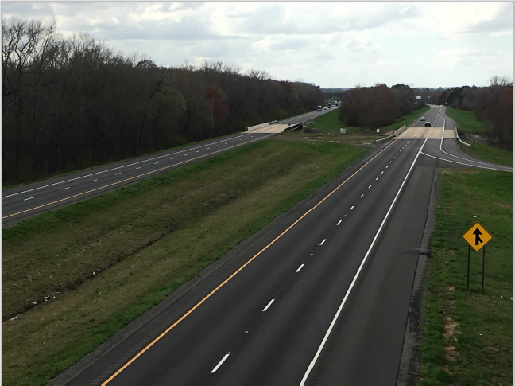
QUESTIONS?

