Slide 1
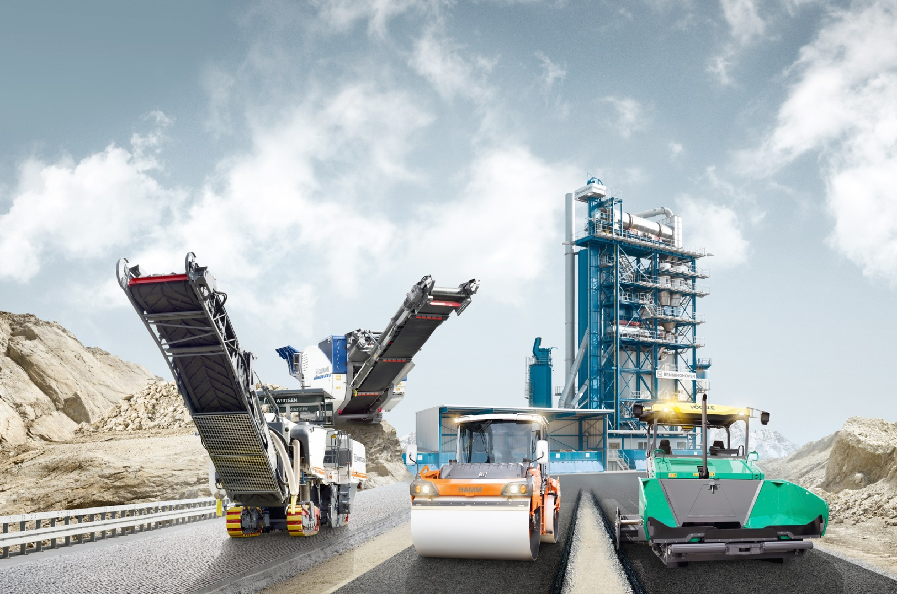
AAPA
Best Practice – Nighttime Paving
M Burris

Slide 2
Best Practices – Nighttime Paving
Night Paving:
The Principles of Paving same for Night or Day Paving
Lighting usually a Major Challenge
Temperature Variation another challenge
Human Behavior in the nights must not be ignored
  Sleepy employees
  Impaired Drivers
  Safety uniform
We will focus on Understanding the Principles of the free floating Screed
……..and Best Practice with a focus on Night Paving
Notes:
3

Slide 3
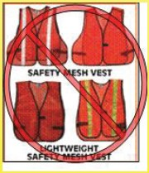
NOT A GOOD CHOICE

Slide 4
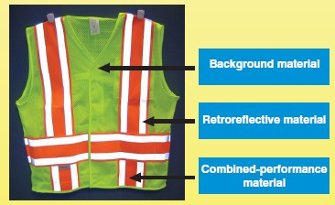
BETTER CHOICE

Slide 5
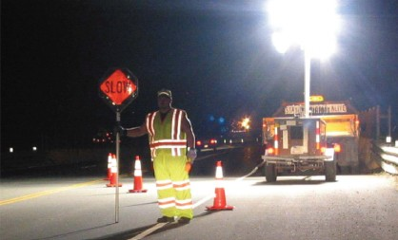
GOOD & BAD

Slide 6
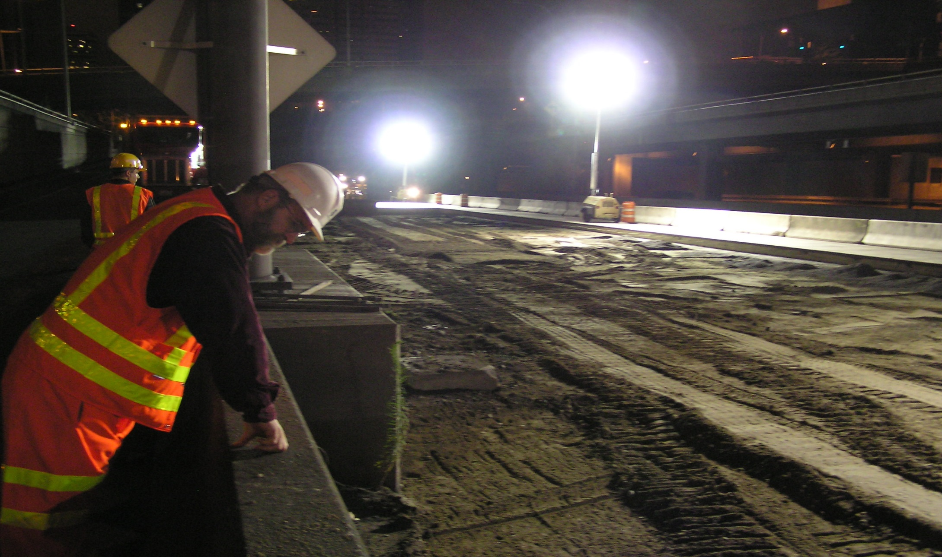
SOME LIGHTS CAN BE BLINDING

Slide 7
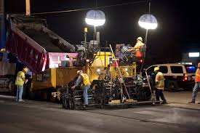
BALLOON LIGHTING

Slide 8
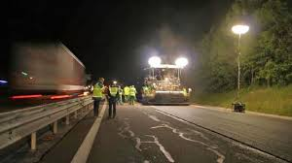
HAVING A LIGHTING PLAN

Slide 9
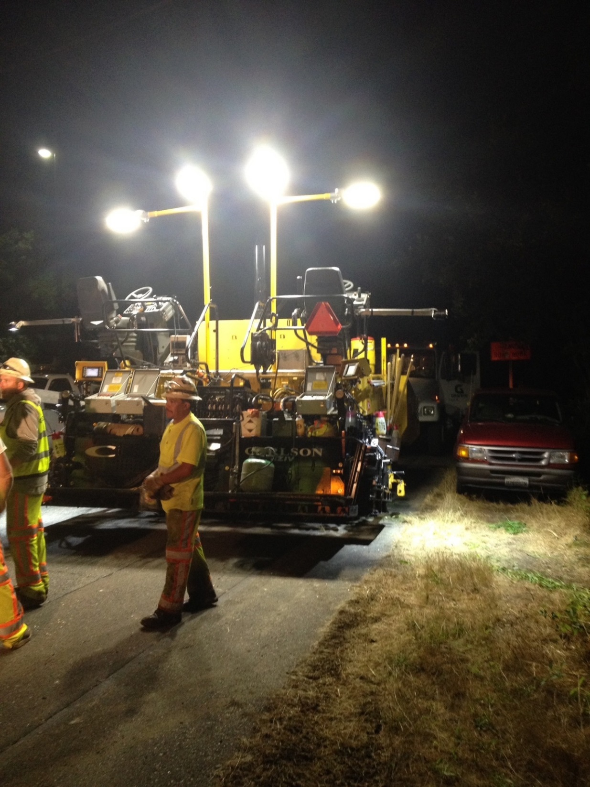
PLAN FOR AN ANTI-GLARE

Slide 10
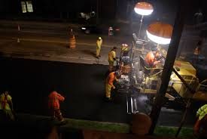
TYPICAL

Slide 11
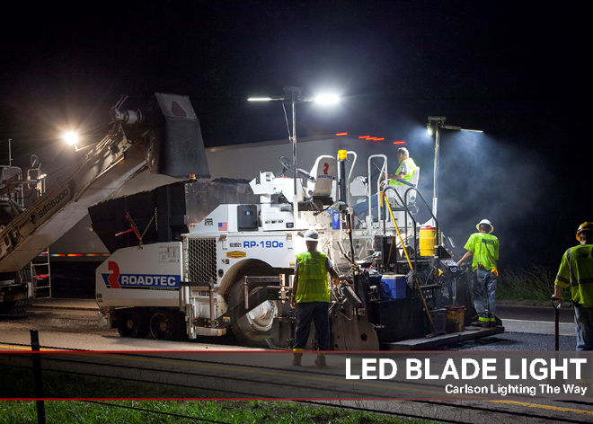
VERY POPULAR, LED BLADE LIGHT

Slide 12
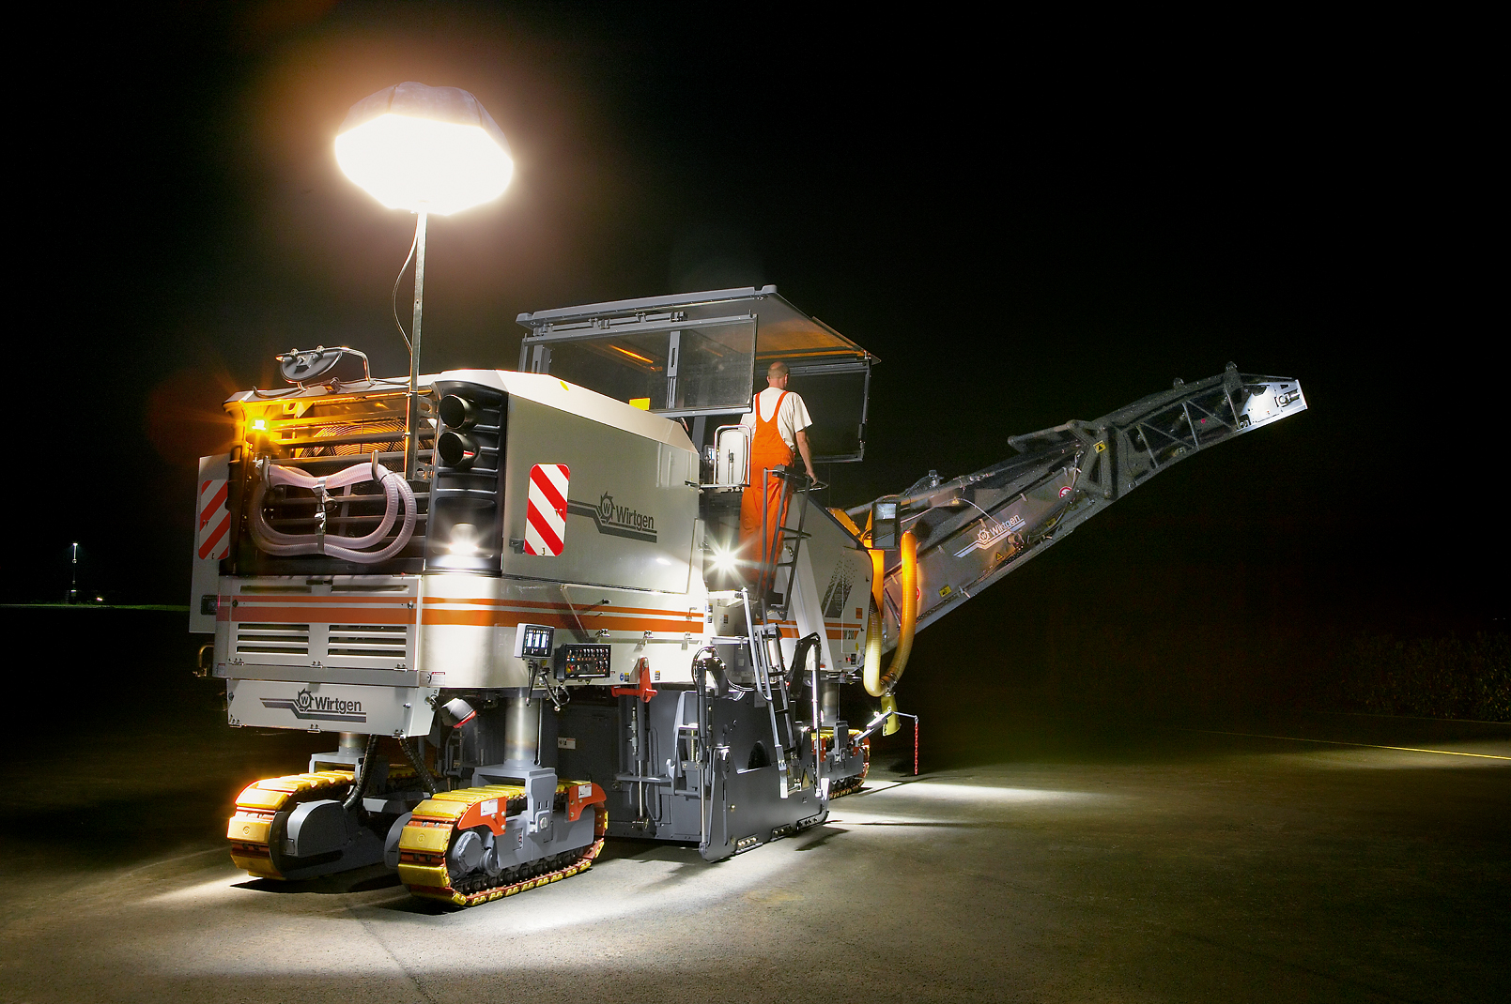
READY FOR OPERATION WHATEVER THE TIME OF DAY
GOOD LIGHTING FOR PERFECT OPERATION AT NIGHT

Slide 13
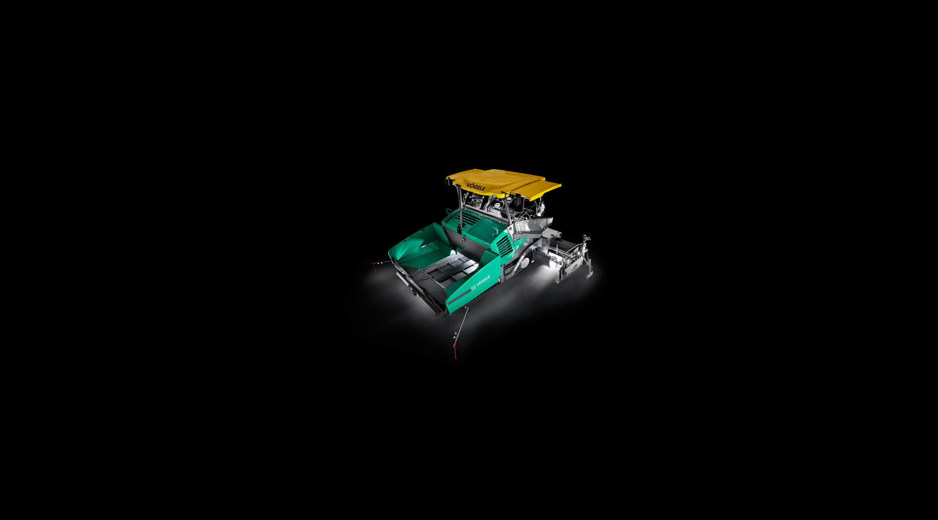
Best Practices – Nighttime Paving
1. Principles of the Free Floating Screed
Forces Acting on the Screed
Managing each Forces to enhance Smoothness & Density
2. Screed Adjustments Impacting The Free Floating Screed
Extensions, Strikeoff, tow point position
Pulling off the Joint
3. Segregation
Mechanical & Thermal
Typical Locations, Causes & Solutions
4. Longitudinal Joint Construction
5. Automatic Grade & Slope
Notes:
3

Slide 14
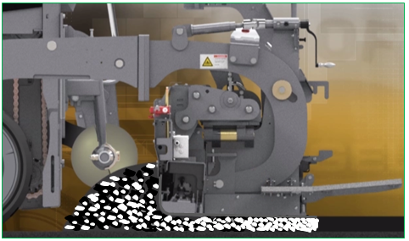
Principles of the Free Floating Screed
Vibratory Screed Compaction:
Aggregate moves together. reduces the air Voids as the screed moves forward
The aggregate size must allow the screed to Float / Not held up on aggregate
Un-Compacted aggregate flowing under screed
Final Screed Compaction
Notes:
3

Slide 15
Principles of the Free Floating Screed
Vibratory Screed Compaction:
Main Screed
Main Strikeoff
Max. Compaction at Trailing Edge
0 Compaction at Strikeoff
Screed Compaction
(Angle of Attack)
Material Flowing Under Screed
Mat Thickness
Notes:
3

Slide 16
Principles of the Free Floating Screed
Vibratory Screed Compaction:
1. Extrusion Compaction - Due to Bull nose on screed plate
2. Gradient Compaction - Due to screed angle of attack
Main Screed
Max Compaction at trailing edge
Main Strikeoff
Mat Thickness
Extrusion Compaction - Due to Bull Nose
Gradient Compaction
- Due to Angle of attack
Notes:
3

Slide 17
Principles of the Free Floating Screed
Vibration Screed Compaction – For a given Mix design:
Extrusion Compaction
Gradient Compaction
Occurs at the Bull Nose
Influence by:
1. Main Strikeoff Adjustment
Occurs along the flat of the Angled Screed plate
Influenced by the following:
Screed weight & Vibration – By design
  Frequency
  Amplitude
Head of material
Tow point position
Extension Angle of attack & Match Height
Notes:
3

Slide 18
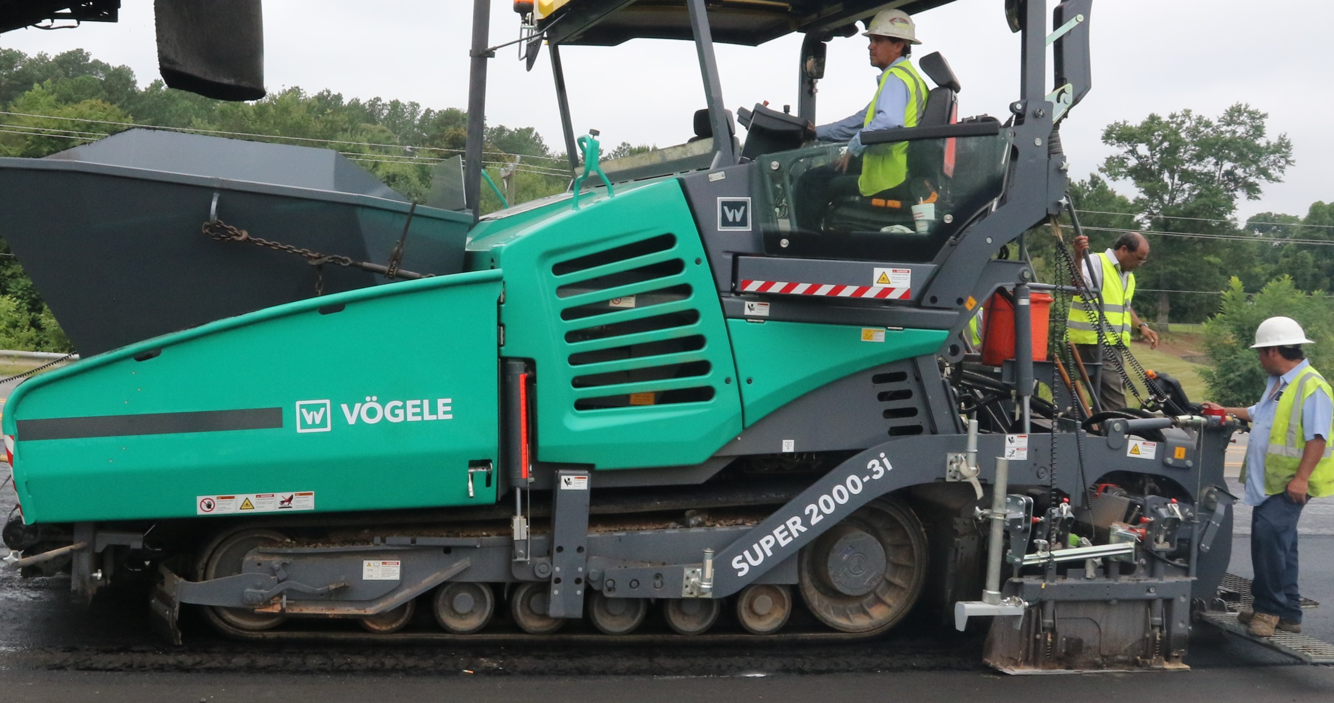
Principles of the Free Floating Screed
Review of Key Components of the Paver:
Notes:
3

Slide 19
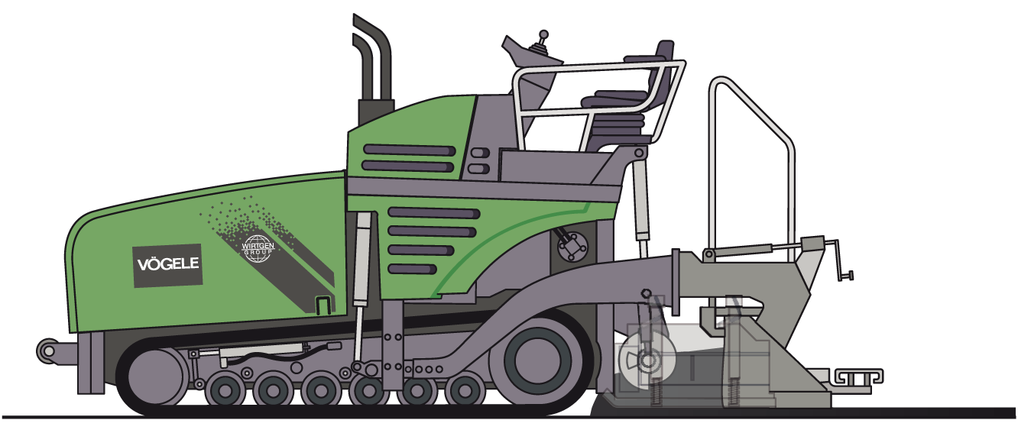
Principles of the Free Floating Screed
Review of Key Components of the Paver:
Tow Point
Cylinder
Tow Arm
(Leveling Arm)
Screed Arm
Tractor
Thickness control Screw
Pivot Point
Screed
Tow Point
(Pull Point)
Stable
Angle of Attack
(5 Forces in Balance)
Mat Depth
Notes:
3

Slide 20
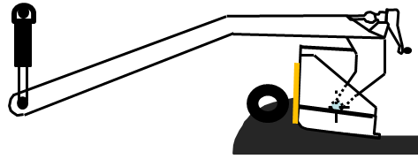
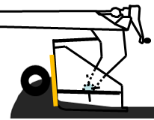
Principles of the Free Floating Screed
Increase or Decrease Mat Depth And Balance
- Mat Depth is Increase or Decrease by Changing the Screed Angle - (Angle of Attack)
1. Manually By using the Thickness Control Screw
2. Manually By using the Tow Point Jog Switch
3. Or Automatically using Grade & Slope Control Systems
Increase Angle - Increase Mat Depth
Decrease Angle - Decrease Mat Depth
Notes:
3

Slide 21
Principles of the Free Floating Screed
It takes 5 x the Length of the tow arm to reach 100% of the new grade
5 Forces holding the screed to grade must reach Equilibrium (Balance)
Approx. 65% of change occurs in the first tow arm length
- Must over compensation for large change in short distance
5 th
4 th
3 rd
2 nd
1st
100 %
85 %
65 %
Notes:
3

Slide 22
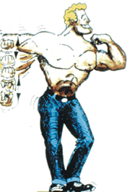
Principles of the Free Floating Screed
Make a change and wait for the screed to respond
- For quick response – Over correct and monitor
Screw Man
Notes:
3

Slide 23
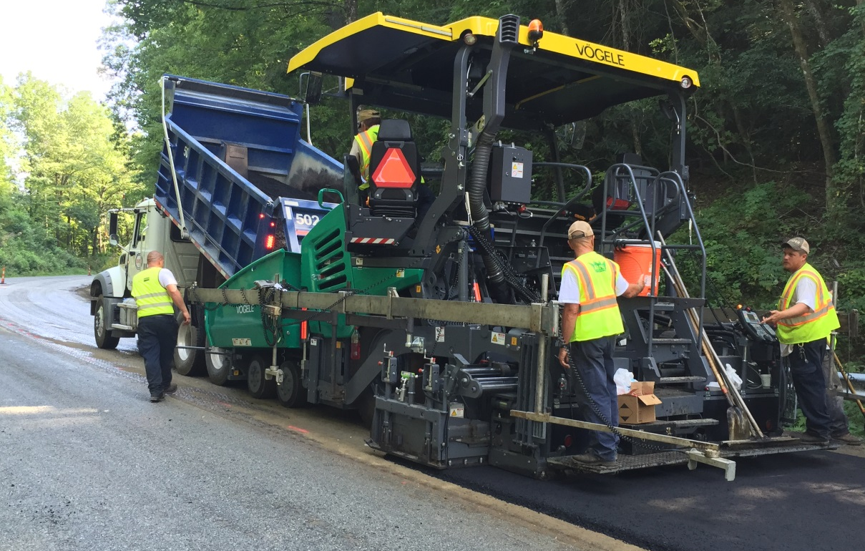
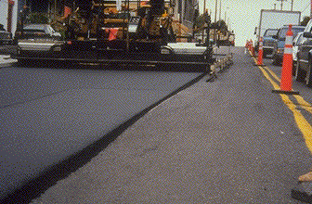
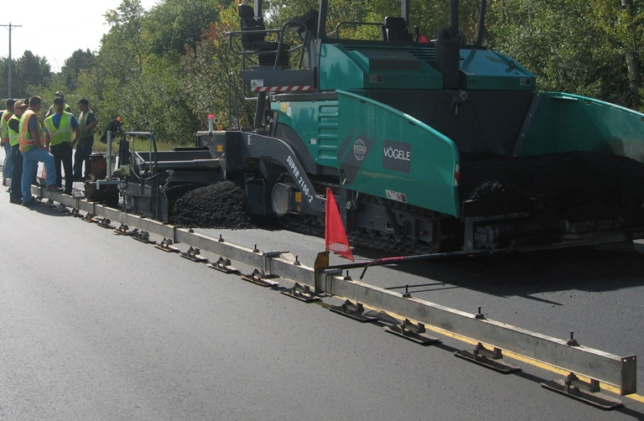
Principles of the Free Floating Screed
Averaging Ski:
Non Contact Beam:
3 to 4 Referencing Sensors
26’ - 50’ Beam available
Mechanical Drag Beam:
Single Sensor referencing off a Drag Beam

Slide 24
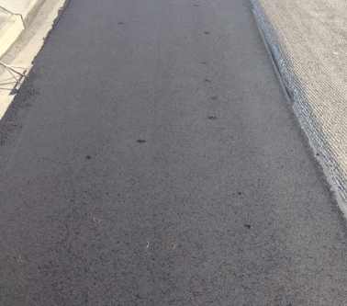
Principles of the Free Floating Screed
Checking Mat Depth:
Know your Subgrade
Allow time for the screed to react
  Don’t Poke the mat Constantly
Notes:
3

Slide 25
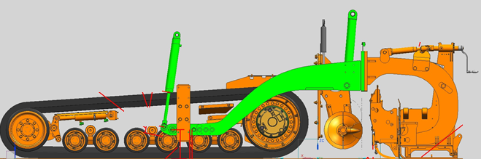
Principles of the Free Floating Screed
Free Floating Screed Averaging the Sub-grade
Sub-Grade
Notes:
3

Slide 26
Principles of the Free Floating Screed
Free Floating Screed Averaging the Sub-grade
It Takes approximately 3 Lifts to Smooth out Uneven Sub-grade
50’
3rd Lift = 35.4%
2nd Lift = 50%
1st Lift = 70.7%
Existing Surface
Notes:
3

Slide 27
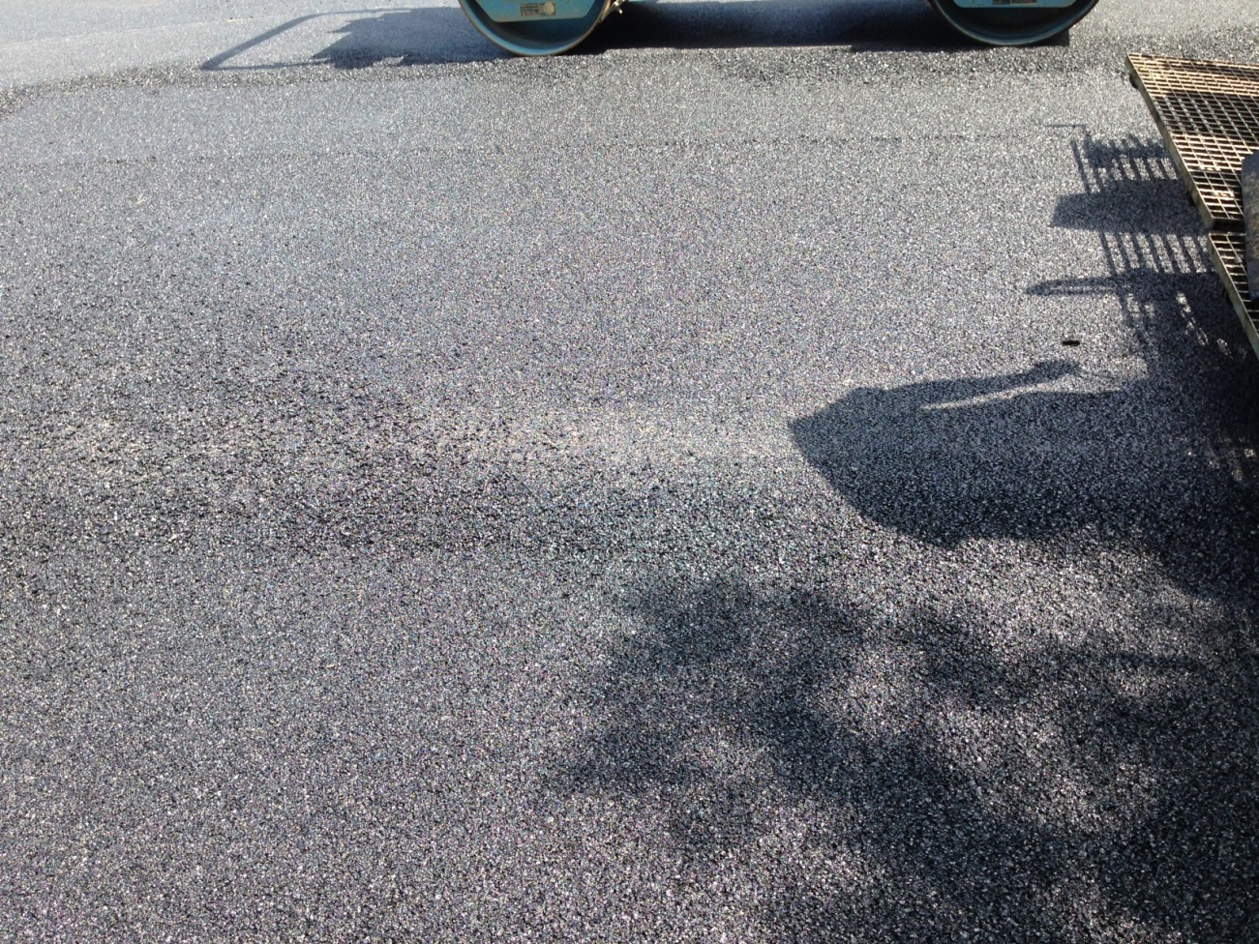
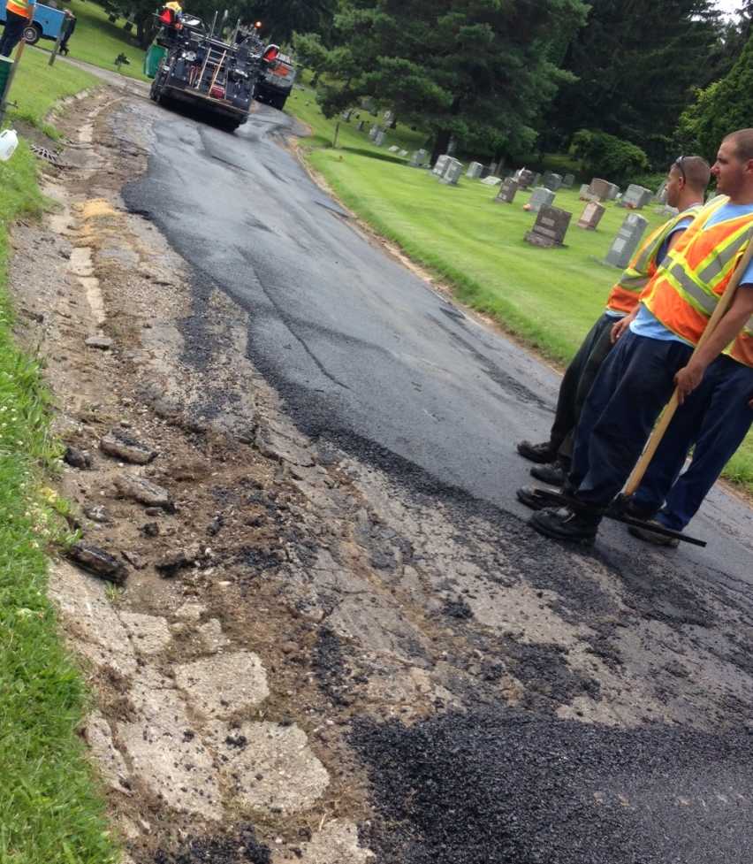
Principles of the Free Floating Screed
Always ensure clean and level Sub-base
The Screed must Float / Not hung up
  Mat depth must be 2.5 to 3 times the largest Aggregate Size
Notes:
3

Slide 28
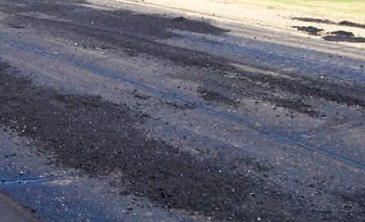
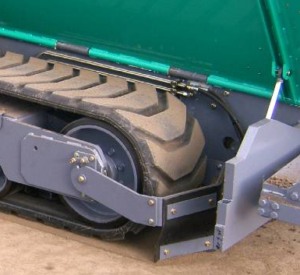
Principles of the Free Floating Screed
Allow the screed to float???????????????
Avoid paving over clumps of asphalt in front of the paver
  Shovel off
  Or Use Track Plough when Available
Notes:
3

Slide 29
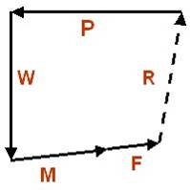
Principles of the Free Floating Screed
Forces acting on the screed:
Depth Held by 5 Forces
Not by Mechanical or Hydraulic Devise
Screed Weight
W
Pull Force
P
Material Head
M
Reaction Force
R
F
Frictional Force
At Equilibrium:
All Forces are in Balance
Constant Mat Depth is Maintained
The screed is free floating with an Equilibrium Angle (Angle of Attack)
Change in any of the 5 Force cause the screed to Rise or Fall
Notes:
3

Slide 30
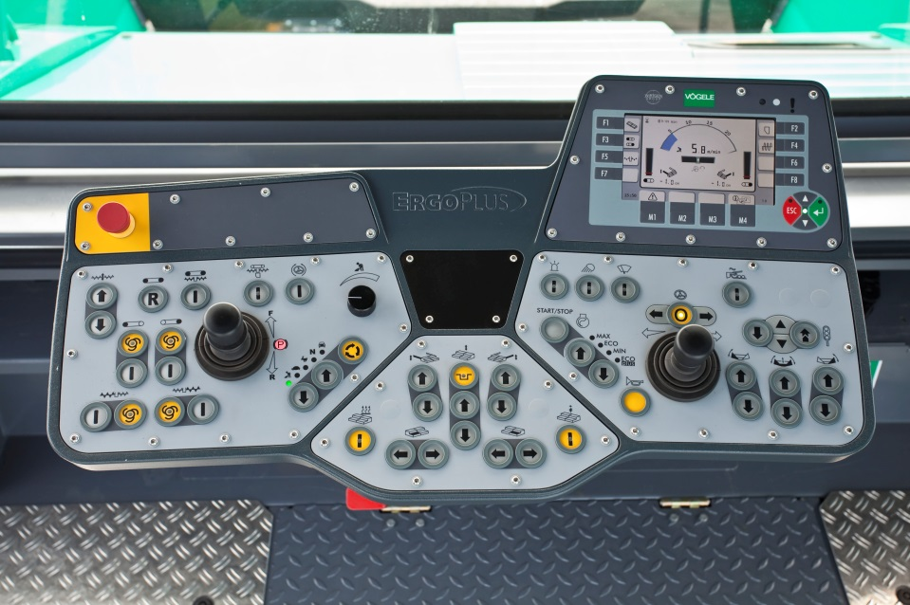
Principles of the Free Floating Screed
Issues Affecting Force # 1 - Pull Forces:
- Must Maintain a constant Speed as Possible
  Speeding up & Slowing Down - Disrupt the Equilibrium of Forces
  Changes Resistance of the screed against the head of Material
  Resulting in Change in mat thickness / Rough Ride
Speed
Dial & Display
P
  Pull Force
Notes:
3

Slide 31

Principles of the Free Floating Screed
Issues Affecting Force # 1 - Pull Forces:
- Maintain a Constant Paving Speed as possible
Plan the Job – focus on the following to determine best Paving Speed
  Material delivery
  Rolling Capabilities
  Tonnage delivered must = Tonnage Laid
  Tonnage Laid = Paving Speed X Mat Width X Mat Thickness
  Several charts available to assist in Calculation
Notes:
3

Slide 32
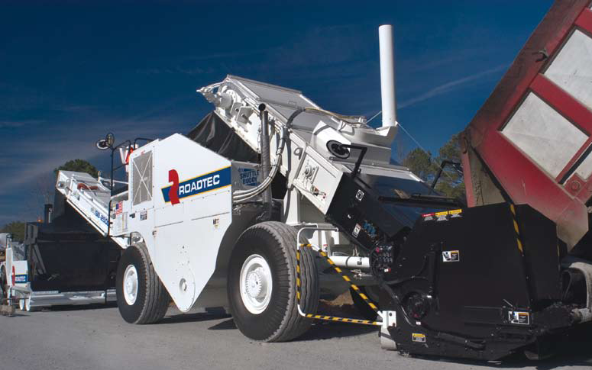
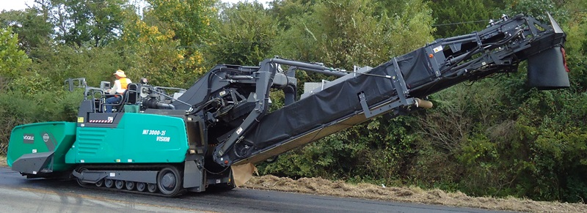
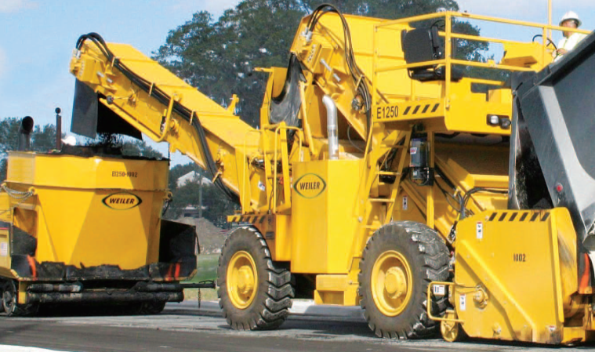
Principles of the Free Floating Screed
Issues Affecting Force # 1 - Pull Forces:
- Use of MTV for Non Contact Continuous Paving
Exchange truck without Stopping
Exchange Truck without bumping the Paver
Maintain Material Consistency
- Gradation Consistency (Mechanical Segregation
- Temperature Consistence (Thermal Segregation)

Slide 33
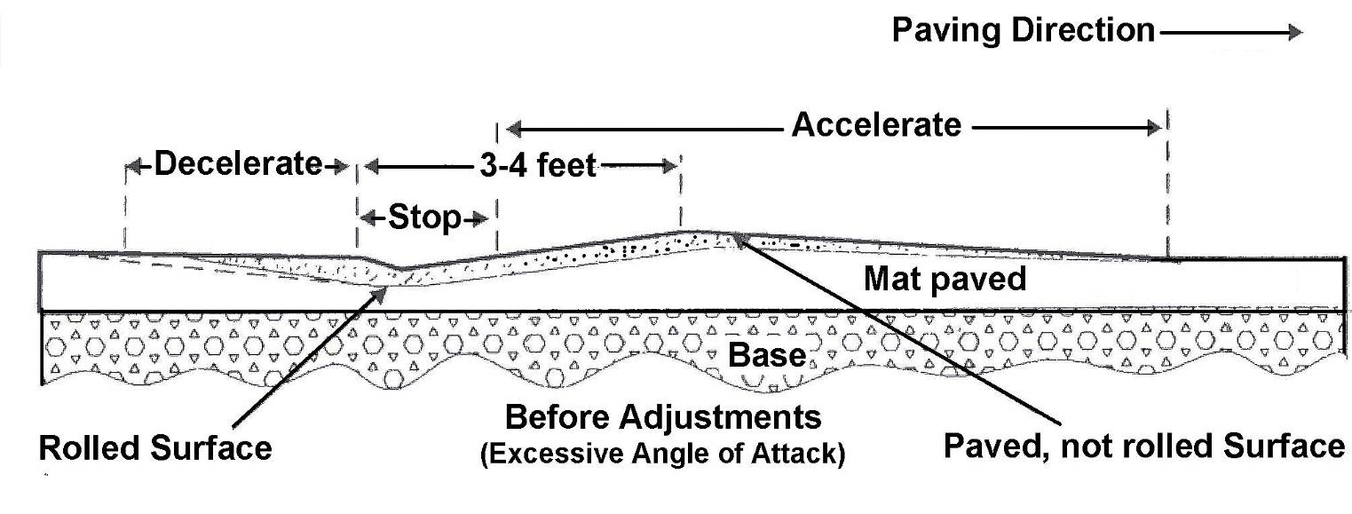
Principles of the Free Floating Screed
Issues Affecting Force # 1 - Pull Forces:
Stopping and Starting
  Result in Settling Dents & Humps
Must Focus on:
1. Automation Engaged When Stopped
2. Vibration Engaged when Stopped
3. Material cooling
P
Notes:
3

Slide 34
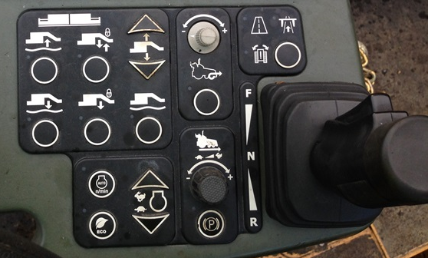
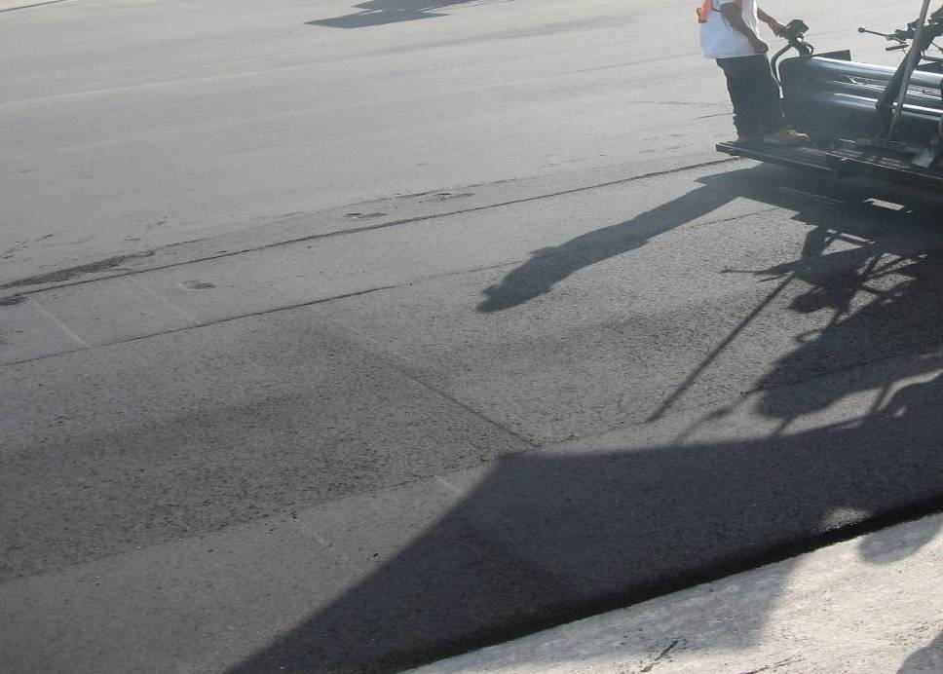
Principles of the Free Floating Screed
Issues Affecting Force # 1 - Pull Forces:
Reducing Settling & Humps
  Use Screed Hold & Freeze when Available to Reduce Settling & Humps
  Operators - Disengage Neutral Lock and Start Moving Instantly
Notes:
3

Slide 35
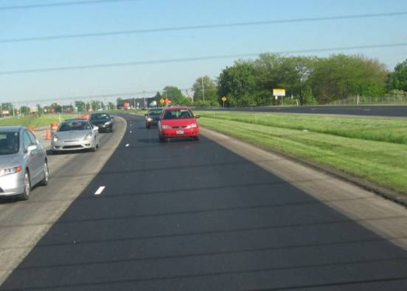
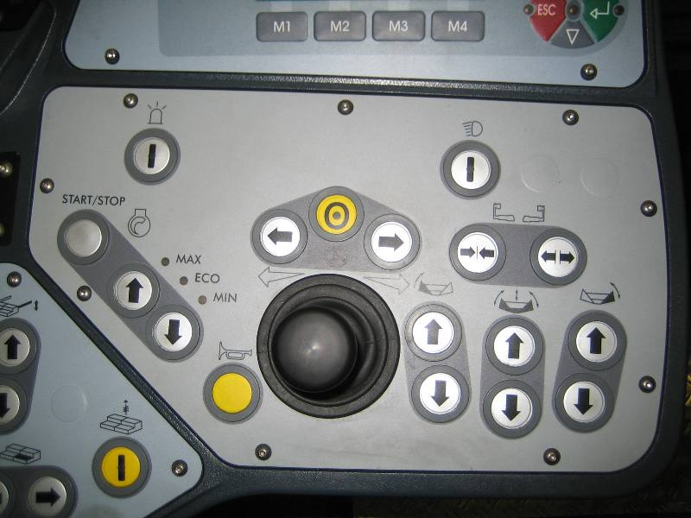
Principles of the Free Floating Screed
Issues Affecting Force # 1 - Pull Forces:
Always ensure straight steering & smooth turns – Use Trim Steer
  Keep the forces in Balance to maintain Consistent grade
Use steering guides or Auto Turning Radius if Available
Use Trim Steer in Turns
Notes:
3

Slide 36
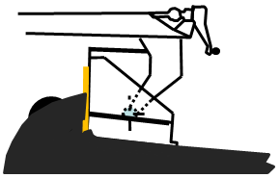
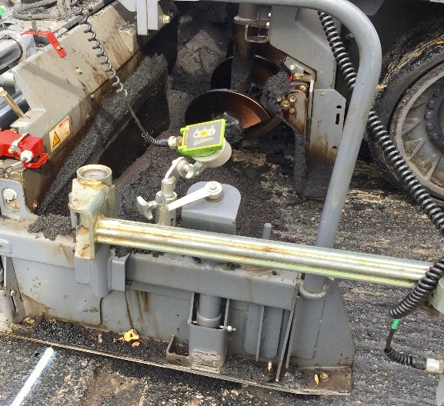
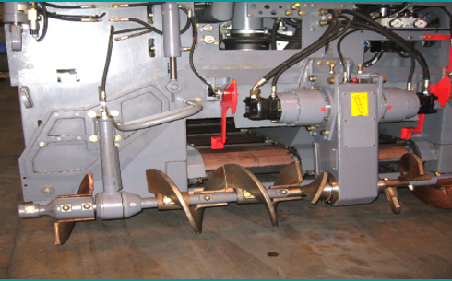
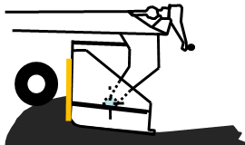
Principles of the Free Floating Screed
Issues Affecting Force # 2 - Head of Material (M):
Maintain a consistent even head of material, covering ½ auger shaft
Use Flow gates or Conveyor sensors to Regulate material delivery
Maintain ½ Auger Shaft
Increase Head.. Screed Rises
M
Decrease Head.. Screed Drops
Notes:
3

Slide 37
Principles of the Free Floating Screed
Issues Affecting Force # 3 - Weight of the Screed:
A heavy screed is Less Reactive but more stable
  More stable for Mainline Paving
Weight brings Rigidity & Ability to Maintain Adjustments
  Lighter screeds more flexible for Commercial Paving
  Weight of the Screed
W
Notes:
3

Slide 38
Principles of the Free Floating Screed
Issues Affecting Force # 4 - Reaction of Material Supporting the Screed
Mix Consistency / Design (Impact on the Mix Internal Frictional Resistance)
a) AC Content
b) Temperature Variation
c) Gradation Consistency
(All affected by Mix Design or Segregation – Will discuss later)
R
Reaction of Material under Screed
Notes:
3

Slide 39
Principles of the Free Floating Screed
Managing Forces # 5 – Shear Force
  1. Mix Consistence / Design
    AC Content
    Temperature Variation
    Gradation Consistency
    (All affected by Mix Design or Segregation – Will Discuss Later)
  2. Screed Adjustments:
    a) Extension screed Angle of Attack
    b) Extension screed Match Height
    c) Strike-off adjustment
    Screed Line of Pull
F
Shear Force
Notes:
3

Slide 40
Principles of the Free Floating Screed
Issues Affecting Forces # 4 & 5 - Friction or Shear Force
  1. Mix Consistence / Design: Changed due to Segregation
  2. Screed Adjustments: Incorrectly adjusted or adjustment change under load
Notes:
3

Slide 41
Screed Adjustments
Review of Vibratory Screed Compaction:
Main Screed
Max. Compaction at Trailing Edge
Screed Compaction
(Angle of Attack)
Material Flowing Under Screed
Mat Thickness
Notes:
3

Slide 42
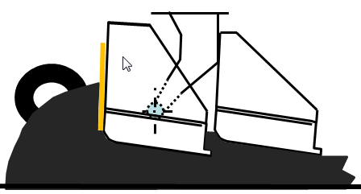
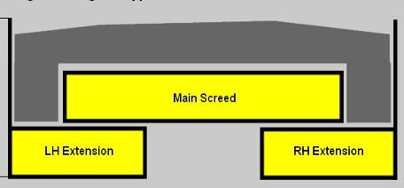
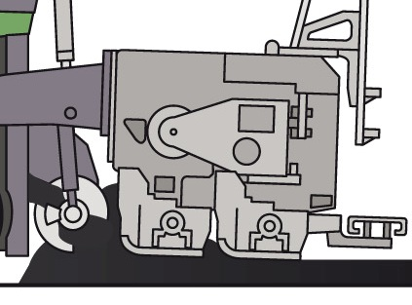
Screed Adjustments
Rear Mount Angle of Attack & vertical Adjust
- Material Flowing Under all Screed Sections must Be Equal
Paving Direction
VA
A
A
A
Main
B
LH & RH
Extension
Thickness of Mat
B
B
Plane A
Plane B
Amount of material Flowing Under Screeds
Notes:
3

Slide 43
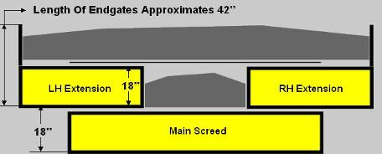
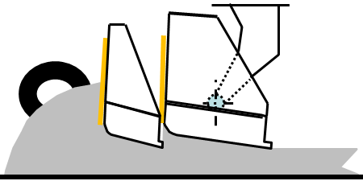
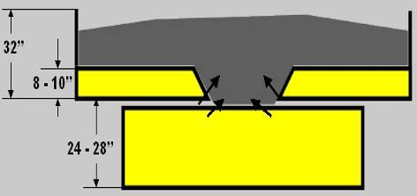
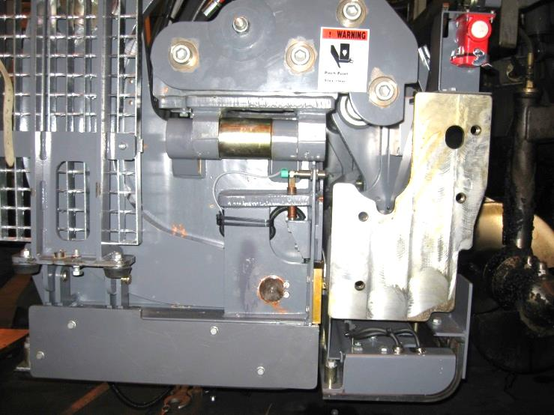
Screed Adjustments
Front Mount Extension Angle of Attack & Vertical Adjust
EIAA - Ext. Independent Angle of Attack, Sets Leading Edges on the same plane
VA - Vertical Adjust, Sets the Trailing Edges on the same plane
Parallelism – Ensure VA is held at all paving width
VA
Ext
Main
Thickness of Mat
Plane A
Plane B
EIAA
Amount of material Flowing Under Screeds
Notes:
3

Slide 44
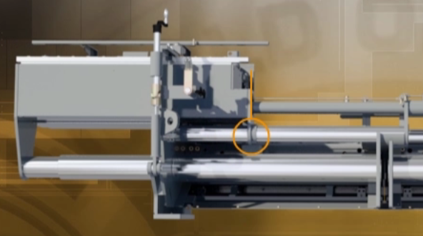
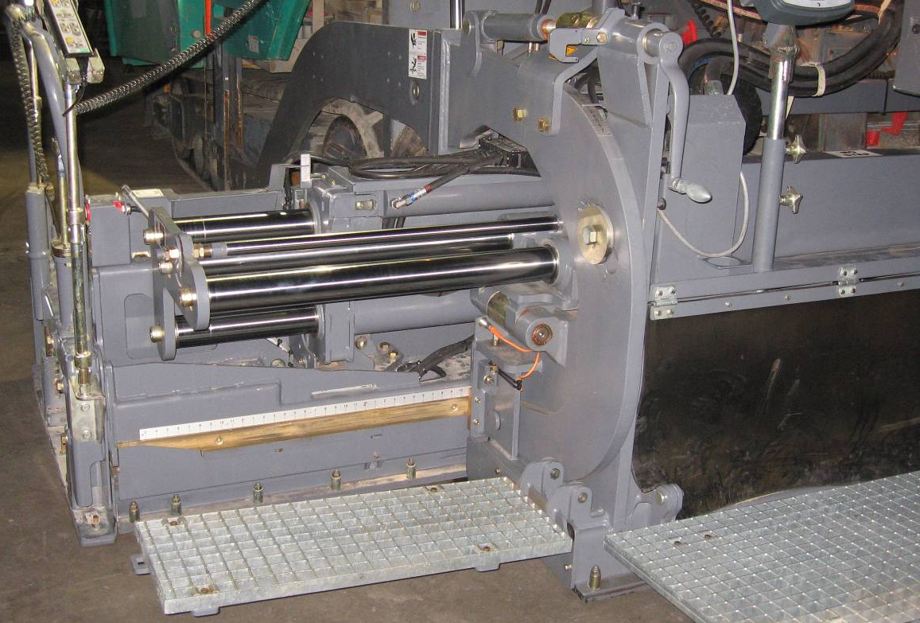
Screed Adjustments
Extension Screed Angle of Attack, VA (Match Height) & Parallelism
Screed Rigidity is important for Consistency under all paving conditions
Sloppy Bushings etc. hinders screed performance
Rear Mount Extension
VR 600
Front Mount Extension
VR 600
Notes:
3

Slide 45




Principles of the Free Floating Screed
Avoid Screed Twisting: - Both Tow point should be close together
Either use Screw or Tow point – NOT one of each
Tow Point
Tow Point
Notes:
3

Slide 46

Screed Adjustments
Extension Screed Angle of Attack & Vertical Adjust
Correct Angle of Attack & Vertical Adjust = Stabile Screed & Quality Mat
Notes:
3

Slide 47


Screed Adjustments
Extension Screed, EIAA Greater Than Main Screed Angle
  The Result Is More compaction under the Extension & shadow at the Center
  Inconsistent Screed Compaction
Extension Compaction
Main Compaction
Notes:
3

Slide 48



Screed Adjustments
Extension Screed Higher than the Main Screed
  The Result Is Lines & Thicker Mat Under the Ext.
  Inconsistent Screed Compaction
  Adjust on the fly with Un-equal width screeds
Unequal Width Front mount Screeds
Equal Width Screeds
Notes:
3

Slide 49

Screed Adjustments
Ideal Vertical Adjust (VA)…… for Unequal Width Front Mount Screed
Extension Slightly Higher than Main Screed to ensure Main is dominant
Notes:
3

Slide 50




Screed Adjustments
EIAA, VA & Parallelism Could Be Out of Alignment in Several Areas
Rigidity & Ability to make Easy Adjustment is Critical
Ext Independent Angle & Height Incorrect
Ext too Low ..Dangerous for Unequal Width Front Mount
Not enough Angle of Attack on the extension
Perfect
Notes:
3

Slide 51



Screed Adjustments
Strike-off Adjustment: - Strikeoff
Strikeoff meters Material Flowing under screed
Affect Extrusion Compaction & Angle of attack
Impact on Surface Texture:
See Manufacturer Specifications
Excess Wear
Too Low… Screed Rides on Trailing Edge
…..Premature Wear on Trailing Edge
Too High… Screed Rides on Nose
…..Premature Wear on the Bull nose
Notes:
3

Slide 52

Screed Adjustments
Pull Point Position for Best Results:
Pull Force Parallel to Base
Too high or too Low have different Impact on Mat Quality
Pull point
Approximately Parallel to Base
P
Low Pull point… ..Screed on Trailing Edge
High Pull point… …Screed on Nose
Notes:
3

Slide 53
Screed Adjustments
Ideal Adjustments for Pulling off the Joint:
1. Determine Thickness of Starting Blocks (1/4” / 1” for Roll Down)
Lower the screed on Starting Blocks
Energies Screed Float Switch In Pave Mode (On Vogele Pavers)
Pull Forward at least 1 ½” to take up slack at Tow Point
Lower Augers approx 2” above screed plate
Set BOTH Tow Point at SAME position based on Mat Depth (for ideal line of Pull)
Null Thickness Control Screw
Take up screw slack & add 2 to 3 turns up depending on screed
Fill Auger Chambers
Should be able to Pull off with or without Automatic
Slide 92
Notes:
3

Slide 54


Segregation
Segregation – Two Types
Gradation: Larger Stones separating from Smaller Stone & fines
Thermal: Generally Cold Crust from Long Haul / Traffic etc.
Gradation
Segregation
Thermal (Cold Crust)
Sloping Surface
Larger Stones

Slide 55


Gradation Segregation
Larger Stones rolling away from Smaller on Sloped Surface
Causing Inconsistent Gradation and Temperature
Change in Internal Frictional Resistance of the aggregate
All of which impact the Equilibrium of the Screed
  Screed looses grade…. no fines / asphalt to hold larger aggregate together

Slide 56


Thermal Segregation
  Will also occurs with Gradation Segregation
Fines and Heat separating from Larger Stones on Sloped Surface
    Heat & Asphalt Remains with the fines
Thermal Image used to detect Temperature Variation
Mat Stripes
Mechanical Segregation
Thermal Profile

Slide 57


Thermal Segregation
  Thermal Segregation:
Cooling of the mix in several areas
  On the surface of the haul truck
  On the side walls of the haul truck
  Around the paver hopper wings or Paver Hopper Insert
Clumps
Thermal Segregation (Crust)
Thermal Profile

Slide 58

Segregation – In the Paver Hopper
Thermal Segregation due to running the Hopper Insert too low
Could be a Combination of Gradation & Thermal Segregation

Slide 59

Segregation – In the Paver Hopper
Thermal Segregation in Truck Bed
Crust from Hauling

Slide 60

Segregation
  2. Thermal Segregation:
  Cold crust from Long Haul etc.

Slide 61

Proper Material Handling while Paving
While Pushing Trucks or using MTV:
Pushing Trucks – 3 areas of concerns
Use of MTV / MTD & Paver Hopper Insert – 4 areas of concerns
Material management as tractor delivers to Screed – With or Without MTV
1
2

Slide 62
Proper Paver Hopper control – Pushing Trucks
In The Paver Hopper – Pushing Trucks:
Segregation Slide 31 to end

Slide 63


Longitudinal Joint Construction
Building a Sound Longitudinal Joint:
Longitudinal Joints usually the first point of failure
Proper construction critical to life of pavements.
Notes:
3

Slide 64


Longitudinal Joint Construction
Building a Sound Longitudinal Joint:
Avoid a Joint when possible
Us a 6’ paver to pull the shoulder
Pull two Lanes together
Pave in Echelon
Notes:
3

Slide 65

Longitudinal Joint Construction
  Steps in Making a good Longitudinal Joints
  1. Control Segregation at the Outside Edges of the Mat
  2. Steer a Straight Line
  3. Compact Unconfined Edge
  4. Maintain Correct Overlap
  5. Place the Proper Depth for Roll Down
  6. Do Not Lute the Joint
  Compact the Joint for Density
  Safety Edges
Notes:
3

Slide 66


Longitudinal Joint Construction
Move Material to the Endgates consistently
Ensure that the augers are turning Continuously
Use Augers Extensions to Help move the material to the Endgates
  Some State specify 18” to 24” From Endgates
Use Tunnel Extensions to Confine material
Notes:
3

Slide 67


Longitudinal Joint Construction
2. Always Steer Straight:
Would be difficult to have a proper overlap on a crooked Joint
Also Steering Straight improve smoothness
First Pass Guide -
Joint – Second Pass
Notes:
3

Slide 68


Slide 69
Longitudinal Joint Construction
3. Compact Unconfined Edge
  However, Keep Pneumatic tire 6” from Un-supported edge
3
Not
Recommended
Recommended
6”
Notes:
3

Slide 70

THIS ROLLER HAS 12 STD NIGHT LIGHTS
Light
Light

Slide 71
Longitudinal Joint Construction
7. Compacting Longitudinal Joints
First Pass
Second Pass
Hot
6” to 8”
Notes:
3

Slide 72


Longitudinal Joint Construction
4 & 5. Minimum Required Overlap for Compaction is 1/2 Inch (13mm)
If the Overlap is Correct
Little or No
Hand work in required
Notes:
3

Slide 74


Rolling Pattern (video)
Longitudinal joint (VIBE roller)

Slide 75


Slide 76

Longitudinal Joint Construction
6. Do Not Lute Joint
Luting Moves Material
Away from the Joint
Resulting in Low Density
At the Joint
Notes:
3

Slide 77


Longitudinal Joint Construction
Joint Edges for Safety
Safety Edge – Outer edge
Michigan Wedge Joint – Inner Edge
  Ensure proper joint compaction
Michigan Wedge Joint
Safety Edge
Notes:
3

Slide 78



Automatic Grade & Slope
Automatic Grade & Slope System:
Automatically Controls Pavement Grade & Traverse Slope
  Grade Sensors: - Measure and Maintain the Longitudinal Grade Profile
  Slope Sensors: - Measure and Hold the Traverse Slope of the Pavement
Vogele Niveltronic
Trimble / CAT
MOBA
Topcon P-32

Slide 79
Automatic Grade & Slope
Integrated Automatic Grade & Slope
Always on Board
A few minutes to remove sensor & Cable from onboard storage
No Parameters to setup
ErgoPlus
Vogele Niveltronic
Trimble / CAT

Slide 80
Automatic Grade & Slope
What are Grade and Traverse Slope??
Grade: The Longitudinal Couture or elevation of the surface being paved
- In the direction of travel of the paver.
Slope: The Traverse Slope of the surface being paved.
A Slope Sensor Connects the Levelling Arm
& Automatically Monitors Traverse Slope
A Grade Sensor Monitors a Reference
& Automatically Maintain Depth

Slide 81



Automatic Grade & Slope
Automatic Grade Control:
Single Grade Sensor following Known References:
  Reference Could be - Joint, a Curb, String Line
  Could also Reference off a Drag Ski
Multiple Grade Sensor on a Beam (Non-Contact Ski) Following Base
  Ski averages the Contour of the Base to Improve Smoothness

Slide 82

Automatic Grade & Slope
Grade control Sensor Position:
Position Approximately At the centerline of the Drive Wheel
Usually better Mounted on The Endgates
Same for Track & Wheel Pavers
AOL

Slide 83


Automatic Grade & Slope
Typical Height of Grade Sensor:
Vogele & MOBA Non Contact Sensor
Vogele &
MOBA
Topcon
18 – 22”

Slide 84

Automatic Grade & Slope
Mechanical Grade Controls:
Make Contact with the Reference

Slide 85

Automatic Grade & Slope
Mechanical Ski - Drag Beam
Single Grade Sensor referencing off a Drag Beam
30’ to 40’ Beam flexes to average the Base
Must be mounted outside of Endgate

Slide 86


Automatic Grade & Slope
Non-Contact Ski with Multiple sensors
Multiple Noncontact Sensors mounted on a Beam fully supported on tow arm
The Individual reading of each sensor is combined to provide an Average
Beam could be up to 15 to 50’ Long
Could easily set up inside the Endgates for tight areas or wide Paving
Mat Reference Ski - Last Sensor Swivels over Mat

Slide 87

Automatic Grade & Slope
Use of Ski in Tight Turns
Length of the Ski must be compatible with the Radius of the turn
Mat Reference Ski - Last Sensor Swivels over Mat

Slide 88


Automatic Grade & Slope
Use of Automation & Ski in Tight Turns
Front sensor will approach the elevated side of the turn first
  Turn off the ski into the turn
2. Ensure the Tow arms are not binding against the Mainframe
2
1
Mat Reference Ski - Last Sensor Swivels over Mat

Slide 89

Lighting for Night Paving
24V LED Balloon lights
  Simple & Reliable – No 120/20V invertors / cooling fans
  Does not attract Bugs / less heat

Slide 90


Slide 91

Questions
Thank You
Notes:
3

